Slide 1
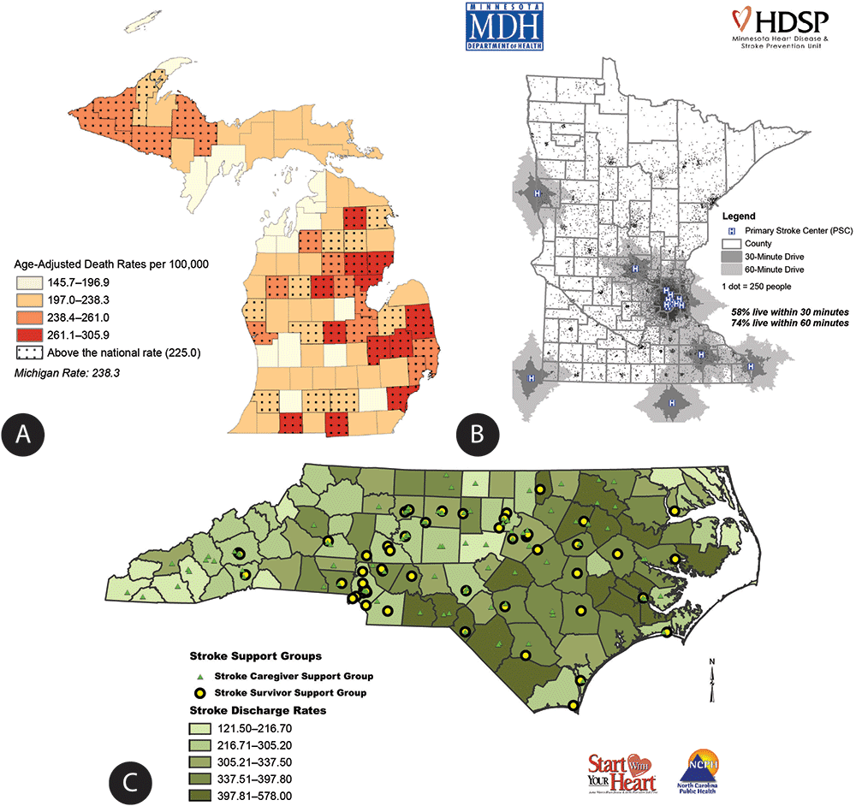
Maps 1
EPID 799C
Fall 2017

Slide 2
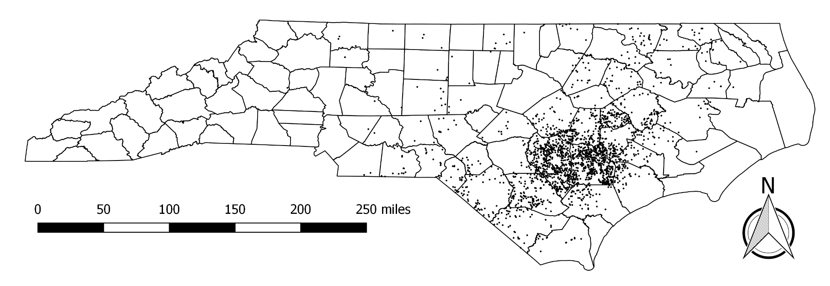
Why make maps (use GIS)?
Easy communication.
Improve models.
Link data.

Slide 3
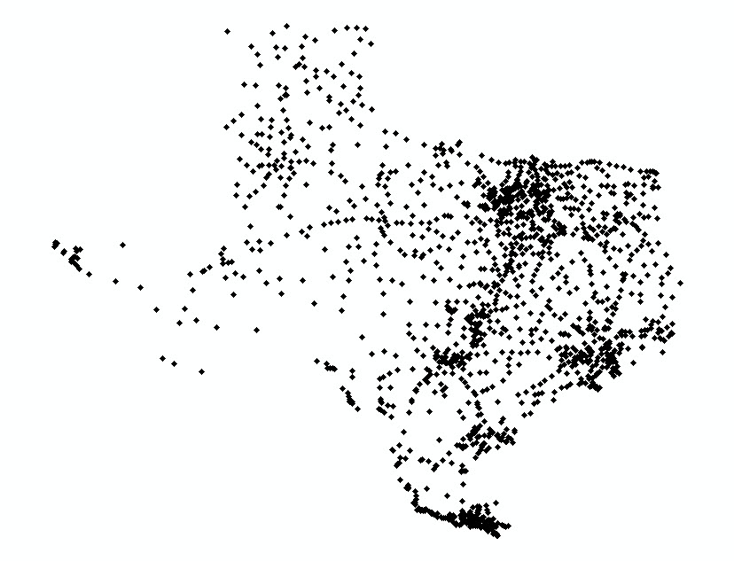
Types of GIS Data – Points (1/4)

Slide 4
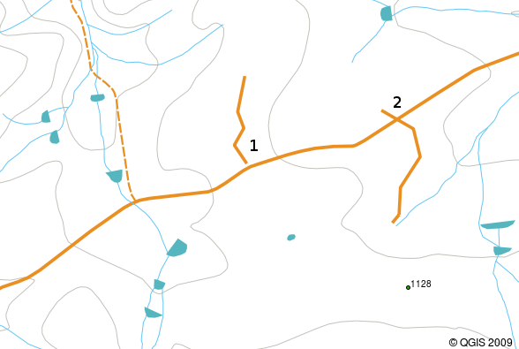
Types of GIS Data - Lines (2/4)

Slide 5
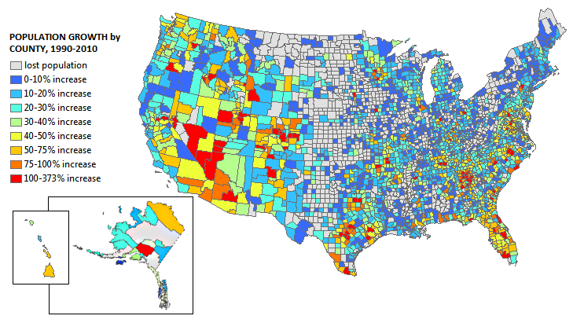
Types of GIS Data – Polygons (3/4)

Slide 6
Types of GIS Data – Raster (4/4)

Slide 7
ESRI (ArcGIS) = The SAS of GIS
We won’t use ArcGIS, but it is important to understand because:
The most common GIS data format (shapefile) has been inherited from ArcGIS.
QGIS (which we will use) is an open-source equivalent to ArcGIS.
Due to marketing, investment, certification, etc. you will see a lot of work done in ArcGIS.
The file format is a nice introduction to spatial data.

Slide 8
Shapefiles – 90’s relic
Most common GIS data format
Information stored across many files:
.shp geometry feature information (i.e. counties)
.shx index of features
.dbf attributes of each geometry (i.e. population)
.prj projection information
.shp.xml metadata (documentation)
Imagine if Word documents were split into 5 files…

Slide 9
Geometry Features (.shp)
Actually just a list of coordinate sets
Software connects each set into a polygon
(1,3)
X Y
0 0
0 2
1 3
2 2
(0,2)
(2,2)
(0,0)

Slide 10
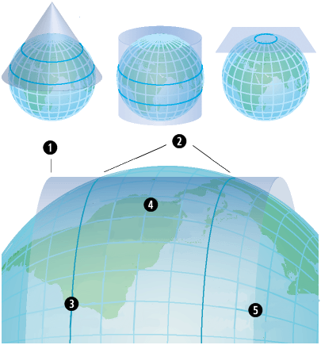
Geometry projection (.prj)
The earth isn't flat, but maps are!
How do the coordinates “stretch” to the earth?
TWO Basic Types:
Geographic (“GPS”)
Latitude/longitude
Pseudo-spherical
Projected (“Survey”)
Feet/meters
Rectangular

Slide 11
Geometry attributes (.dbf)
Just a regular dataset
Each row is a polygon in dataset
ID Area Toxins Cases
0 12 1000 10
1 99 0 1
2 120 200 5
3 54 50 2

Slide 12
ESRI/ArcGIS Junk (don't delete!)
Shapefile index (.shx)
Helps ArcGIS do queries faster
Metadata (.shp.xml)
Data source, notes, etc.
Other (also in .shp)
Presence of holes in features
Bounding box (maximum map extent)
Shape type (point, line, polygon)

Slide 13
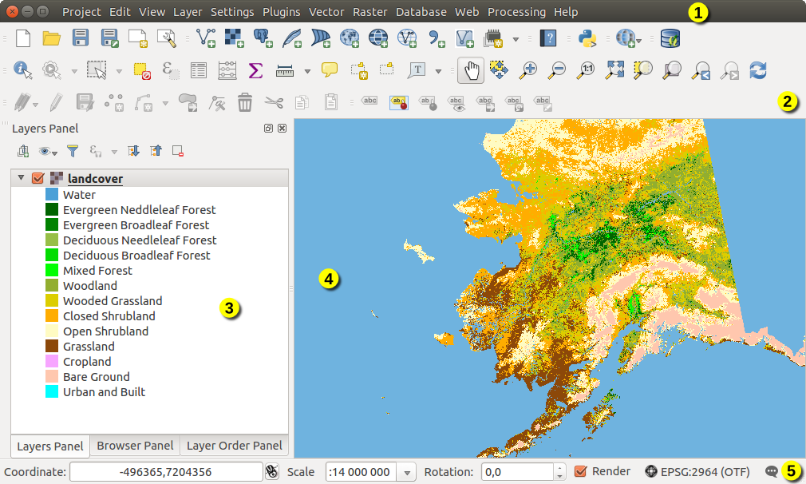
Using QGIS
Point-and-click; nice for making maps (start in R)

Slide 14
The sp package in R
Packs GIS data into an addressable object (with @)
You can also use [ ] notation to subset
SpatialPointsDataFrame
@
@
@
proj4string
polygons
data
bbox
$
$
plotOrder
var1
var2

Slide 15
Working with spatial data
With rgeos and rgdal installed, common data commands will be intuitively translated!
plot(myshape)
myshape$var1
myshape[1:2,]
myshape[myshape$var1==FALSE,]
Sp objects work like any other object:
mile3 <- gbuffer(myshape,3*5280)
cents <- gcentroid(myshape)

Slide 16
Side note: There’s a new structure in town!
Simple features (sf) spec – just a dataframe!
The spatial information is stored as another “variable’
Not quite as efficient in some ways, but easier to work with. Can eventually overload dplyr functions.

Slide 17
Let’s Try!
Prepare your county tbl

