Slide 1
Learn R! Functions
Nathaniel MacHardy
Fall 2014

Slide 2
Overview
Part I: “functional” data types
Logical, Factor, List
Part II: Useful Functions
Getting data into R
Part III: Getting More Functions!
Packages
Writing Functions
Lab: Basic bivariate analysis

Slide 3
Review of Functions
result <- rnorm(mean=0,sd=1,n=100)
mean
0
sd
result
1
rnorm
n
100

Slide 4
Logical Atoms
Other Atoms: Numeric, Character
Logical Atoms are TRUE or FALSE
r.is.easy <- TRUE
if(r.is.easy) {
cat(“R is easy!”)
}
plot(x, axes=FALSE)

Slide 5
Creating Logical Atoms
R can evaluate tests (more on cheat sheet)
age < 18
sex==“F”
== is equal to
<= less than / equal to
>= greater / equal
!= NOT equal to
%in% is in the set (lab example)

Slide 6
Boolean Expressions
TRUE & TRUE TRUE (AND)
TRUE | FALSE TRUE (OR)
!FALSE TRUE (NOT)
(age > 18) & !(sex==“M”)

Slide 7
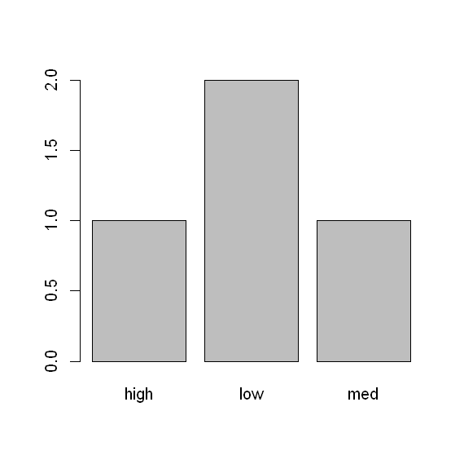
“Functional” data types: Factors & Lists
Useful for functions
Factors
Categories
Lists
Mixed types
Flexible length
ID | DIAG_1 | DIAG_2 | DIAG_3 | …
A013 | CVD | HT | ISCH
B243 | HT | CVD

Slide 8
The Factor Type
Like a vector, but numeric AND character
Discrete “levels” (num), with “labels” (char)
Example: low=1, med=2, high=3
Index | Level | Label
1 | 1 | “low”
2 | 1 | “low”
3 | 3 | “high”
4 | 2 | “med”
5 | 2 | “med”

Slide 9
Building Factors
Easy to build manually:
x <- c(1,2,2,1,3,1)
f <- factor( x,
levels=c(1,2,3),
labels=c(“low”,”med”,”high”) )
R can also construct on the fly
y <- c(“low”,”med”,”med”,”low”,”high”,”low”)
f <- factor(y)

Slide 10
Inspecting/Using Factors
x
levels(x)
labels(x)
length(x)
plot(x)
Lab examples

Slide 11
The List Type
Like a vector, but more flexible
Can be any length
Can have mixed types
mylist <- list(“Apple”,123,0.99,TRUE,”Banana”,NA)
list[1] “Apple”
List[3] 0.99
“Apple” | 123 | 0.99 | TRUE | “Banana” | NA

Slide 12
Usage Example: A List of Vectors
Useful for text entry fields
diagnosis
1 2
3
diagnosis[1] “CVD” “HTN” “ISCH”
Diagnosis[3] “HTN”
CVD | HTN | ISCH
HTN

Slide 13
Inspecting / Using Lists
mylist
diagnosis[1][1]
biglist <- c(list1,list2)
aggregate(outcome,
by=list(“sex”,”agecat”)
FUN=mean)
Lab examples

Slide 14
Part II: Useful Functions
Example: Getting data into R
Set Working directory
Import Data
Save in Native R format

Slide 15
Part II: Useful Functions
Example: Getting Data into R
Prepare your data
Plan A: Save as a .csv file
Plan B: Find a package to import it
GIS, SAS, SPSS, Stata, Access databases, etc.
Establish working directory
Run an import command
Plan A: read.csv
Save as a native .RData file

Slide 16
Why .CSV?
CSV = Comma Separated Values
Standardized, simple
View as spreadsheet in excel
View raw text in notepad
Universal support
Export/import: SAS, SPSS, STATA, Excel, Access, etc.

Slide 17
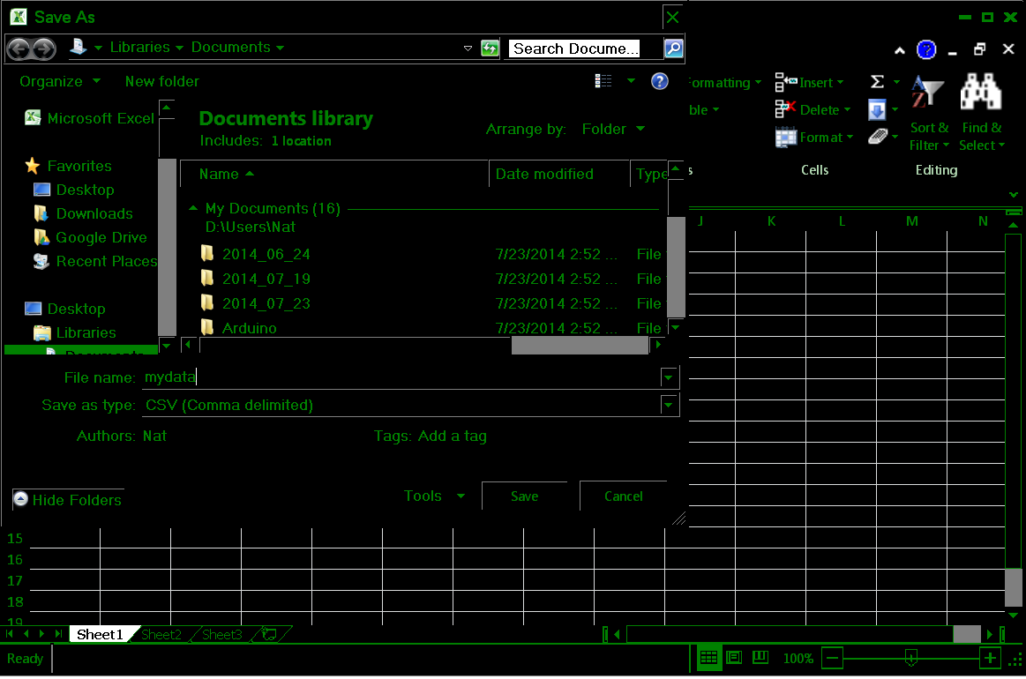

Slide 18
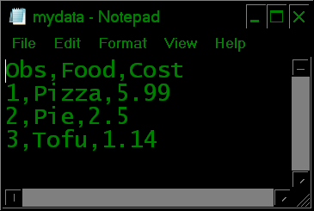
Actual Content of .csv

Slide 19
Setting a Working Directory
Where R is looking in your file structure
Get using getwd()
Set using setwd(“D:/example/”)
Allows use of relative paths
somedata <- read.csv(“D:/example/file.csv”)
anotherway <- read.csv(“file.csv”)

Slide 20
Using read.csv
Default: mydata <- read.csv(“somefile.csv”)
Imports characters as type “factor”
Good if your data is ready for analysis
Easy to make data management errors
Useful argument: stringsAsFactors =FALSE
i.e. read.csv(“somefile.csv”,stringsAsFactors=FALSE)
imports strings (text) as character
Good if you need to do more processing

Slide 21
Part III: More Functions
R Packages
Each is a bundle of related functions
Example: maps, Bayesian stuff, etc.
Two-step process:
Install package (once per computer)
Load package (once per R session)

Slide 22
Step 1: Install Packages (once)
Easiest way: use menus
Tools > install packages (Rstudio)
Packages > install package (Basic Rgui)
Alternate way: use install.packages(“maps”)

Slide 23
Step 2: Load package (each session)
library(maps)
Typically at the top of the script
Find package help using ??
??maps

Slide 24
Step 3: Try it!
Examples (from ?map)
map() # low resolution map of the world
map('usa') # national boundaries
map('county', 'new jersey') # county map map('state', region = c('new york',
'new jersey', 'penn'))
# map of three states
map("state", ".*dakota", myborder = 0)
# map of the dakotas
map.axes()
# show the effect of myborder = 0

Slide 25
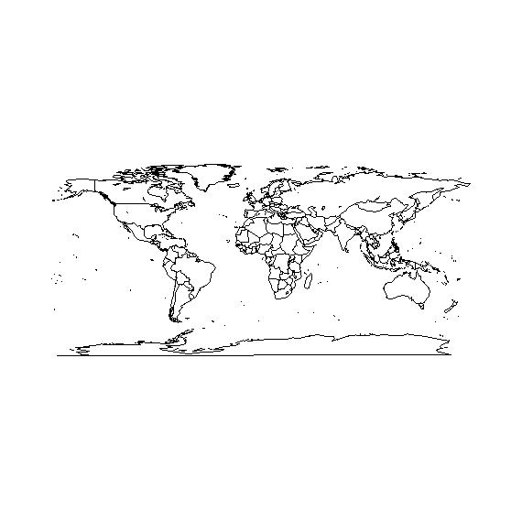
Step 3: Try something!
map()
All right!

Slide 26
Writing Functions
You can write functions yourself
Simplify tasks
Build complex projects
Share/re-use code
Indistinguishable from other R functions!
No other macro language to learn
Just need to learn the construction syntax
Most of R is actually written in R!

Slide 27
Using the function function
natsfunction <- function(x, y) {
result <- x*y
return(result)
}
natsfunction(12,10)
natsfunction(x=12,y=10)

Slide 28
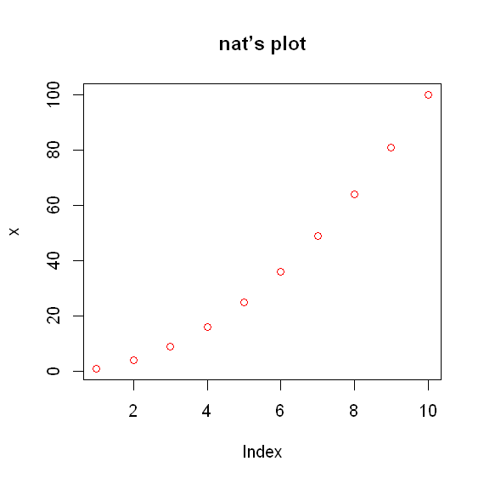
Another example: a shortcut
natplot <- function(data, ...) {
data <- data^2
plot(data, ..., col="red",main="nat’s plot")
}
natplot(1:10)

Slide 29
Tips: Writing Functions
Executing the function “body” prepares the function
Can then be used by name as much as you want
Needs to be re-run each time you run R
My approach: put functions in a another file (or several) e.g. functions.R
Run the file from your current script using source(“functions.R”)
Makes it easy to re-use common shortcuts

Slide 30
Lab: Bivariate Analysis
Experiment with new types
Logical
Factor
List
Import data
Load a package
Write shortcut functions

