Slide 1
Learn R! Reports
Nathaniel MacHardy
Fall 2014

Slide 2
Overview
Quick Methods for Figures
Screenshots
Export…
Graphics devices
R Markdown
Sweave (LaTeX)

Slide 3
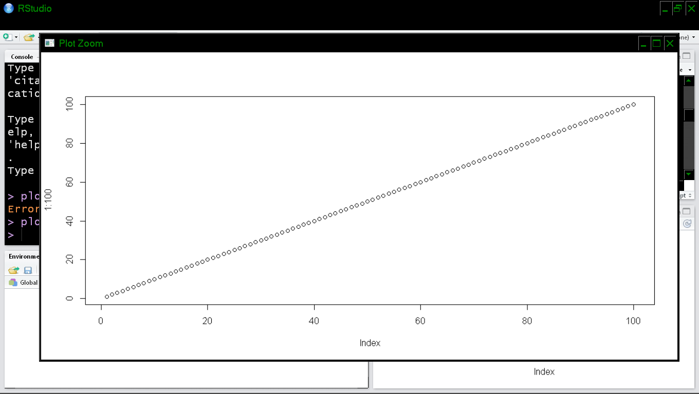
Screenshots
Press Print Screen Key, paste into MS Paint
Quick, universal, great for presentations, WORKS
Terrible quality, inconsistent, annoying to re-do

Slide 4
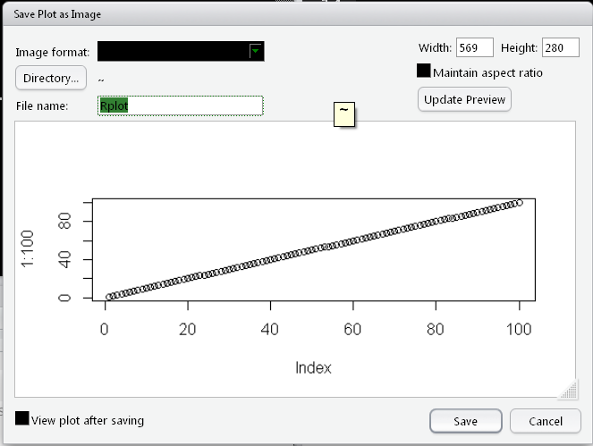
Export Image (RStudio)
Click Export… on plot window
Must manually click through dialog each time

Slide 5
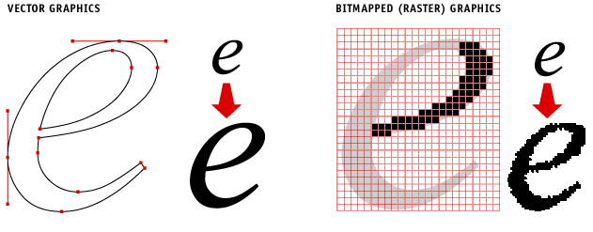
Choose Vector!
Raster
.bmp, .jpg, .png, .gif
Grid of pixels
Gets blocky if zoomed
Vector
.svg, .pdf
Drawing instructions
“Infinite” resolution

Slide 6
Don’t Compress!
.png
.jpg

Slide 7
Hierarchy of Computer-Generated Image Conversion
Vector: .pdf, .svg
Lossless Raster: .bmp, .png
Compressed Raster: .jpeg, .gif

Slide 8
R Graphics Devices
pdf(“figure1.pdf”)
plot(1:10)
# more commands
dev.off()
# Most useful Options:
pdf(“options1.pdf”,
width=7, height=7)
dev.off()
# Other Devices
bmp()
svg()
jpeg()
bmp()
tiff()

Slide 9
ALWAYS USE PDF
Pdf can be converted to anything without loss!

Slide 10
What if my publisher/boss/advisor asks for something other than pdf?
Get the pdf figure looking great
Use GIMP (GNU Image Manipulation Program; free/better photoshop) to import the pdf and export in the correct format
Any format, Any DPI
User-friendly interface
Exception: stone-age print shops often ask for CMYK figures; use Krita (also free) to do this easily

Slide 11
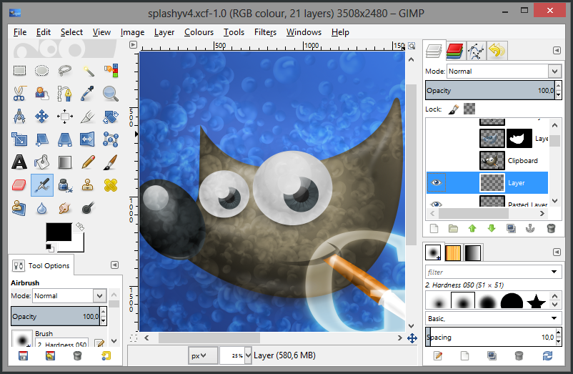
www.gimp.org

Slide 12
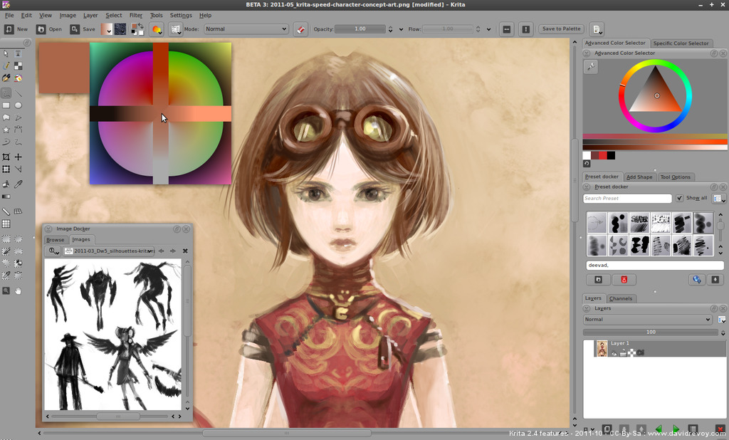
krita.org

Slide 13
Writing Reports with R Markdown
Simple, fast
Generates MS word file (.doc)
Less control over style/layout than Sweave
In Rstudio, go to file > New > R Markdown…
RStudio will generate an example header
Save your file with the .Rmd extension
Press Knit!

Slide 14
Sample Markdown Document
---
title: "Example"
author: "Nat"
date: “Friday, October 31, 2014"
output: word_document
---
Here is my cool report. This is just some text - see figure below
```{r, echo=FALSE}
# R code here will be run and the results pasted into the document
plot(1:10)
```

Slide 15
Markdown Markup 1
*italic* **bold**
# Header 1
## Header 2
### Header 3
Item 1
Item 2
Item 3
+ Item 3a
+ Item 3b

Slide 16
Markdown Markup 2
```{r}
summary(cars$dist)
summary(cars$speed)
```
There were `r nrow(cars)` cars studied

Slide 17
Markdown Tables
First Header | Second Header
------------- | -------------
Content Cell | Content Cell
Content Cell | Content Cell
```{r results="asis",echo=FALSE}
library(knitr)
kable(head(iris[,1:3]), format = "markdown")
```

Slide 18
LaTeX with Sweave
Takes more time to code than R Markdown
Greater control of style, format, etc.
Good for long documents
I did my master’s paper in LaTeX
First, install LaTeX
Go to file > new S Weave, then save as .Snw
Click Compile Pdf when donw

Slide 19
Sample Sweave document
\documentclass{article}
\begin{document}
\SweaveOpts{concordance=TRUE}
This is a cool \LaTeX document.
Backslashes anc curly brackets are used for control sequences.
The junk below calls R code.
<<fig=TRUE>>=
# this is an R code chunk
plot(1:100)
@
\end{document}

Slide 20
