Slide 1
Numerical Descriptives in R
EPID 799C
Monday, Sept. 11, 2017

Slide 2
Today’s Overview
Lecture: Basic descriptive statistics in R
Practice: Group exercises with the births dataset

Slide 3
Key Functions for Numerical Summary Measures
Measures of Centrality
mean()
median()
mode()
Measures of Spread
min() max()
quantile() range()
sd() var()

Slide 4
Key Functions for Numerical Summary Measures
Measures of Centrality
mean()
median()
mode()
Measures of Spread
min() max()
quantile() range()
sd() var()
General syntax:
function(dataset$variable)
Example:
mean(births$mage)

Slide 5
Key Functions for Numerical Summary Measures
Measures of Centrality
mean()
median()
mode()
Measures of Spread
min() max()
quantile() range()
sd() var()
What happened?

Slide 6
Key Functions for Numerical Summary Measures
Measures of Centrality
mean()
median()
mode()
Measures of Spread
min() max()
quantile() range()
sd() var()
General syntax:
function(dataset$variable)
If there is missing data:
function(dataset$variable, na.rm = TRUE)

Slide 7
Key Functions for Numerical Summary Measures
Measures of Centrality
mean()
median()
mode()
Measures of Spread
min() max()
quantile() range()
sd() var()

Slide 8
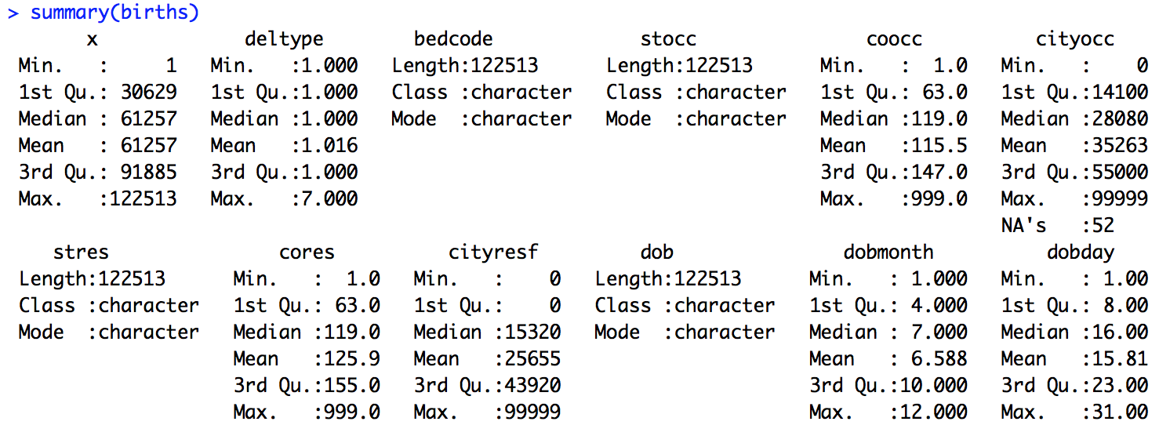
Key Functions for Multiple Summary Measures
summary() is a generic function that produces result summaries depending on the class of the first argument

Slide 9
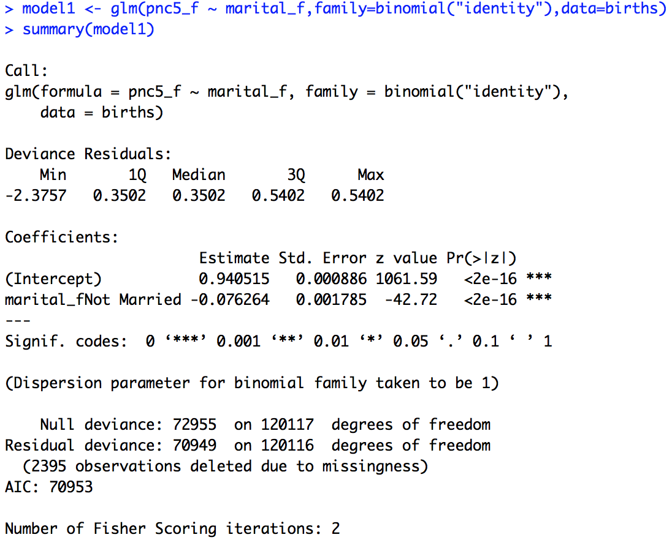
Summary() is flexible & takes different classes of objects
Looking ahead:
summary() helps you look at and summarize your regression model output!

Slide 10
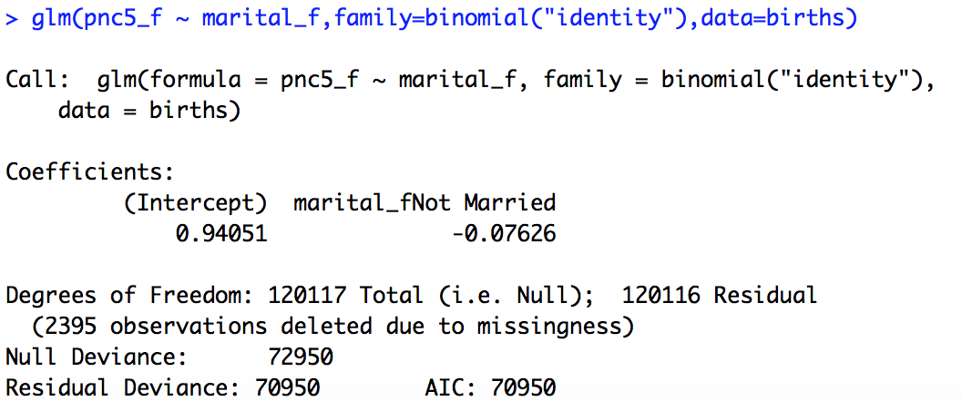
Summary() is flexible & takes different classes of objects
Backing up:
Factor variables are an important class in R and useful for producing summary statistics, plots, and regression models

Slide 11
Key Functions for Multiple Summary Measures
describe() from the Hmisc package is another generic method for summarizing a vector, matrix, or dataframe

Slide 12
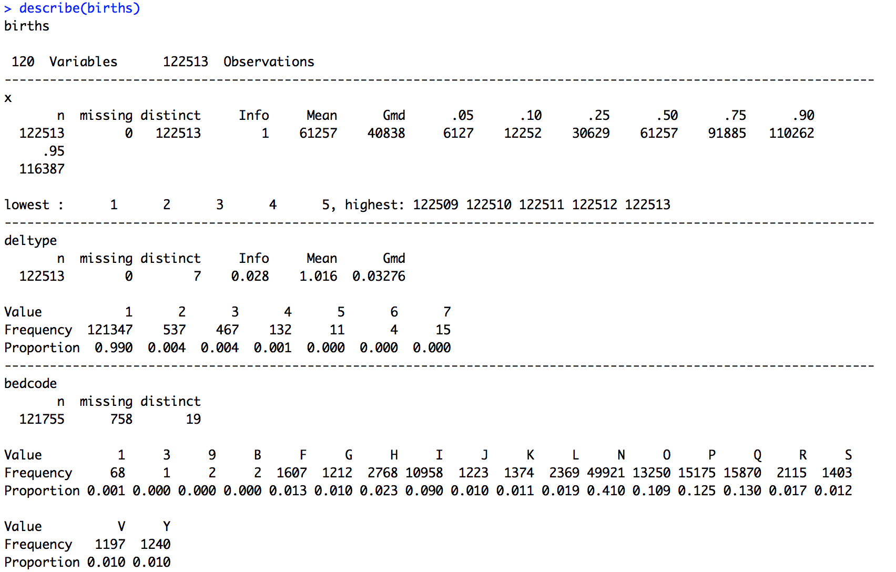
Key Functions for Multiple Summary Measures
describe() from the Hmisc package is another generic method for summarizing a vector, matrix, or dataframe

Slide 13
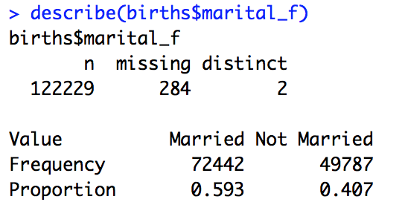
Summary() and Describe() with Categorical Variables
Use of these functions is not limited to numeric variables:

Slide 14
Summarizing Multiple Variables: The Apply() Family
Using the sapply function to get summary statistics:
Calculates means for all variables in births dataset (excludes missing values and returns NA for non-numeric variables)
Using the lapply function to get summary statistics:
Get mean, min, max, and sample size for specified variables, and bind together in a dataframe

Slide 15
Summary Statistics by Subset or Group
Use indexing within the function
Use tapply(Summary Variable, Group Variable, Function)

Slide 16
Summary Statistics by Subset or Group
Many other ways to do this!
My favorite: using the dplyr package (more on this soon)

Slide 17
Descriptive Statistics for Dates
Use the lubridate package to work with dates/times
In your homework: recode the dob string variable so that R recognizes it as a date
Once R recognizes this variable as a date, you can use the same descriptive statistic functions to evaluate and summarize the date values in your data

Slide 18
Practice with Descriptive Statistics
Practice exercises are posted to the course website
All questions focus on the births dataset
Work as a group on the descriptive statistics exercises
Apply the functions we’ve introduced today
For R veterans, try out the challenge questions
Will require some pre-processing of the data

