Slide 1
Graphical Descriptives in (Base) R
EPID 799C
Wed Sep 12 2017

Slide 2
Today’s Overview
Lecture & Practice: Back to births
Homework 1: Graphics & Recoding
Lecture: Primer on info-viz theory
(groundwork for ggplot2 next week)

Slide 3
Graphics in Base R
Using births

Slide 4
Base Graphics
Why R for graphics?
Fast, flexible, etc. Yes, you get super powers.
Why (not) base R for graphics?
Want to take advantage of human higher abstraction

Slide 5
Base Graphics
Generally two flavors
Functions that accept raw data (like vectors) as arguments
Functions that accept more complex objects (like tables, models, shapefiles) built from data

Slide 6
Key Functions for Base Graphics
Main functions
plot() multitool
hist() barplot() boxplot()
Parameters
col=, xlab=, ylab=, pch=, main=
(point character.)
Helpful data helpers
jitter() density()

Slide 7
Let’s Try
Please note: there are faster, more intuitive ways to do all of this right around the corner!
Create a scatterplot of wksgest and mage using plot.
D’oh! Overplotting! Use the jitter() function to help.
Let’s try colors. Create an empty vector called my_colors of the same length as other variables using rep() and length() or nrow().
Using square brackets, assign “red” or “blue” to my_colors when cigdur is “Y” or ”N” respectively.
Use plot() with col=my_colors argument to plot with colors.

Slide 8
Let’s Try: scatterplots, cont.
Put a title on the graph using the “main=” argument to plot().
Add x and y labels using xlab and ylab arguments to plot().
Change the marker type using the pch= option (try “.”, or google for numeric options that translate to symbols.
Let’s add another “layer” with the points(), lines() or abline(). Calculate the mean of each variable and place this point on the graph using points().
Place a green vertical and horizontal dashed line on the graph using abline and the col and lty parameters.
Now save the plot by placing pdf(“plot.pdf”) before plotting functions and then dev.off() afterwards

Slide 9
Let’s Try : other plots
Create a boxplot of mage using …boxplot()!
Create a histogram of mdif using hist(). Change breaks=0:100
Create a table of mage and plot() and barplot() it.
Create a table of cigdur vs. pnc5; plot() and barplot() again.
Create a sample() of the dataset with 1000 random points and a few columns, then plot() it.
Create a boxplot of mage by preterm_f or pnc5_f or cigdur_f using the ~ operator.
Plot the density() of mage.

Slide 10
Answers
#.............................
# Graphical Exploration
#.............................
# Base R graphical Experiments...
plot(births$mage, births$wksgest)
plot(jitter(births$mage), jitter(births$wksgest), pch=".")
cig_color = rep(NA, nrow(births))
cig_color[births$cigdur == "Y"] = "red"
cig_color[births$cigdur == "N"] = "blue"
plot(jitter(births$mage), jitter(births$wksgest), pch=".", col=cig_color)
points(mean(births$mage, na.rm=T), mean(births$wksgest, na.rm=T))
abline(v=mean(births$mage, na.rm=T));abline(h=mean(births$wksgest, na.rm=T))
boxplot(births$mage)
hist(births$mdif)
hist(births$mdif, breaks = 0:100)
table(births$cigdur, births$pnc5_f)
cig_tbl = table(births$cigdur, births$pnc5_f)
plot(cig_tbl)
barplot(cig_tbl)
births_sample = births[sample(nrow(births), 1000), c("mage", "mdif", "wksgest")]
plot(births_sample)
boxplot(births$mage ~ births$pnc5_f) #notch =T
plot(density(births$mage, na.rm=T))

Slide 11
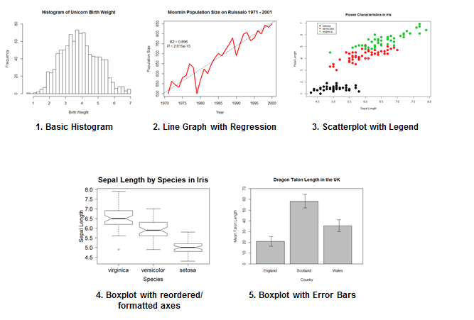
Resources
Datacamp
The web!

Slide 12
Homework 1
Graphics & Recoding

Slide 13
Graphics on HW1
HW 1 Questions
  #5 B & (optional) C
  #6 b.a.
We don’t really have the tools yet to explore as much as we want to. More graphics in HW2.

Slide 14
Recoding race/ethnicity
Subsetting
Nested ifelse()
The merge() function
The factor() directly

Slide 15
Let’s Try : recoding race

Slide 16
Answers
# Options for coding mrace
race_sample = data.frame(mrace=sample(5, 20, replace=T)) #note the 5!
race_helper = data.frame(mrace=1:4, race1=c("White", "Black", "American Indian or Alaska Native","Other")) # could read as csv
race_coded = merge(race_sample, race_helper) #defaults to inner join! Will drop non-matches without param help.
race_coded = merge(race_sample, race_helper, all.x=T, all.y=F)
race_coded$race2 = NA
race_coded$race2[race_coded$mrace == 1] = "White"
race_coded$race2[race_coded$mrace == 2] = "Black"
race_coded$race2[race_coded$mrace == 3] = "American Indian or Alaska Native"
race_coded$race2[race_coded$mrace == 4] = "Other"
race_coded$race3 = ifelse(race_coded$mrace==1, "White",
ifelse(race_coded$mrace==2, "Black",
ifelse(race_coded$mrace==3, "American Indian or Alaska Native",
ifelse(race_coded$mrace==4, "Other", NA))))
race_coded$race_f = factor(race_coded$mrace, levels=1:4,
labels=c("White", "Black", "American Indian or Alaska Native","Other"))
race_coded
str(race_coded)
# Thinking ahead to raceeth variable… or any other options
raceeth_helper = data.frame(race=c("White", rep("Black", 2), rep("American Indian or Alaska Native", 2)),
methic=c("N", "Y", "N", "Y", "N"),
race_eth = c("White nH", rep("Black", 2), rep("American Indian or Alaska Native", 2)))

Slide 17
Info-Viz Theory

Slide 18
Why Graphics
The obvious:
Powerfully conveys content
Takes advantage of our powerful visual systems
Broader audience than a table of numbers or a paragraph of findings
The less obvious:
Can be a way to explore / understand data…
if fast and intuitive enough!

Slide 19
High Level

Slide 20
High Level
Graphics serve a story
…when there’s a narrative
Graphical integrity
don’t cheat, on purpose
or unintentionally
Minimize “data-ink” ratio
Consider data “words,” small multiples, and sentences!
Wouldn’t be a graphics lecture without a Tufte reference:
Edward Tufte, (2001) The Visual Display of Quantitative Information.

Slide 21
Graphical Excellence
Graphics serve a story
http://www.pointerpointer.com/

Slide 22
Graphical Integrity
Avoid:
Distortion
Chart-junk
Dimensionality mixing (3d*)
…
See http://www.vox.com/2015/9/29/9417845/planned-parenthood-terrible-chart

Slide 26
Low Level
Pre-attentive attributes…
and a side-note on color
Reduce processing demands
chiefly through simplicity and gestalt principles
Stephen Few, (2009) Now you see it: Simple visualization techniques for quantitative analysis.
Stephen Few, (2012) Show me the numbers: Designing tables and graphs to enlighten.

Slide 27
(Some) Pre-attentive attributes of visual perception

Slide 28
1: Color Group Language
And two theoretical side-notes on color…
Alpha (not greyscale, but “see-through-ness”)
Brewer (is cool)! http://colorbrewer2.org/
Sequential
Diverging
Qualitative
Grey (intensity)
Qualitative

Slide 29
Color is: Meaningful (A Priori)
Meaning-loaded
Culture specific
Organization specific
PMS 288 PMS 542
http://styleguide.duke.edu/identity/color-palette/
http://identity.unc.edu/colors/
Blue tones matter to many people. Yet: “If you prick us, do we not bleed?” (Merchant of Venice)
RY
Girls / Women
Boys / Men
Aposematism
EMOTIONAL associations! Some semi-born out through research.
Also: LINKS (and visited ones, etc.)
Note how this PPT theme messes w/ this.
Heteronormative &
dominant culture reinforcing.
Don’t do this.
This is a classic example… but ALSO an
over-simplification of culture as if it were homogenous and independent!
For more, check out:
http://lifehacker.com/learn-the-basics-of-color-theory-to-know-what-looks-goo-1608972072

Slide 30

Gestalt Principles of Visual Perception
Simplicity Proximity
Similarity Enclosure
Closure Continuity
Connection Figure &
Ground
http://graphicdesign.spokanefalls.edu/tutorials/process/gestaltprinciples/gestaltprinc.htm
http://www.smashingmagazine.com/2014/03/design-principles-visual-perception-and-the-principles-of-gestalt/
PS I’m leaving some out!

Slide 31
Think with a Grammar of Graphics
(R: ggplot2, and other things)
Data! ← shape (long/wide) & statistical transforms sometimes required. dplyr:: in two weeks!
Aesthetic “mappings” e.g. x position in space←var1, color←var2, shape←var3
Geometries column, bar, boxplot… violin, map, slopegraph, etc.
Scales
Coordinate Systems
Positional adjustments (tweaks)
Facets (small multiples)

Slide 32
Next Week
ggplot2!

