Slide 1
ggplot2 I
EPID 799C
Mon Sep 18 2017

Slide 2
Today’s Overview
The ggplot package: Basic Syntax
Homework 1: due Wed 9/20 notes: <20 weeks considered not viable, exclude by “recode as missing”, we mean NA.
Homework 2: Out this week, starting today

Slide 3
Ggplot2
Basic Syntax

Slide 4
ggplot components
data
aesthetic mapping
geometric object
statistical transformations
scales
coordinate system
position adjustments
faceting

Slide 5
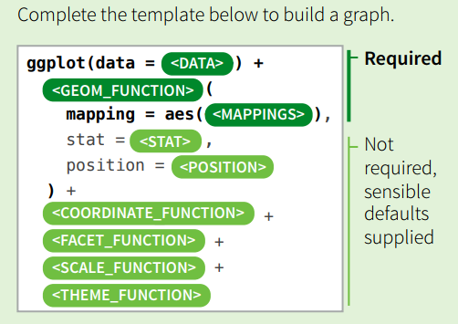
ggplot components

Slide 6
ggplot components
Or minimally,
ggplot(data=<DATA>)+ <GEOM_FUNCTION>(mapping = aes(<MAPPINGS>))
e.g., using mpg dataset
ggplot(mpg)+ geom_point(aes(displ, hwy, color=class))

Slide 7
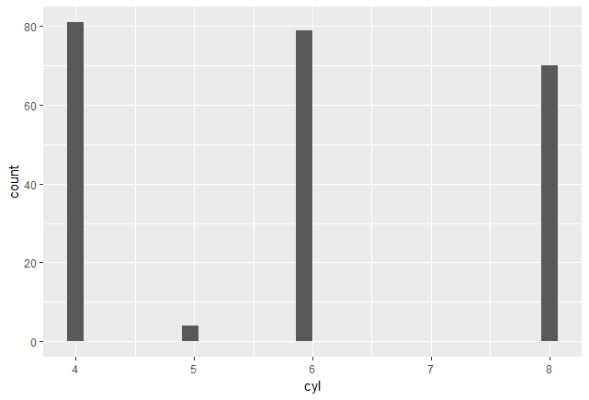
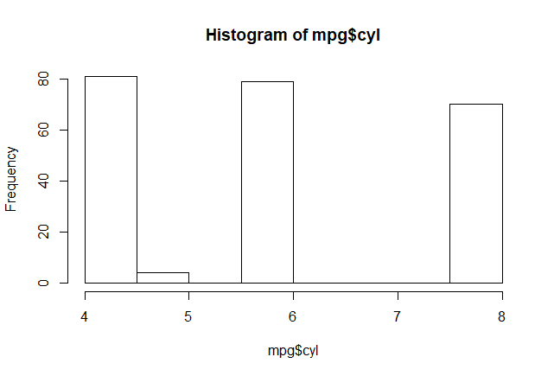
hist(mpg$cyl) ggplot(mpg)+geom_histogram(aes(x=cyl))
ggplot(mpg, aes(cyl))+geom_histogram()
qplot(mpg$cyl, geom="histogram")

Slide 8
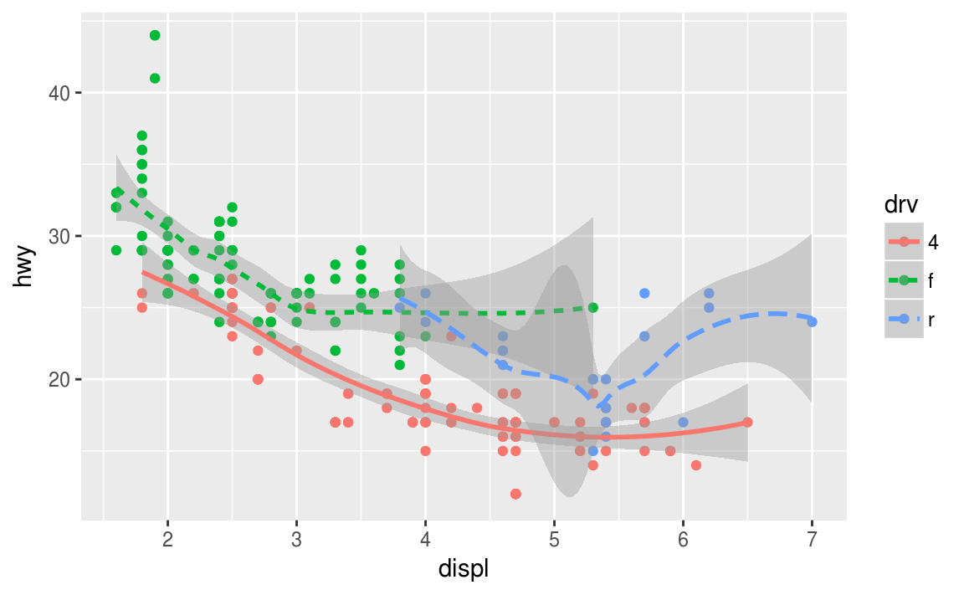
Anatomy of a ggplot

Slide 9
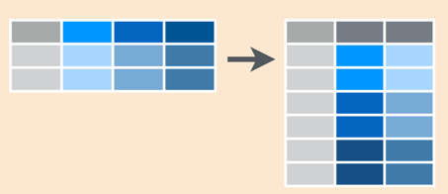
data
Ggplot likes “long”, well structured data.frames
ggplot “stats” can make quick transformations
dplyr will help with complicated transformations
tidyr will help go from wide to long

Slide 10
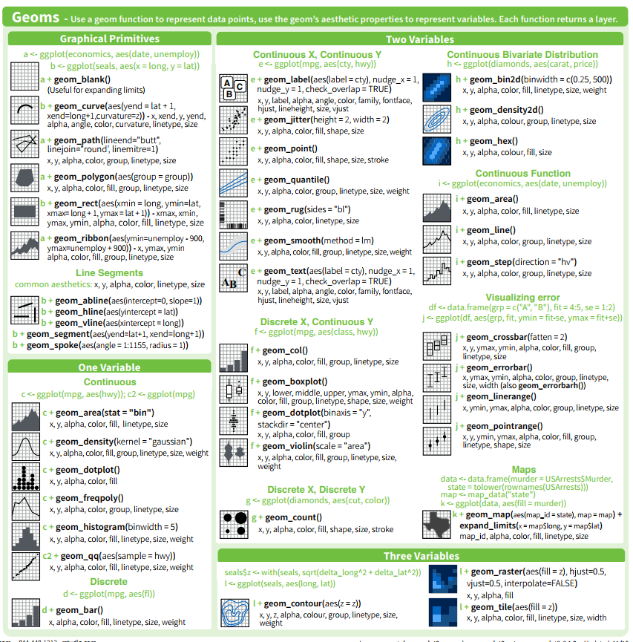
geoms
…and many more in sister packages

Slide 11
Let’s Try:
Create a scatterplot of wksgest and mage using ggplot and geom_point.
D’oh! Overplotting! Use the geom_jitter() geometry instead.
Let’s try colors. Map cigdur to color. That’s it!
Fancier: change color to preterm_f, change the point character to a “.”, and set alpha = 0.1

Slide 12
Answers
ggplot(births)+geom_point(aes(wksgest, mage))
ggplot(births)+geom_jitter(aes(wksgest, mage))
ggplot(births)+geom_jitter(aes(wksgest, mage, color=cigdur))
ggplot(births)+geom_jitter(aes(wksgest, mage, color=preterm_f), pch=".", alpha=0.2)

Slide 13
Cheatsheet: https://www.rstudio.com/wp-content/uploads/2015/03/ggplot2-cheatsheet.pdf
... Or right in RStudio!

Slide 14
Let’s Try: Exploring geometries
Pick a few variables of interest from the raw variables of interest… mdif wksgest mage mrace methnic cigdur cores …or our recoded versions! pnc5_f preterm_f raceeth
Pick a relevant geometry from the cheat sheet
Run the example geometry using the supplied ggplot2 dataset (e.g. diamonds, economics, mpg, iris)
Create a comparable graph using the births dataset by mapping your variables onto one or more aesthetic elements: e.g. X, y, color, fill, shape, group, linetype, size, weight, alpha

Slide 15
Answers
Various!

Slide 16
Facets
Facets take an R formula object (e.g . ~ x, y ~ x) and split your graph into small multiples based on that.
Can also “free the scales” so they aren’t shared across plots.
ggplot(births, aes(mage, wksgest))+
geom_jitter(aes(color=preterm_f), pch=".", alpha=0.2)+
geom_smooth()+ facet_grid( ~ raceeth_f)

Slide 17
Themes
Change the theme with theme_NAME(), e.g. theme_minimal().
Can define your own themes, or tweak existing ones.
See https://cran.r-project.org/web/packages/ggthemes/vignettes/ggthemes.html for more themes.

Slide 18
Back to data
Sometimes we need to transform our data to get at the question we have in mind.
e.g. What is the relationship of preterm birth and maternal age?

Slide 19
Let’s Try: ggplots from new data
Create a plot of the relationship of preterm birth and maternal age using: ggplot(births)+ geom_histogram(aes(x=mage, fill=preterm_f), position="fill")
OK, but ew. Let’s create a new dataset to plot with. Create a plot of the relationship of preterm birth and maternal age.
Hint: dplyr will make this easy. But for now, use the table function and data.frame functions to create a data.frame with a column for each maternal age, the number of births, and the percent preterm.
Challenge: Sew a dplyr statement to a ggplot statement all in one go. Hint %>% … %>% ….+ …+ … +

Slide 20
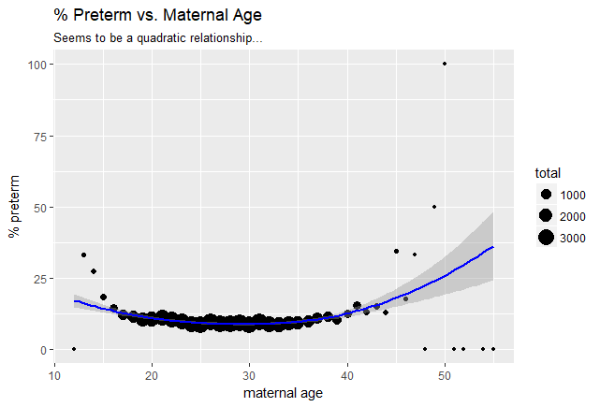
Answers
t1 = table(births$mage, births$preterm)
mage_df = data.frame(mage = as.numeric(row.names(t1)), n_preterm = t1[,2], total = t1[,1] + t1[,2])
mage_df$pct_preterm = mage_df$n_preterm / mage_df$total * 100
ggplot(mage_df, aes(mage, pct_preterm))+geom_point()
ggplot(mage_df, aes(mage, pct_preterm))+geom_point(aes(size=total))+geom_smooth(color="blue")
ggplot(mage_df, aes(mage, pct_preterm))+
geom_point(aes(size=total))+
geom_smooth(aes(weight=total), color="blue")+
labs(title="% Preterm vs. Maternal Age", x="maternal age", y="% preterm",
subtitle="Seems to be a quadratic relationship...")

Slide 21
Homework 2
Plots coming up

Slide 22
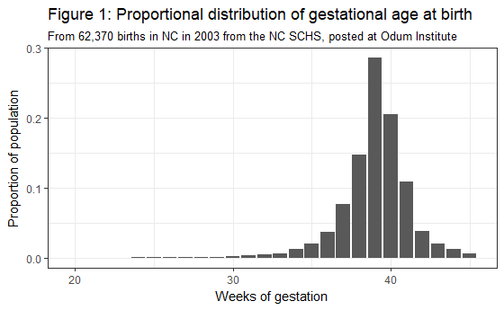
Plots in HW 2

Slide 23
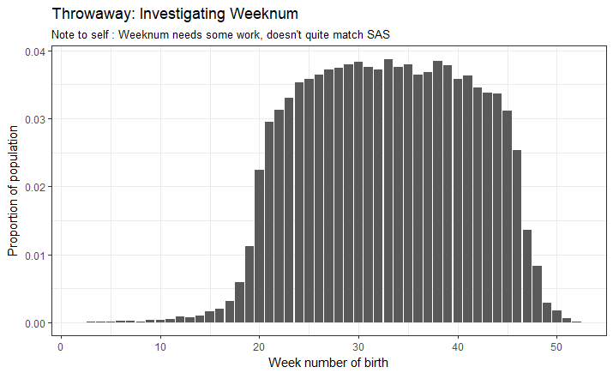
Plots in HW 2

Slide 24
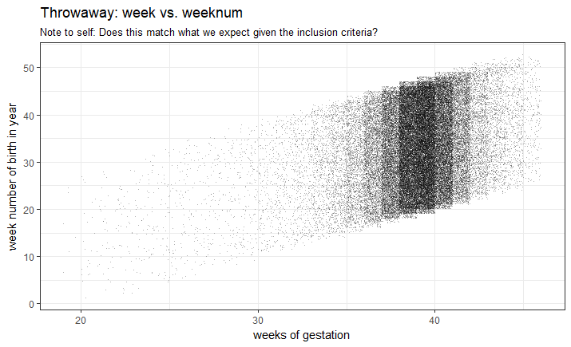
Plots in HW 2

Slide 25
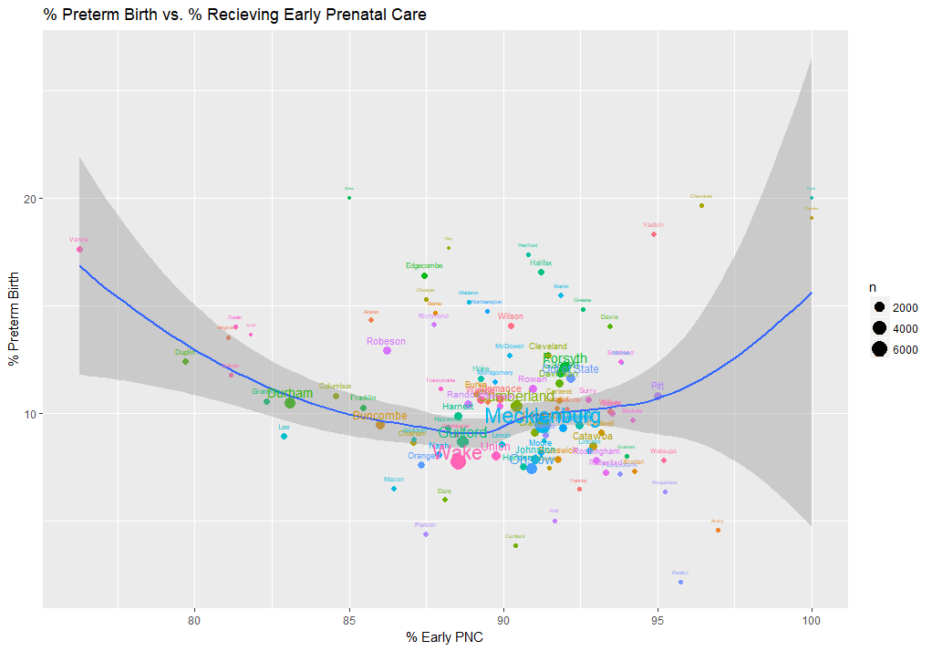
Plots in future HW

Slide 26
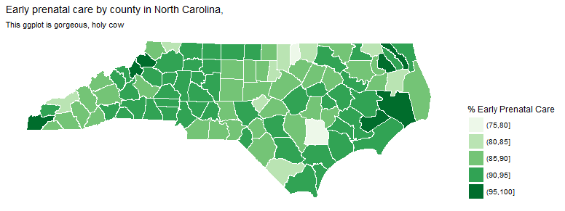
Plots in future HW

Slide 27
Worth a skim: http://r-statistics.co/Top50-Ggplot2-Visualizations-MasterList-R-Code.html
http://chartmaker.visualisingdata.com/

Slide 28
Coming up next in ggplot
Colors, themes, ggplot extension packages

