Slide 1
Maps 3:
Examples in Practice
EPID 799C Fall 2017

Slide 2
Today: Examples & Patterns
Long
Industrial Hog Operations (IHOs) - Title VI complaint
Alcohol exposure index
Death by police (WIP)
Short
Cumulative exposures
Flooding
Dissertation / Traffic Stops
Tobacco scraping / machine learning

Slide 3
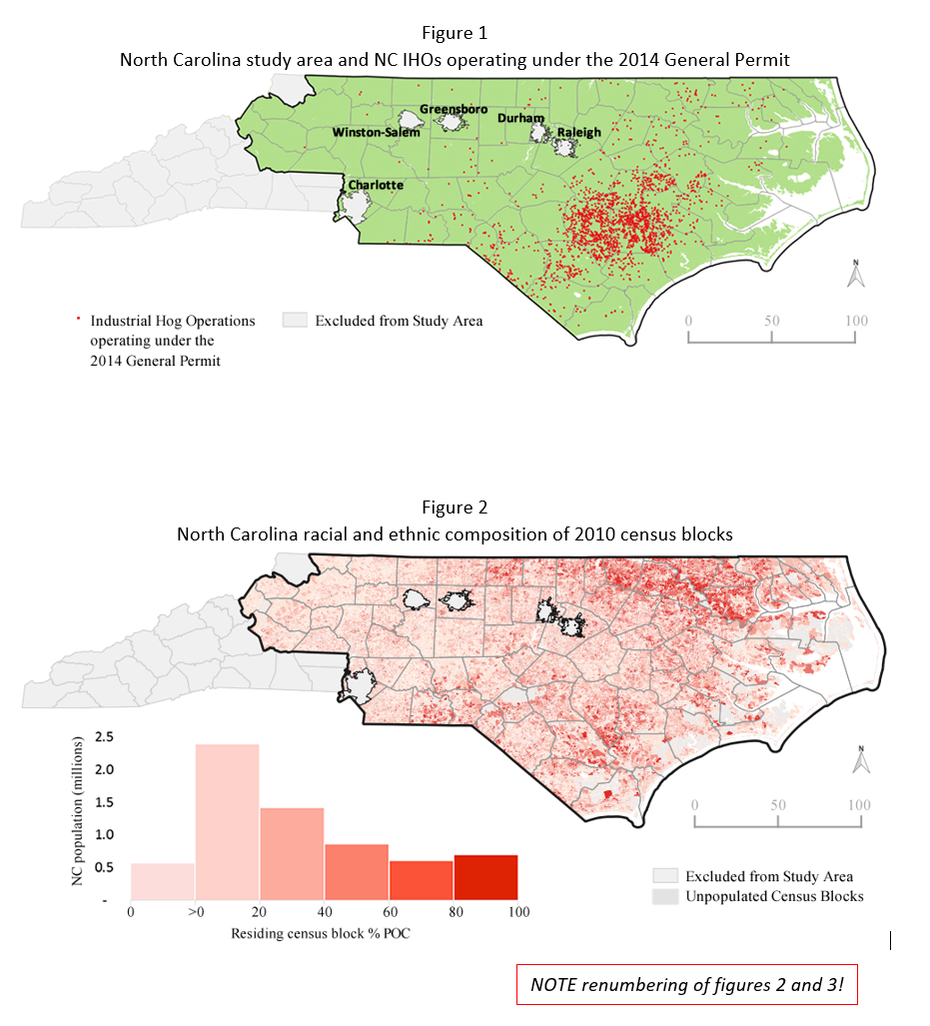
IHOs

Slide 4
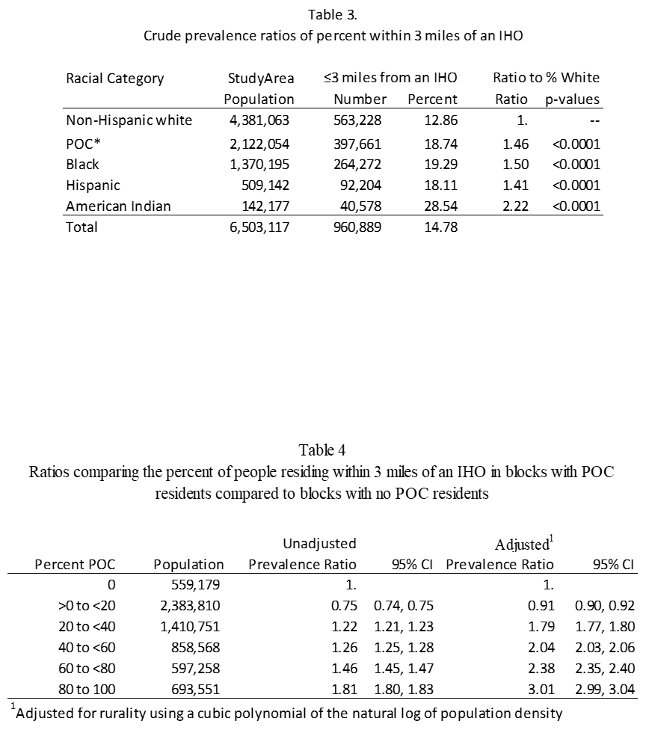
IHOs

Slide 5
IHOs: R
~ 800 lines of (very inefficient) code.
########################################################################################
# General Structure
# 1. Prep the IHO dataset: filtering and merging to unique permits
# 2. Prep geography: Import NC counties, create point/buffer (3mi) shapefiles for IHOs.
# 3. Exclusions: Create exclusion shapes for "no-touch" counties and top 5 cities. Map.
# 4. Prep Demographics: Import 2010 census data and shapefiles at block level. Merge.
# 5. Spatial punch: Strip exclusion blocks from shapefile/data frame to get study area.
# 6. Spatial aggregation: Merge 3mi buffer exposure data into blocks. Export shapefile.
# 7. Regressions.
# 8. Datapoints and graphics.
########################################################################################
Patterns:
Duplicate an analysis where you know the answer! Rosetta Stones are great ways to learn.
Repeated analysis over and over. Brought 4 hours for every change to one button click.
For court use, *everything* is documented. Still using it – request for original data and scripts this week.
Text to speech is excessive, but neat.

Slide 6
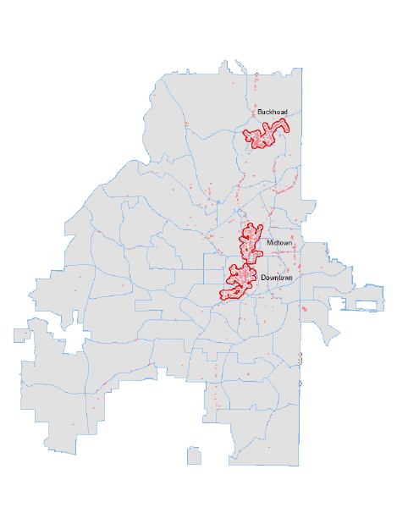
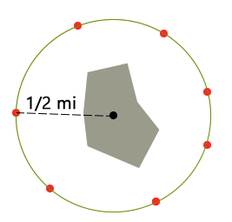
Alcohol Exposure Index
Left. On-premises alcohol outlets and cluster zones in Atlanta, GA, 1997–2007.
Above Example of spatial index construct. The alcohol retailer exposure index for a region (e.g. cluster or city-wide) is built by the sum of the inverse distances from each population (e.g. census block) cluster centroid to the nearest seven retailers. In this example, each of the nearest seven retailers are ½ mile from the centroid of the region , making, the spatial index for this region 14(14 = 7 x inverse(1/2)).. All individuals are ascribed this exposure, and then populations within the region are summed to obtain the total or average alcohol retailer exposure by demographics or alcohol retailer type.

Slide 7
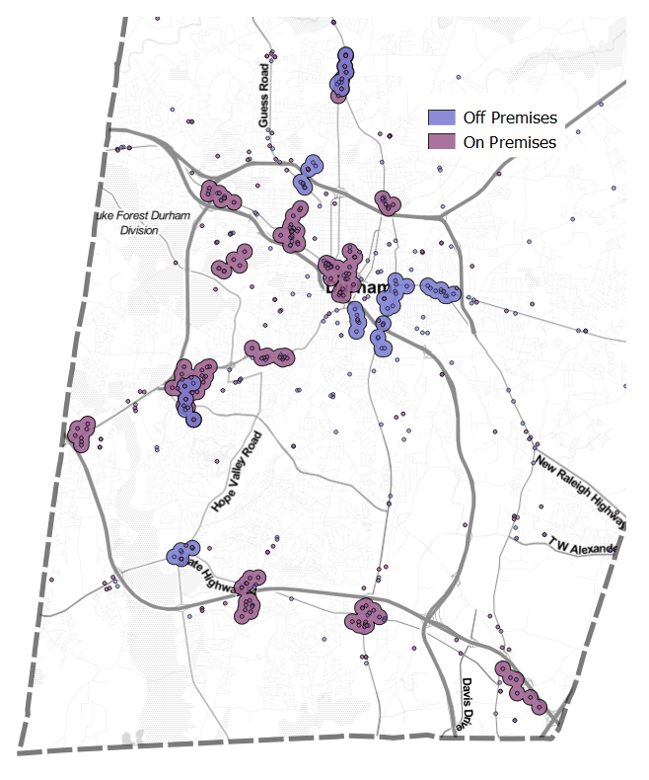
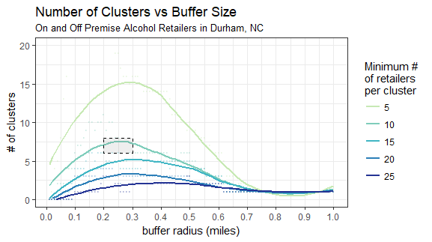
Alcohol Exposure Index
Left. Map of On- and Off-Premises Alcohol Retailer Locations and Clusters in Durham County, NC. Separate on- and off-premises clusters were defined as five or more alcohol retailers within 0.15 miles. There were no clusters located farther north or east of this window in Durham County.
Above: Number of Clusters vs. Buffer Size of On- and Off-Premises Retailers in Durham County, NC. For example, note how, for clusters of minimum size 10, buffer counts begin to collapse after using buffers greater than 0.25 miles to nearest alcohol retailers.

Slide 8
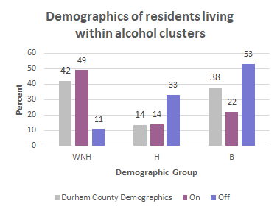
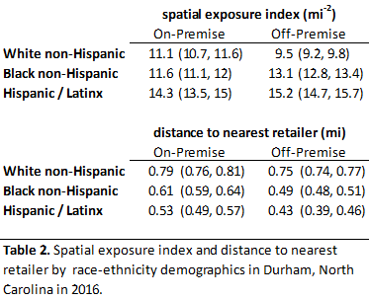
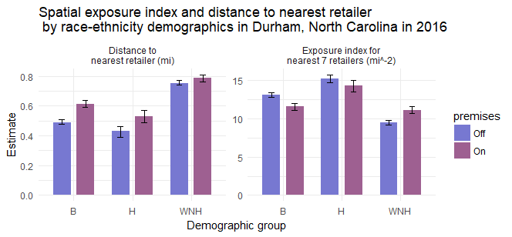
Alcohol Exposure Index
Right. Demographics of Durham County Residents Living within On- and Off-Premises Alcohol Clusters . Hispanic and Black residents were more likely to live within an off-premises alcohol retailer cluster than White non-Hispanic residents. Demographic data from 2010 US Census

Slide 9
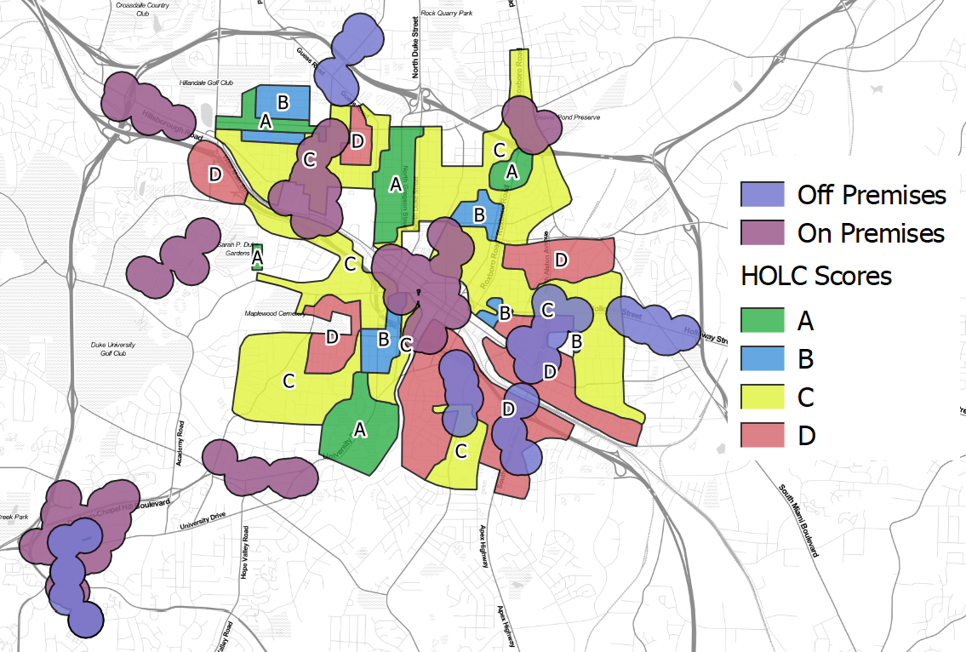
Alcohol Exposure Index
Above. Home Owners’ Loan Corporation (Redlining) Map of Durham, NC (1933) and On- and Off-Premises Alcohol Retailer Cluster Locations (2007). Note the largest off-premises alcohol retailer cluster is over the largest “Grade D” neighborhoods.

Slide 10
Alcohol Exposure Index: R (WIP)
Load libraries & read files
Recode: match constructs (race-eth, dates, etc.)
Get unique locations (for spatial matching)
Function: make distance matrices, returns list of matrices
Function: report matches
Run tests & output
Machine learning tests
Patterns:
Save points – output results and read them right back in.
Higher level functions & process wrappers
Retailing a color palette in maps and graphs - nice

Slide 11
Police Killings
Death by “legal intervention”
Linking project – Violent Death Reporting System (VSRS) to crowd-sourced data
What are the differences in community ascription of death by police and formal VDRS coding?

Slide 12
Police Killings: Distance Matrices
Simpler but non-trivial linking methods use approximate text distance linking (Levinschtein distance or others) on a fully concatenated string.
Example:
A=“John Q Smith 2017/02/12 White Raleigh NC”
B= “John P Smith 2016/12/21 White Raleigh NC”
Number of substitutions, additions, deletions
to get from A to B = 5
But this doesn’t take advantage of the content (e.g. date distance or place distance).

Slide 13
Police Killings: Distance Matrices
First build individual content-specific distance matrices for each element …
(example distance range in parentheses)
Name: text distance (0->32)
Race-eth: binary 0-1
Date: days different (0-707)
City: text distance (0-19)
State: binary 0-1

Slide 14
Police Killings: Distance Matrices
… Then collapsing them into a single n-dimensional distance by any of a number of methods. These aggregate link indices performs well by themselves.
Name Race-eth Date City State
Unweighted sum scaled sum (0-1) Normalized sum (~-3,~3)

Slide 15
Police Killings: Exploratory Tree Models
Predictive trees can also be used for categorization.
They benefit from
Maintain separate distance matrix information as decision nodes
Being able to “reuse” covariates if useful
Do not require single a priori or parameterized generalized linear relationships

Slide 16
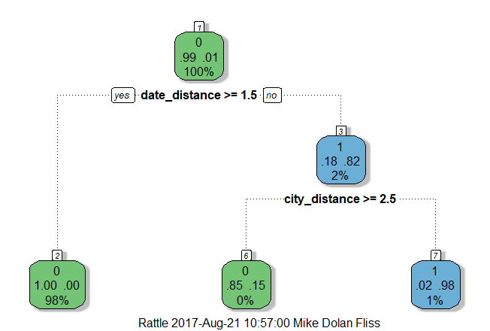
Police Killings: Exploratory Tree Models
With violent deaths / deaths by police being relatively rare at the local level, even without decedent name in the tree model, date distance (in days) and the approximate text distance in the city name, by themselves, correctly categorize 99% of links between the Mapping Police Violence and The Counted datasets. Name is more useful when using the entire violent death dataset.
Treating dates numerically instead of as strings in a concatenated ID may have application to other death linking projects.

Slide 17
Police Killings: Future Improvements
NVDRS: Waiting for national VDRS data to test on a “supervised” (hand linked) subset
Stabilization if single aggregate index, consider stabilizing (e.g. dates >30 are all 30, long name distances are cut off)
Package Helpers: RecordLinkage package in R uses regressive trees. Need to efficiently bin as well.
Spatial Distance Matrix: Considering creating a lookup table of geocoded place distances on city-state to benefit from spatial distance, e.g.
1) Chapel Hill, TN to Chapel Hill, NC
text distance = 2 , spatial distance = 226 miles
2) Chapel Hill to Carrboro
text distance = 9, spatial distance = 0.5 miles

Slide 18
Police Killings: R (WIP)
Load libraries & read files
Recode: match constructs (race-eth, dates, etc.)
Get unique locations (for spatial matching)
Function: make distance matrices, returns list of matrices
Function: report matches
Run tests & output
Machine learning tests
Patterns:
Implement what you intuit and test it on a data subset
Packages exist that may do it better (RecordLinkage)
Trees, again, very doable
A little spatial / text-mining goes a long way

Slide 19
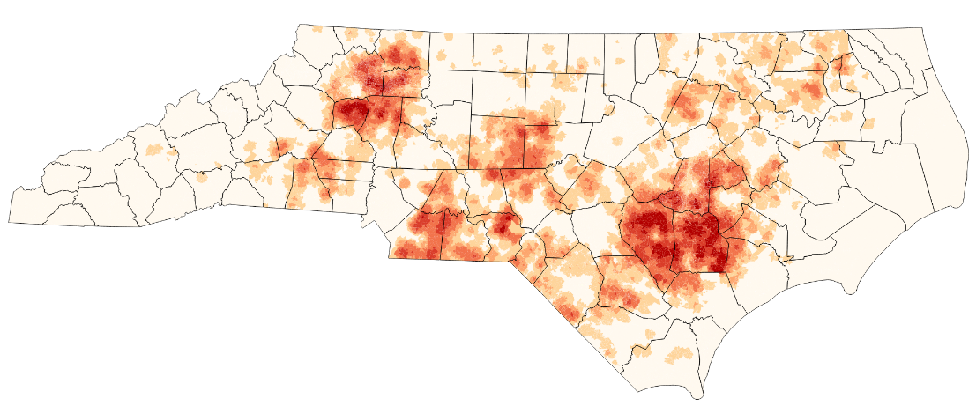
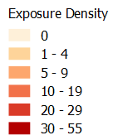
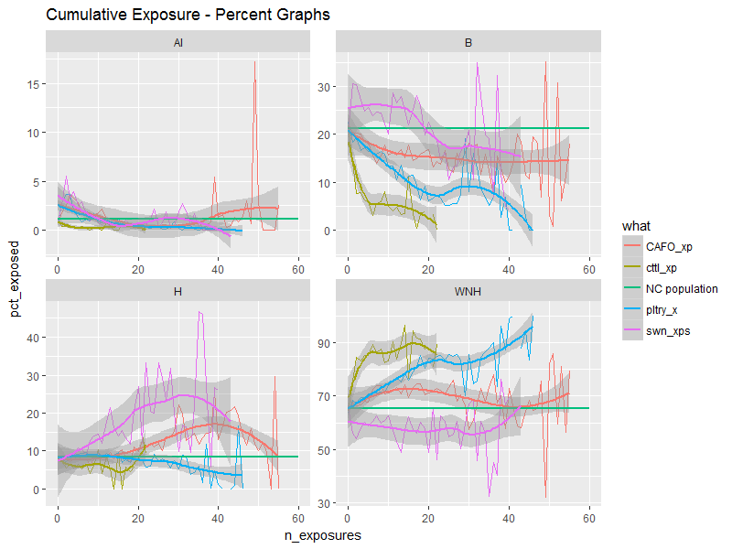
Cumulative Exposures
Maps of cumulative density
All CAFOs
(additive)
(CAFOs to start)
Patterns:
Extend / make generic previous analysis.
Identify which structures hold results

Slide 20
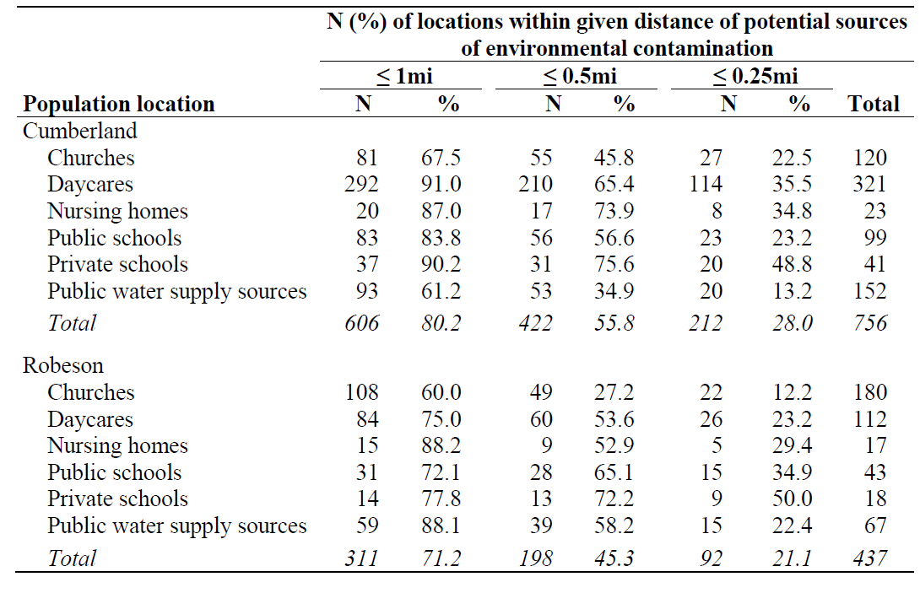
Flooding / Cumulative Exposure
Two counties to start
Patterns:
Collapse / rbind layers.

Slide 21
Race-Ethnic Disparities in Law Enforcement Traffic Stops
Bigger than we have time for, but:
Residential-based traffic stop rates tend to underestimate disparities
Fayetteville decreased racial disparities by prioritizing different stop types, though could do more
Spatial data very helpful: counting, “punching”, etc.
Reports for NAACP, SCSJ
Quick data processing
Spatio-temporal mapping
Patterns:
Simulation
Spatial work→QGIS

Slide 22
Tobacco
R consulting grew into a job
Cleaning scripts
  100s of files in various formats. R can iteratively loop through them with list.files() and use a header file
Reports galore
Machine learning categorization prototypes
Nuanced data cleaning (messy spatial data)
Modeling & map-building

Slide 23
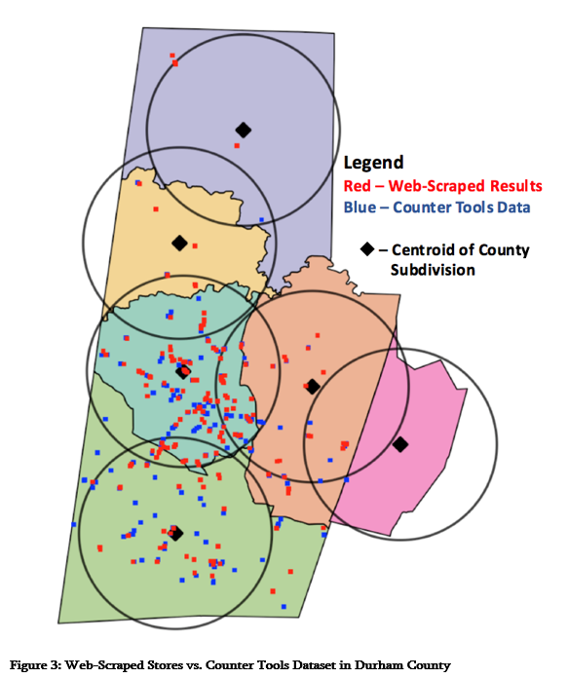
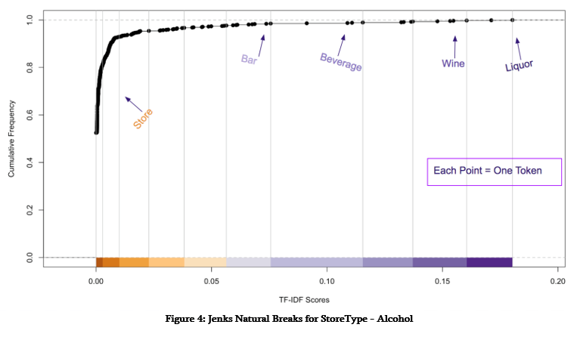
Tobacco – Data+
Patterns:
Basic tree-ML isn’t so hard! Just try.
A little text-mining goes a long way / learn dplyr!
Web-scraping
Text-mining
Machine learning

Slide 24
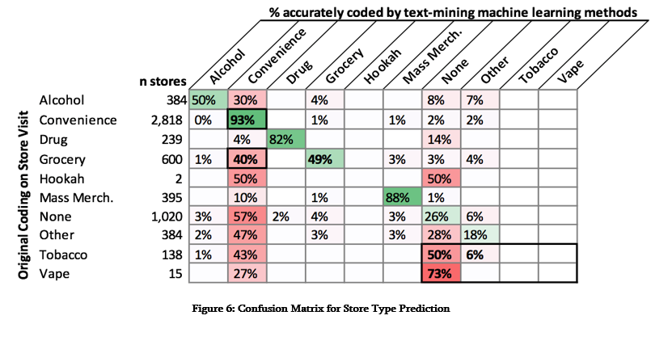
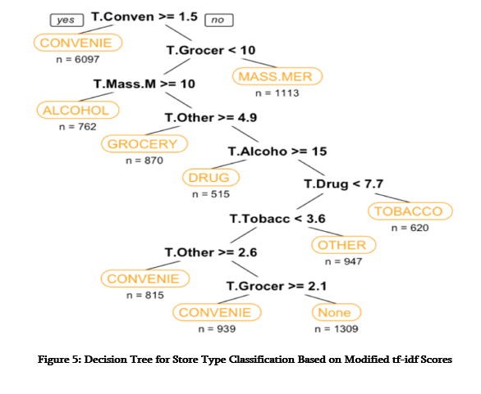
Tobacco – Data+
Patterns:
Epi gives concepts applicable / extensible elsewhere – confusion matrix (Sn/Sp)
Trees are cool and worth learning and easy to implement in R.

Slide 25
Questions / Thoughts?

