Slide 1
What does youR future hold?
Genetic Data?
Package Development?
Team Collaboration?
Sara Levintow
Wednesday, Nov. 8, 2017

Slide 2
Today’s Overview
Using R to manage and analyze genetic data
  Project example: HIV phylogenetics in North Carolina
Turning your data and code into R packages
  Project examples: sharkR, ipwrisk
Collaborating efficiently with others on R projects
  Version control using Git
  Create a Bitbucket account that we’ll use during Monday’s lecture

Slide 3
Using R with Genetic Data
Common challenge to genetic analyses is the need to use multiple programs to conduct different parts of the analysis.
  Repeatedly reformatting data
  Tedious and inefficient
R is a powerful tool to conduct an analysis start to finish, drawing on the variety of packages available.
  Many packages for statistical, population genetic, genomic, phylogenetic, and comparative genomic analyses
  No need to reformat your data or switch operating systems to get through a full analysis

Slide 4
R packages to check out
Population genetics: genetics, adegenet, rmetasim
Phylogenetics: ape, phangorn, treemap
GWAS: GenABEL, snpMatrix
Importing sequence data: seqinr
See more here:
https://cran.r-project.org/web/views/Genetics.html
http://gaow.github.io/genetic-analysis-software/0/

Slide 5
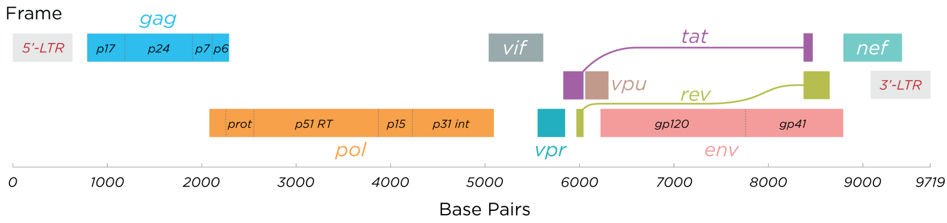
HIV Phylogenetics
Global spread of HIV is characterized by the virus’ high genetic variability and rapid evolution.
HIV genetic diversity impacts diagnosis, pathogenesis, transmission, and vaccine development.
In HIV phylogenetics, we analyze differences in genetic sequences of the virus to understand disease progression, drug resistance, and transmission dynamics.
Wiki HIV Genome

Slide 6
Pairwise Genetic Distance Analyses
Measure of genetic diversity: How different are two sequences?
If two sequences come from the same person: How much variability do we see over time? What are the clinical implications?
If two sequences come from two different people: Are their infections epidemiologically linked? Do they belong to the same transmission cluster?

Slide 7
Pairwise Genetic Distance Analyses
We used the ape package:
  Read in a CSV file of 15,000 sequences (from the pol gene, 1497 bp), read in as a character variable
  Changed the sequences from character to the R class DNAbin – very powerful bit-level coding scheme for DNA sequences.
  Used the dist.dna function from ape to compute a matrix of pairwise distances for all pairs of sequences
Pairwise genetic distance used to define transmission clusters among these 15,000 HIV+ patients in NC.
  Transmission cluster had less than 3.5% pairwise genetic distance between all sequences belonging to that cluster (among other conditions).

Slide 8
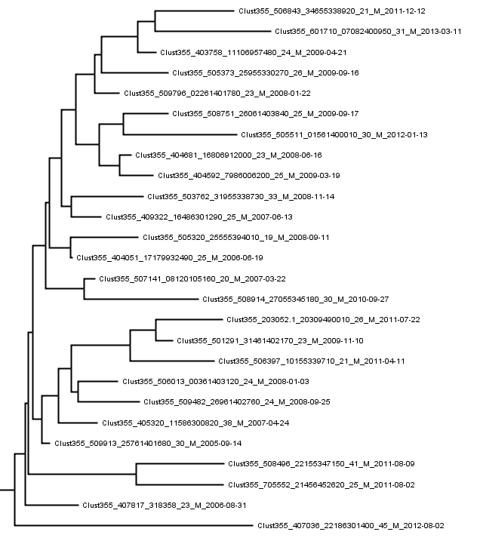
Phylogenetic Trees
40 tree files with sequences from 2,348 patients identified in 2,309 transmission clusters.
Very difficult to manipulate or analyze.
No easy way to extract important statistics for each cluster that appeared on the tree.

Slide 9
Phylogenetic Trees
Used ape package again!
Read the 40 tree files into R and created a dataframe with all tree data.
Easy to extract the statistics we needed (posterior probability for each cluster).
Eliminated 20 clusters that did not have sufficient statistical support from subsequent analyses.

Slide 10
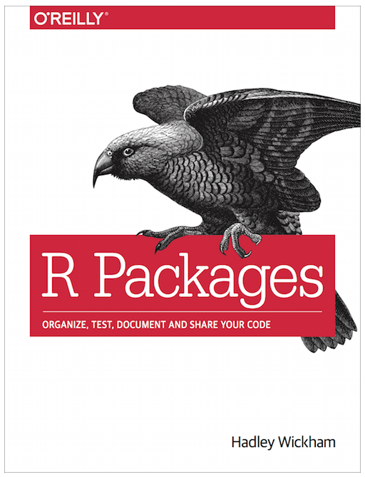
Package Development
Packages = fundamental units of reproducible R code.
  Reusable R functions.
  Documentation describing how to use those functions.
  Sample data to try out those functions.
Turning your code into a package allows you to:
  Efficiently re-run previous analyses or use previously developed functions.
  Easily share it with others.
http://r-pkgs.had.co.nz/

Slide 11
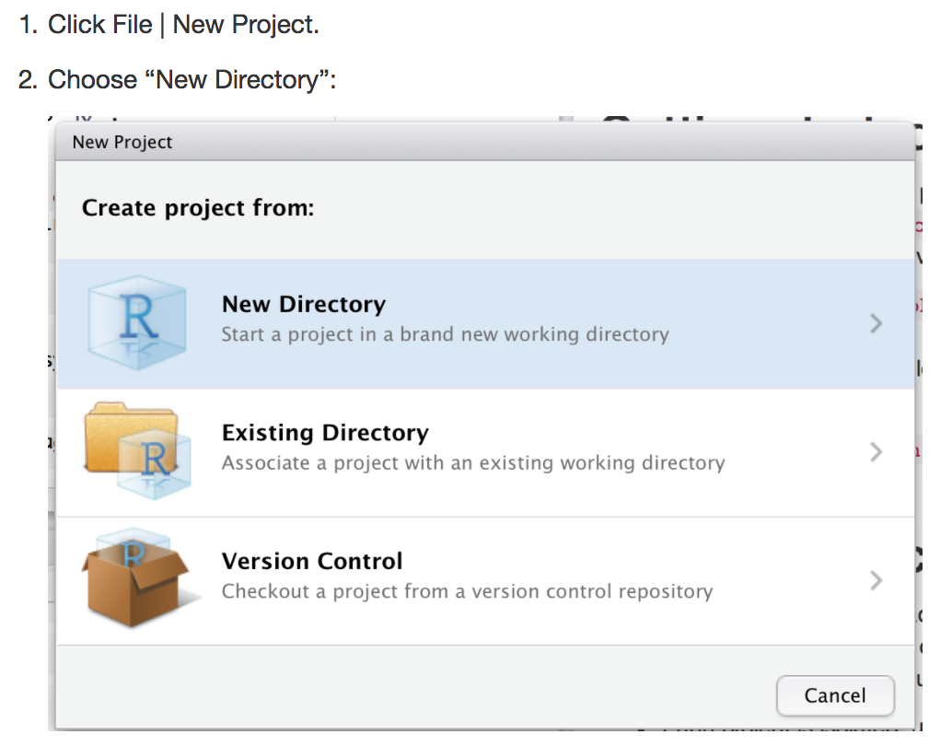
Get started on your package by creating an R project
http://r-pkgs.had.co.nz/

Slide 12
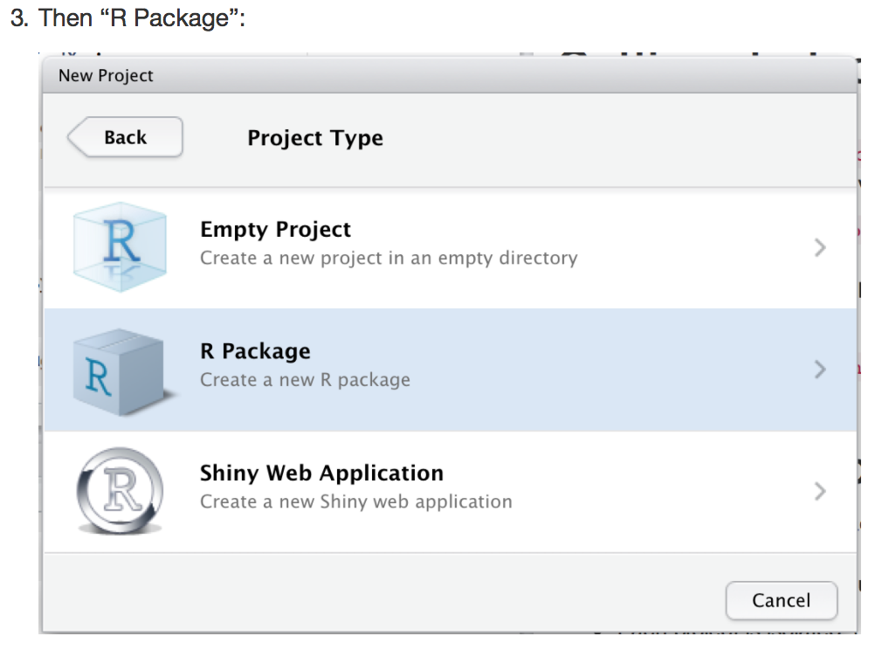
Get started on your package by creating an R project
http://r-pkgs.had.co.nz/

Slide 13
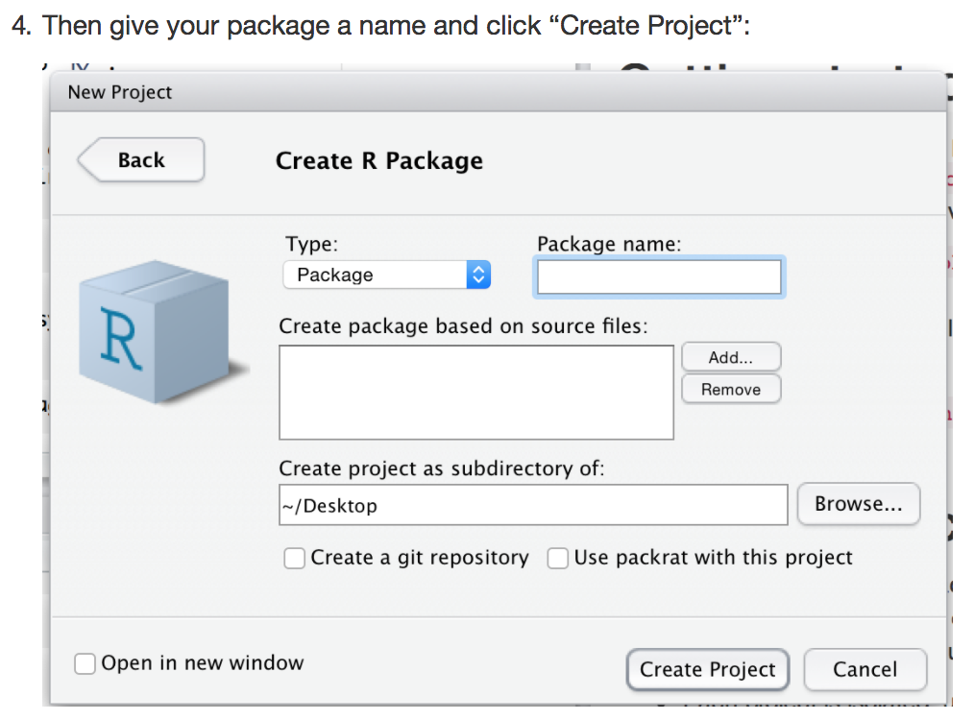
Get started on your package by creating an R project
http://r-pkgs.had.co.nz/

Slide 14
Package Development
Once you’ve created the R project file, you can open it and start working on your package:
  Write R scripts with reusable R functions.
  Develop documentation (readme files, vignettes) for those functions.
  Read in data (stored in your project) to try out those functions.
Going from R project to package:
  Use “Build” tab next to “Environment”, “History”
  Easy access to all of the functions and data contained by your package:
  library(mypackage)

Slide 15
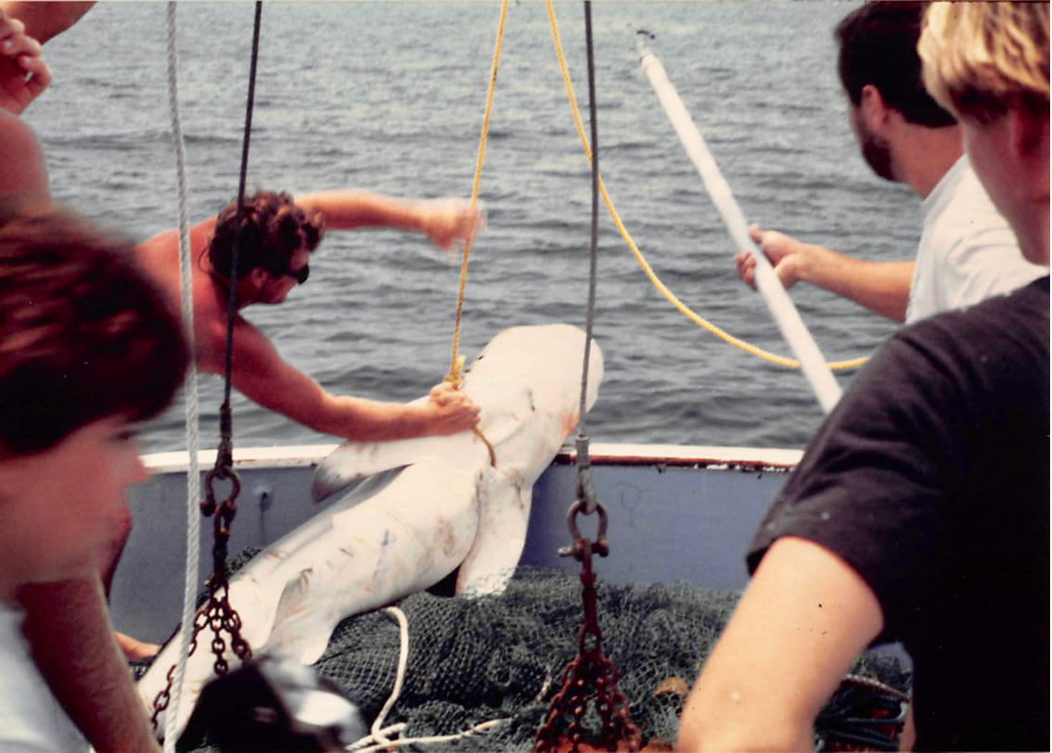
Package Development: sharkR
http://ims.unc.edu/home/research/ https://bitbucket.org/novisci/sharkr
Enable access to data from a multi-year longline shark sampling survey.
Conducted from 1972 to 2011 by Frank J. Schwartz of the UNC Institute of Marine Sciences.

Slide 16
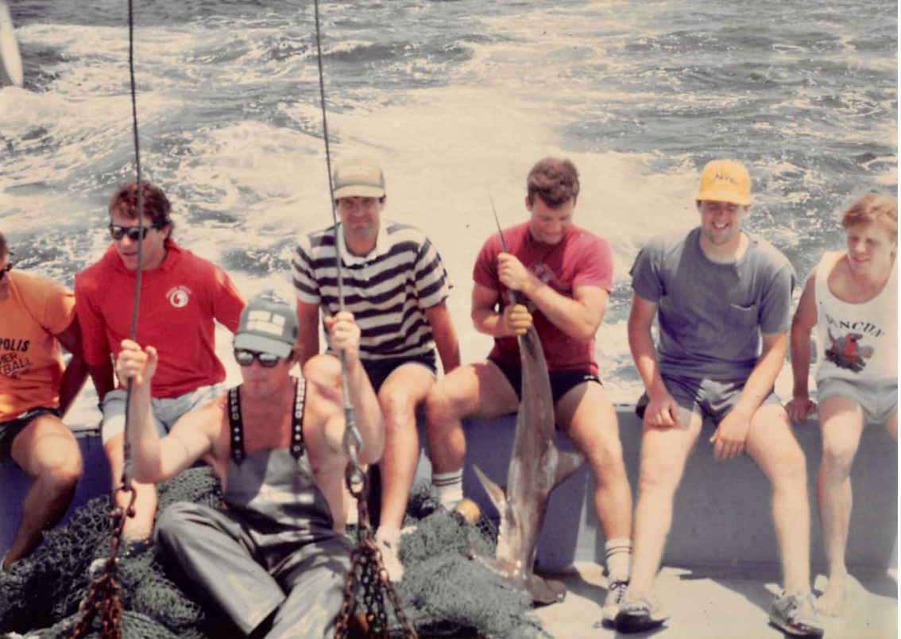
Package Development: sharkR
http://ims.unc.edu/home/research/ https://bitbucket.org/novisci/sharkr
Collected data on shark abundances, species, and sizes.
Dataset contains 7,931 observations with variables on:
Date and time of shark capture
Classification of high or low tide
Type of shark species
Length of the shark
Temperature and precipitation

Slide 17
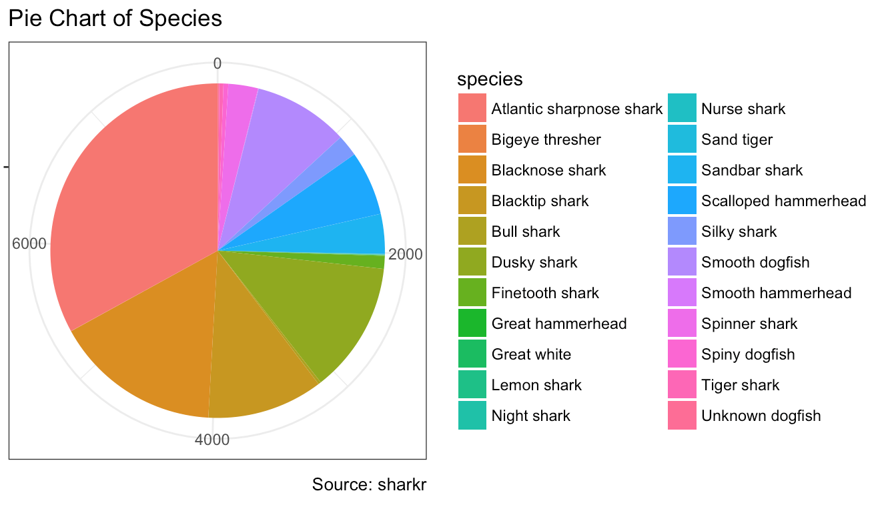
Package Development: sharkR
In addition to the dataset, the package also has code for basic analyses.

Slide 18
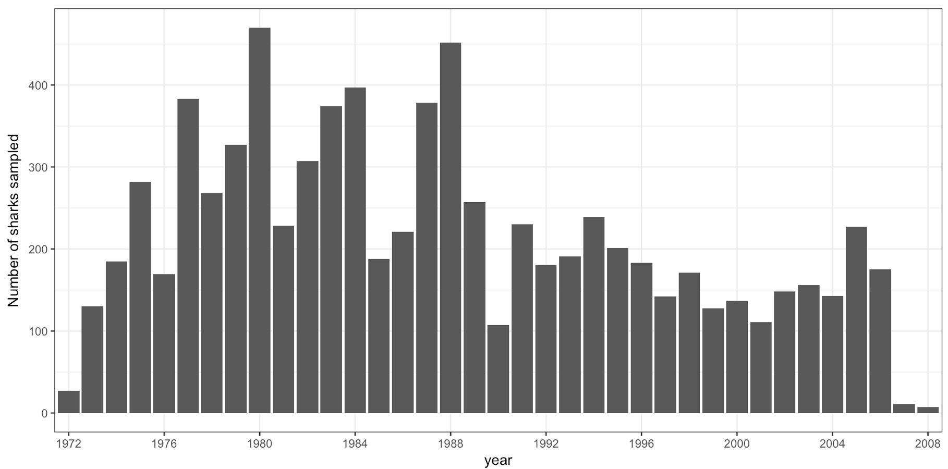
Package Development: sharkR
In addition to the dataset, the package also has code for basic analyses.

Slide 19
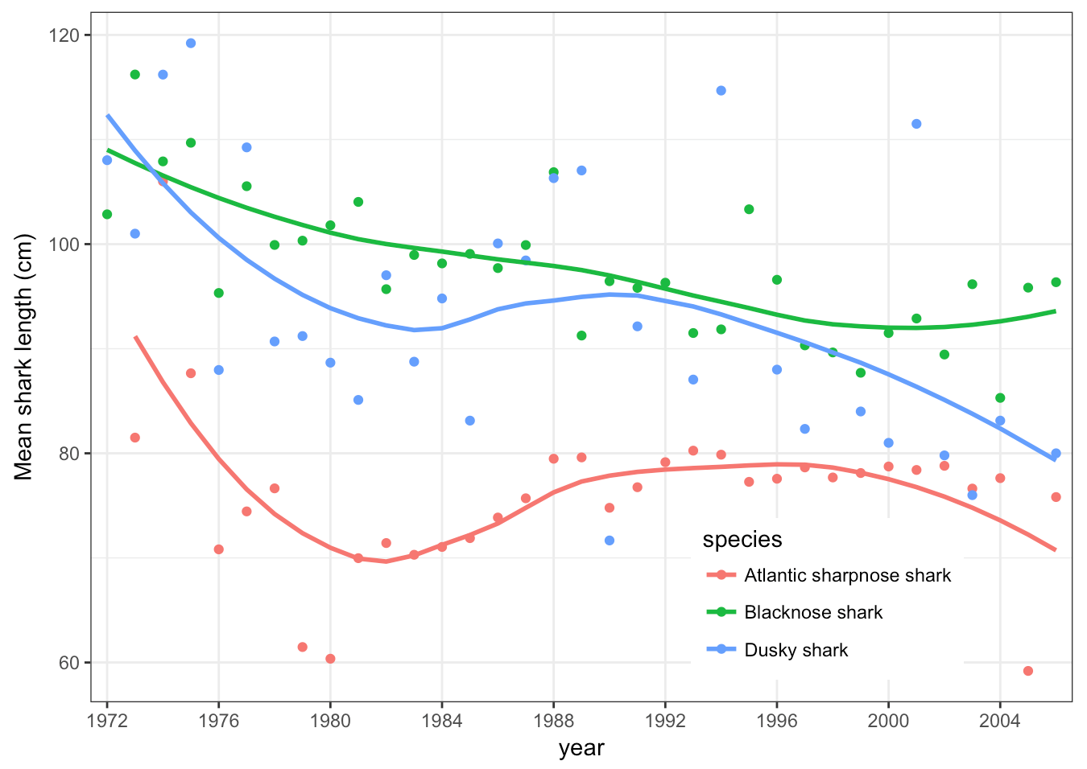
Package Development: sharkR
In addition to the dataset, the package also has code for basic analyses.

Slide 20
Package Development
WIHS2009
Data from the Women’s Interagency HIV Study (WIHS), an ongoing observational cohort study with semiannual visits at 10 sites in the US
Will use this package on Monday for data access
ipwrisk
Under development by Alan Brookhart
Easy-to-use tools for estimating the cumulative risk of an outcome, including counterfactual outcomes, using inverse-probability weighted estimators
Will include examples using the WIHS dataset, among others

Slide 21
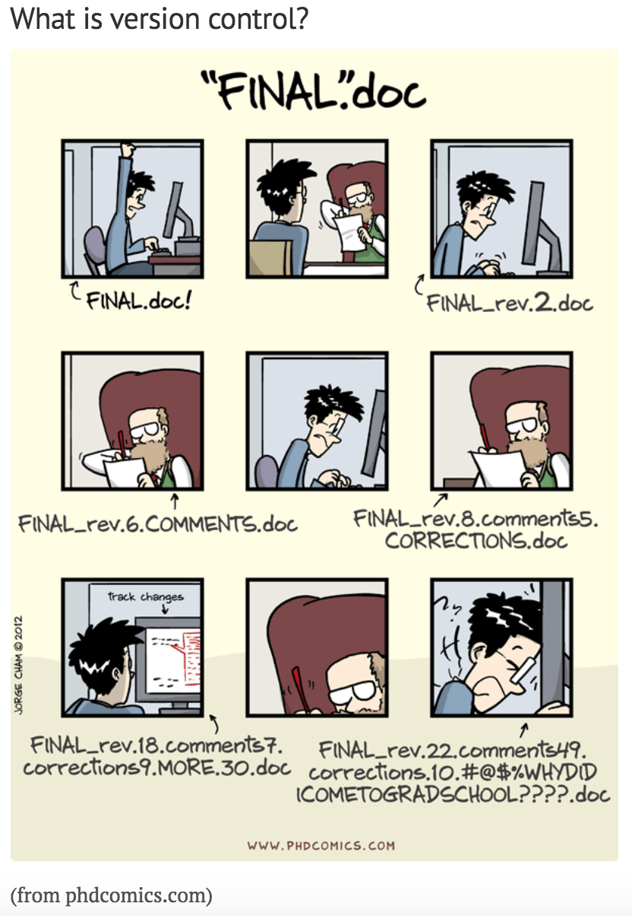
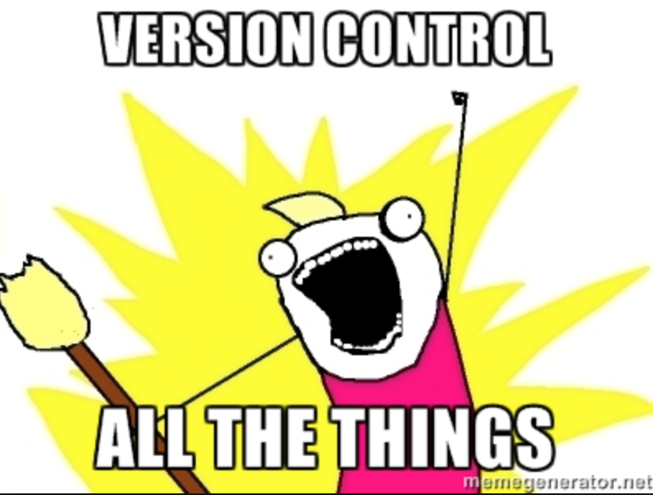
Team Collaboration aka Version Control

Slide 22
Version Control Software
Keeps the entire history of a file, allowing you to inspect a file throughout its lifetime
Tag particular versions of the file so you can return to it easily
Facilitates collaboration and increases transparency of each team member’s contributions
Enables experimentation with code, without breaking the main project
“Lab notebook” of the digital world
From http://r-bio.github.io/intro-git-rstudio/

Slide 23
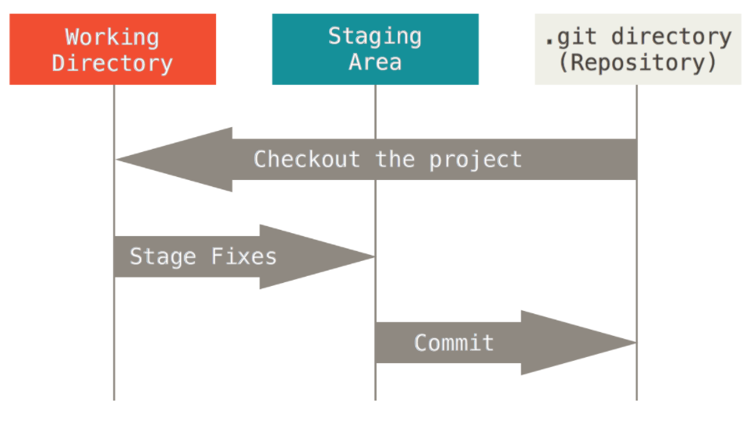
Git is a powerful implementation of version control.
Tracks changes to your code and shares those changes with others.
Seamlessly integrate your contributions to a file that others are working on.
Stores the entire history of your project locally (your computer) and on a public repository (websites like GitHub, Bitbucket).
RStudio provides shortcuts to common Git commands.
Makes sharing your package so easy!

Slide 24
Helpful resources for learning Git
https://www.git-tower.com/blog/workflow-of-git
https://www.codecademy.com/learn/learn-git
http://r-pkgs.had.co.nz/git.html
http://r-bio.github.io/intro-git-rstudio/

Slide 25
For Monday and beyond…
Sign up for a free Bitbucket account: https://bitbucket.org/
On Monday, you’ll run this code in Rstudio to access the WIHS data:
install.packages("devtools")
library(devtools) devtools::install_bitbucket("novisci/wihs2009",
auth_user="youremail@yourdomain.com", password=.rs.askForPassword("Bitbucket Password"))
library(WIHS2009)

