Slide 1
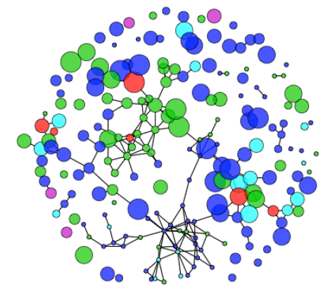
Using R for Network Models and Infectious Disease Transmission
Sara Levintow
November 27, 2017

Slide 2
Acknowledgments
Kimberly Powers
EPID 754 Advanced Methods in Infectious Disease Epidemiology, UNC
Martina Morris, Steven Goodreau, Samuel Jenness, Darcy Rao
Network Modeling of Epidemics (NME) Short Course, University of Washington
Steven Bellan, Juliet Pulliam, Jonathan Dushoff, Rebecca Borchering
Clinic on the Meaningful Modeling of Epidemiological Data, South Africa

Slide 3
Infectious Disease Epidemics
Significant morbidity and mortality due to infectious disease.
Recently: Ebola, Zika, influenza, HIV and other STIs…
The transmissible nature of infectious disease results in epidemics.
Infectious outcomes require special methods for study.
UNC Epid methods curriculum focuses on non-infectious outcomes (one person’s outcome does not affect another person’s outcome).
Defining feature of infectious disease is that the incidence among susceptible people depends on the prevalence of infectious individuals.

Slide 4
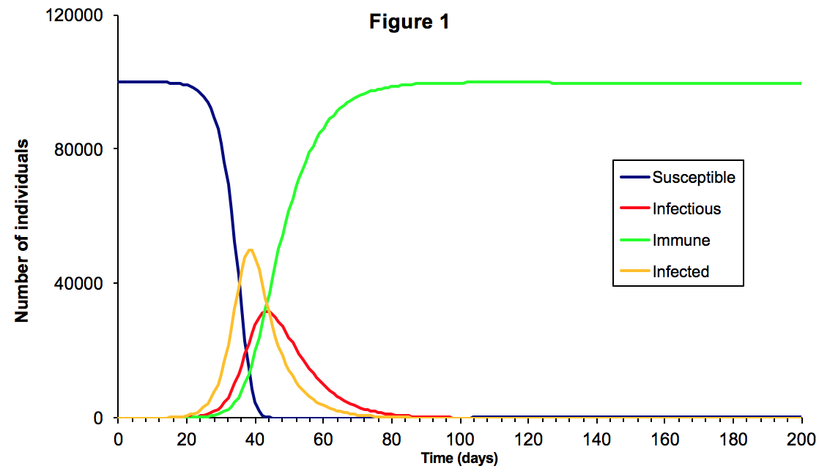
Mathematical Modeling of Epidemics
Special research methods in order to:
Understand patterns of infectious disease
Quantify importance of disease determinants
Predict future course of epidemic
Evaluate and compare potential interventions
Mathematical models enable analysis and simulation of complex phenomena.
Use numbers and equations to represent the system of interest (population and infectious agent).
Today’s focus: models of infectious disease epidemics driven by person-to-person transmission.

Slide 5
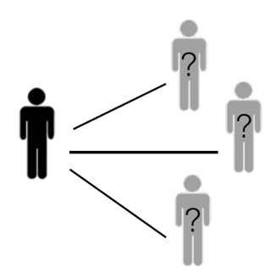
Infectious Disease Dynamics
Transmission of many infectious diseases is influenced by complex dynamics of human relationships.
Selection of social contacts and sexual partners
Partnership formation, persistence, and dissolution
Number of risk acts in partnership
Temporal overlap in partnerships (concurrency)
All of these aspects of relationships influence and are influenced by disease transmission.
Relationships interact with both demographic and epidemic processes
Particularly for HIV/STIs

Slide 6
The Importance of Networks
Social and sexual networks are a powerful determinant of infectious disease transmission.
The reachable path of infection over time depends on network structure.
This reachable path is determined by the cumulative time-ordered path of partnerships.
Concurrency removes the protection of sequence over time.
These features are most important in epidemic contexts with:
Sexually transmitted infections
Diseases that require proximity for transmission

Slide 7
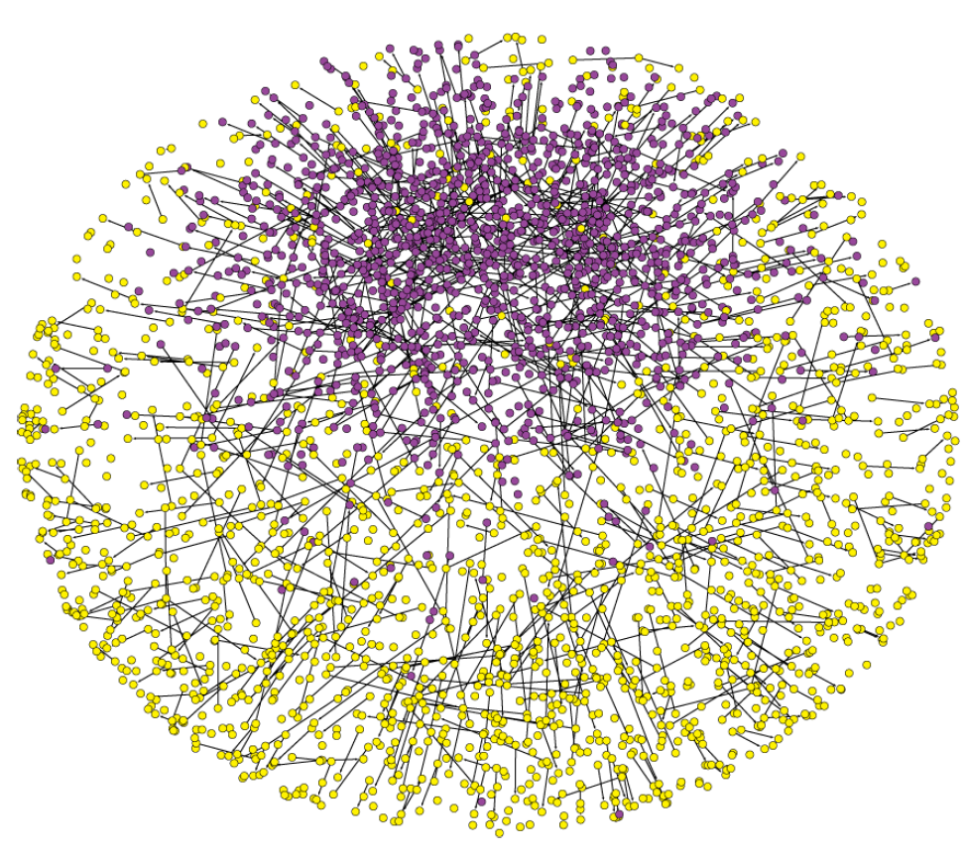
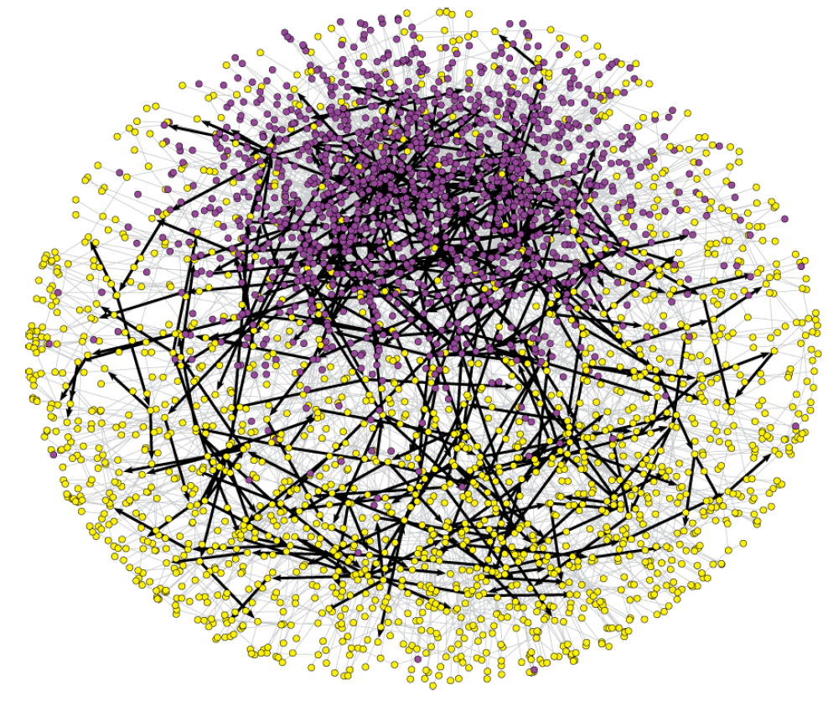
Network Connectivity
Epidemic persistence is a function of both static and temporal connectivity.
What is the network connectivity at any given time?
What is the reachable path over time?
Daily connectivity
Reachable path
over 10 years
Figure credit:
NME 2017 short course

Slide 8
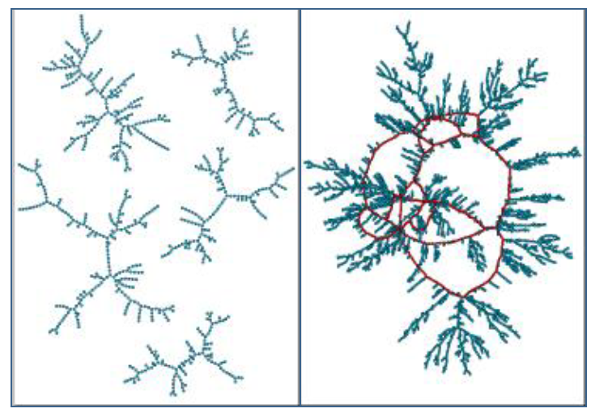
Networks 101: Terminology
Node
Node
Link
Node: the entity of interest.
Also called actors or vertices.
Link: the relationship of interest.
Also called a tie, an edge, or a line.
Components: groups of reachable nodes.
Also called a subgraph.
Network: the collection of all nodes and links.
Also called a graph.
There are many different attributes of nodes, links, components, and networks.
This has implications for the structures we can observe and what we want to model.
Multiple components
1 huge component
Figure credit: NME 2017

Slide 9
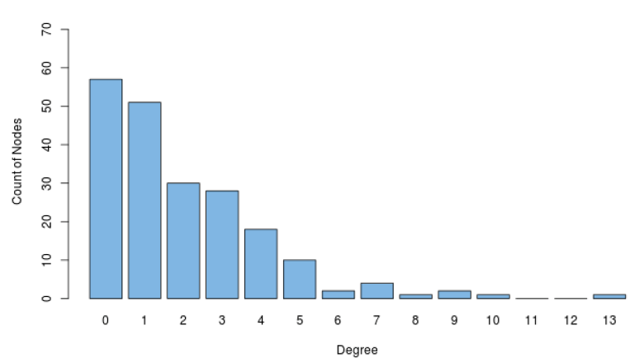
Network-Level Statistics
Density: Fraction of all possible dyads that have a link.
Isolate count: Number of nodes without any links.
Node mixing by attribute (age, sex, race, etc).
Degree: The number of links for a given node.
Degree distribution: Count of nodes by number of links (degree).
What are some ways these network statistics could impact spread of infection?
Figure credit: NME 2017

Slide 10
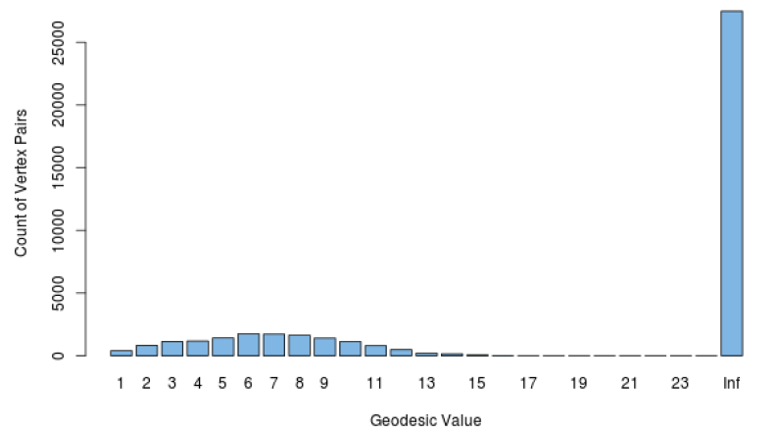
Network-Level Statistics: Connectivity
Geodesic: shortest path between two nodes (infinite if they are unreachable).
Geodesic distribution Component size distribution
Multiple components
1 huge component
Figure credit: NME 2017

Slide 11
How do we collect network data?
Network census: all members of the population are asked about their partnerships within a relevant time interval.
Rare in most forms of network epidemiology (although more common in sociology).
Basically non-existent/not feasible in HIV/STI research.
Egocentric network data: a random sample of the population is asked about a subset of their partnerships within a relevant time interval.
Partners do NOT have to be recruited into the sample.
Much more common in epidemiological studies.
Focus of the rest of lecture.

Slide 12
Example: Egocentric Network Data Collection
Q21: Please fill in the initials or nickname of all partners with whom you have had sex with in the past 6 months, even if you only had sex with this person once.
We are asking you to identify these recent sexual partners by their initials or a nickname. To ensure confidentiality, please do not use the individual's full name (i.e. first and last name). Start with the most recent and work backwards.

Slide 13
Example: Egocentric Network Data Collection
Q22: What is your relationship to [**partner initials**]?
Q23: In total, how many times have you had sex with [**] in the past 4 weeks?
Q24: How many of those times did you use a condom?
Q25: When was the first time you ever had sex with [**]?
Q26: When was the last time you had sex with [**]?
Q27: The last time you had sex, did you use a condom?
Q28: Do you think you will have sex with [**] again?
Q29: As far as you know, during the time that you and [**] have had a sexual relationship, has [**] had any other sexual partners, such as girlfriends/boyfriends, wives/husbands, or sex workers?
Q30: Has this person told you they were infected with HIV/AIDS?

Slide 14
Moving from Description to Inference
Network-level statistics help us to explore and describe key features of our observed data.
Density
Degree distribution
Node mixing by attribute
Geodesic distribution
We also want to compare these statistics to what we would expect by chance → ultimately to evaluate hypotheses about the processes that led to the network we observed.

Slide 15
Moving from Description to Inference
Select a network statistic from the observed data and compare it to the distribution simulated from a common reference distribution (“null model”).
Two basic tests:
Conditional Uniform Graph (CUG): How likely is it to observe this network density due to chance alone?
Bernoulli Random Graph (BRG): How likely is it that the observed links/ties in our data are due to chance alone?

Slide 16
Moving from Description to Inference
Basic statistical test (CUG, BRG): Does a particular aspect of your network differ from a simple random graph?
Exponential random graph model (ERGM): Test for multiple structural properties simultaneously.
Fundamental element of networks that make them different from estimating other statistical models: dependencies between observations.
Model estimation based on cross-sectional egocentrically sampled network data.
Markov Chain Monte Carlo (MCMC) is an iterative search algorithm to find the maximum likelihood estimates (MLE) for our model coefficients.
At the MLE of the coefficients, the expected values of the network statistics (based on the model) equal the observed network statistics (based on the data).

Slide 17
Modeling Dynamic Networks with STERGMs
ERGMs model cross-sectional network structure = the log odds of a partnership existing.
Separable temporal ERGMs (STERGMs) are an extension to model both partnership formation and partnership dissolution (rather than just partnership presence).
Determinants of formation of ties differ from those that facilitate their dissolution.
We want to be able to control model parameters for formation and dissolution separately.
To fit a STERGM, need cross-sectional egocentrically sampled network data that includes a measure of partnership duration

Slide 18
ERGMs vs. STERGMs
Slide credit: NME 2017

Slide 19
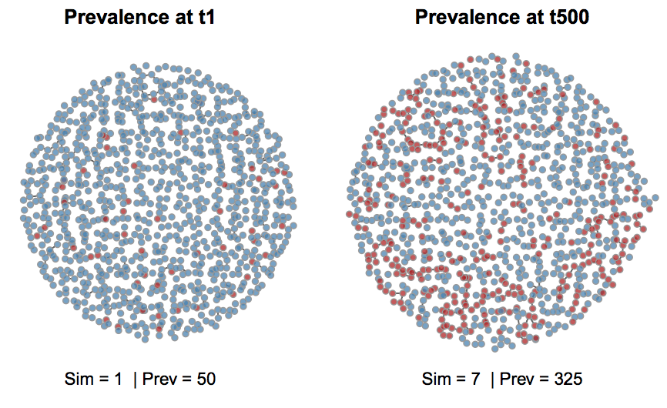
Network Model Simulations
A fitted model describes a probability distribution across all possible networks of the same size.
Model terms and estimated coefficients place higher probabilities on some networks, lower probabilities on others.
Using your fitted model, you can simulate a network which will be consistent with the network statistics in the observed data.
Then – finally!! – we can simulate an epidemic in the network and see what happens…

Slide 20
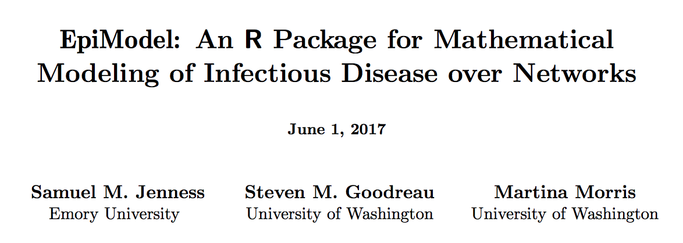
Links to check out:
EpiModel website
EpiModel methods paper
Statnet (used by EpiModel)

Slide 21
EpiModel
R package with tools for building, simulating, and analyzing mathematical models for the population dynamics of infectious disease transmission.
Robust framework for modeling the spread of epidemics on networks.
Previously was very challenging
Growing importance of modeling HIV/STI epidemics
Built-in core functions and ability to create extension modules.
Approachable for students new to infectious disease modeling
While also facilitating advanced modeling and novel research questions
“[EpiModel] provides an in silico laboratory to gain insight into the dynamics of complex systems, test empirical hypotheses about the determinants of a specific outbreak trajectory, and forecast the impact of interventions...”
Samuel Jenness, Steven Goodreau, Martina Morris, EpiModel Vignette

Slide 22
EpiModel Workflow for Network Models
Calculate network statistics from observed data or literature
Parameterize the network model
Fit the network model
Parameterize the epidemic model
Simulate the epidemic
Analyze the simulation data
Network model + epidemic model = Modeling epidemics over networks

Slide 23
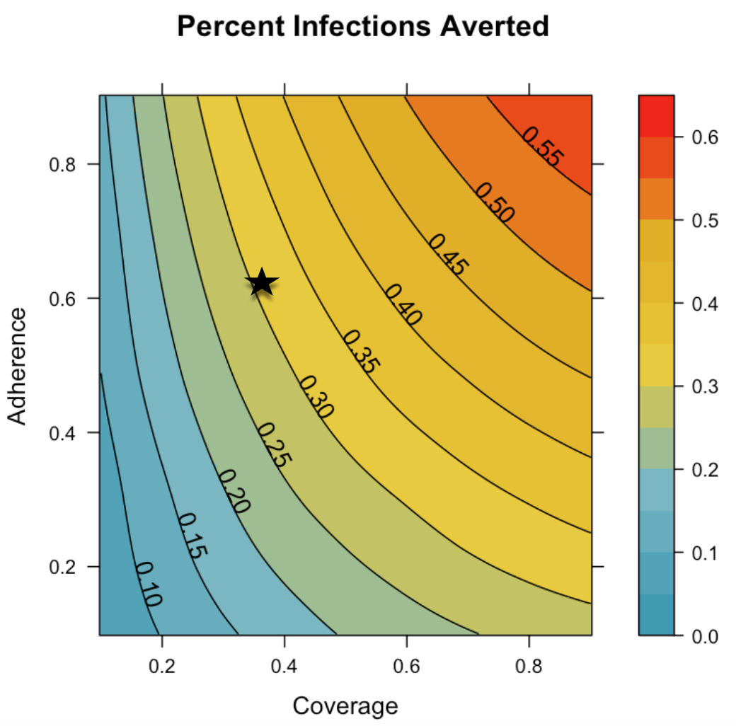
Real-World Network Model

Slide 24
Study Aims
Model HIV transmission dynamics among MSM in the US after implementation of PrEP according to CDC guidelines
Use a robust mathematical framework to represent complex MSM biobehavioral population evolution
Quantify reduction in HIV incidence associated with:
Individual behavioral criteria in the guidelines, separately and jointly
Varying levels of PrEP coverage, adherence

Slide 25
Goal is to understand the impact of the implementation of the CDC guidelines, also considering varying PrEP coverage and adherence.

Slide 26
Overview of Methods
Stochastic network model with parameters based on robust, partnership-based HIV incidence studies of MSM in Atlanta and national-level data on clinical care engagement.
Epidemiological, demographic, and intervention modules designed in EpiModel software.
Simulates open population of MSM, aged 18 to 40, in the US over a 10-year time span.
Estimated percentage of infections averted (PIA) and the number needed to treat (NNT) under different scenarios of PrEP implementation, coverage, and adherence.

Slide 27
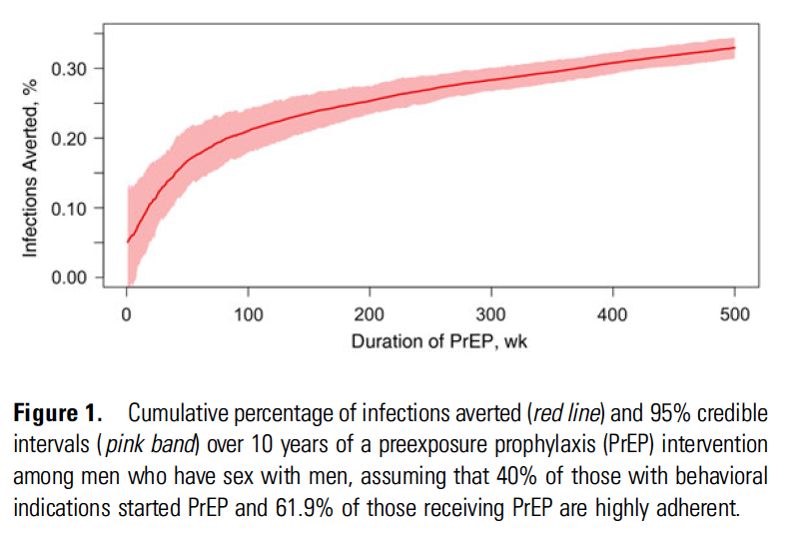
Key Findings
At 40% coverage of indicated MSM over the next decade, application of CDC guidelines would avert 1,162 infections per 100,000 person-years.
= 33.0% of expected infections.

Slide 28
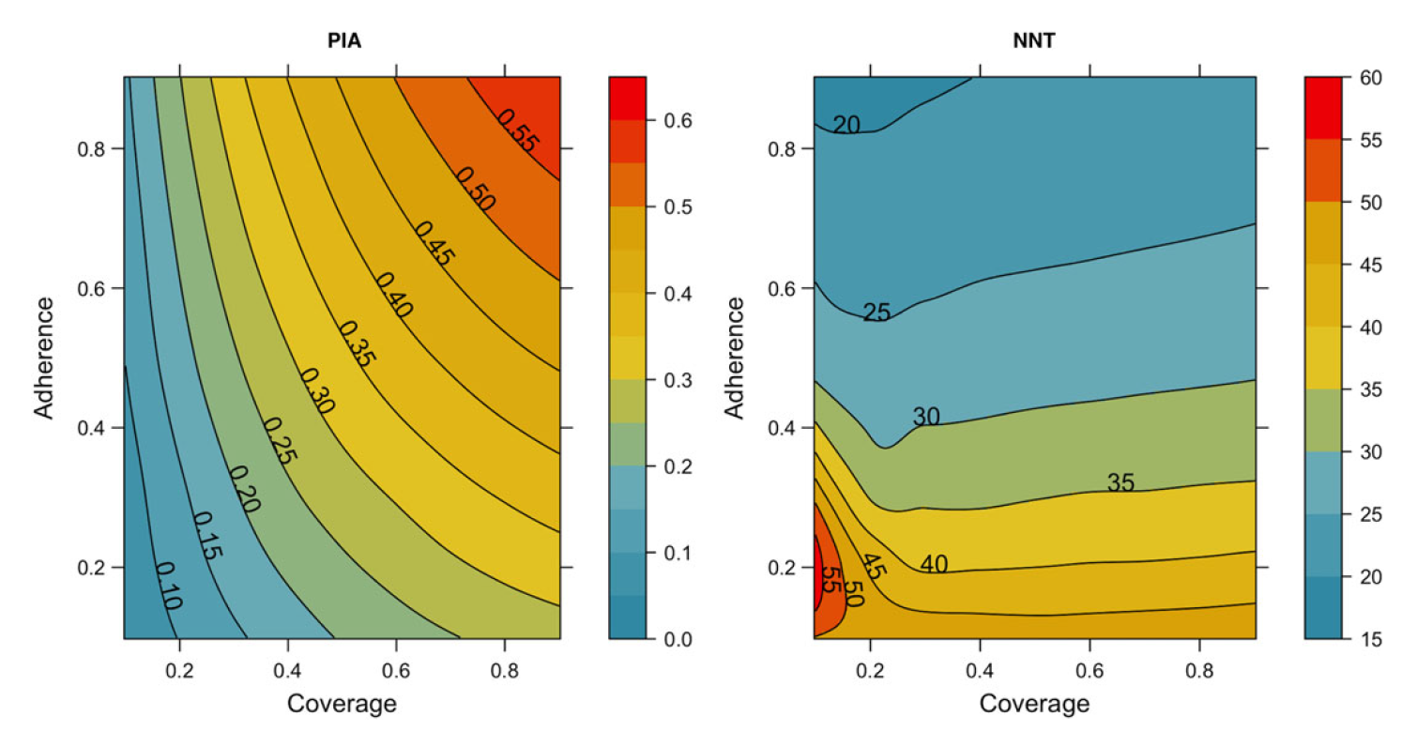
The predicted NNT for the guidelines would be 25.
Increasing coverage and adherence jointly raise the PIA, but reductions to the NNT were associated with better adherence only.

Slide 29
Comparison with Non-Network Models
This network model finds greater effectiveness and efficacy of PrEP than prior studies that relied on simpler models, without network structure.
These prior models fundamentally do not account for the complex network structure that must be targeted for greatest impact.
“The complex structure of main, casual, and one-time sexual MSM partnership networks in which HIV infection risk occurs contributes to the high prevalence of HIV among MSM in the United States and will be critical to target for any intervention seeking to mitigate that epidemic.” p. 1805

Slide 30
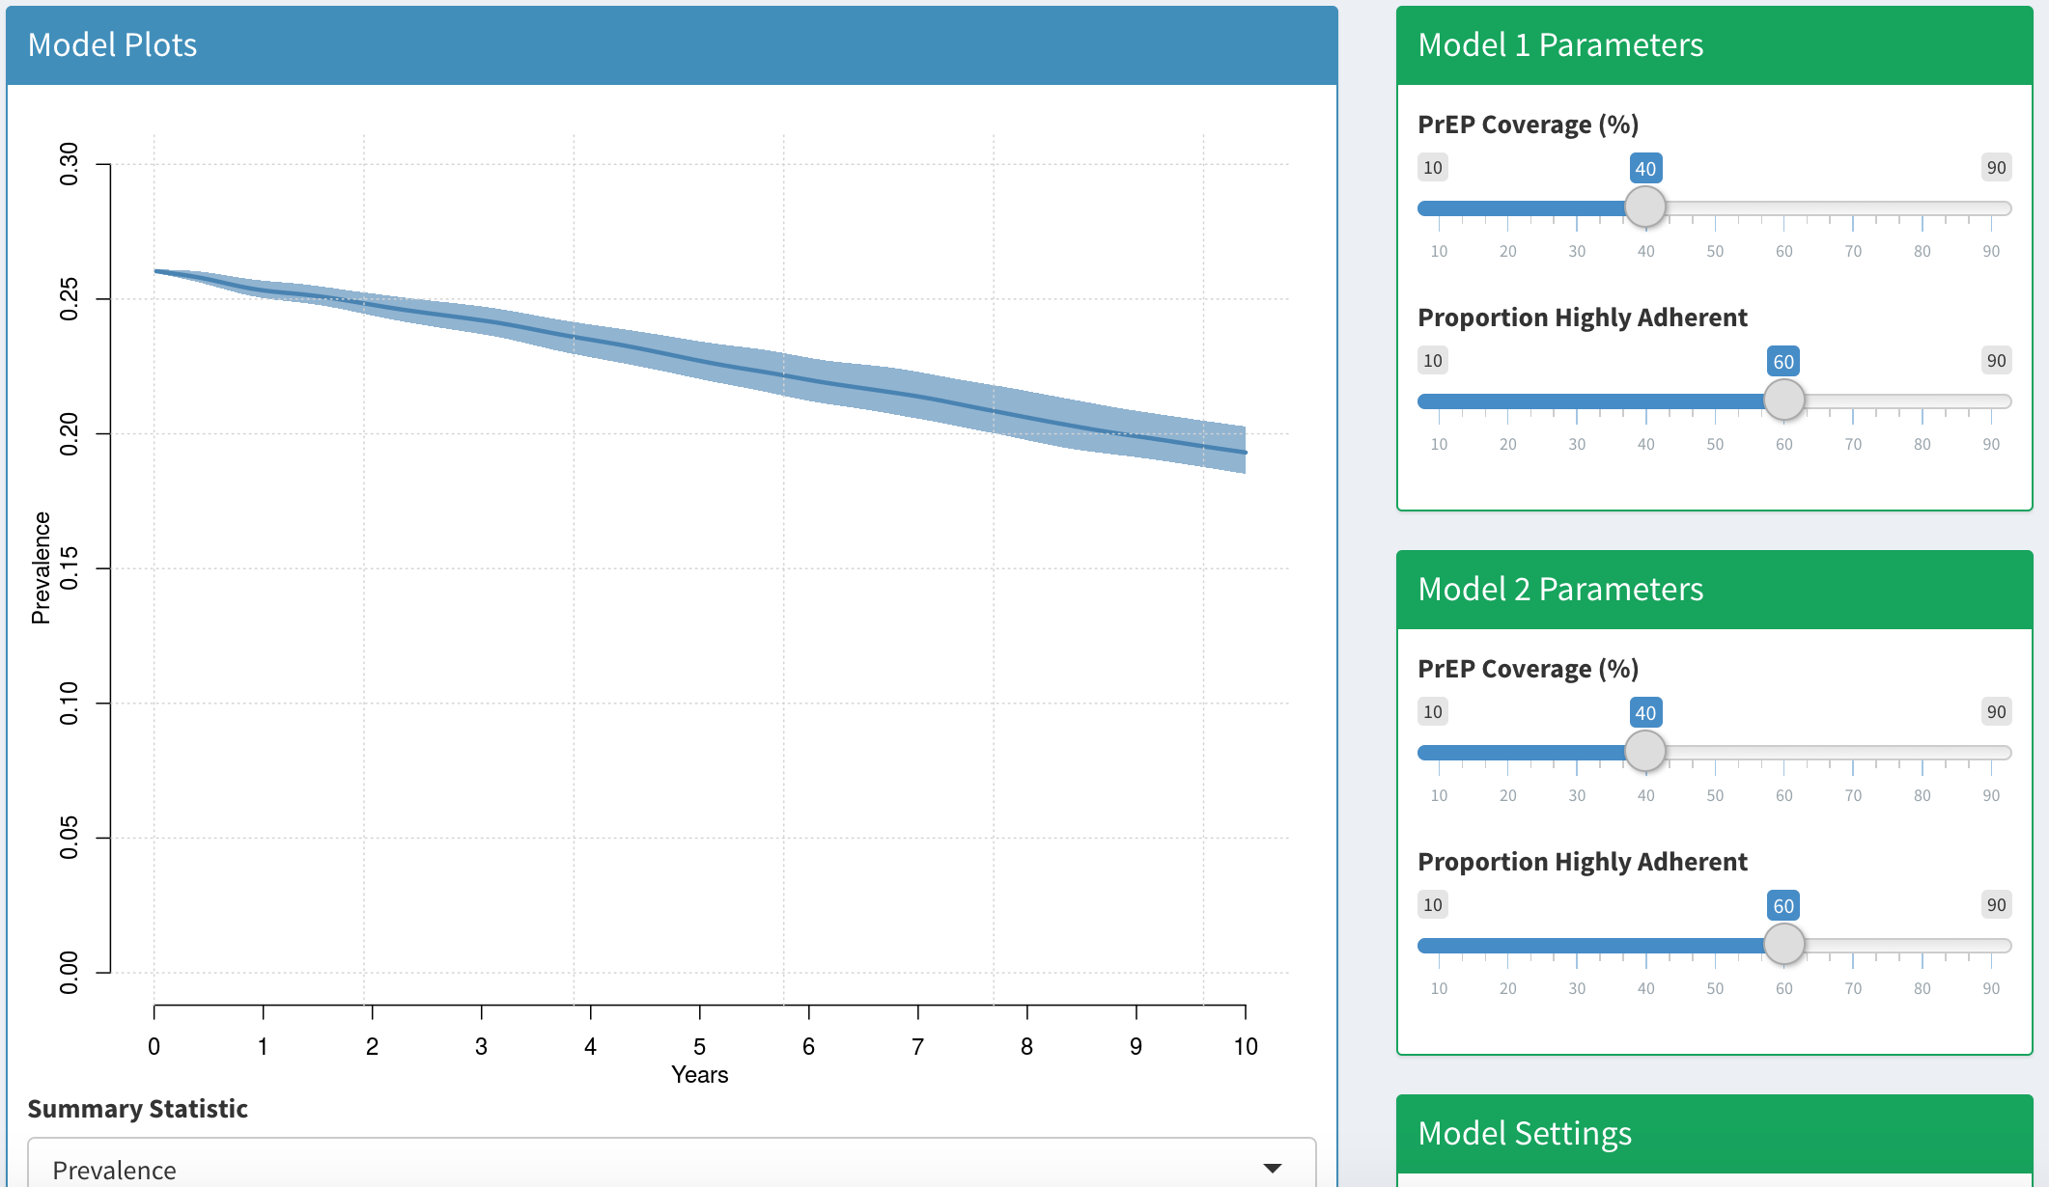
From Modeling to Public Health Practice
http://prism.shinyapps.io/cdc-prep-guidelines/

Slide 31
EpiModel example code and tutorials
On course website L21 Network Modeling of Infectious Disease.R

Slide 32
Resources
Real-World Network Models
Jenness 2016 JID
Jenness 2016 Sex Transm Infect
Jenness 2017 CID
Jenness 2017 PLOS ONE
Goodreau 2017 Lancet HIV
I am biased to the UW modeling group…
But watch as many others start to use their network modeling approach and software.
ERGMs
ERGM Terms for Modeling
STERGMs
Using Egocentric Data to Fit Network Models
Software
EpiModel website
EpiModel methods paper
Statnet (used by EpiModel)
Training
UW Network Modeling for Epidemics short course
International Clinics on Infectious Disease Dynamics and Data (MMED and DAIDD clinics)
Duke Network Analysis Center

