Slide 1
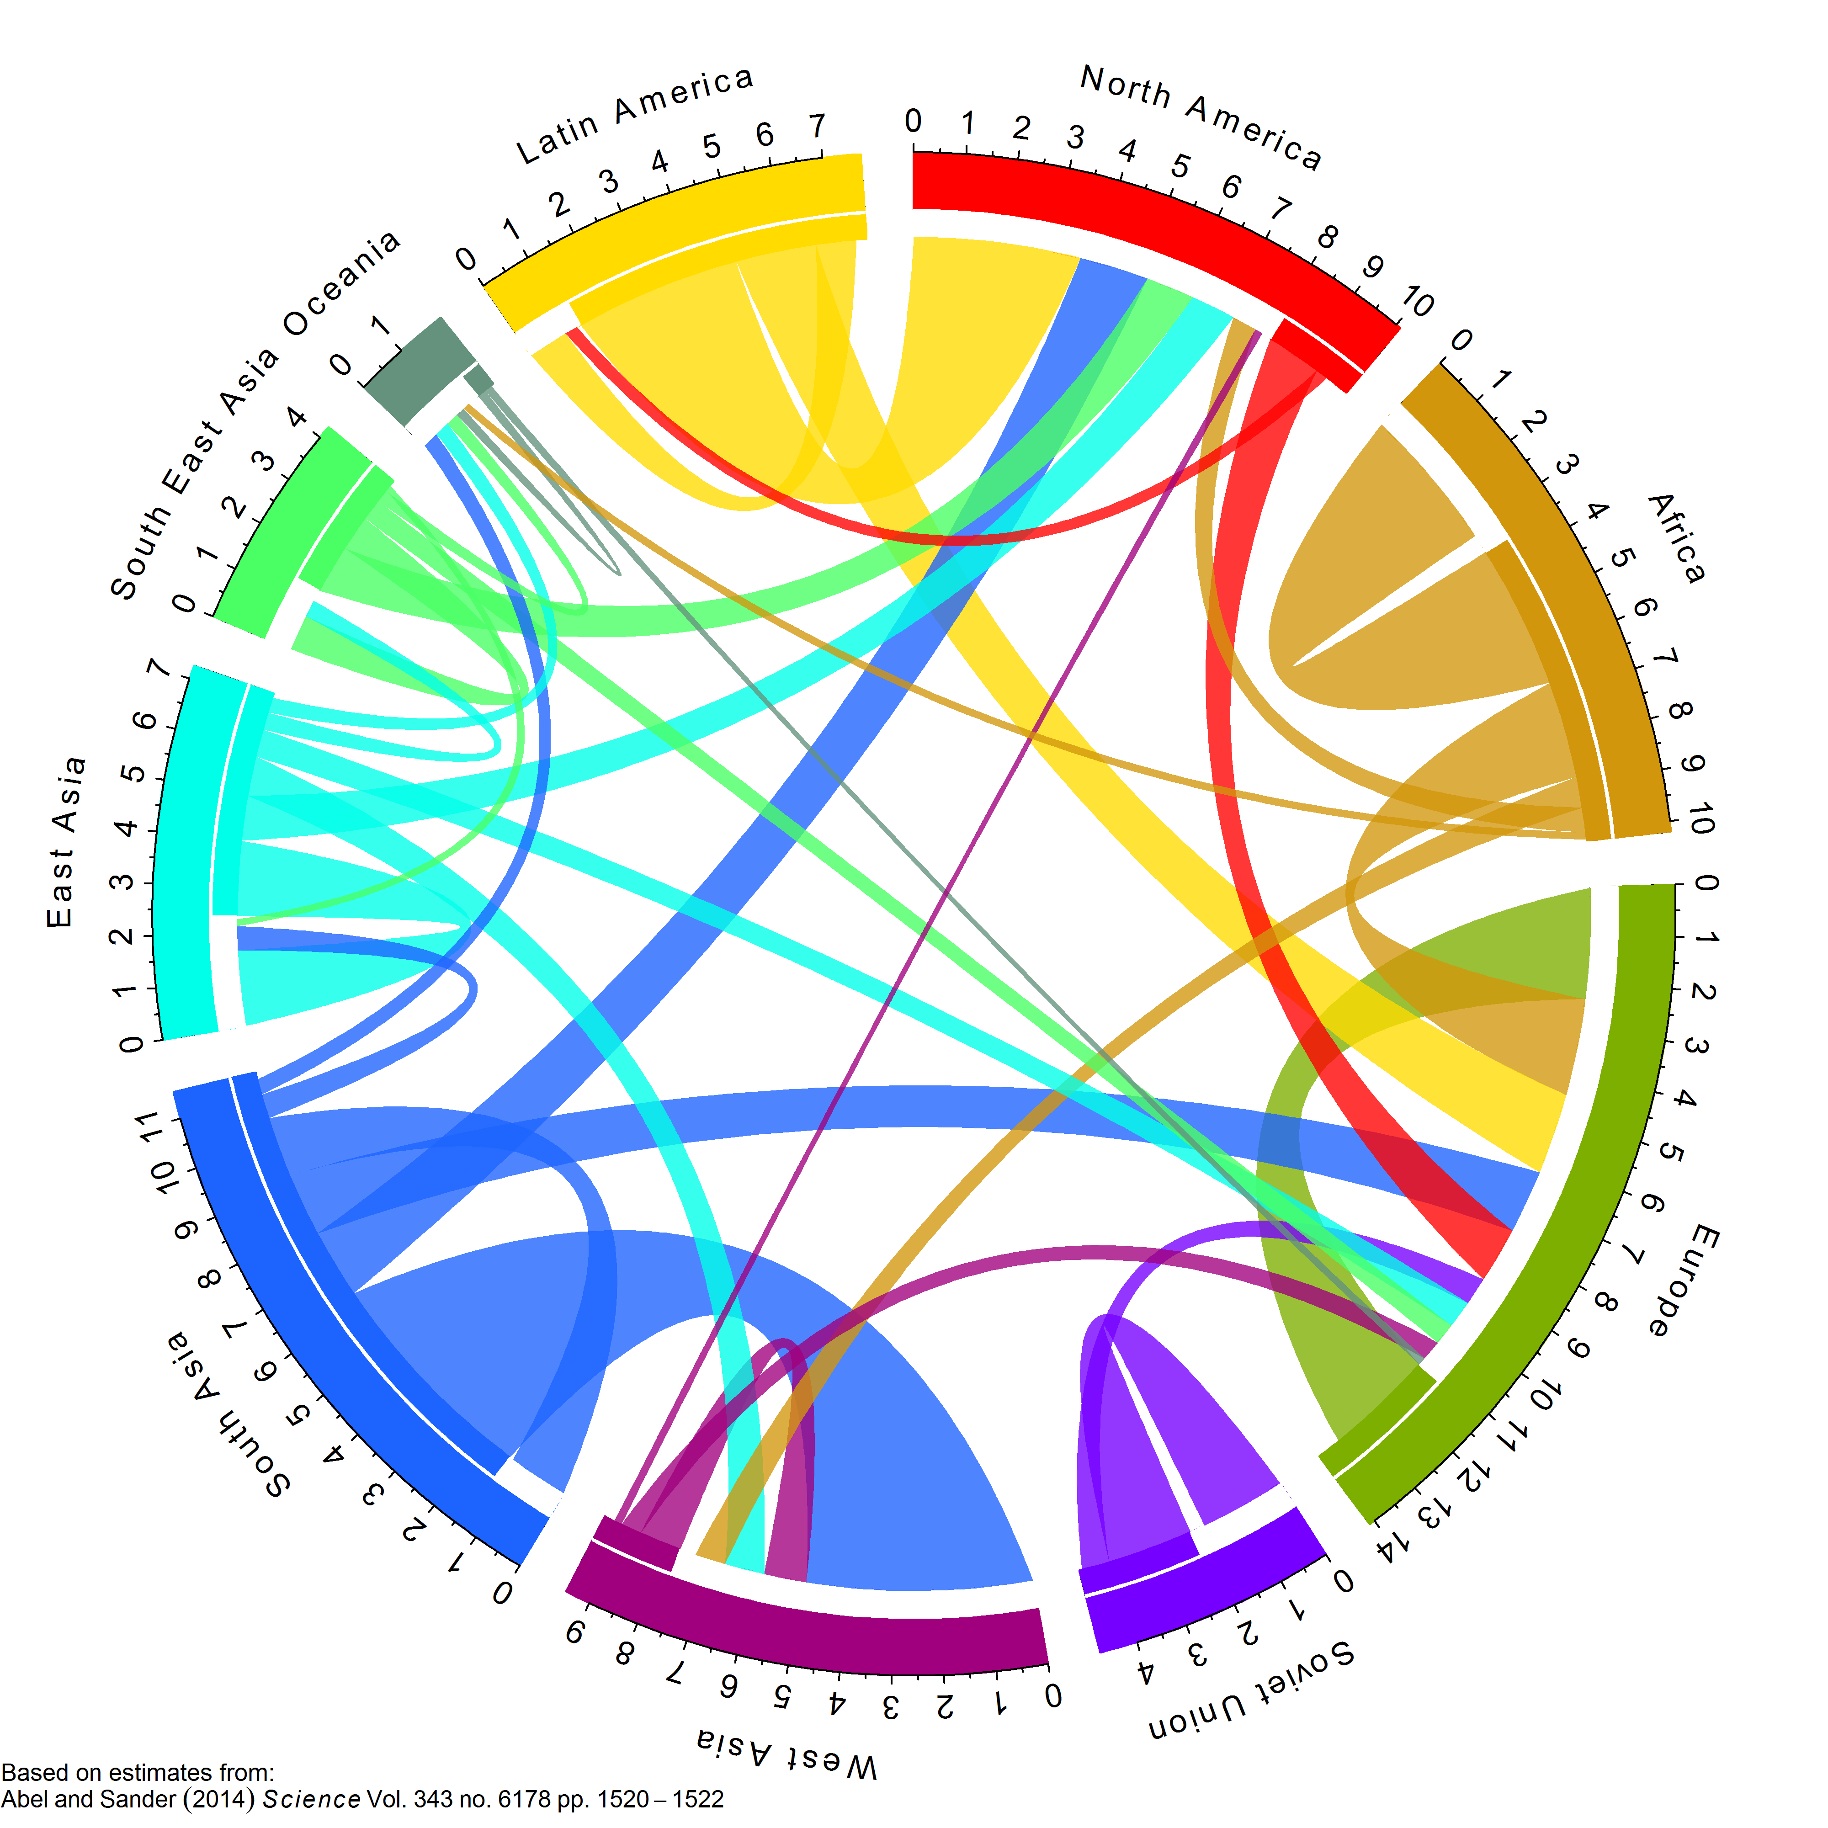
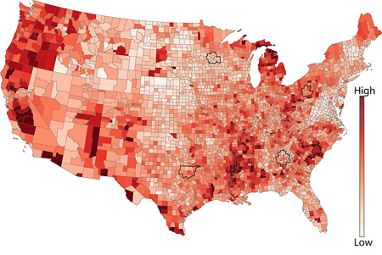

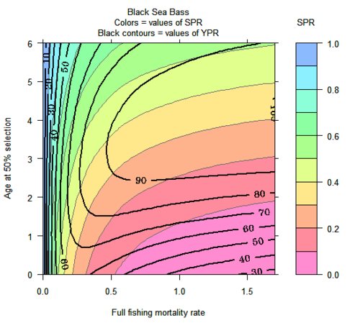
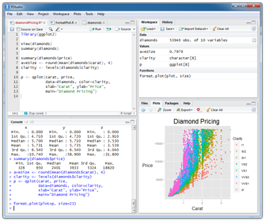
For Epidemiologists
Mike Fliss
Sara Levintow
Nick Brazeau
MW 10:10-11:25am
McGavran-Greenberg 1303.
Fall 2018
learnr.web.unc.edu
Notes:
Check out these cool graphs while you wait for class to start! These notes are an overview of the points I want to hit when talking during each slide.

Slide 2

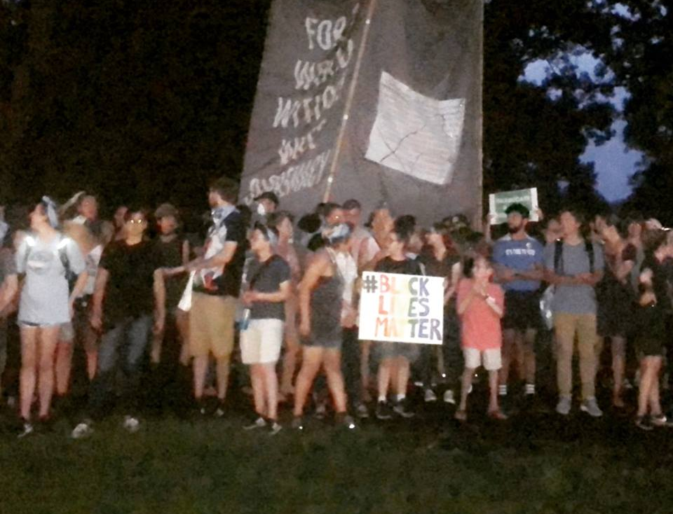

Welcome to Campus / Acknowledging a Victory!
Useful Resources
Library Guide to History of Silent Sam
Teaching after Silent Sam
UNC Dept of History statement
The Center for the Study of the American South
Notes:
We’ll be talking about disparities later in the class, but as a student and alumnus, I think it’s my responsibility to publicly celebrate the efforts by current organizers (and decades of past organizers) to remove this symbol of white supremacy. There’s more work, current work, to do, and maybe you’ll find ways to contribute to it, but for now, if you’re new to campus, some of these links might be helpful context on the decades of protest. Part of why I love being here is there are powerful communities fighting for justice, including justice in public health, and there’s also a lot of work still to do. It’s a very dynamic and meaningful atmosphere to do organizing, and there are ways to (carefully!) link R programming to that organizing as an asset to community groups. More on disparities later, but for now – welcome to campus. ☺

Slide 3
Welcome & Overview
Website, syllabus, course format, homework

Slide 4

Welcome & Overview
Course logistics
  Introductions
  Website: learnr.web.unc.edu
  Sign up sheet (see website)
  Google group (see website)
  Datacamp (optional)
  Syllabus review
All about R
  How is R different from SAS?
  How do I install R/Rstudio?
Homework
  Hopefully ready today, but if not: Install R and RStudio for next class!
  Handle logistics! Registration, get data, sign up sheet, google group, etc.
Notes:
Welcome to the R class! Today I will talk about course logistics and give you some background on R. I’ll also demo how to install R and your homework for today will be to install R for next week. I’ll also have you fill out a short survey online so that I and the other teachers can get to know you and the level of R experience you are at.

Slide 5
Introductions
Who you are
What program / year you’re in
Why you’re in the class
What experiences (other language experience, content areas, etc.) you’re hoping to contribute
Please (all, including auditors!) fill out the sign-in sheet while listening!
Notes:
Please fill out the sign-in sheet so we can get a head count and figure out how to handle auditors. My name is Nat and I am a 6th year epidemiology student. I have been using R for many years and informally teaching an R seminar for several semesters. Xiaojuan and Alan are at a conference and couldn’t be here today because of a conference. Mike is also helping out a lot with the class, thanks Mike!

Slide 6
Back to the Course: Approach and Format
Course theory:
  Designed for those familiar with SAS or another programming language.
  Using dataset and questions from EPID core curricula (births, disparities)
  Practical. See, try, modify, why, apply.
Logistic goals:
  Minimal out-of-class responsibilities.
  Project: Direct relevance to your existing work.
  Wind down assignments before the end-of-semester rush.
Notes:
The course is designed for people who already know how to use a statistical programming language, likely SAS. Because of this, we will use a practical approach. We’ll use the method that all of use essentially rely on for learning new things about R ourselves: find and example of what we want to do, get it working, figure out how to make it do what we want, understand how it works, and finally apply it in other places. We want the course to be useful but not full of busywork. We’ll divide the course into two: a first part covering the core of R and a second part just covering special topics. There are R resources listed on the syllabus. Feel free to work with others, but don’t just copy the final working code and end there. One of the cool things about R is that it is an open, collaborative language!

Slide 7
Back to the Course: Approach and Format
Course progression:
  Part one: Language basics / Core R
  Part two: R packages & homework.
  Part three: special topics lectures
Use any resources you want!
  Internet searches, forums, books, other open courses
  Group work on exercises is encouraged but not required (don’t just copy…)
  Better to turn in broken/incomplete code you kind of understand (so we can help) instead of working code you don’t understand.
  R is open and collaborative! Practice that here!
Notes:
The course is designed for people who already know how to use a statistical programming language, likely SAS. Because of this, we will use a practical approach. We’ll use the method that all of use essentially rely on for learning new things about R ourselves: find and example of what we want to do, get it working, figure out how to make it do what we want, understand how it works, and finally apply it in other places. We want the course to be useful but not full of busywork. We’ll divide the course into two: a first part covering the core of R and a second part just covering special topics. There are R resources listed on the syllabus. Feel free to work with others, but don’t just copy the final working code and end there. One of the cool things about R is that it is an open, collaborative language!

Slide 8
Student Responsibilities and Expectations
Class exercises
  Follow along with example code, activities, interactive exercises in R.
  Work in small groups always allowed. Find folks with similar schedules!
Homework
  Five assignments during middle half of class, due on Mondays
  Generally lags the class material
  Follows a single dataset (NC Births) through steps of a public health analysis
  We’ll work on in class, & handhold through hardest parts (e.g. HW2 apply)
Project
  Last 1/3 of the class (but start thinking about now, or midway through)
  Dataset / question of your choice, ideally something useful for you
  Share a few slides with the class to show off your work at the end
Notes:
Pretty self-explanatory here. Unfortunately a bit wordy.

Slide 9
On Class Exercises: Slide Types
Header
We Try
(all together)
Listen
You Try
(alone or in pairs)
Answers
(so no matter what, you can keep up)

Slide 10
Student Responsibilities and Expectations
Outside Learning – if you have time for immersion!
  Datacamp: Got the class an upgraded education account to all the tutorials on DataCamp – invites to come through the class roster.
  Outside Reading: Lots of good, free books (or pay to get paper copies). R for Data Science is a great introduction, and Advanced R is excellent for serious under-the-hood and “why does that work” stuff.
  Subscribe to key blogs, the Rstudio blog or the GitHub repositories of your favorite packages.
  Like learning a new language try to “speak” it = code something most days to keep the learning going. R is a different modality than you might be used to (functional programming, etc.).
Notes:
Pretty self-explanatory here. Unfortunately a bit wordy.

Slide 11
Let’s Talk R!
Open source programming language and software environment for statistical computing and graphics
Created by Ross Ihaka and Robert Gentleman (University of Auckland, New Zealand)
Currently supported by the R Foundation for Statistical Computing (Vienna, Austria)
More info on the history of R at https://www.R-project.org/

Slide 12
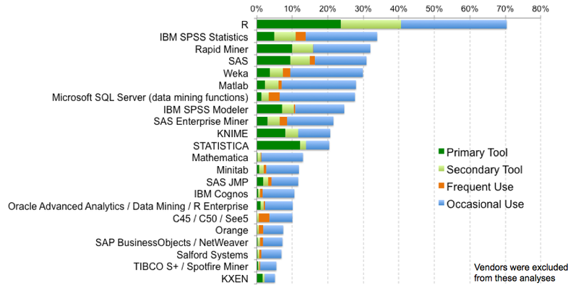
Popularity of
From “The Popularity of Data Science Software”
By Robert A. Muenchen
http://r4stats.com/articles/popularity/

Slide 13

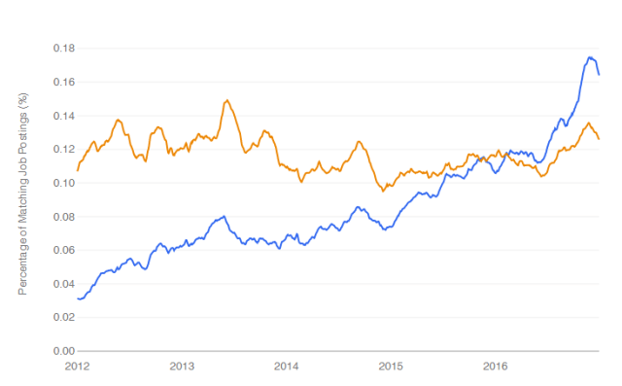
Growth of esources
From “The Popularity of Data Science Software”
By Robert A. Muenchen
http://r4stats.com/articles/popularity/
R jobs surpassed SAS jobs in 2016

Slide 14
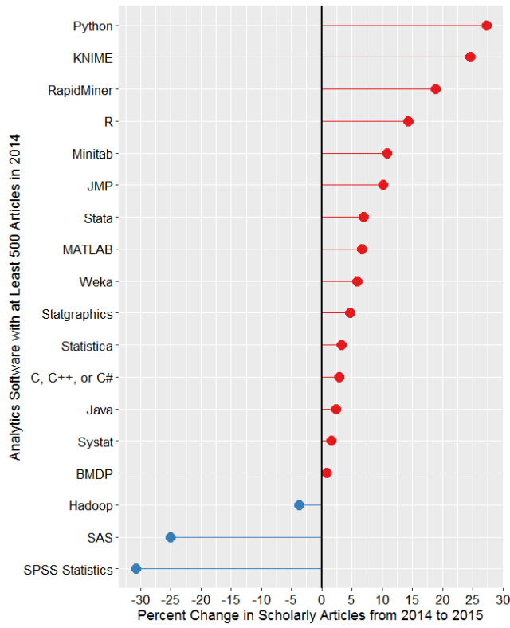
Growth of esources
R surpassed SAS in scholarly article citations in 2015, continuing the trend.
From “The Popularity of Data Science Software”
By Robert A. Muenchen
http://r4stats.com/articles/popularity/

Slide 15
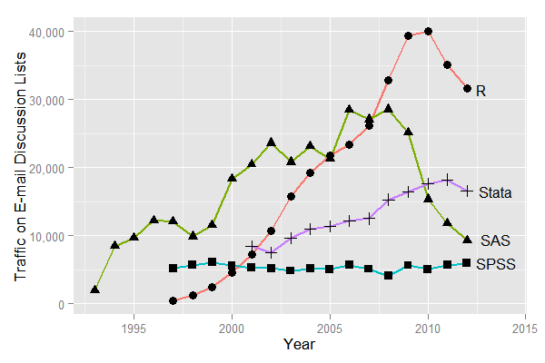
Growth of esources

Slide 16

Why ? Important features:
Free: costs nothing, runs anywhere, modify anything you want
Popular: across disciplines, increasing prominence in epidemiology •
Powerful: do more with less (time, code, heartache)
Efficient: good for big datasets, simulations, demanding calculations
Flexible: do many things, in many different ways (error-checking)
Transparent: you can look at how anything works, code sharing, etc.
Community: package development, helpful people, fast bug iteration
Higher level thinking: Avoid SAS “card” thinking. Abstraction and grammars
And why RStudio?
Short answer: super helpful
It also looks similar to the SAS interface you’re probably used to
Notes:
R is pretty great and beloved by all. Mike will talk about why Rstudio is awesome during the next session, but the short answer is that it is super helpful. You’re also probably familiar with the layout from SAS.

Slide 17
Challenges of
Free: no one to sue! no centralized or official tech support.
Popular: not entrenched! Resistance to change.
Powerful: can require some different thinking. Obfuscated code.
Efficient: thinking and coding efficiently takes work (disk v RAM?)
Flexible: you can write rickety / Rube Goldberg code. Try not to.
Transparent: sometimes you have to get into the guts. Can be gross.
Community: Conflicts – between people, packages, syntax.
Higher level, abstracted thinking: is hard!
All that… and still VERY much worth it!

Slide 18

vs.
No division of your code into PROC/DATA parts
No separate macro language; variables, functions do this better
“Modern” computer science language: functions, objects, abstraction
SAS output is just output. R output is an object, so can be input, too.
Graphical data exploration is easier in R, but takes learning

Slide 19
DATA births;
SET epid.births;
IF weeks >= 37 THEN preterm = 0;
ELSE IF 20<=weeks<=36 THEN preterm = 1;
RUN;
births$preterm <- ifelse(births$weeks<37, 1, 0)

Slide 20
Today’s Activity: RStudio Tour
Install/Update R and Rstudio: Hopefully you’ve done this, but if not: a help guide is available on the course website.
We will be available during office hours (still figuring them, but likely right after class) if you are having trouble with this.
Make sure R&RStudio work before you come to next class! We code every class.
If you’re not there yet, get a buddy to watch them do this next Rstudio tour!
Notes:
Demo how to install R and RStudio on the classroom computer. Run a few lines of code.

Slide 21
RStudio IDE : A Guided Tour!
Scripts, execution, comments, navigation, style
(if we get to it today)

Slide 22
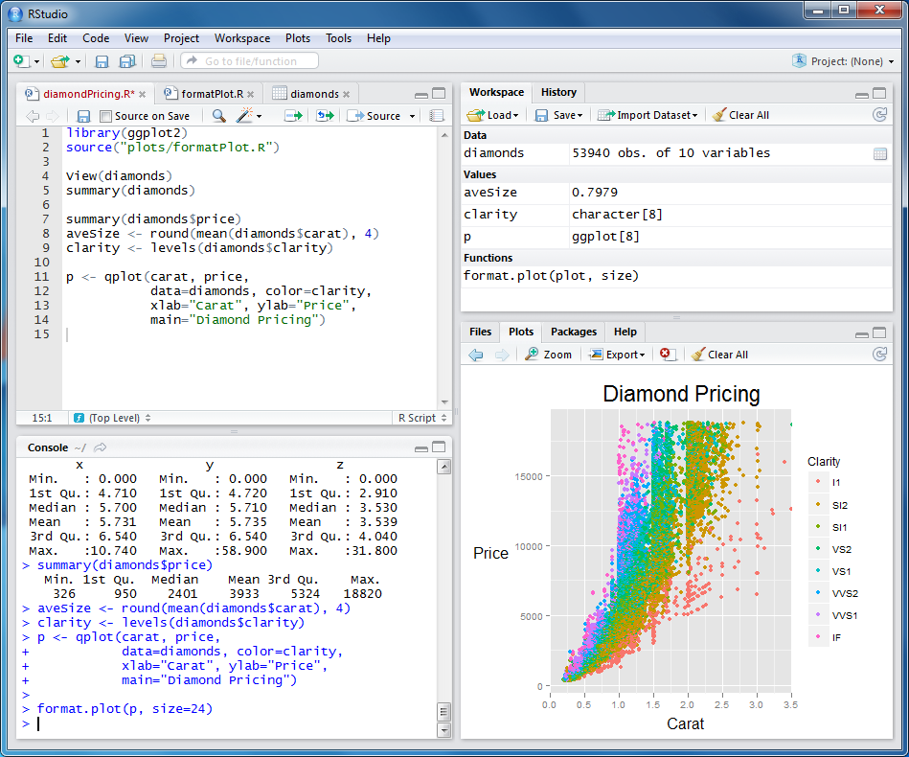
Rstudio…

Slide 23
RStudio…
…is an IDE!
(an “Integrated Development Environment”)
A good IDE “… allows you to work at full speed.”
Is separate from R – watch (or subscribe) for upgrades & read release notes
References to check out later (also on website):
  https://www.rstudio.com/resources/webinars/rstudio-essentials-webinar-series-part-1/
  https://www.rstudio.com/online-learning/#R
http://programmers.stackexchange.com/questions/102018/what-features-of-an-ide-would-make-it-more-useful-than-a-general-purpose-editor
https://channel9.msdn.com/Forums/Coffeehouse/106446-What-makes-a-good-IDE

Slide 24
RStudio Panes
Environment
/ History
Script Editor
Files, Plots,
Packages, Help
Console
Notes:
Panes can be maximized, minimized, or put in separate windows in many cases.

Slide 25
Our first script: the absolute minimum
Open and save R scripts with icons at top left of Editor
No command terminator (farewell, semicolon! Can use if you want.)
Use # for comments
Use <- or = as assignment operator (reads as “gets”)
Example:
x <- rnorm(100, mean=1.2, sd=3) # 100 from normal dist
summary(x) # get summary stats
plot(x) # plot these 100 values

Slide 26
We Try: RStudio
IDE Layout
  Panes: use, navigation
  Help→cheatsheets→RStudio
Running code
  Console, script, blocks, comments, inline (e.g. load()).
Comments
  #, post-#, code blocks, comment blocks, links, code outline
Key keyboard shortcuts
  https://support.rstudio.com/hc/en-us/articles/200711853-Keyboard-Shortcuts
  Alt-Shift-K
  Favs: control, panes, autocomplete, running code, F1… so many.
Style
  R: http://adv-r.had.co.nz/Style.html
  Google: https://google.github.io/styleguide/Rguide.xml

Slide 27
You try
Create a new script window
Save your script as “Births Analysis.R” or something similar
Set up a comment header with info like your name
Set up a comment block or two: something like “Reading Files & Loading Libraries”
(For now) load the data using the Rdata file, and run a test expression or two on it.
You’ve just got your first points on Homework 1!

Slide 28
Answers
#............................
# Births 2012 Analysis for EPID 799C
# Mike Dolan Fliss, August 2018
#............................
# Notes go here.
#............................
# Libraries and working directories ####
#............................
birth_file = "D:/User/Dropbox (Personal)/Education/Classes/18Fall_EPID799C_RforEpi/data/R for epi 2018 data pack/births_sm.rdata” # Could use setwd() too.
#............................
# ............................
# Read 2012 birth data ####
# ............................
load(birth_file) # <- our first function
#..................................................

Slide 29
Questions?

