Slide 1
L07 Apply and purrr
EPID 799C
Fall 2018

Slide 2
Before we start
Questions on HW1?
^{A little group work today…}

Slide 3
Today’s Goal
1 Thing:
Homework 2 (inclusion criteria)
^{A little group work today…}

Slide 4
Birth Variables = 1 if include, 0 otherwise (could T/F also…)
incl_hasgest
incl_enoughgest
incl_lateenough
incl_earlyenough
incl_singleton
incl_hasanomdata
incl_noanomolies
include_allpass
1. Simple enough – vectorization, one line apiece
2. Will use apply, all(), and a helper variable for this.
3. Will use apply and grepl() to create this, then subset.

Slide 5
Reminder: Function…als
Functions that take functions

Slide 6
Functionals
Take a function as an input, return a vector.
“For each of these things, do this, mush it together and give me the results.”
http://adv-r.had.co.nz/Functional-programming.html

Slide 7
lapply()
cols_to_use = c("wksgest", "plur", "kotel")
lapply(births[,cols_to_use], summary)

Slide 8
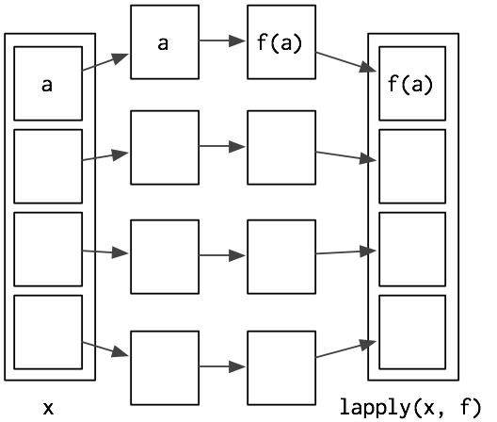
lapply()
http://adv-r.had.co.nz/Functional-programming.html

Slide 9
sapply() and vapply()
Like lapply(), but simplify output to produce atomic vectors. sapply() is short hand, vapply() is more explicit.
sapply(iris, is.numeric)
vapply(iris, is.numeric, logical(1)) vapply(iris, is.numeric, numeric(1))

Slide 10
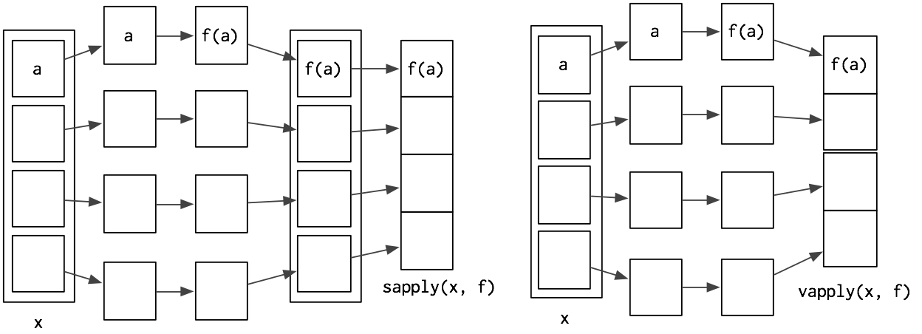
sapply() and vapply()
http://adv-r.had.co.nz/Functional-programming.html

Slide 11
Map()/mapply/tapply()
Want multiple inputs or to iterate over objects?
Map(), etc.
Different length objects?
tapply()
Skim: http://adv-r.had.co.nz/ , Functional Programming / Functionals / Function Operators for more, or the purr:: package. Will introduce a little purrr at the end of class today.
Also relevant: anonymous inline functions.

Slide 12
Reminder: Function…als
Functions that take functions

Slide 13
Birth Variables
incl_hasgest
incl_enoughgest
incl_lateenough
incl_earlyenough
incl_singleton
incl_hasanomdata
incl_noanomolies
include_allpass
1. Simple enough – vectorization, one line apiece
2. Will use apply, all(), and a helper variable for this.
3. Will use apply and grepl() to create this, then subset

Slide 14
Simple inclusion criteria
weeknum: lubridate::week to the rescue!
incl_hasgest: e.g. gest is not missing, as numeric.
incl_enoughgest: wksgest 20 or more
incl_lateenough: wksgest – weeknum 19 or less (Less than 20 weeks gestation before Jan 1 of year)
incl_earlyenough: weeknum - wksgest 7 or less (Start date of gestation was 45 (max gest in'11) w prior to Jan 1 of next year, so all births are observed in year)
incl_singleton: weeknum - wksgest 7 or less

Slide 15
Birth Variables
incl_hasgest
incl_enoughgest
incl_lateenough
incl_earlyenough
incl_singleton
incl_hasanomdata
incl_noanomolies
include_allpass
1. Simple enough – vectorization, one line apiece
2. Will use apply, all(), and a helper variable for this.
3. Will use apply and grepl() to create this, then subset.

Slide 16
Congenital anomaly variables
congen_anom = c("anen","mnsb","cchd", "cdh", "omph","gast", "limb", "cl","cp","dowt","cdit", "hypo")
Remember how to subset? head() check!
Many ways to do this… e.g. Read in a small csv with a “is_congen_anom_var” flag.

Slide 17
Congenital anomaly variables
incl_hasanomdata: all by ROW are not U, as numeric
incl_noanomalies: all by ROW are N, as numeric

Slide 18
Birth Variables
incl_hasgest
incl_enoughgest
incl_lateenough
incl_earlyenough
incl_singleton
incl_hasanomdata
incl_noanomolies
include_allpass
1. Simple enough – vectorization, one line apiece
2. Will use apply, all(), and a helper variable for this.
3. Will use apply and grepl() to create this, then subset

Slide 19
Eligibility Drops
grepl() to subset for “incl*” variable names (let’s talk grep!)
apply FUN=sum over COLUMNS
Subtract en masse from nrow(births)

Slide 20
include_allpass
grepl() to subset for “incl*” variable names
apply FUN=all over ROWS
Assign vector to new variable include_allpass
Note: using 1/0 with these include variables. Could use T/F. Will cause some warnings that we should expect!

Slide 21
A nice summary statement!
cat() to concatenate and print.
nrow(births) and nrow(old_births) for comparison
formatC() function for a bit of text cleanup (also see stringr package for more intuitive string functions)

Slide 22
Table 1
cat() to concatenate and print.
nrow(births) and nrow(old_births) for comparison
formatC() function for a bit of text cleanup (also see stringr package for more intuitive string functions)

Slide 23
purrr
In very short.
https://jennybc.github.io/purrr-tutorial/index.html

Slide 24
purrr
Purrr is a more internally consistent function set for the apply(), [slvmt]apply() family of functions.
Internal consistency here means knowing what you’re going to get out (e.g. vs. mysterious sapply/vapply simplifications)
Purrr also has a few additional powers. Works very well with list-columns (which we haven’t seen yet).
In short: map_[TYPE] (e.g. map_dbl, map_lgl) takes a list and a function and does the function to each thing in the list, returning (expecting!) the type in a list or vector.

Slide 25
purrr
map is lapply. map takes a list, runs a function on it, and returns the list of results.
map_dbl, map_lgl, map_int, map_chr, are vapply. Takes a list and a function and does the function to each thing in the list, returning (expecting!) the type in a 1D vector. (note: vapply is variable here)
map_df, map_dfr, map_dfc return a dataframe (by row or column)
pmap, map2 are mapply (multiple-apply). Takes multiple inputs, gives a list of outputs.
Works great with tidyverse, e.g. tidyr::nest(), dplyr::summarise, etc.

Slide 26
Simple examples: map_dbl, pmap_lgl
# Base functions, Jenny Bryan
# https://jennybc.github.io/purrr-tutorial/bk01_base-functions.html
#.......................
# Simple examples ####
#.......................
purrr_eligibility_drops = nrow(old_births) -
map_dbl(old_births[,grepl("incl_", names(old_births))], sum, na.rm=T) #(HW2.1.Q4c optional)
purrr_allpass = pmap_lgl(births[, grepl("incl_", names(births))], all) #(HW2.1.Q4d indicator for the inclusion criteria yes/no)
identical(purrr_allpass, births$include_allpass)
# Benefits? We know we're getting logicals!

Slide 27
map_df (&map_dfc, map_dfr)
#.......................
# map_df* example ####
#.......................
my_summary = function(x){
data.frame(sum=sum(x, na.rm=T),
mean=mean(x, na.rm=T),
max=max(x, na.rm=T))}
births_numbers = births[, map_lgl(births, is.numeric)]
summary_df = map_dfr(births_numbers, my_summary)
rownames(summary_df) = names(births)[map_lgl(births, is.numeric)]
summary_df
#.......................

Slide 28
map, dplyr, list-column PREVIEW
#.......................
# As promised, some list-column magic. :) ####
#.......................
# 3 line intro to glms in R! :p
overall_model = glm(preterm_f ~ pnc5_f, data=births,
family = binomial(link = "identity"))
summary(overall_model)
broom::glance(overall_model)
broom::tidy(overall_model)
coef(overall_model)[2]

Slide 29
map, dplyr, list-column PREVIEW
crude_model = function(df){
glm(preterm_f ~ pnc5_f, data=df,
family = binomial(link = "identity"))
}
nested_df = births %>%
group_by(raceeth_f) %>%
nest() %>% # .key="model_data" to name that col.
mutate(model = map(data, crude_model)) %>%
mutate(model_summary = map(model, broom::glance)) %>%
mutate(effect = map_dbl(model, ~ coef(.x)[2])) %>%
mutate(p_val = map_dbl(model, ~ broom::tidy(.x)$p.value[2]))
# ^ note alternate formula syntax. function(x)...also ok
nested_df

