Slide 1
Recoding II: Numerical & Graphical Descriptives
EPID 799C, Lecture 5
Monday, Sept. 10, 2018

Slide 2
Today’s Overview
Recoding review: Key variables in births dataset
Functions for numeric descriptive statistics
Functions for base graphics
Practice with recoding and functions (HW #1)

Slide 3
Getting Started
# Set your path
setwd("~/Documents/EPID 799 R/2018/R for epi 2018 data pack/")

Slide 4
Getting Started
# Set your path
setwd("~/Documents/EPID 799 R/2018/R for epi 2018 data pack/")
# Read in data
births <- read.csv("births2012.csv", stringsAsFactors = F, header = T)

Slide 5
Getting Started
# Set your path
setwd("~/Documents/EPID 799 R/2018/R for epi 2018 data pack/")
# Read in data
births <- read.csv("births2012.csv", stringsAsFactors = F, header = T)
# Variable names in lowercase
names(births) <- tolower(names(births))

Slide 6
Getting Started
# Set your path
setwd("~/Documents/EPID 799 R/2018/R for epi 2018 data pack/")
# Read in data
births <- read.csv("births2012.csv", stringsAsFactors = F, header = T)
# Variable names in lowercase
names(births) <- tolower(names(births))
# Load packages

Slide 7
Recoding Review: Key variables
Exposure: Early prenatal care using mdif
Outcome: Preterm birth using wksgest
Covariates for HW #1:
Maternal age using mage
Cigarette use using cigdur
Date of birth using dob
Infant sex using sex
Maternal race using mrace and methnic

Slide 8
Exposure: Early prenatal care
What do we know about the variable mdif? How do we want to recode it?
summary(births$mdif)
table(births$mdif, useNA = "always")

Slide 9
Exposure: Early prenatal care
One option for creating numeric variable pnc5 from mdif:
births$mdif[births$mdif==99] <- NA
births$pnc5 <- ifelse(births$mdif<=5, 1, 0)
#check your work!
table(births$mdif, births$pnc5, useNA = "always")

Slide 10
Exposure: Early prenatal care
One option for creating factor variable pnc5_f from pnc5:
births$pnc5_f <- factor(births$pnc5,
levels = c(0, 1),
labels = c("No Early PNC", "Early PNC"))
table(births$mdif, births$pnc5_f, useNA = "always")

Slide 11
Outcome: Preterm birth
What do we know about the variable wksgest? How do we want to recode it?
summary(births$wksgest)
table(births$wksgest, useNA = "always")

Slide 12
Outcome: Preterm birth
What do we know about the variable wksgest? How do we want to recode it?
summary(births$wksgest)
table(births$wksgest, useNA = "always")

Slide 13
Outcome: Preterm birth
What do we know about the variable wksgest? How do we want to recode it?
summary(births$wksgest)
table(births$wksgest, useNA = "always")

Slide 14
Outcome: Preterm birth
One option for creating numeric variable preterm from wksgest:
births$wksgest[births$wksgest==99] <- NA
births$preterm <- ifelse(births$wksgest<37, 1, 0)
table(births$wksgest, births$preterm, useNA = "always")

Slide 15
Outcome: Preterm birth
One option for creating factor variable preterm_f from preterm:
births$preterm_f <- factor(births$preterm,
levels = c(0, 1),
labels = c("Term", "Preterm"))
table(births$wksgest, births$preterm_f, useNA = "always")

Slide 16
Covariate: Maternal age
Your turn: Check out the distribution of mage. How might you recode this variable?

Slide 17
Covariate: Maternal age
Your turn: Check out the distribution of mage. How might you recode this variable?
#For now: recode 99 as missing
births$mage[births$mage==99] <- NA
#For later: think about specifying mage in models… Numeric? Factor? Higher order terms or splines?

Slide 18
Functions in R
Functions are R objects (just like everything else!).
Nearly everything in R is done through functions.
There are many built-in functions that you are already familiar with.
A strength of R is the user’s ability to write their own functions.
Resources for getting started:
https://www.statmethods.net/management/functions.html
https://www.statmethods.net/management/userfunctions.html

Slide 19
Functions for Numeric Descriptive Statistics
Our focus today is on built-in functions for summarizing continuous or categorical variables:
A variable is continuous if it can take any of an infinite set of ordered values.
Represented as vectors of numbers or date-times.
A variable is categorical if it can only take one of a small set of values.
Represented as factors or vectors of characters.
(From R for Data Science, http://r4ds.had.co.nz/)

Slide 20
Functions for Continuous Variables
Measures of Centrality
mean()
median()
mode()
Measures of Spread
min() max()
quantile() range()
sd() var()

Slide 21
Functions for Continuous Variables
Measures of Centrality
mean()
median()
mode()
Measures of Spread
min() max()
quantile() range()
sd() var()
General syntax:
function(dataframe$variable)
Example:
mean(births$mage)

Slide 22
Functions for Continuous Variables
Measures of Centrality
mean()
median()
mode()
Measures of Spread
min() max()
quantile() range()
sd() var()
What happened?

Slide 23
Functions for Continuous Variables
Measures of Centrality
mean()
median()
mode()
Measures of Spread
min() max()
quantile() range()
sd() var()
General syntax:
function(dataframe$variable)
If there is missing data:
function(dataframe$variable, na.rm = TRUE)

Slide 24
Functions for Continuous Variables
Measures of Centrality
mean()
median()
mode()
Measures of Spread
min() max()
quantile() range()
sd() var()

Slide 25
Functions for Continuous or Categorical Variables
table()
summary()
Hmisc::describe()
tableone::CreateTableOne()

Slide 26
table()
Produces a contingency table of counts.
If given >1 argument, gives the counts at each combination of levels.
useNA = "always" (always!)

Slide 27
table()
Most useful for a quick read of counts and presence of missing data.
Can also create table objects to use as input for other functions:
table(births$pnc5_f, births$preterm_f, useNA = "always")
pnc_by_preterm <- table(births$pnc5_f, births$preterm_f, useNA = "always")
prop.table(pnc_by_preterm, margin = 1)
#try setting margin=2. What's the difference?

Slide 28
summary()
Generic function that produces result summaries depending on the class of the first argument.

Slide 29
summary()
Generic function that produces result summaries depending on the class of the first argument.
Wait... I thought there were only 22 missing ages. What’s going on?

Slide 30
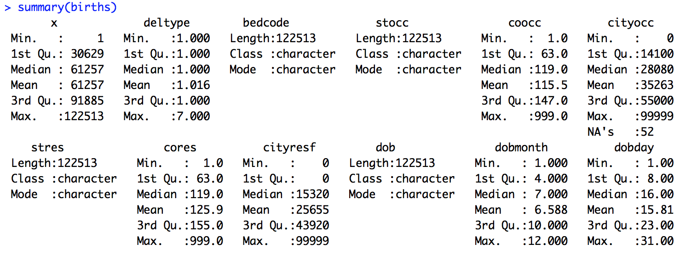
summary()
Results summary when the argument is a dataframe.

Slide 31
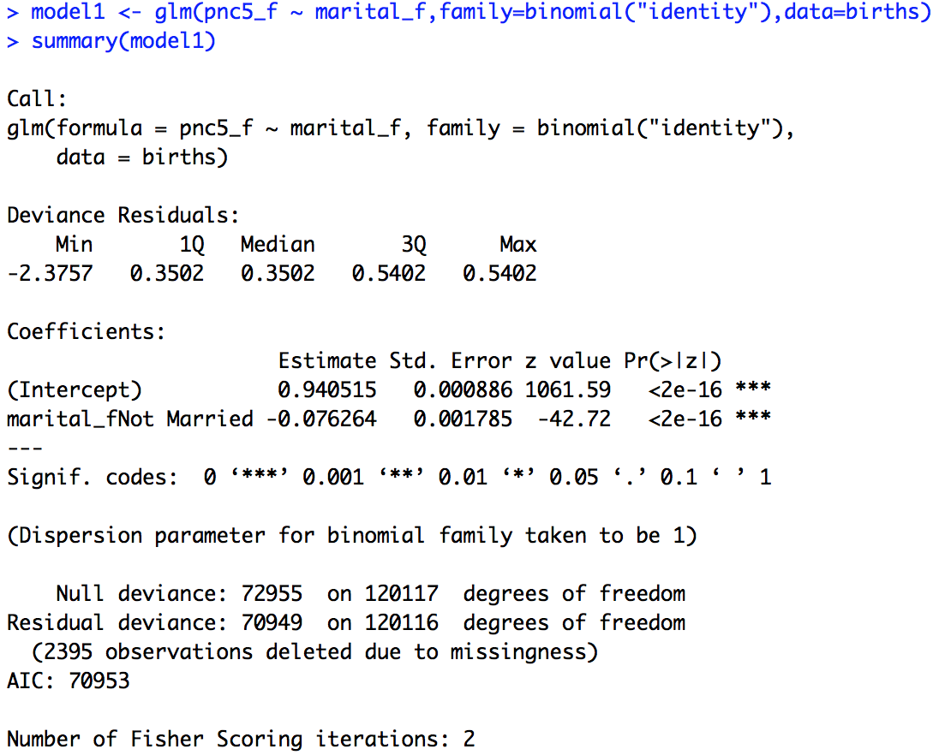
Summary() is flexible & takes different classes of objects
Looking ahead:
summary() for model output

Slide 32
Summary() is flexible & takes different classes of objects
Looking ahead:
summary() for model output
Review:
Factor variables in R (marital_f, pnc_f)

Slide 33
describe()
describe() from the Hmisc package is another generic method for summarizing a vector, matrix, or dataframe
install.packages('Hmisc') #only the first time
library(Hmisc) #every time you want to use it

Slide 34
describe(births$mage)

Slide 35
describe(births$mage)
describe(births)
describe(births[,c("cigdur","dob","sex","mrace","methnic")])

Slide 36
describe(births$mage)
describe(births)
describe(births[,c("cigdur","dob","sex","mrace","methnic")])
What’s the difference in output?
How might you recode these variables?

Slide 37
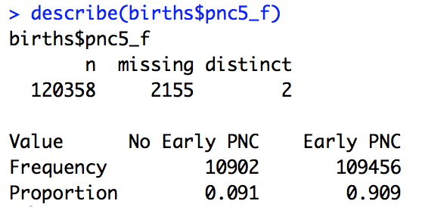
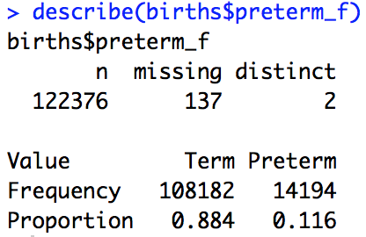
Describe() with Categorical Variables
Default is to tell you proportions and missing values.

Slide 38
tableone package
Create an object summarizing characteristics of study population (continuous and categorical variables).
Key arguments for CreateTableOne() function:
vars = variable names to be summarized
strata = stratifying variable name (optional)
data = dataframe where all variables exist
Other arguments and more details here: https://cran.r-project.org/web/packages/tableone/tableone.pdf

Slide 39
tableone package
install.packages('tableone') #only the first time
library(tableone) #every time you want to use it
#Simple examples
CreateTableOne(vars = c("pnc5_f", "preterm_f", "mage"), data = births)
CreateTableOne(vars = c("pnc5_f", "mage"), strata = "preterm_f", data = births)

Slide 40
tableone package
CreateTableOne() can handle both continuous and categorical variables.
CreateContTable() only continuous
CreateCatTable() only categorical
Use tableone and survey packages together to easily create tables of weighted data.
More to come later this semester!

Slide 41
Graphics in R
In R, there are a lot of ways to do the same thing, and this is especially true for visualization.
Base graphics are R’s built-in functionality for charts and graphs.
R packages extend this functionality, with ggplot being the most popular.
Today is a brief tour of base graphics, but most of the semester, we’ll use ggplot.

Slide 42
Functions for Base Graphics
Main Functions
plot(), hist(), barplot(), boxplot(), dotchart()
Key Arguments
Data to plot (x=, y=)
Add text (xlab=, ylab=, main=)
Add color, symbol, line (col=, pch=, lty=, lwd=)
Helpers
jitter(), density(), abline()
Base Graphics Cheat Sheet: http://publish.illinois.edu/johnrgallagher/files/2015/10/BaseGraphicsCheatsheet.pdf

Slide 43
plot() examples
b <- births[1:10000,] #smaller dataset for faster plotting
plot(b$mage, b$wksgest) #basic plot
plot(b$mage, b$wksgest, xlab="Maternal age in years", ylab = "Gestational age in weeks") #add axis labels
plot(jitter(b$mage), jitter(b$wksgest), pch=".", xlab="Maternal age in years", ylab = "Gestational age in weeks") #add jitter to both mage and wksgest to reduce overplotting

Slide 44
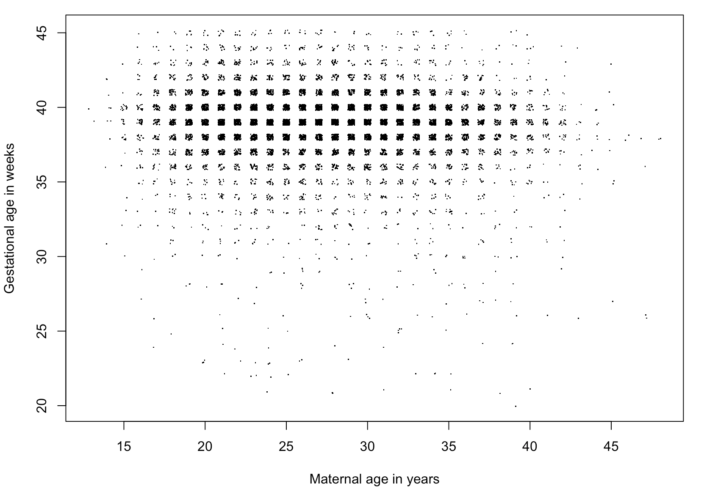

Slide 45
#Your turn: how would you annotate this code?
color <- rep(NA, nrow(b))
color[b$cigdur == "Y"] <- "red"
color[b$cigdur == "N"] <- "blue"
plot(jitter(b$mage), jitter(b$wksgest), pch=".", col=color, xlab="Maternal age in years", ylab = "Gestational age in weeks")
abline(v=mean(b$mage, na.rm=T))
abline(h=mean(b$wksgest, na.rm=T))

Slide 46
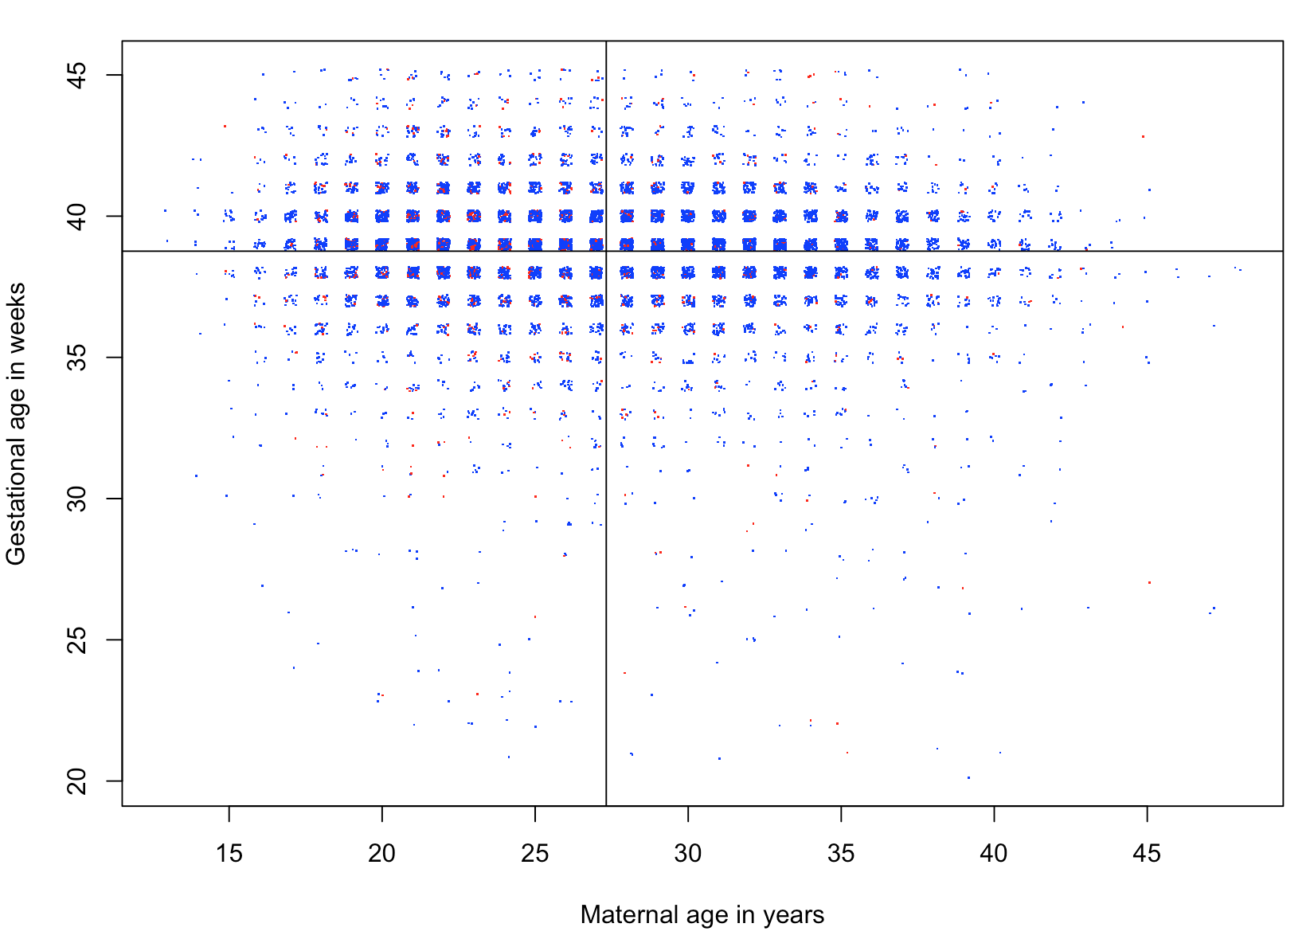

Slide 47
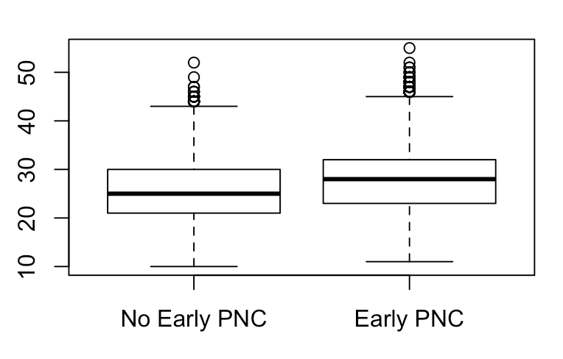
boxplot()
boxplot(births$mage) #mage overall
boxplot(births$mage ~ births$pnc5_f) #mage by pnc group

Slide 48
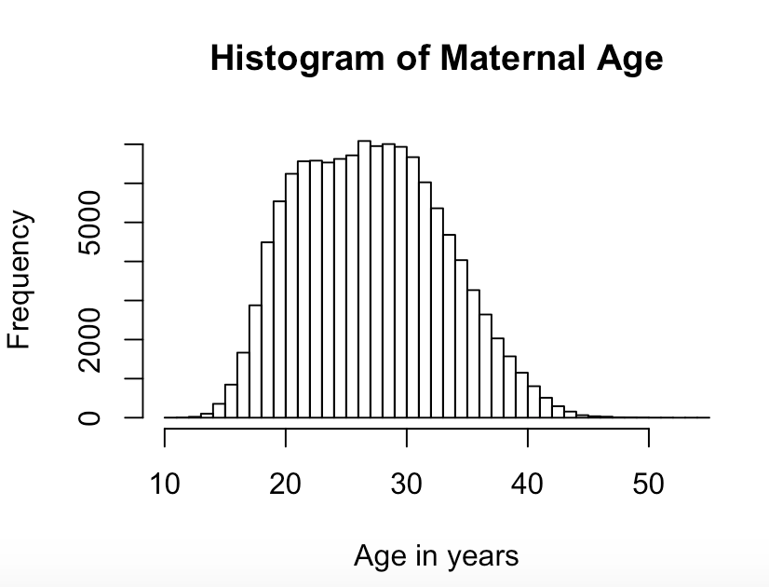
hist()
hist(births$mage)
hist(births$mage, breaks = 40, main = "Histogram of Maternal Age", xlab = "Age in years")

Slide 49
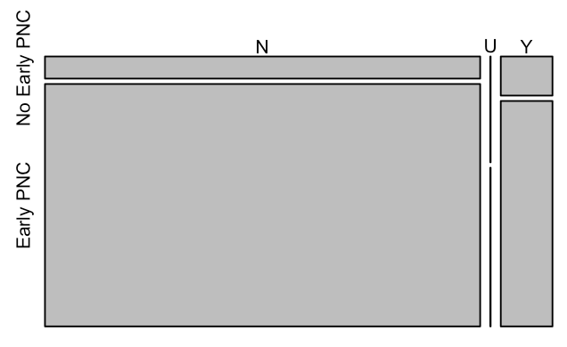
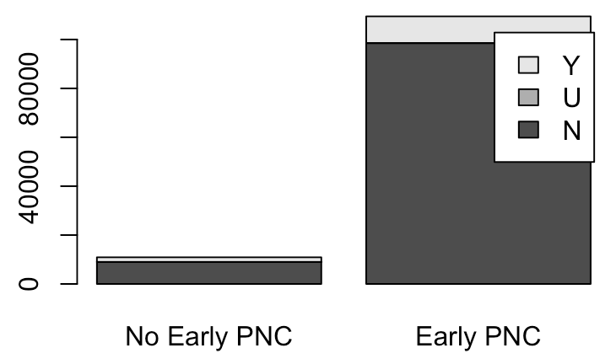
plot() and barplot() with table object
table(births$cigdur, births$pnc5_f) #3x2 table
smoke_by_pnc <- table(births$cigdur, births$pnc5_f) #saved as table object smoke_by_pnc
plot(smoke_by_pnc) barplot(smoke_by_pnc, legend.text=T)

Slide 50
plot() and barplot() with table object
table(births$cigdur, births$pnc5_f) #3x2 table
smoke_by_pnc <- table(births$cigdur, births$pnc5_f) #saved as table object smoke_by_pnc
plot(smoke_by_pnc) barplot(smoke_by_pnc, legend.text=T)
Very ugly!!! Just to give you a sense of the most basic plots!

Slide 51
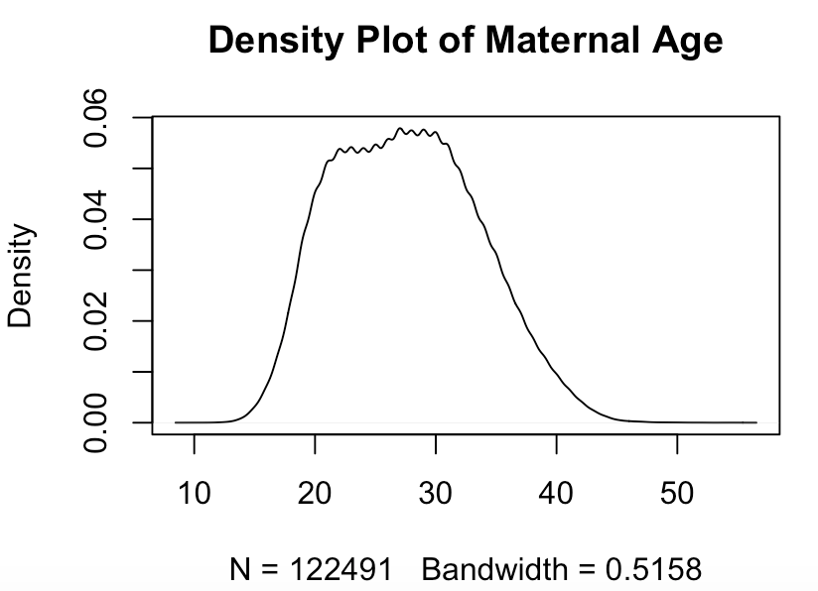
plot() with density()
plot(density(births$mage, na.rm=T), main = "Density Plot of Maternal Age")

Slide 52
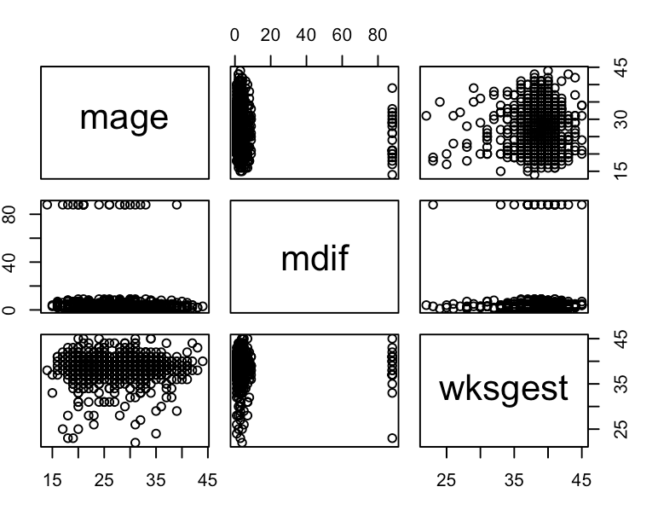
plot() with a dataframe
births_sample <- births[sample(nrow(births), 1000), c("mage", "mdif", "wksgest")]
plot(births_sample)

Slide 53
Practice with Recoding
Today, we recoded the main exposure and outcome variables and the covariate maternal age. Now, let’s recode the covariate cigarette use. Take a look at the existing variable cigdur using the table() or describe() function.
Recode the existing character variable cigdur to a new integer variable smoke, so that it is coded as 1 for “Y”, 0 for “N”, and missing (NA) otherwise.
Convert that integer variable smoke to a factor variable smoker_f with levels “Smoker” and “Non-smoker.”

Slide 54
Practice with Functions
What is the mean maternal age among smokers? Among non-smokers?
What proportion of births were preterm among smokers? Among non-smokers?
Use the CreateTableOne() function to summarize early prenatal care, preterm births, and maternal age, stratified by smoking status.
With a plotting function of your choice, visualize the relationship between smoking status and the original weeks of gestation variable (wksgest).

Slide 55
Plan for Wednesday
Introduction to apply() family of functions
Introduction to dplyr package
Practice coding for HW #2

