Slide 1
Recoding III: Introducing apply()
EPID 799C, Lecture 6
Wednesday, Sept. 19, 2018

Slide 2
Introducing the Apply() Family
Functions in base R to manipulate slices of data from matrices, arrays, lists, and dataframes in a repetitive way without explicit use of loop constructs.
Also known as “functional functions” (functions taking a function as an argument).
Typically require very few lines of code.
Family members:
apply() lapply()
sapply() vapply()
mapply() rapply()
tapply() eapply()
Q: How can I use a loop to […insert task here…]?
A: Don’t. Use one of the apply functions.
https://nsaunders.wordpress.com/2010/08/20/a-brief-introduction-to-apply-in-r/

Slide 3
Motivation 1 from Last Week’s Lecture
#Need to recode 99’s as R’s missing value NA
births$mdif[births$mdif==99] <- NA
births$wksgest[births$wksgest==99] <- NA
births$mage[births$mage==99] <- NA
births$totpreg[births$totpreg==99] <- NA
births$visits[births$visits==99] <- NA
# …and so on…

Slide 4
Motivation 1 from Last Week’s Lecture
#Need to recode 99’s as R’s missing value NA
births$mdif[births$mdif==99] <- NA
births$wksgest[births$wksgest==99] <- NA
births$mage[births$mage==99] <- NA
births$totpreg[births$totpreg==99] <- NA
births$visits[births$visits==99] <- NA
# …and so on…
This is repetitive and error-prone!!

Slide 5
Motivation 2 from Last Week’s Lecture
#Need min, max, mean, standard deviation, and interquartile range for all continuous variables
min(births$mage, na.rm = T)
max(births$mage, na.rm = T)
mean(births$mage, na.rm = T)
sd(births$mage, na.rm = T)
IQR(births$mage, na.rm = T)
# …and now repeat for a bunch of other variables…

Slide 6
Motivation 2 from Last Week’s Lecture
#Need min, max, mean, standard deviation, and interquartile range for all continuous variables
min(births$mage, na.rm = T)
max(births$mage, na.rm = T)
mean(births$mage, na.rm = T)
sd(births$mage, na.rm = T)
IQR(births$mage, na.rm = T)
# …and now repeat for a bunch of other variables…

Slide 7
General Idea
“For each of these things…
(columns or rows in a dataframe, elements of a vector, etc.)
…do this…
(apply a function)
…put it together…
(compile the results of applying that function to each thing)
…and give me the results.”
(create a new object or print results to the console)

Slide 8
apply()
Syntax: apply(X= , MARGIN= , FUN=, …)
X = the matrix you want to perform a function on
MARGIN = defines how the function is applied (1 for rows, 2 for columns)
MARGIN=1 applies the function on each observation (row) at a time.
MARGIN=2 applies the function on each variable (column) at a time.
FUN = any R function you want to apply
Could be built-in or user-defined

Slide 9
apply() example
apply(X = births[,c("mage","wksgest","totpreg","visits")],
MARGIN = 2,
FUN = mean, na.rm=T)
#Mean of non-missing values for each variable

Slide 10
lapply()
Applies a function to each element of a list or vector, returning a list
X = a list or vector
FUN = R function to be applied
No longer need margin since function is applied to each element of the list

Slide 11
apply() vs. lapply()
a <- apply(X = births[,c("mage","wksgest","totpreg","visits")],
MARGIN = 2,
FUN = mean, na.rm=T)
l <- lapply(X = births[,c("mage","wksgest","totpreg","visits")],
FUN = mean, na.rm=T)
What’s the difference between the R objects we created, a and l?

Slide 12
lapply() for one of our motivating examples
lapply(X = births[,c("mage","wksgest","totpreg","visits")],
FUN = function(x) rbind(min = min(x, na.rm=T),
max = max(x, na.rm=T),
mean = mean(x, na.rm=T),
sd = sd(x, na.rm=T),
iqr = IQR(x, na.rm=T)))

Slide 13
lapply() for one of our motivating examples
lapply(X = births[,c("mage","wksgest","totpreg","visits")],
FUN = function(x) rbind(min = min(x, na.rm=T),
max = max(x, na.rm=T),
mean = mean(x, na.rm=T),
sd = sd(x, na.rm=T),
iqr = IQR(x, na.rm=T)))
This is an anonymous function.

Slide 14
lapply() for one of our motivating examples
lapply(X = births[,c("mage","wksgest","totpreg","visits")],
FUN = function(x) rbind(min = min(x, na.rm=T),
max = max(x, na.rm=T),
mean = mean(x, na.rm=T),
sd = sd(x, na.rm=T),
iqr = IQR(x, na.rm=T)))
This is an anonymous function.
Alternatively, we could have created it outside of apply() and named it in our environment.
my_key_stats <- function(x) {
rbind(min = min(x, na.rm=T),
max = max(x, na.rm=T),
mean = mean(x, na.rm=T),
sd = sd(x, na.rm=T),
iqr = IQR(x, na.rm=T))
}
Then, in apply() we would specify FUN = my_key_stats.

Slide 15
lapply() for one of our motivating examples
#Create R object with output
my_summary <-
lapply(X = births[,c("mage","wksgest","totpreg","visits")],
FUN = function(x) rbind(min = min(x, na.rm=T),
max = max(x, na.rm=T),
mean = mean(x, na.rm=T),
sd = sd(x, na.rm=T),
iqr = IQR(x, na.rm=T)))

Slide 16
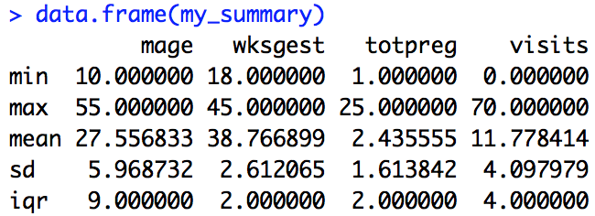
lapply() for one of our motivating examples
#Create R object with output
my_summary <-
lapply(X = births[,c("mage","wksgest","totpreg","visits")],
FUN = function(x) rbind(min = min(x, na.rm=T),
max = max(x, na.rm=T),
mean = mean(x, na.rm=T),
sd = sd(x, na.rm=T),
iqr = IQR(x, na.rm=T)))
data.frame(my_summary) #outputs a dataframe instead of a list

Slide 17
sapply()
Very similar to lapply, but tries to simplify output to a vector or matrix
X = list or vector
FUN = R function to be applied
No margin specified

Slide 18
sapply() vs. lapply()
lapply(births, mean, na.rm=T)
sapply(births, mean, na.rm=T)
What’s the difference in output?

Slide 19
sapply() for the other motivating example
#Our missing data function
fix_missing <- function(x) {
x[x == 99] <- NA
x
}
#Variables with missing data coded as 99
vars_to_fix <-births[,c("mage","wksgest","totpreg","visits")]
#Recoding each variable with our function
vars_fixed <- sapply(X = vars_to_fix, FUN = fix_missing)

Slide 20
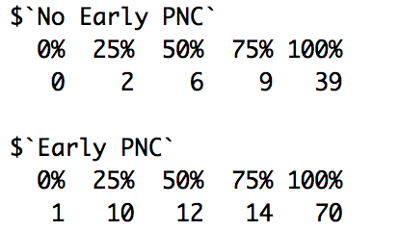
tapply()
Run a function by group (i.e., levels of a factor variable).
Syntax is similar, but now includes INDEX= to specify the grouping variable.
Simple example:
tapply(X = births$visits, INDEX = births$pnc5_f, FUN = quantile, na.rm=T)

Slide 21
Final Thoughts
The best way to prepare for apply()… is to dive into examples!
Oftentimes, it takes writing out repetitive/inefficient/error-prone code to realize that an apply() function could have saved the day.
Developing intuition for apply() takes practice… which we’ll continue throughout this semester.

