Slide 1
Generalized Linear Models (GLM) in R: Part 2
EPID 799C
Fall 2018
Let’s start HW4!
(Get your births dataset ready)

Slide 2
Overview
A working class!
Expect to be very similar to homework 4, coming out soon

Slide 3
Crude effects
Create a summary data.frame/table for crude effects: Using either dplyr:: functions or table() and prop.table() as we did in class, report the effect of early prenatal care on preterm birth by:
the crude risk difference ← just do this for now
…the crude risk ratio ?
…the crude odds ratio ?

Slide 4
Crude effects by race-ethnicity
Create a summary data.frame/table for crude effects: Using either dplyr:: functions or table() and prop.table() as we did in class, report the effect of early prenatal care on preterm birth by:
the crude risk difference ← just do this for now
…the crude risk ratio ?
…the crude odds ratio ?

Slide 5
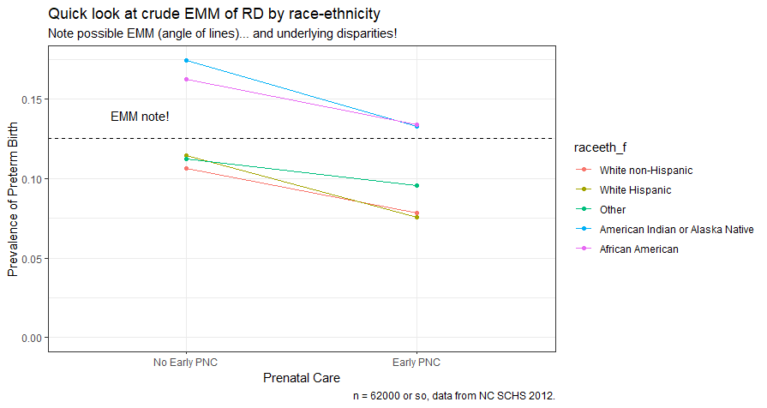
Let’s make this!

Slide 6
Let’s make this….but how?
df structure?
ggplot aes mappings?
geometries?
tweaks?
Scales
Title/subtitle/caption
Note
Theme
…more?

Slide 7
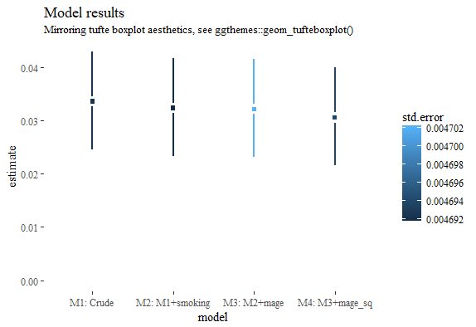
Let’s make this!

Slide 8
BUT HOW?!
Models
Combine
Base
Dplyr
Dplyr + purr
Even more advanced purrr!
First: ggplot df looks like…?

