Slide 1
Effect Measure Modification
EPID 799C
Fall 2018

Slide 2
Today
A continuation of modeling:
How do we get group-specific effect estimates and confidence intervals from models when we have EMM?
Also: a recursion primer

Slide 3
Review
We’ve looked at a Directed Acyclic Graph to identify model covariates to control to assess the causal relationship of early prenatal care on preterm birth. We know EMM won’t show up on the DAG.
We’ve constructed Generalized Linear Models for risk difference (also looked at RRs and ORs) without EMM.
We’ve looked at crude EMM using dplyr:: and table(). Moderate modification?
Now we want modeled, stratum-specific effect estimates and CIs controlling for our other covariates (smoking, maternal age). We want a full EMM model.

Slide 4
Model Specification 1: Crude
Risk Preterm =
$β_{0}+β_{1}×PNC5$
Variable coefficients like $β_{1}$ (slopes) represent a linear change in risks (a risk difference) for a 1 unit increase in their associated variable.
$β_{0}:$ Risk of preterm with no early prenatal care
$β_{1}:$ Additional risk (risk difference) with early prenatal care

Slide 5
Model Specification 2
Risk Preterm =
$β_{0}+β_{1}×PNC5+β_{2}×smoker$
Coefficient slopes represent a linear change in risks (a risk difference) for a 1 unit increase in their associated variable.
$β_{0}:$ Risk of preterm with no early prenatal care
$β_{1}:$ Additional risk (risk difference) with early prenatal care (expect negative RD since protective)
$β_{2}:$ Additional risk (RD) with smoking status (note: no interaction term, so this additional risk is regardless of PNC5 status)

Slide 6
Model Specification 3
Risk Preterm =
$β_{0}+$ $$β_{1}×PNC5+ \\ Β_{2}×RaceEth+ \\ β_{3}smoker+ \\ β_{4}mage+β_{5}mage_sq…$$
No interaction term… but since race-ethnicity has multiple levels, so that $Β_{2}$ is really a vector of coefficients. Now $β_{0}$ is the baseline risk for White non-Hispanic mothers, each $Β_{2i}$ for non-referent levels of race-ethnicity (AA, WH, AI/AN, other) is the increased risk of preterm birth by race-ethnicity status of the mother….*

Slide 7
Model Specification 3
Risk Preterm =
$β_{0}+$ $$β_{1}×PNC5+ \\ Β_{2}×RaceEth+ \\ β_{4}smoker+ \\ β_{5}mage+β_{6}mage_sq…$$
* …SORT OF. Remember the Table 2 Fallacy when not looking at EMM: we didn’t draw our DAG to properly estimate these other coefficients. But may still useful to think about their statistical (non-causal) interpretation.

Slide 8
Full Model Specification w/ EMM
Risk Preterm =
$β_{0}+$ $$β_{1}×PNC5+ \\ Β_{2}×RaceEth+Β_{3}PNC5×RaceEth+ \\ β_{4}×smoker+ \\ β_{5}×mage+β_{6}×mage_sq…$$
Coefficient slopes represent a linear change in risks (a risk difference) for a 1 unit increase in their associated variable.

Slide 9
Coding schemes
R’s default for expanding unordered factors in a model is indicator coding: R breaks up factors in models to all be referent to the baseline, meaning you need n-1 levels to describe n levels of a factor.

Slide 10
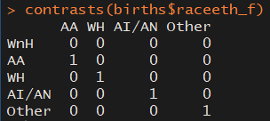
Let’s Look: Contrast Matrix

Slide 11
Full Model Specification w/ EMM
Risk Preterm =
$β_{0}+$ $$β_{1}×PNC5Yes+ \\ β_{2}×RaceEthAA+β_{6}PNC5×RaceEthAA+ \\ β_{3}×RaceEthWH+β_{7}PNC5×RaceEthWH+ \\ β_{4}×RaceEthAIAN+β_{8}PNC5×RaceEthAIAN+ \\ β_{5}×RaceEthOther+β_{9}PNC5×RaceEthOther+ \\ β_{10}smokerYes+ \\ β_{11}mage+β_{12}mage_sq…$$

Slide 12
Full Model Specification w/ EMM
Under that coding schema…
$β_{0}$ is no longer the baseline risk (no PNC) for all groups – it’s the baseline risk for White non-Hispanic mothers*.
$β_{2,3,4,5}$ are the increment in risk for each race-ethnicity status (compared to WnH) without prenatal care*.
$β_{6,7,8,9}$ are the increment in risk by each race-ethnicity status (compared to WnH) with prenatal care*.
* …controlling for other covariates like smoking and mage as specified in the model

Slide 13
Contrasts
…So if we want the group-specific RDs by race, ethnicity, we could imagine subtracting one equation from another. Many terms drop out, leaving:
$β_{1}$: Effect (RD) of PNC5 for WnH moms
$β_{1}+β_{6}$: Effect (RD) of PNC5 for AA moms
$β_{1}+β_{7}$: Effect (RD) of PNC5 for WH moms
$β_{1}+β_{8}$: Effect (RD) of PNC5 for AI/AN moms
$β_{1}+β_{9}$: Effect (RD) of PNC5 for RE:Other moms

Slide 14
We can get these point-estimates by hand a few ways…
# Point estimates by hand, a few ways
mfull_emm_rd$coefficients[2] #WnH
RD_WnH = mfull_emm_rd$coefficients["pnc5_fPNC starts in first 5 mo"] #WnH
RD_WnH +
mfull_emm_rd$coefficients["pnc5_fPNC starts in first 5 mo:raceeth_fAA"] #AA
sum(mfull_emm_rd$coefficients[c(2,10)]) # AA
sum(mfull_emm_rd$coefficients[c(2,11)]) # WH
sum(coef(mfull_emm_rd)[c(2,12)]) # AI/AN
sum(coef(mfull_emm_rd)[c(2,13)]) # Other

Slide 15
…But what about the CIs?

Slide 16
Contrast Package
Lets you define arbitrary contrasts across your model that you’re interested in by setting two coefficient specifications as lists.
contrast(<MODEL OBJECT>,
a=list(<COEFA>), b=list(<COEFB>)
Handles more than GLMs – also multi-level/LME, gee, etc. If you need exponentiated estimates, pass in fun=exp. See help page

Slide 17
Contrast Package: Example 1
For our full model…
contrast(mfull_emm_rd,
a=list(pnc5_f = "PNC starts in first 5 mo", raceeth_f = "AA", smoker_f =”Non smoker”, mage=0, mage_sq=0),
b=list(pnc5_f = "No PNC before 5 mo", raceeth_f = "AA", smoker_f=“Non smoker”, mage=0, mage_sq=0))
Gets us the RD effect estimate and 95% CI for AA moms getting prenatal care vs. those who aren’t.
Note that unchanging model levels are required to have something, but “drop out” of the estimation. This is similar to how predict() works.

Slide 18
Contrast Package: Example 2
For all levels of EMM:
raceeth_diff = contrast(mfull_emm_rd,
a=list(pnc5_f = "PNC starts in first 5 mo", raceeth_f = levels(births$raceeth_f),
smoker_f = “non Smoker", mage=0, mage_sq=0),
b=list(pnc5_f = "No PNC before 5 mo", raceeth_f = levels(births$raceeth_f),
smoker_f=“non Smoker", mage=0, mage_sq=0))
print(raceeth_diff, X=T)
Gets us the RD effect estimate and 95% CI for all levels of race-ethnicity including referent. Can use data.frame() to piece together a results table for graphing.

Slide 19
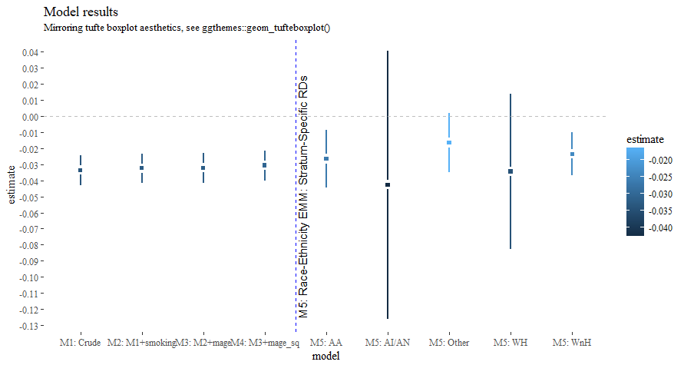

Slide 20
Let’s Try: Contrasts
#............................................
# EMM / final model
#............................................
glm(data=births, preterm_f ~ pnc5_f + smoker_f, family=binomial(link="identity")) #Discussion of model spec
head(births)
table(births$race_f, births$methnic) # note my "ethnicity" coding may not be ideal.
mfull_emm_rd = glm(data=births,
preterm_f ~ pnc5_f * raceeth_f +
smoker_f + mage + mage_sq,
family=binomial(link="identity"))
summary(mfull_emm_rd)
broom::tidy(mfull_emm_rd)
# Point estimates by hand, a few ways
mfull_emm_rd$coefficients[2] #WnH
RD_WnH = mfull_emm_rd$coefficients["pnc5_fPNC starts in first 5 mo"] #WnH
RD_WnH + mfull_emm_rd$coefficients["pnc5_fPNC starts in first 5 mo:raceeth_fAA"] #AA
sum(mfull_emm_rd$coefficients[c(2,10)]) # AA
sum(mfull_emm_rd$coefficients[c(2,11)]) # WH
sum(coef(mfull_emm_rd)[c(2,12)]) # AI/AN
sum(coef(mfull_emm_rd)[c(2,13)]) # Other
C(births$raceeth_f) # get or set contrasts
contrasts(births$raceeth_f) # Let's look: contrast matrix
# See contr.treatment or contr.sum
# Contrasts using contrast package
library(contrast)
contrast(mfull_emm_rd,
a=list(pnc5_f = "PNC starts in first 5 mo", raceeth_f = "AA", smoker_f = "Smoker", mage=20, mage_sq=400),
b=list(pnc5_f = "No PNC before 5 mo", raceeth_f = "AA", smoker_f="Smoker", mage=20, mage_sq=400))
raceeth_diff = contrast(mfull_emm_rd,
a=list(pnc5_f = "PNC starts in first 5 mo", raceeth_f = levels(births$raceeth_f), smoker_f = "Smoker", mage=20, mage_sq=400),
b=list(pnc5_f = "No PNC before 5 mo", raceeth_f = levels(births$raceeth_f), smoker_f="Smoker", mage=20, mage_sq=400))
print(raceeth_diff, X=T)
EMM_df = data.frame(model=paste0("M5: ", raceeth_diff$raceeth_f),
estimate=raceeth_diff$Contrast, std.error = raceeth_diff$SE,
X2.5..=raceeth_diff$Lower, X97.5..=raceeth_diff$Upper)
ggplot(bind_rows(model_results,EMM_df), aes(model, estimate,color=std.error, fill=std.error))+
geom_linerange(aes(ymin=X2.5.., ymax=X97.5..), size=1)+
geom_point(shape=15, size=4, color="white")+ geom_point(shape=15)+
scale_y_continuous(limits=c(NA,NA), breaks=seq(-0.15, 0.05, 0.01))+
geom_hline(yintercept = 0, lty=2, color="grey")+
geom_vline(xintercept = 4.5, lty=2, color="blue")+
annotate(geom = "text", x = 4.6, y=-0.05, angle=90, label="M5: Race-Ethnicity EMM: Stratum-Specific RDs")+
labs(title="Model results", subtitle="Mirroring tufte boxplot aesthetics, see ggthemes::geom_tufteboxplot()")+
ggthemes::theme_tufte()

Slide 21
Other ways
Specifying the contrast type using functions like: C() : Sets the "contrasts" attribute for the factor.
contrasts(): Set and view the contrasts associated with a factor.
model.matrix() : creates a design (or model) matrix, e.g., by expanding factors to a set of dummy variables (depending on the contrasts) and expanding interactions similarly.
Create a custom contrast matrix so that individual coefficients are more meaningful under EMM. Possible but beyond scope of this class. Good luck. ☺

Slide 22
References
A (sort of) complete guide to contrasts in R http://rstudio-pubs-static.s3.amazonaws.com/65059_586f394d8eb84f84b1baaf56ffb6b47f.html
contrast package https://cran.r-project.org/web/packages/contrast/vignettes/contrast.pdf

Slide 23
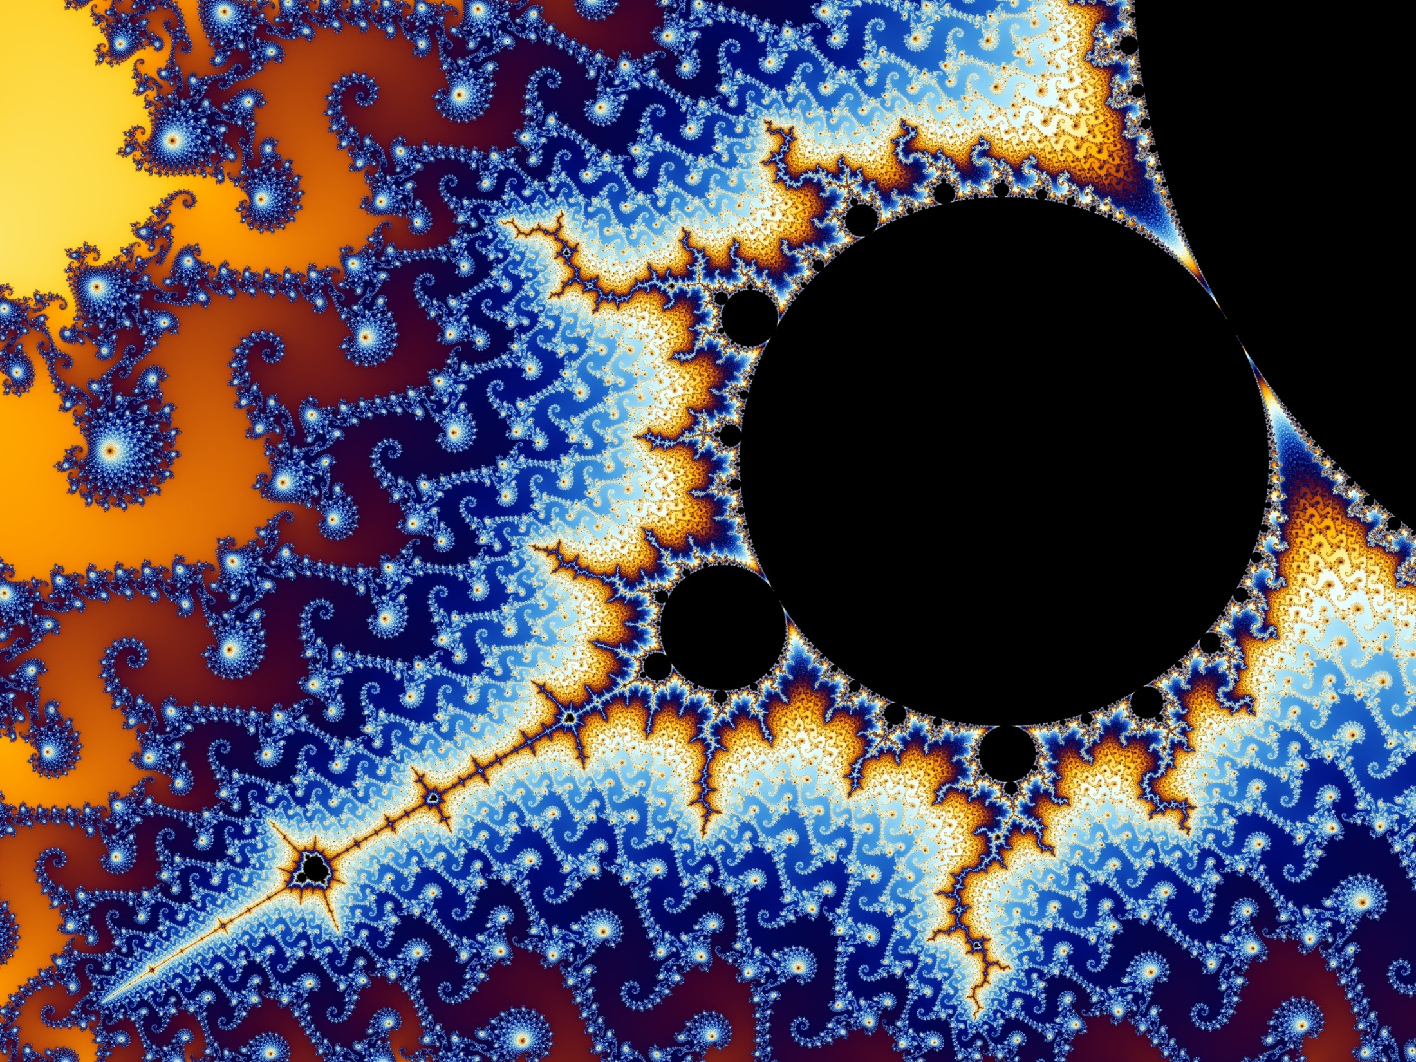
Recursion
The B in Benoit B Mandelbrot stands for Benoit B Mandelbrot.

Slide 24
Recursion
In order to understand recursion you must first understand recursion.
why are these
bad examples of useful recursion?

Slide 25
Use recursion if on each iteration your task splits into two or more similar tasks https://stackoverflow.com/questions/126756/examples-of-recursive-functions
…SMALLER tasks
…has reasonable base cases / terminating conditions
…is typically of unknown length / complexity

Slide 26
Typical teaching examples from computer science
Sorts galore
Tree traversal
Scheme / lists
…but what about public health?

Slide 27
A question on time clusters
Hospital arrivals within 15 minutes apart become part of a cluster… including anyone time-adjacent to their own “time neighbors.”
(May not actually be Nidia’s question, but caught my attention as a good example…)
Toy example: How many time clusters in h = c(1, 2, 4, 5, 6, 7, 10, 11, 13, 27)

Slide 28
Factorial, a classic!
my_factorial = function(n, verbose=F){
if(n == 0) {
if(verbose){print(" = ")}
return(1)
} else{
if(verbose){print(paste0(n, " x"))}
return(n * my_factorial(n-1, verbose))
}
}
my_factorial(5)
my_factorial(5, verbose = T)

Slide 29
Now, some cluster finding
library(tidyverse)
h = c(1, 2, 4, 5, 6, 7, 10, 11, 13, 27)
cluster_maker = function(a, b, d = 1 , found_list = NULL, verbose = F){
# a = 4; b=h; d=1; found_list=NULL
if (verbose) {print(cat("Called with a=", a, "b=", b, "d=", d, "found= ", found_list))}
# if starting, find myself! Then remove myself from rest of list
if(is.null(found_list)){ found_list = a }
rest_of_list = b[!(b %in% found_list)] # Reduce!
# Find new matches, if I haven't seen them before, and add to found list
new_matches = b[abs(a-b)<=d]
new_matches = new_matches[!(new_matches %in% found_list)]
found_list = c(new_matches, found_list)
# for loop version
child_answers = NULL # collect my children results 1 by 1
for(new_find in new_matches){ # more traditional would be first of list, rest of list
child_answers = c(child_answers, cluster_maker(new_find, rest_of_list, d, found_list))
} # Could also unlist(map...) instead of a loop
found_list = found_list %>% union(child_answers) %>% `[`(order(.))
# ^ FANCY! Just merge and sort.
return(found_list) # returns my results plus children results
}
h
cluster_maker(1, h, 1)
cluster_maker(2, h, 1)
cluster_maker(4, h, 1, verbose = T)
cluster_maker(5, h, 1)
cluster_maker(7, h, 2)

Slide 30
More purrr practice!
results_df = tibble(cluster_list = map(h, ~ cluster_maker(.x, h, 1)),
cluster_lengths = map_int(cluster_list, length),
cluster_id = map_chr(cluster_list, ~ paste(.x, collapse = " ")))
length(unique(results_df$cluster_id))

Slide 31
Critical Thinking
Might there be creative O(1)* ways to do this?
h = c(1, 2, 4, 5, 6, 7, 10, 11, 13, 27)
I think so!!

