Slide 1
R Markdown
Nick Brazeau
October 24, 2018
Class 16

Slide 2
Housekeeping
Homework 4
Due 10/29
Homework 5 is posted
3 Questions
Due 11/12
Final Projects
11/28 and 12/3

Slide 3
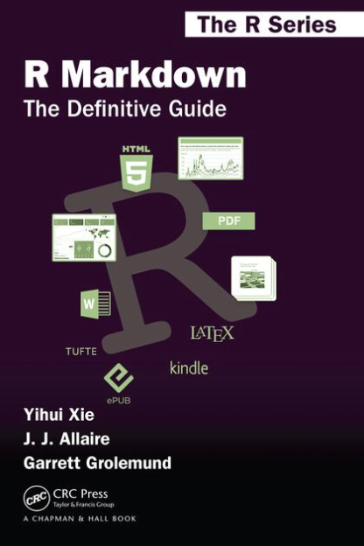
Acknowledgements
Mike Fliss & Sara Levintow
Yihui Xie
Yihui wrote knitr, backbone of Rmarkdown,
Rsweave, etc.
J.J. Allaire
Allaire, Yihui, & others wrote the rmarkdown package
R Markdown: The Definitive Guide
Yihui Xie, J. J. Allaire, Garrett Grolemund
R studio & rOpenSci
Only 304 pages!

Slide 4
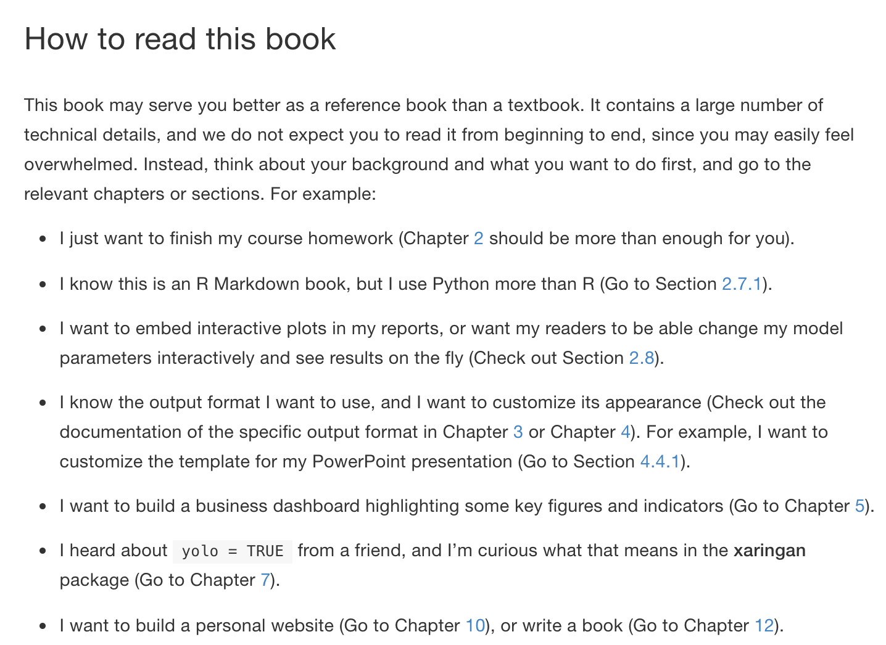
The Definitive Guide

Slide 5
Examples of R Markdown Reports/Files/Notebooks…
Your Instructors and Classmates
Molly Deutsch-Feldman
Mike Fliss
Sara Levintow
Kelsey Sumner
Tutorials
Writing math (with LaTeX)
Prior Lectures (but too meta to do an Rmarkdown lecture on Rmarkdown)
Your Homework Answers
Shiny

Slide 6
Examples of the Power of R Markdown from the Definitive Guide
https://bookdown.org/yihui/rmarkdown/basics-examples.html

Slide 7
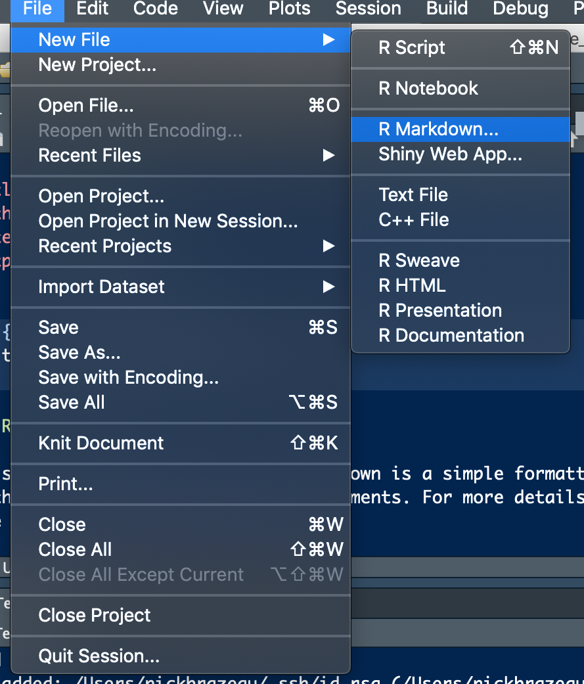
Now that you’re inspired…
Let’s practicing using R projects
Let’s make our first Rmarkdown File

Slide 8
R Markdown – What’s Different and What’s the Same
How R Markdown files are rendered (think of these new instances of R)
Headers (YAML metadata)
Body
Code Chunks (and engines)
Chunk Options
To Run or Not to Run
Include Code or hide code
Output options

Slide 9
R Markdown – What’s Different and What’s the Same
^^ R Markdown Cheat Sheet (link at end)

Slide 10
Compiling/Rendering a R Markdown file
Scripts must be completely “self-sustaining” (which makes them reproducible)
Live Demo

Slide 11
YAML Headers
R Markdown uses YAML metadata to determine how you want your file to be rendered.
Enclosed by “------”
Many, many options
Basics: Title, Author, Date, Output Type (html, word, pdf …)
^^ R Markdown Cheat Sheet (link at end)

Slide 12
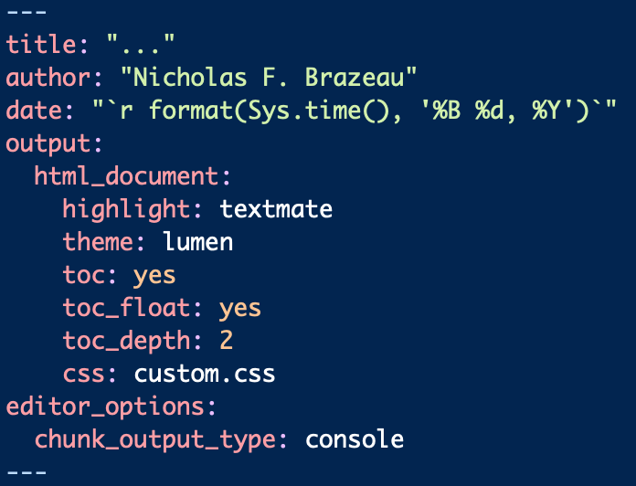
My Typical YAML
Preferences (at this point shocking to you all that I have some)
This is for html (most flexible)
Call Time/Date when rendered
Code highlighting (tango is also great)
Table of Content
Table of Content Levels
Live Demo

Slide 13
Sara’s YAML for Code Folding
Easy to Fold Code
Which is great for later use or discussions of coding decisions (at this point shocking to you all that I have some)
Little harder to Fold Outputs (like we did on your HW)
This required javascript (and stackoverflow and “borrowing” code from a friend)

Slide 14
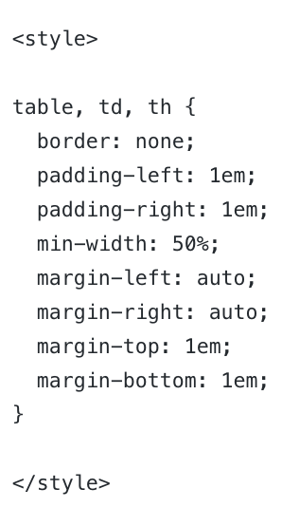
Advanced Content Aside: Javascript, CSS
When R Markdown files are knitted to htmls, they can interpret CSS and/or Javascript (html-languages)
CSS/Javascript are website design langauges (check out W3 if you’re interested)
Complete customization
IMO, easy to spend a lot of time and effort…StackOverflow is your friend!
^^ That just to increase whitespace between columns in my table

Slide 15
More YAML Options
https://rmarkdown.rstudio.com/markdown_document_format#overview

Slide 16
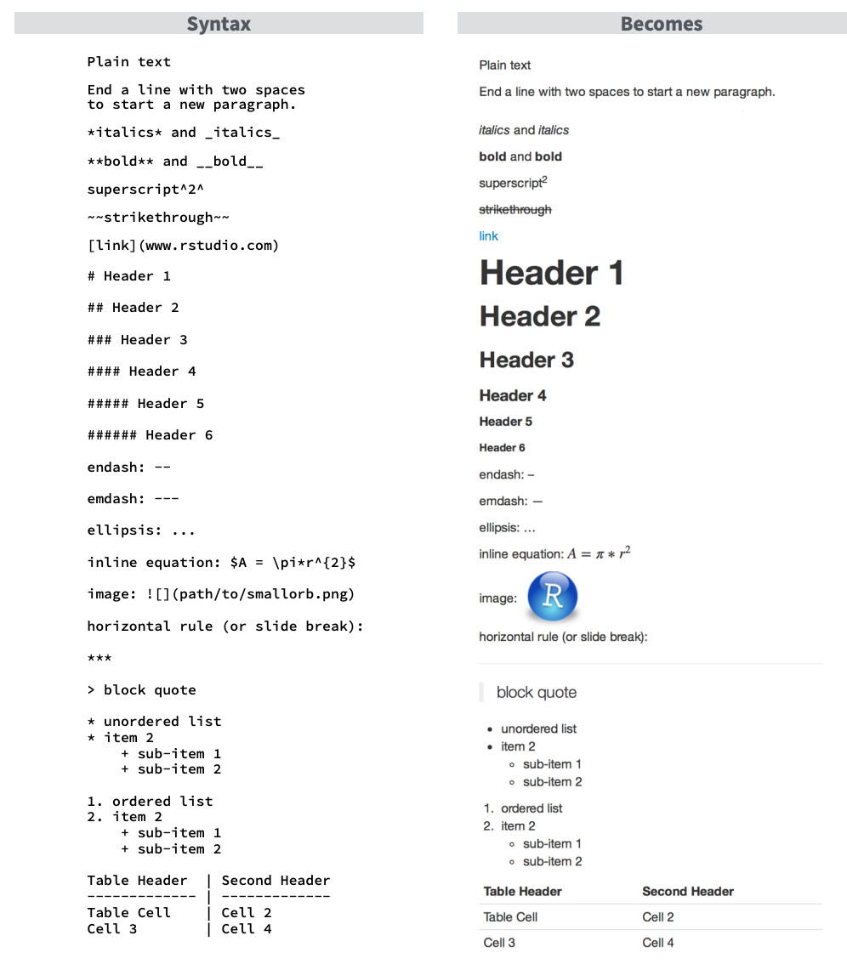
The R Markdown Body (i.e. outside of Code Chunks)
Interpreter is Markdown
”Basic” Language
Cheat sheets galore
Recommend a Markdown IDE
Mac = macdown
PC folks
Live Demo
https://www.rstudio.com/wp-content/uploads/2015/03/rmarkdown-reference.pdf

Slide 17
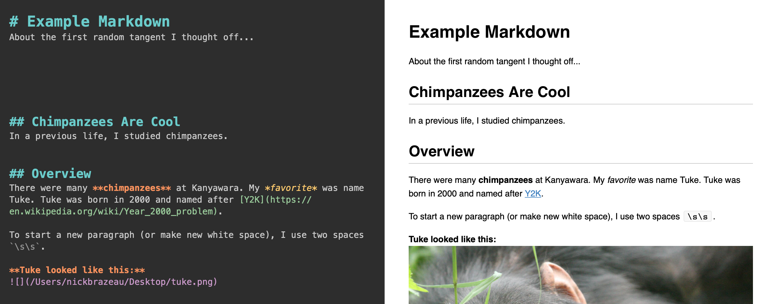
The R Markdown Body (i.e. outside of Code Chunks)

Slide 18
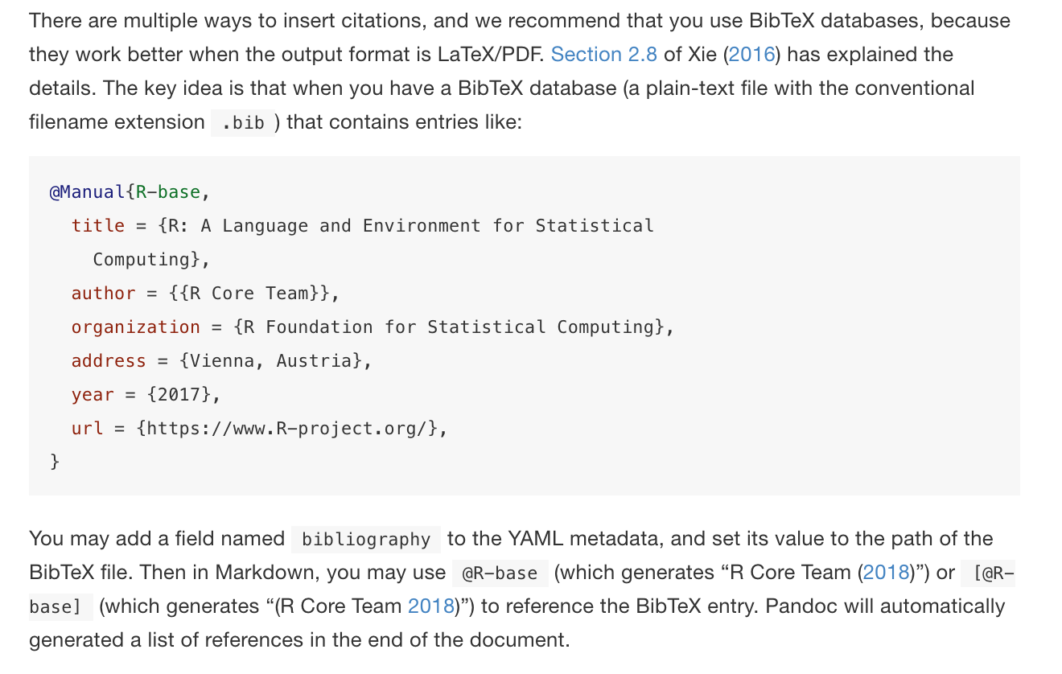
Advanced Markdown – Citations

Slide 19
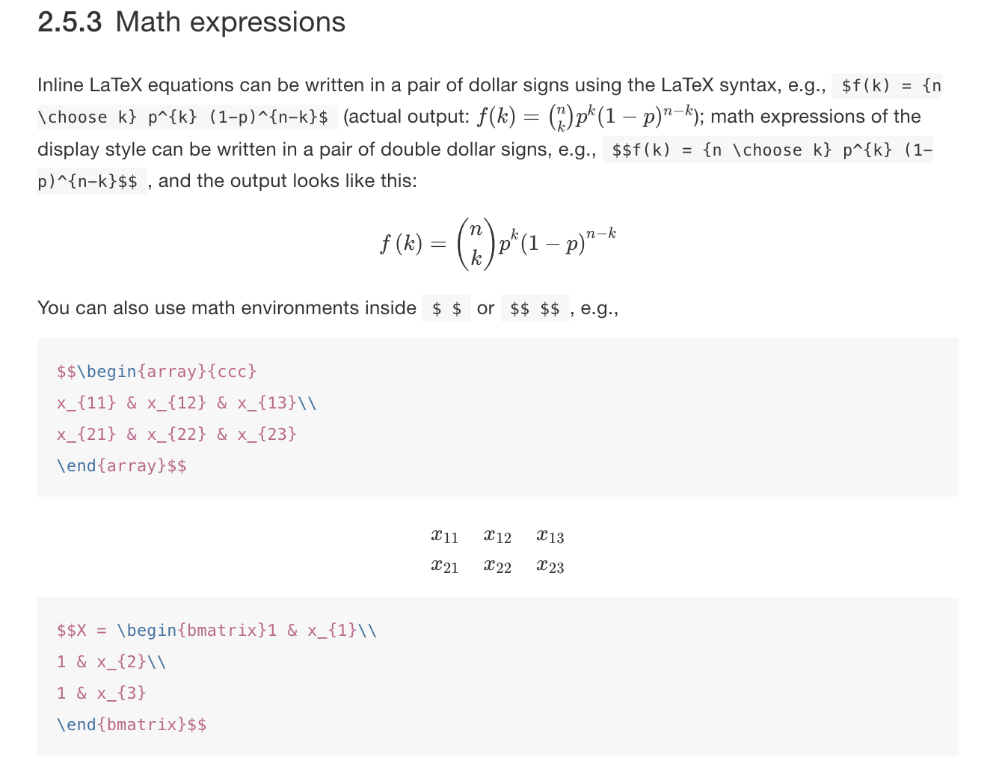
Advanced Markdown – Math

Slide 20
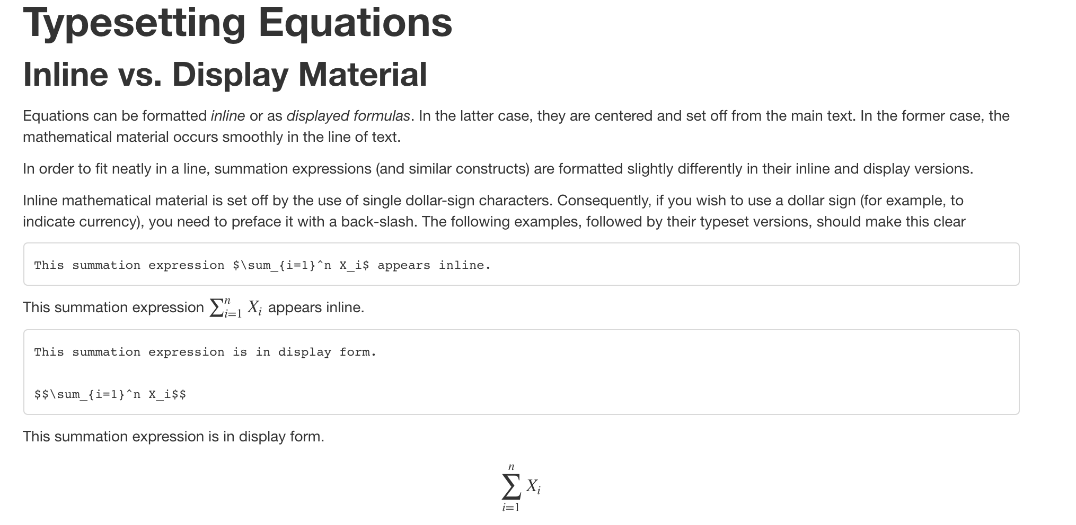
Advanced Markdown – Math
http://www.calvin.edu/~rpruim/courses/m343/F12/RStudio/LatexExamples.html
http://www.statpower.net/Content/310/R%20Stuff/SampleMarkdown.html
https://www.calvin.edu/~rpruim/courses/s341/S17/from-class/MathinRmd.html

Slide 21
The R Markdown Body (i.e. outside of Code Chunks)
Markdown Cheatsheets
https://www.rstudio.com/wp-content/uploads/2015/02/rmarkdown-cheatsheet.pdf
https://github.com/adam-p/markdown-here/wiki/Markdown-Cheatsheet
https://www.markdownguide.org/cheat-sheet/

Slide 22
Code Chunks
Code Chunks are essentially blocks of code that are interpreted by a specific ”engine”
Default is R (but many others available, see end)
You write a code chunk like this:
```{<engine>, <chunk options>}
my code
```
```{r, eval=T, echo=T}
paste(“hello world”)
```

Slide 23
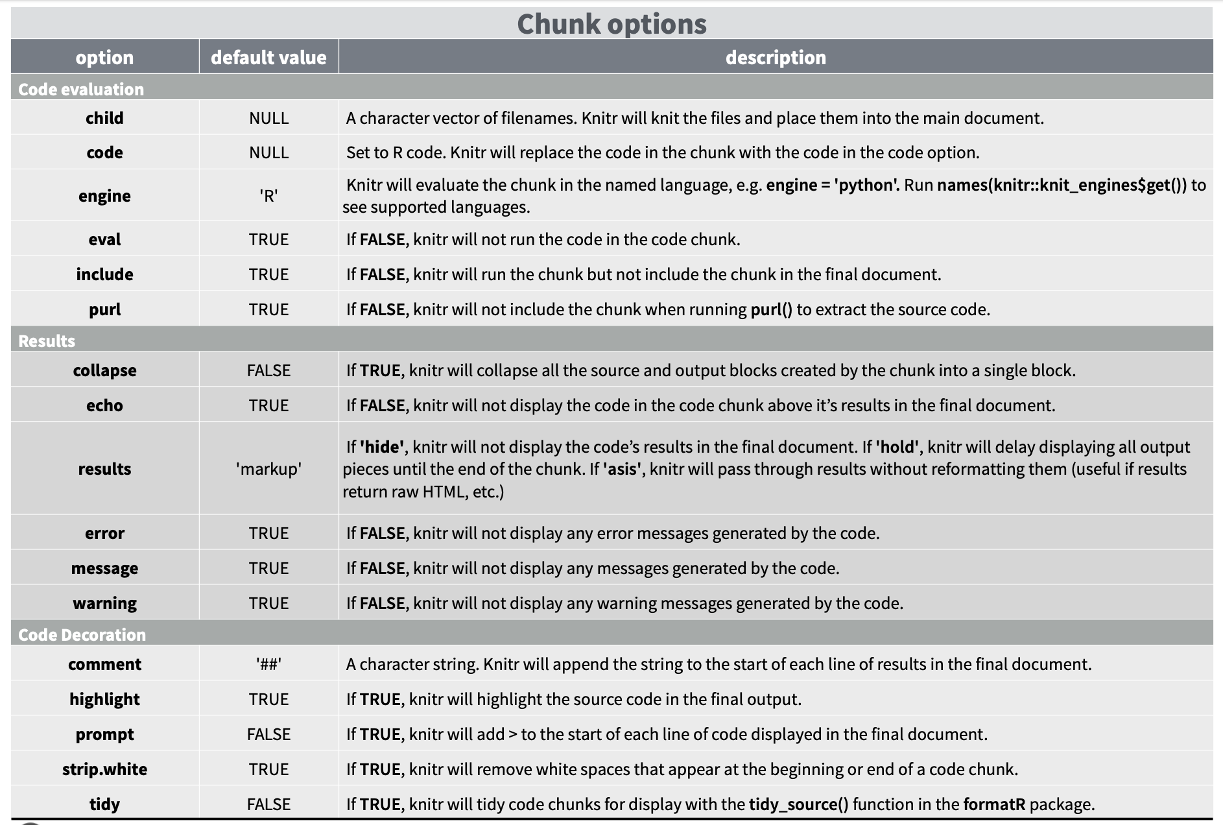
Code Chunk Options
https://www.rstudio.com/wp-content/uploads/2015/03/rmarkdown-reference.pdf

Slide 24
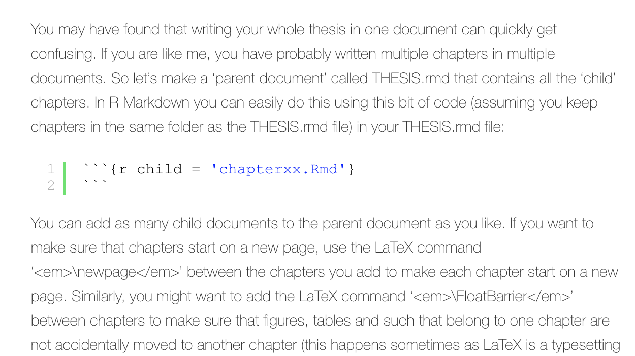
Advanced – Child Code Chunk
Renders R Markdown files “at that code chunk”
Similar concept to sourcing a file
But…now that file is an entire R Markdown file
https://rosannavanhespenresearch.wordpress.com/2016/03/29/writing-your-thesis-with-r-markdown-4-putting-the-thesis-together/

Slide 25
Explore Some Code Chunk Options

Slide 26
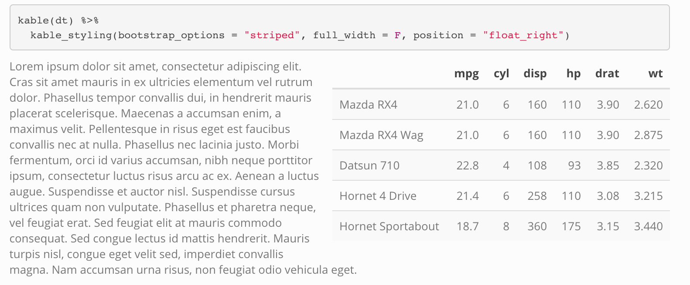
Check Out Option Outputs (and DT later)
knitr::kable
kableExtra::

Slide 27
A Note on Global Options for Code Chunk Options
Of note, warning=F, message=F, error=F is not great practice. Good to know if you have errors in your code… I often want to make “clean” reports don’t want to worry about R “talking to me” too much.
Better to load libraries ”quietly” if you don’t want them to talk and output in your R report (instead of turning messages off).

Slide 28
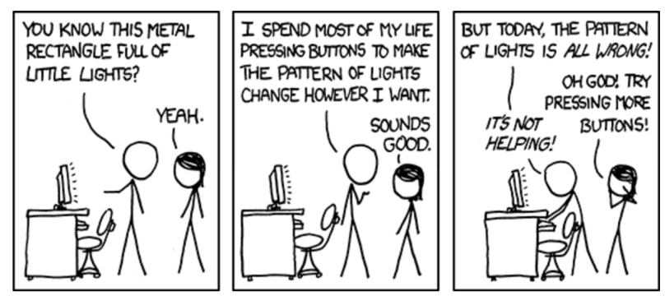
Checking In

Slide 29
Packages for Reports
DT
Broom
TableOne
Stargazer
plotly
DT and plotly cannot be rendered as Word Documents or as PDFs because they rely on html code (they are html widgets)
Pros – interactive
Cons – can only use html outputs…

Slide 30
DT
https://rstudio.github.io/DT/

Slide 31
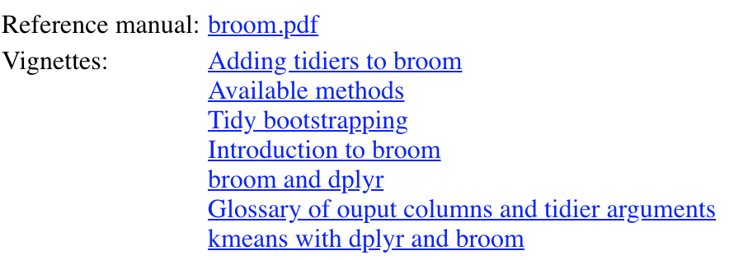
Broom
Insane number of features!
Several vignettes

Slide 32
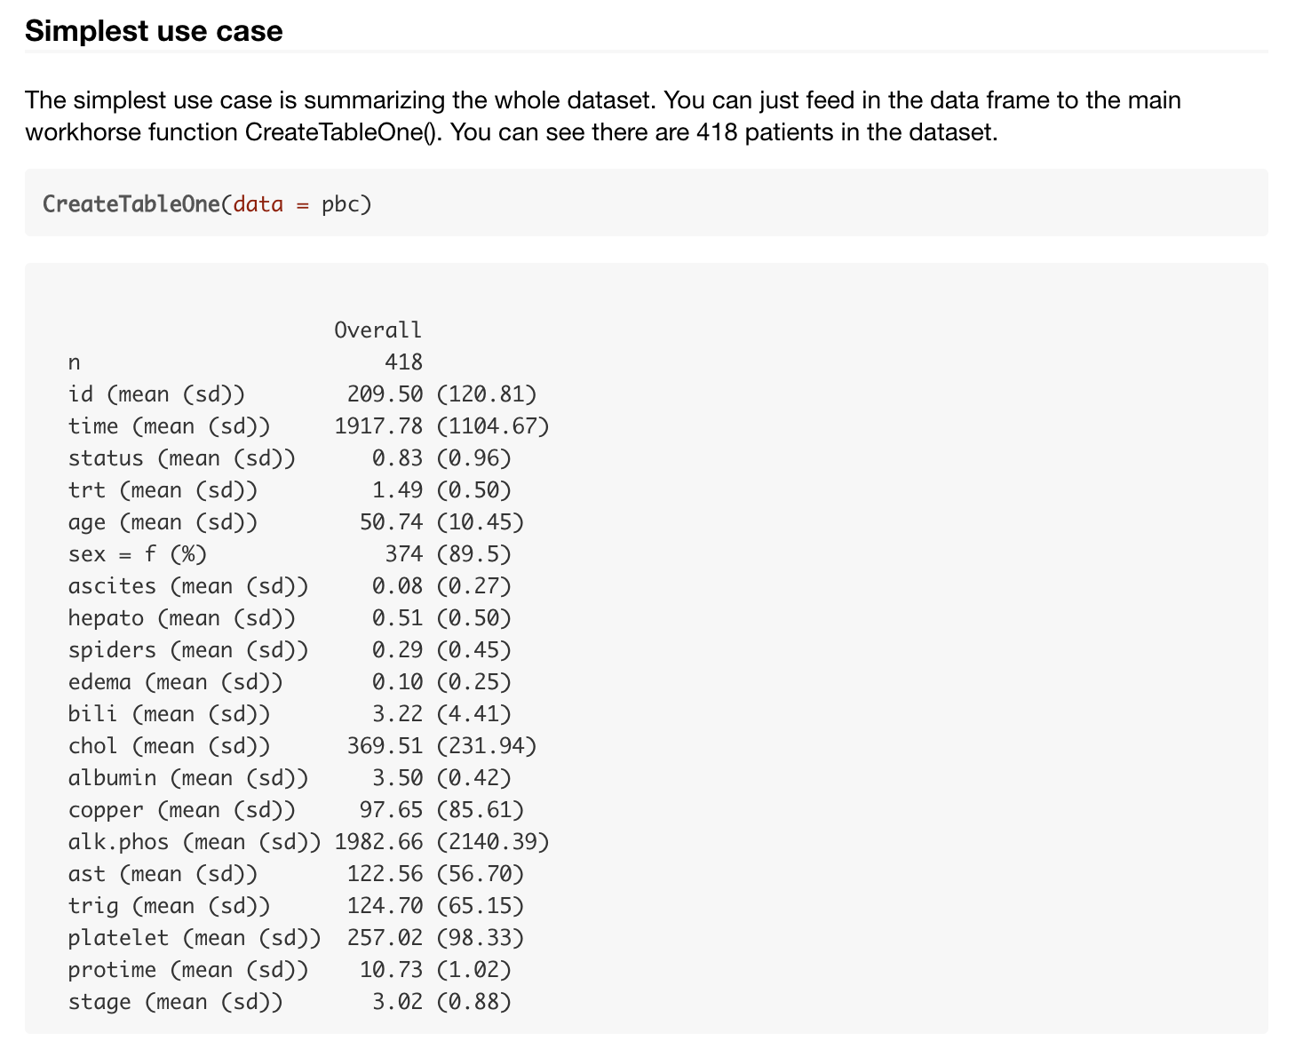
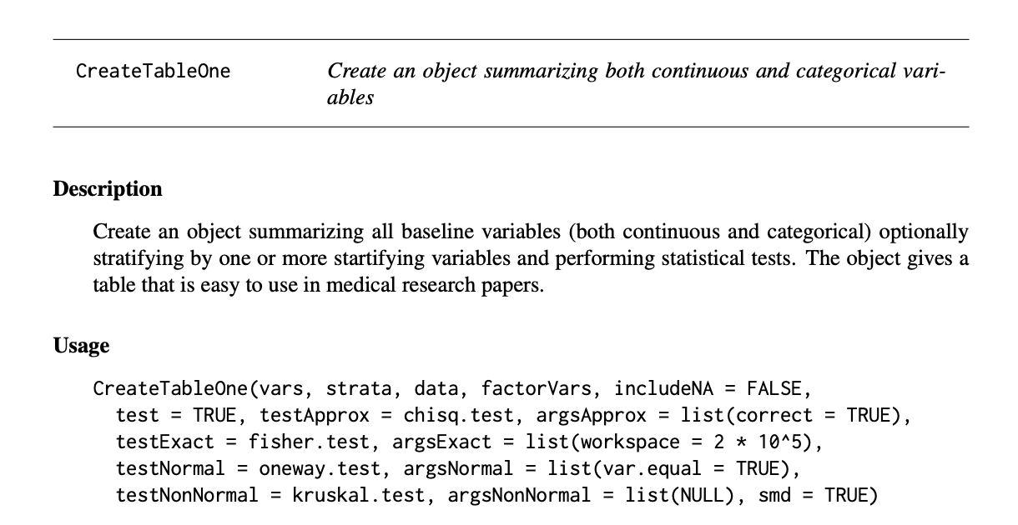
TableOne

Slide 33
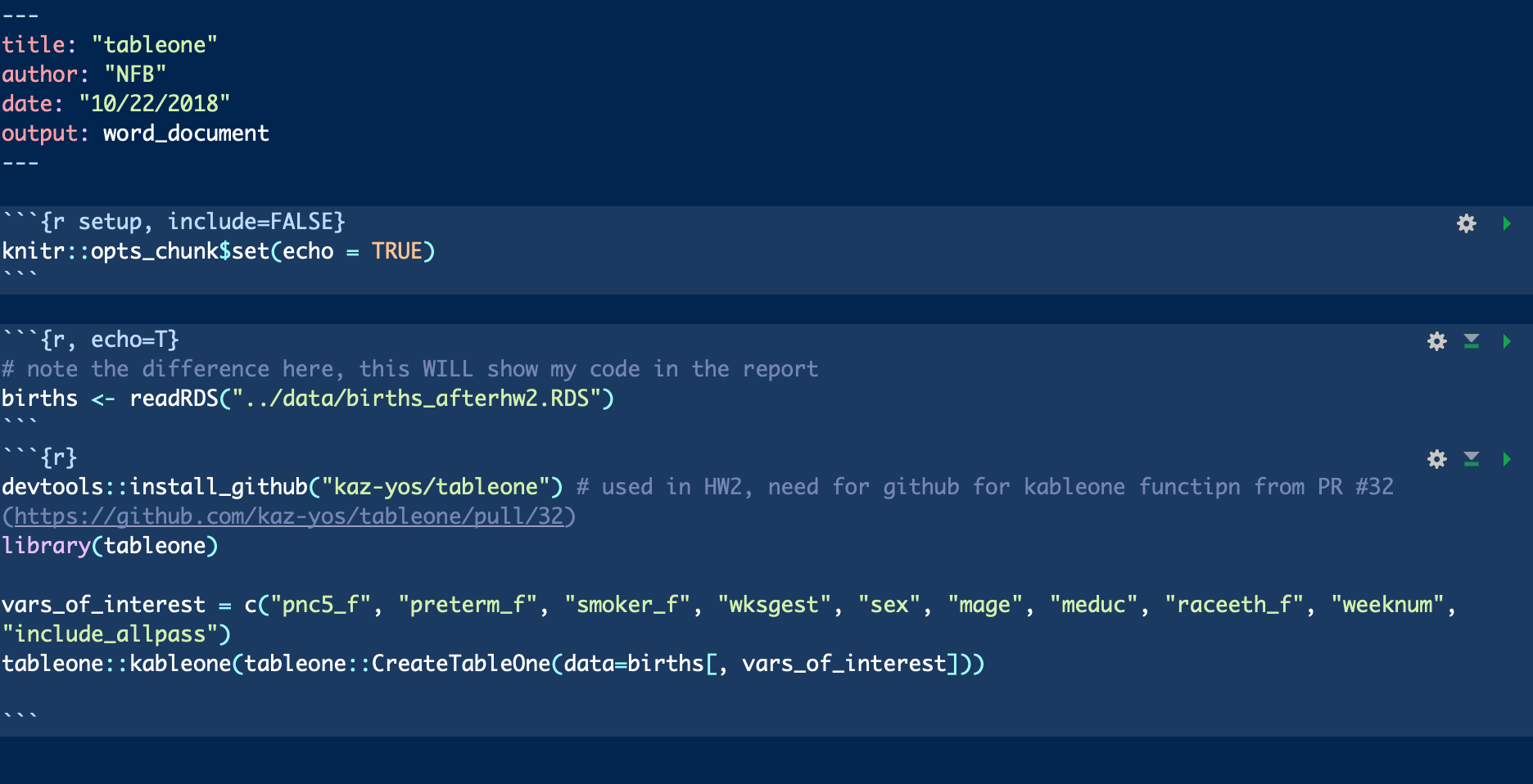
TableOne → To Word
Live Demo
Inspired by Mike!

Slide 34
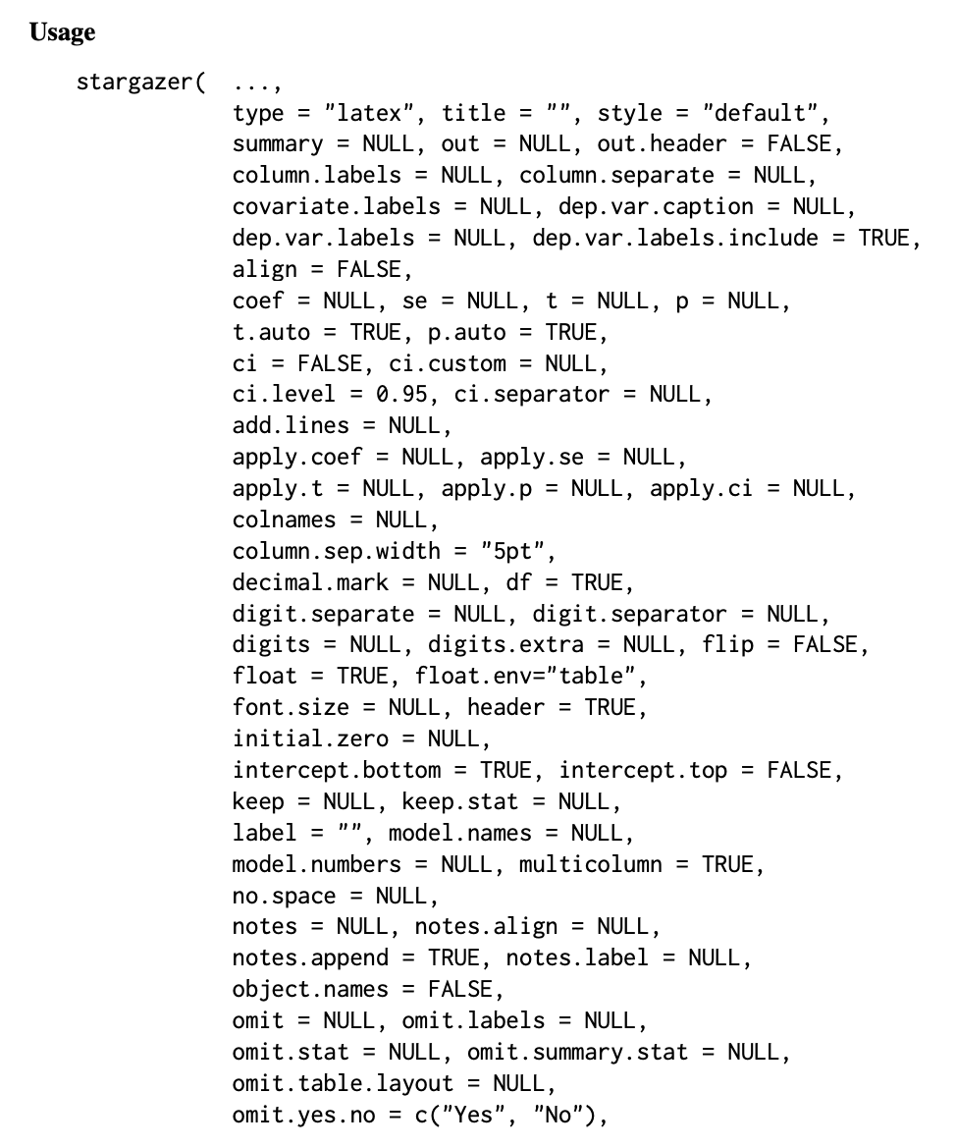
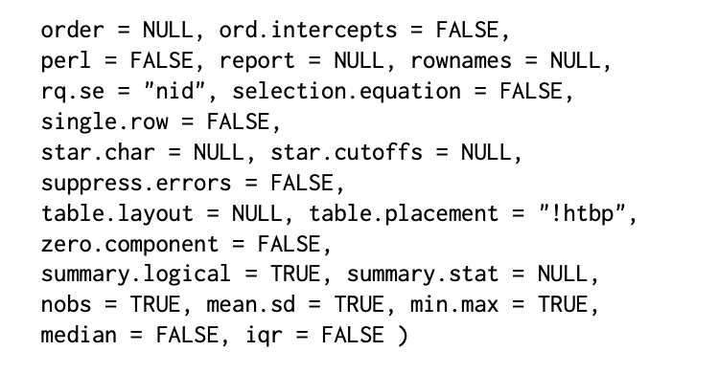
Stargazer
https://cran.r-project.org/web/packages/stargazer/stargazer.pdf

Slide 35
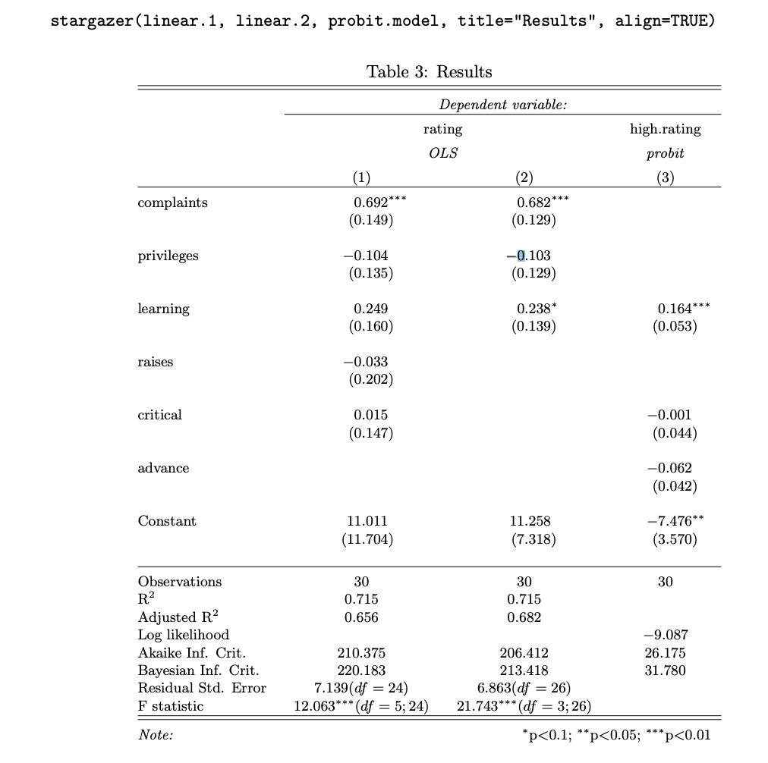
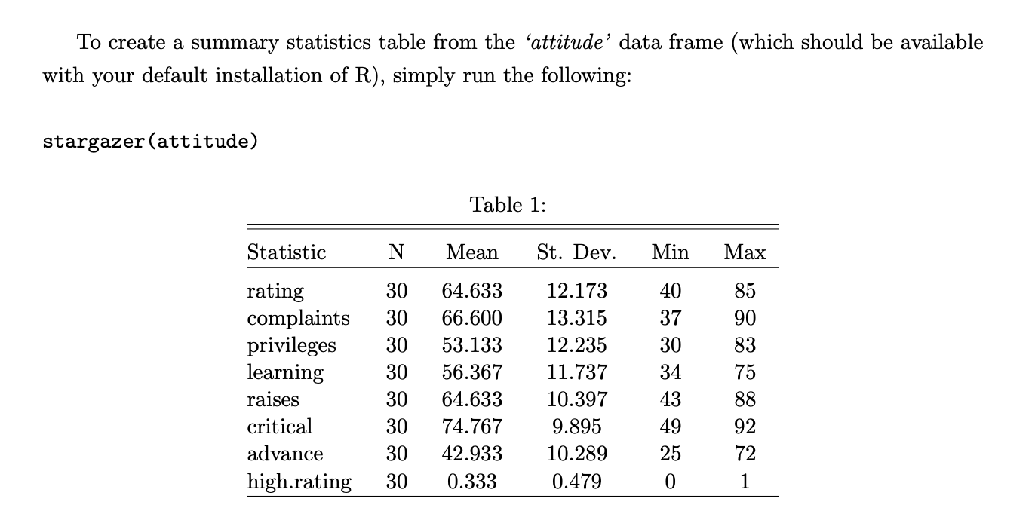
Stargazer Vignette Examples
https://cran.r-project.org/web/packages/stargazer/stargazer.pdf

Slide 36
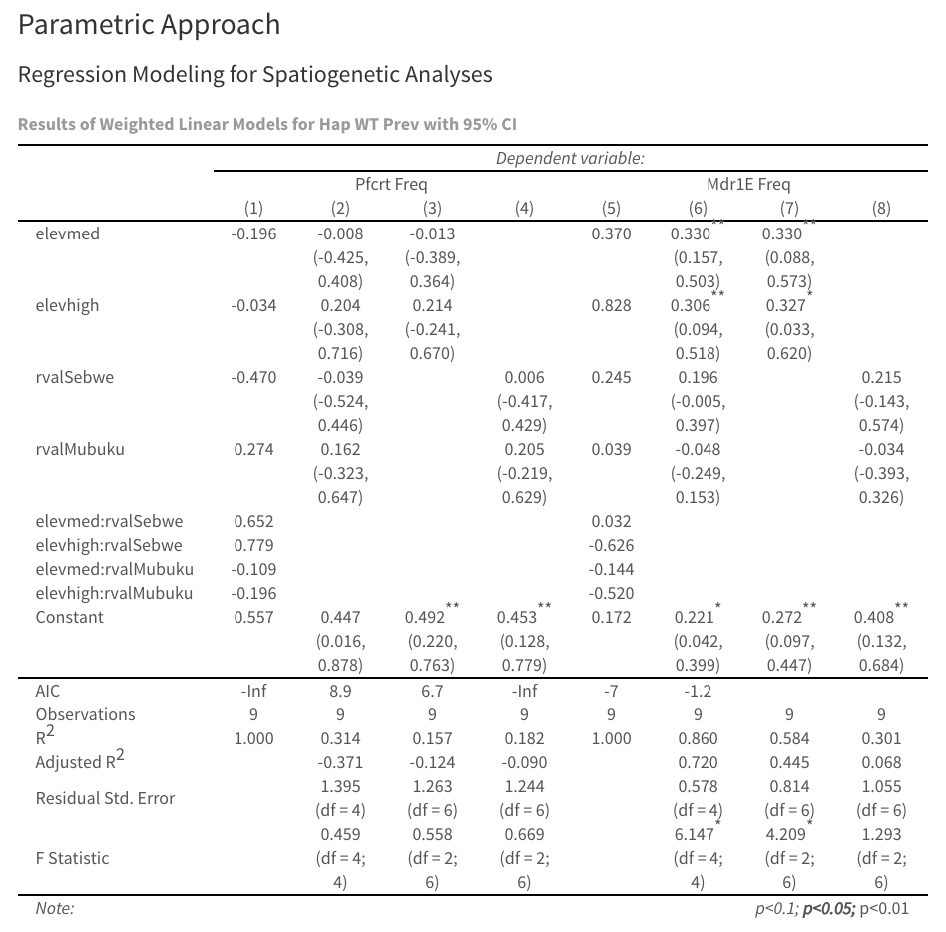
Stargazer

Slide 37
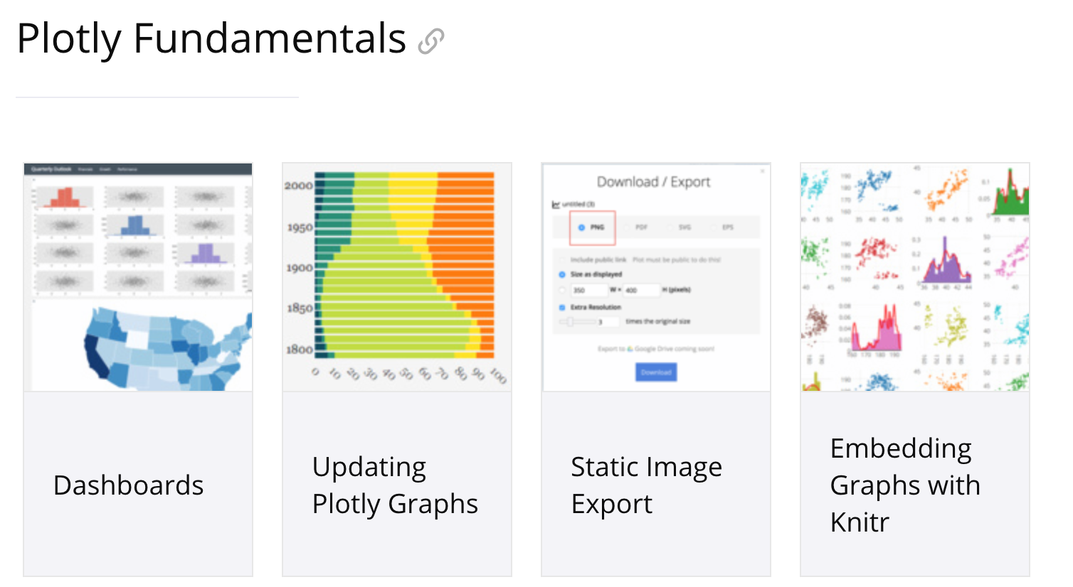
plotly
Interactive Plots!
I’m just scratching surface with plotly::ggplotly(<obj>)

Slide 38
Advanced: Using R Markdown for Other Engines
Can basically use R Markdown to run any program
Pros – completely reproducible
Cons – slow?
Live Demo

Slide 39
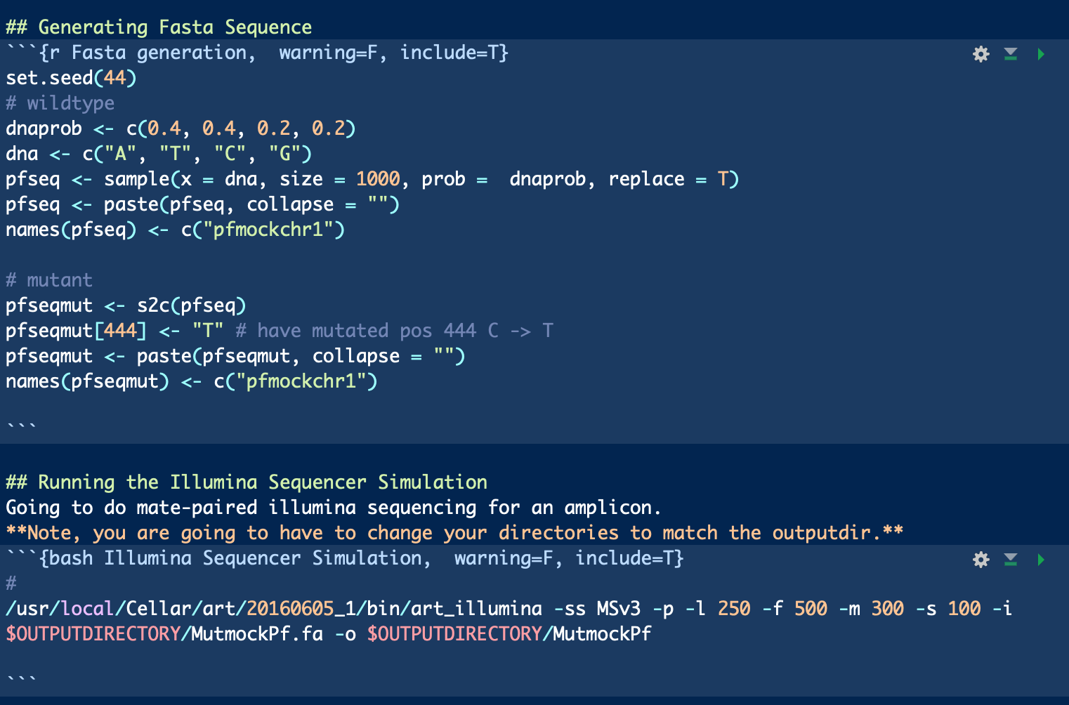
Advanced: Using R Markdown for Other Engines – Why?
Knitting a Pipeline Together
Using Several Different Tools but analyzing results in R
Many more!
Example here: Simulate DNA sequence in R. Then use NIH’s ART program to simulate NGS data

Slide 40
R Markdown Cheat Sheet
https://www.rstudio.com/resources/cheatsheets/#rmarkdown

Slide 41
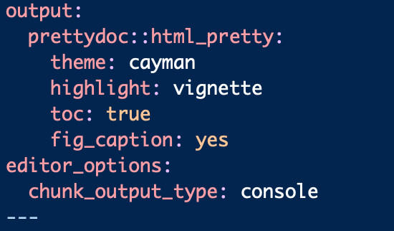
Advanced: prettydocs
R package for making pretty documents
http://yixuan.cos.name/prettydoc/

Slide 42
Advanced: Extensions of R Markdown
Blogdown
Bookdown
Websites
Dashboards
Notebooks
… So Many More!

Slide 43
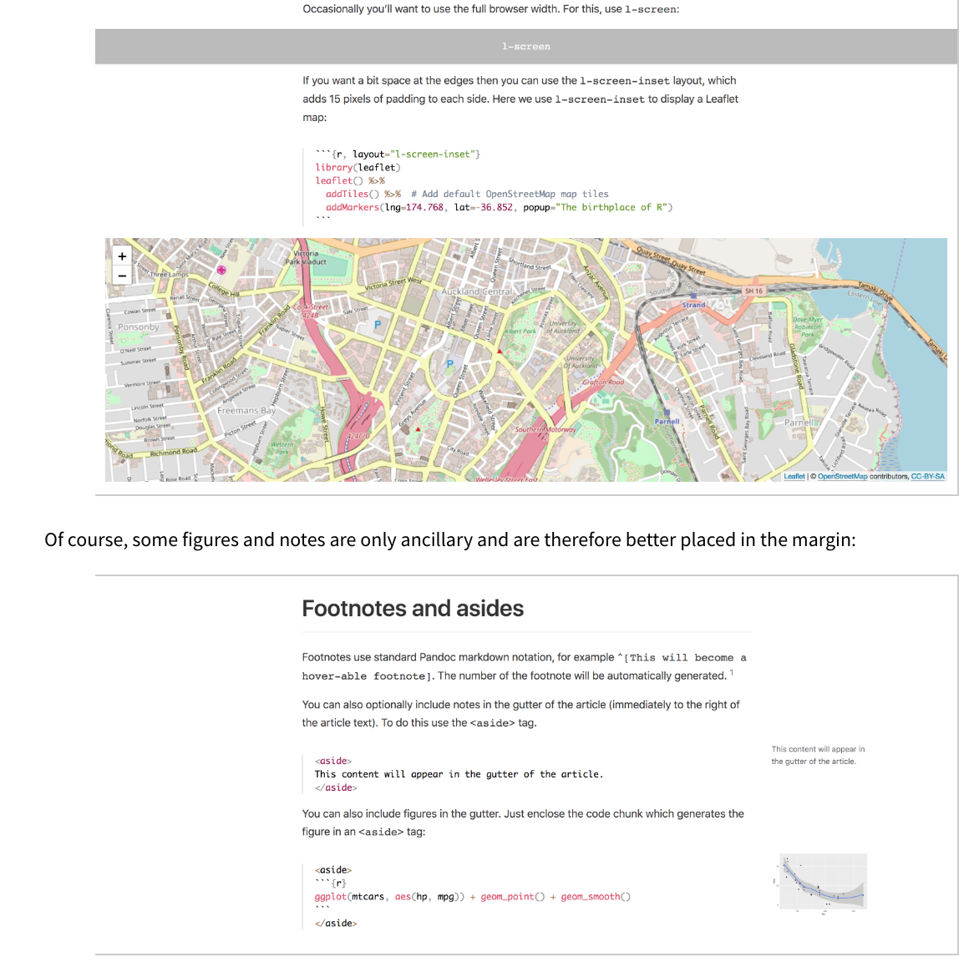
Advanced: New Kid on the Block
Radix
Looks amazing…
Ran out of time
https://blog.rstudio.com/2018/09/19/radix-for-r-markdown/

Slide 44
R Markdown Tips
Don’t do this!
Every time I wanted to make a formatting change, I had to wait 5 minutes.
With >1,000 of code and a ton of chunks, my names started to get weird…
Pv_cross_log2_subset _chrom1_transformed_....

Slide 45
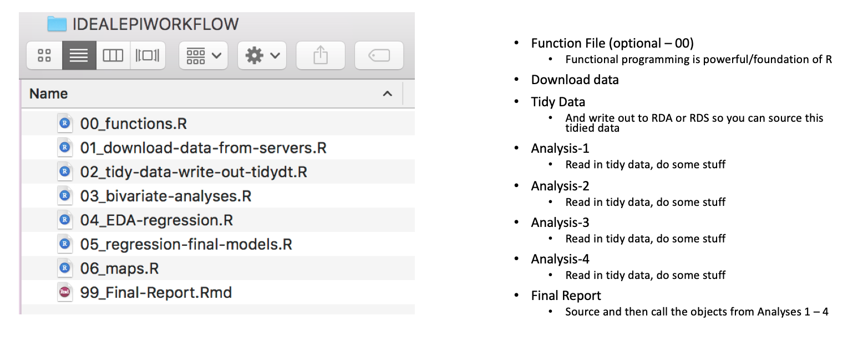
R Markdown Tips
Do this?

Slide 46
R Markdown Tips
Let someone else do the heavy lifting for themes (a ton of options)
If a picture is worth a thousand words, interactive plots are worth ten-thousand
Use markdown to explain your coding choices or thought process (you can tell a story…).
Knitting to PDF can be difficult. If you want to use a lot of LaTeX, consider Sweave.
Use R Markdown!

