Slide 1

EPID 701
R for Epidemiologists
Mike Dolan Fliss, PhD, Instructor
Hillary Topazian, M.Sc., TA
Spring 2020
Roseneau 235
T/Th 9:30-10:45am
After settling in,
Download these slides and the course data pack from…
learnr.web.unc.edu
Notes:
Welcome to the R class! Today I will talk about course logistics and give you some background on R. I’ll also demo how to install R and your homework for today will be to install R for next week. I’ll also have you fill out a short survey online so that I and the other teachers can get to know you and the level of R experience you are at.

Slide 2
Welcome & Overview
Course logistics
  Introductions
  Website: learnr.web.unc.edu
  Course roster (see website)
  Google group (see website)
  Syllabus review
All about R
  How is R different from SAS?
  How do I install R/Rstudio?
  Rstudio Tour
Homework
  Hopefully ready today, but if not: Install R and RStudio for next class!
  Handle logistics! Registration, get data, sign up sheet, google group, etc.

Slide 3

Neighbor Introductions
Turn to a neighbor you don’t know and introduce yourself!
Your Name
What program / year you’re in
Why you’re in the class / what you’re hoping to use R for

Slide 4
Class Introductions
Same thing but for everyone!
Your Name
What program / year you’re in
Why you’re in the class / what you’re hoping to use R for
Listen, but please fill out the ROSTER on the website at the same time.

Slide 5

What are you bringing?
Add your name at the top!
By your name, share what you’re bringing to the class. Experiences, background, other language experience, content area interest, specific focus / preferences, etc. Your background is your contribution.
When done, fill out the ROSTER (linked on the website)

Slide 6

Who is this course for?
Example Learning Personas
Li Na Newcomer is a 2nd year PhD student brand new to R, apart from her introduction in EPID 700. She’s not sure about her dissertation or project yet. She’s heard R is good for epidemiologists to know and is considering repeating her 718 SAS project in R. Public speaking isn’t her favorite, but she likes small group work. She has a heavy course load.
Magda Masters is a 2nd year Masters student drawn to improving their quantitative skills in a tool that is increasingly popular and will be free / usable in many practice situations. Magda has never used R before, is strong in Excel, and has some stats background. Magda has historically been intimidated by programming. They have a light course load.
Denise Defense is a 4th year PhD student, preparing their dissertation proposal / has just proposed. Has been using R for years, but looking for clean up and best practices of managing a larger project and improving their foundational understanding. Denise hopes to work on her dissertation as her project, and have finished classes.
Pablo Practitioner is a practicing epidemiologist at the county or state level. They work in a mostly SAS / STATA environment but have heard good things about R’s ability to save themselves time and expand their capacities. Pablo prefers small groups and is red/green color blind. They’re listening in* to lectures from afar.
Examples: https://rstudio-education.github.io/learner-personas/

Slide 7
What’s missing?
While I review course format, Anonymously add to google doc, for yourself or on behalf of others, questions about the learning personas / who this class is for.
For example:
Backgrounds that the previous learning personas don’t cover
Preferences, abilities, or priorities
Is this class for me IF….
Will we cover X?

Slide 8
Course Approach and Format
Course progression:
  Part one: Language basics & Base R foundations (less!)
  Part two: R packages & homework (more! Especially Tidyverse)
  Part three: special topics lectures & project work (suggestions welcome! Got one? → Parking lot.)
Course resources (everything is allowed):
  Internet searches, forums, books, other open courses
  Group work on exercises is encouraged but not required (don’t just copy…)
  Turn in broken/incomplete code you kind of understand (so we can help) instead of working code you don’t understand.
  R is open and collaborative! Practice that here!
Notes:
The course is designed for people who already know how to use a statistical programming language, likely SAS. Because of this, we will use a practical approach. We’ll use the method that all of use essentially rely on for learning new things about R ourselves: find and example of what we want to do, get it working, figure out how to make it do what we want, understand how it works, and finally apply it in other places. We want the course to be useful but not full of busywork. We’ll divide the course into two: a first part covering the core of R and a second part just covering special topics. There are R resources listed on the syllabus. Feel free to work with others, but don’t just copy the final working code and end there. One of the cool things about R is that it is an open, collaborative language!

Slide 9
Course Approach and Format
Course theory:
  Designed for those familiar with SAS statistical programming language.
  Using dataset and questions from EPID core curricula (births, disparities)
  Practical. See, try, modify, why, apply.
Course goals:
  Project: Direct relevance to your existing work.
  Minimal out-of-class responsibilities irrelevant to your work.
  Wind down assignments before the end-of-semester rush and push on final project.
Notes:
The course is designed for people who already know how to use a statistical programming language, likely SAS. Because of this, we will use a practical approach. We’ll use the method that all of use essentially rely on for learning new things about R ourselves: find and example of what we want to do, get it working, figure out how to make it do what we want, understand how it works, and finally apply it in other places. We want the course to be useful but not full of busywork. We’ll divide the course into two: a first part covering the core of R and a second part just covering special topics. There are R resources listed on the syllabus. Feel free to work with others, but don’t just copy the final working code and end there. One of the cool things about R is that it is an open, collaborative language!

Slide 10


Feedback welcome!
No, really.

Slide 11




Student Responsibilities and Expectations:
During Class
  Code during follow-alongs with worked examples, activities, interactive exercises in R. Will happen most classes! Come ready to code with us.
  Respond to interactive, quick questions during class. Quick pre-quizzes (already know this?) and quick post-exercises.
  Participate in small groups during class. Group work is always allowed, just cite it. Find folks with similar schedules!
  Ask if a question is timely. A parking lot for questions that can wait or you’d rather be anonymous. Hand wiggle / sign if you’re getting lost.
Notes:
Pretty self-explanatory here. Unfortunately a bit wordy.

Slide 12
Student Responsibilities and Expectations
Homework & Project
Homework
  Five assignments during middle half of class
  Generally lags the class material. Will post 1-2 weeks in advance.
  Follows a single dataset (NC Births) through steps of a public health analysis
  We’ll work on in class, & handhold through hardest parts (e.g. apply/purrr)
Project
  Last 1/3 of the class (but start thinking about now, or midway through)
  Dataset / question of your choice, ideally something useful for you
  Share a few slides with the class to show off your work at the end
Notes:
Pretty self-explanatory here. Unfortunately a bit wordy.

Slide 13
Student Responsibilities and Expectations
Outside Learning
Outside Learning – required for language immersion!
  Outside Reading: Lots of good, free books (or pay to get paper copies). R for Data Science is a great introduction, and Advanced R is excellent for serious under-the-hood and “why does that work” stuff. Recommendations on website.
  Subscribe to key blogs, the Rstudio blog or the GitHub repositories of your favorite packages. Constant improvements & time savers!
  Like learning a new language try to “speak” it = code something most days to keep the learning going. R is a different modality than you might be used to (functional programming, etc.).
Notes:
Pretty self-explanatory here. Unfortunately a bit wordy.

Slide 14
What’s missing?
While I review course format, Anonymously add to google doc, for yourself or others, questions about the learning personas.
For example:
Backgrounds that the previous learning personas don’t cover
Preferences, abilities, or priorities
Is this class for me IF….
Will we cover X?
Notes:
Please fill out the sign-in sheet so we can get a head count and figure out how to handle auditors. I’ll start, then go to Hillary!

Slide 15
Let’s Talk R!
Open source programming language and software environment for statistical computing and graphics
Created by Ross Ihaka and Robert Gentleman (University of Auckland, New Zealand)
Currently supported by the R Foundation for Statistical Computing (Vienna, Austria)
More info on the history of R at https://www.R-project.org/

Slide 16
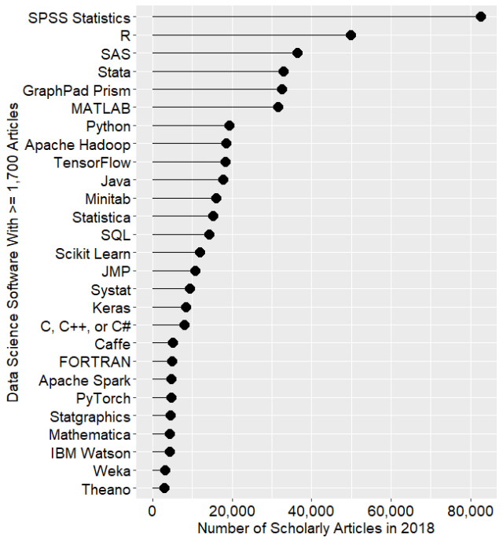
R Popularity
Scholarly Articles
From “The Popularity of Data Science Software”
By Robert A. Muenchen
http://r4stats.com/articles/popularity/

Slide 17
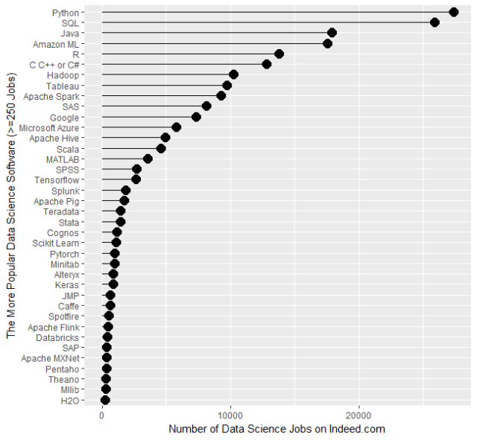
R Popularity
Data Science Jobs
From “The Popularity of Data Science Software”
By Robert A. Muenchen
http://r4stats.com/articles/popularity/

Slide 18
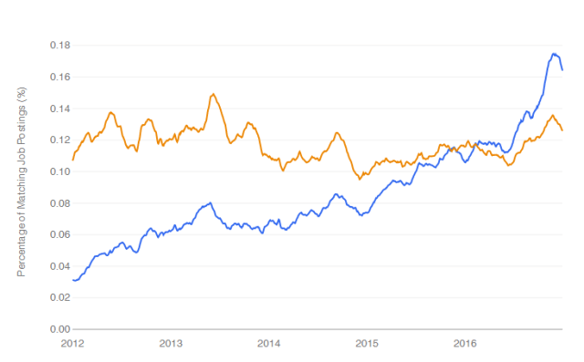
R Popularity
Data Science Jobs
From “The Popularity of Data Science Software”
By Robert A. Muenchen
http://r4stats.com/articles/popularity/
R jobs surpassed SAS jobs in 2016

Slide 19
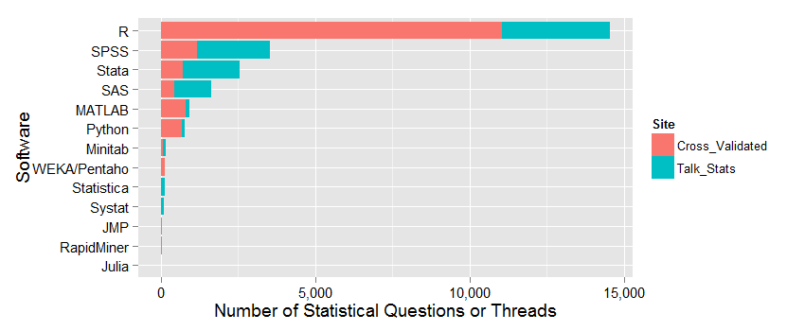
R Popularity
Thriving Community

Slide 20
Important features:
Free: costs nothing, runs anywhere, modify anything you want
Popular: across disciplines, increasing prominence in epidemiology •
Powerful: do more with less (time, code, heartache)
Efficient: good for big datasets, simulations, demanding calculations
Flexible: do many things, in many different ways (error-checking)
Transparent: you can look at how anything works, code sharing, etc.
Community: package development, helpful people, fast bug iteration
Higher level thinking: Avoid SAS “card” thinking. Abstraction and grammars
And why RStudio?
Short answer: super helpful
It also looks similar to the SAS interface you’re probably used to
Notes:
R is pretty great and beloved by all. Mike will talk about why Rstudio is awesome during the next session, but the short answer is that it is super helpful. You’re also probably familiar with the layout from SAS.

Slide 21
Challenges
Free: no one to sue! no centralized or official tech support.
Popular: not entrenched! Resistance to change.
Powerful: can require some different thinking. Obfuscated code.
Efficient: thinking and coding efficiently takes work (disk v RAM?)
Flexible: you can write rickety / Rube Goldberg code. Try not to.
Transparent: sometimes you have to get into the guts. Can be gross.
Community: Conflicts – between people, packages, syntax.
Higher level, abstracted thinking: is hard!
All that… and still VERY much worth it!
Let’s be honest! http://r4stats.com/articles/why-r-is-hard-to-learn/

Slide 22


vs.
No division of your code into PROC/DATA parts
No separate macro language; variables, functions do this better
“Modern” computer science language: functions, objects, abstraction
SAS output is just output. R output is an object, so can be input, too.
Graphical data exploration is easier in R, but takes learning

Slide 23
DATA births;
SET epid.births;
IF weeks >= 37 THEN preterm = 0;
ELSE IF 20<=weeks<=36 THEN preterm = 1;
RUN;
births$preterm <- ifelse(births$weeks<37, 1, 0)
# …OR many other ways! See tidyverse
births = births %>%
mutate(preterm = if_else(weeks < 37, 1, 0))

Slide 24
What have you heard?
What else have you heard about R? The good and the bad.
Notes:
Please fill out the sign-in sheet so we can get a head count and figure out how to handle auditors. I’ll start, then go to Hillary!

Slide 25
Next Up: RStudio Tour!
Install/Update R and RStudio: Hopefully you’ve done this, but if not: a help guide is available on the course website.
We will be available during office hours (for starters: right after class) if you are having trouble with this.
Make sure R & RStudio work before you come to next class! We code together every class.
If you’re not there yet, get a buddy to watch them do this next RStudio tour!
Notes:
Demo how to install R and RStudio on the classroom computer. Run a few lines of code.

Slide 26

Let’s take a break!

Slide 27

RStudio IDE :
A Guided Tour!
Scripts, execution, comments, navigation, style

Slide 28
Check In!
Do you feel comfortable doing each of these things in RStudio?
Anonymously share (Yes/No/Somewhat/Not #3/etc.)
Opening & saving a script file
Structuring a script
Changing your theme
Installing / loading a package
Navigating / coding fast
in RStudio
Notes:
Please fill out the sign-in sheet so we can get a head count and figure out how to handle auditors. I’ll start, then go to Hillary!

Slide 29
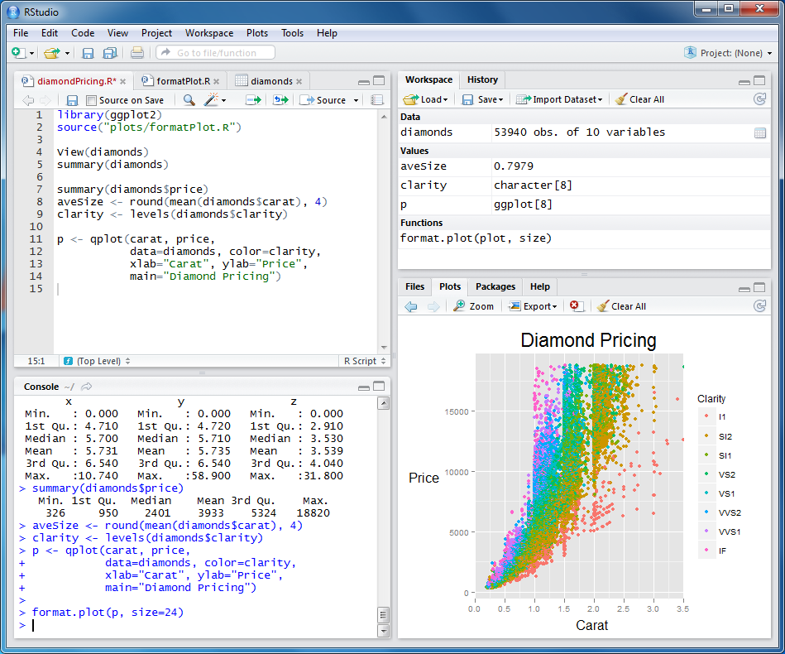
RStudio…

Slide 30
RStudio…
…is an IDE!
(an “Integrated Development Environment”)
A good IDE “… allows you to work at full speed.”
Is separate from R – watch (or subscribe) for upgrades & read release notes
References to check out later (also on website):
  https://www.rstudio.com/resources/webinars/rstudio-essentials-webinar-series-part-1/
  https://www.rstudio.com/online-learning/#R
http://programmers.stackexchange.com/questions/102018/what-features-of-an-ide-would-make-it-more-useful-than-a-general-purpose-editor
https://channel9.msdn.com/Forums/Coffeehouse/106446-What-makes-a-good-IDE

Slide 31
RStudio Panes
Environment
/ History
Script Editor
Files, Plots,
Packages, Help
Console
Notes:
Panes can be maximized, minimized, or put in separate windows in many cases.

Slide 32
Our first script: the absolute minimum
Open and save R scripts with icons at top left of Editor
No command terminator (farewell, semicolon! Can use if you want.)
Use # for comments
Use <- or = as assignment operator (reads as “gets”)
Example:
x <- rnorm(100, mean=1.2, sd=3) # 100 from normal dist
summary(x) # get summary stats
plot(x) # plot these 100 values

Slide 33
Let’s Code: RStudio
IDE Layout
  Panes: use, navigation
  Help→cheatsheets→Rstudio
Global Options
  Themes, environment
Running code
  Console, script, blocks, comments, inline, (e.g. load() ).
Comments
  #, post-#, code blocks, comment blocks, links, code outline
Key keyboard shortcuts
  https://support.rstudio.com/hc/en-us/articles/200711853-Keyboard-Shortcuts
  Alt-Shift-K
  Favs: control, panes, autocomplete, comments, running code, F1… so many.
Style
  R: http://adv-r.had.co.nz/Style.html
  Google: https://google.github.io/styleguide/Rguide.xml

Slide 34
You try!
Open R and…
Create a new script window
Save your script as “Births Analysis.R” or something similar
Set up a comment header with info like your name
Set up a comment block or two: something like “Reading Files & Loading Libraries”
(For now) load() the data using the Rdata file and run a test expression or two on it.
You’ve just got your first points on Homework 1!
Head to the google doc and type “Done” next to your name when done!
Notes:
Please fill out the sign-in sheet so we can get a head count and figure out how to handle auditors. I’ll start, then go to Hillary!

Slide 35
Answers – Something like below….
#............................
# Births 2012 Analysis for EPID 799C
# Mike Dolan Fliss, Jan 2020
#............................
# Notes go here.
#............................
# Libraries and working directories ####
#............................
birth_file = "D:/User/Dropbox (Personal)/Education/Classes/18Fall_EPID799C_RforEpi/data/R for epi 2018 data pack/births_sm.rdata” # Could use setwd() too.
#............................
# ............................
# Read 2012 birth data ####
# ............................
load(birth_file) # <- our first function
#..................................................

Slide 36

Questions?
Notes:
Expect to at least respond to size of class issues.

