Slide 1
Suggestions for Class Arrival
Open the notes doc for today and add your name
Open lecture-specific scratchpad R script to “take notes”
Open your HW1 script.
Suggestion: Start a HW2 Script!

Slide 2
EPID 701 Spring 2020 R for Epidemiologists
R Recoding II:
Finishing recoding & inclusion criteria
2020.01.30 – L7 – Mike
learnr.web.unc.edu
Notes:
Welcome to the R class! Today I will talk about course logistics and give you some background on R. I’ll also demo how to install R and your homework for today will be to install R for next week. I’ll also have you fill out a short survey online so that I and the other teachers can get to know you and the level of R experience you are at.

Slide 3
From Keynote Address
" RStudio has changed its corporate structure to become a certified “Delaware Benefit Corporation,” a move that legally allows it to consider the needs of the R community when making decisions instead of focusing solely on what’s financially best for its stockholders.
“Our directors and officers now have a fiduciary duty to pursue public benefits along with balancing the needs of all our stakeholders,” not just its corporate owners, founder and CEO J.J. Allaire said in his keynote speech at RStudio Conference this morning in San Francisco.
Those benefits include the creation of free open source software for data work, and helping people spread knowledge “regardless of economic means,” Allaire said.

Slide 4
Finishing recoding & inclusion criteria
Finishing Recoding
Birth date
Race & ethnicity factor w/ case_when()
Inclusion Criteria
Original & recoded variables
Congenital anomalies w apply & purr::map_*
Notes:
Suggest: get two scripts open. Class scratchpad, and HW1. Load births into the scratchpad at the top.

Slide 5
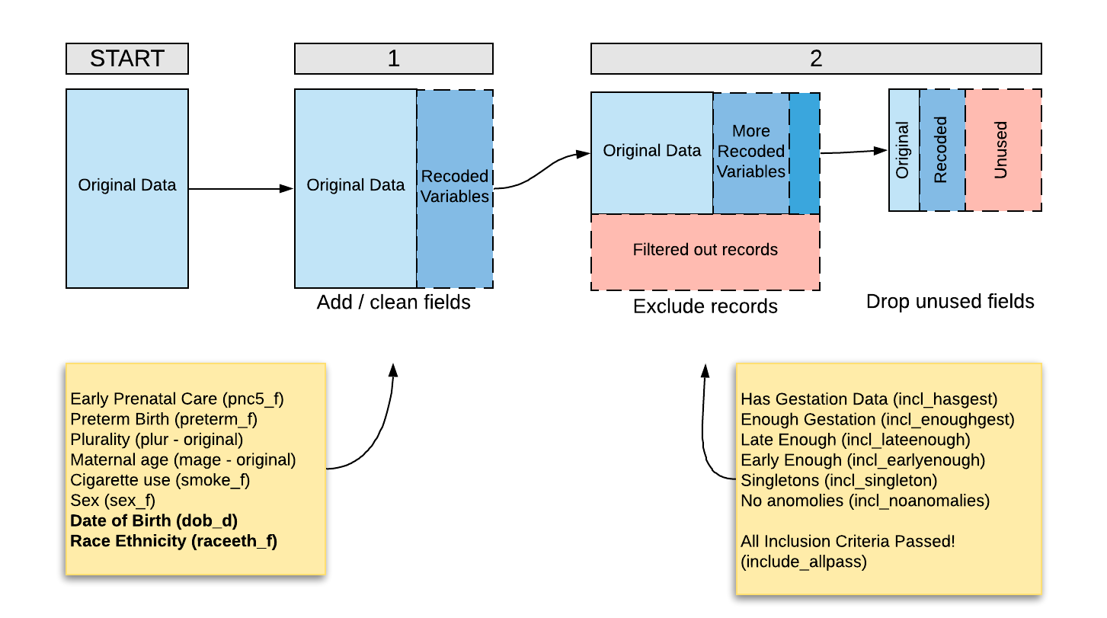
Big Picture

Slide 6
Big Picture

Slide 7
Finish Recoding
Dates, Race-Ethnicity

Slide 8
Two Tasks
Date-ify the Date of Birth variable dob_d and calculate week of year variable weeknum
Combine Race & Ethnicity into raceeth_f variable
Notes:
Here’s where the power comes in.

Slide 9
Dates
Date work?
Lubridate!
Notes:
Suggest: get two scripts open. Class scratchpad, and HW1. Load births into the scratchpad at the top.

Slide 10
dob_d, weeknum
births$dob_d <- lubridate::ymd(births$dob)
# Note read_csv() will try to help!
# Also: know when to lubridate:: ?
births$weeknum = births$dob_d %>% week
# Done! Thanks, lubridate!
Post-Check
What's the mean birth date and mean week number?

Slide 11
Race / Ethnicity
Pause for a meaning check
Coding the factor
Notes:
Suggest: get two scripts open. Class scratchpad, and HW1. Load births into the scratchpad at the top.

Slide 12
Where we're (crudely) going:
mrace methnic raceeth_f
1 1 Y White Hispanic
2 1 N White non-Hispanic
3 1 U Other
4 2 Y African American
5 2 N African American
6 2 U African American
7 3 Y American Indian or Alaska Native
8 3 N American Indian or Alaska Native
9 3 U American Indian or Alaska Native
10 4 Y Other
11 4 N Other
12 4 U Other

Slide 13
(At least a little) Critical Thinking
Social construct.
Constructed, often, to intentionally exclude.
Consequences for coding
Size dynamics, literal (genocide) & statistical erasure & suppression
Groups that no one identifies with (gender example), etc.
Proxy for measure of structural Racism
Treatment by others? Passing dynamics.
Language & framing is problematic… but conventional
Not everyone "Hispanic" has ever spoken Spanish, etc. Latinx…
"Who is Hispanic? Anyone who says they are. And nobody who says they aren’t. " (Pew: Lopez et al., 2019)
Except… traffic stop examples.
And what about this birth dataset? See documentation for oddities.
To the extent possible, you may and, if you wish, are encouraged to code race-ethnicity differently! Trying to get more detailed data, will report out.

Slide 14
Race-Ethnicity v1 Line by line
Good places to start, but… eventually, avoid this!
Eeek!
# Subsettting only
births$raceeth_f = NA # Create a new variable. Doesn't have to be NA ("Other?")
# Start replacing parts of it
births$raceeth_f[births$mrace == 1 & births$methnic == "N"] = "White non-Hispanic"
# etc. So much etc.

Slide 15
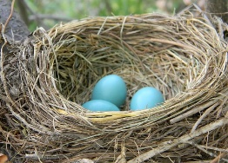
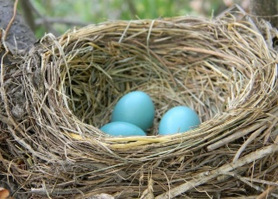
Race-Ethnicity v2: Nested if_else()
So many nests!!
If you're doing more than 1 extra nestin if_else() , it's time to try something else

Slide 16
Race-Ethnicity v3 case_when
# dplyr knows we're in births, otherwise need births$ every time
births$raceeth_f = case_when(
births$mrace == 1 & births$methnic == "N" ~ "White non-Hispanic",
births$mrace == 1 & births$methnic == "Y" ~ "White Hispanic",
births$mrace == 1 & births$methnic == "U" ~ "Other",
births$mrace == 2 ~ "African American",
births$mrace == 3 ~ "American Indian or Alaska Native",
births$mrace == 4 ~ "Other", # if TRUE ~ "Other", NA->Other
TRUE ~ NA_character_
) %>% as_factor()
# If the first formula isn't applicable, keep moving down.
# Order matters, but no nesting!

Slide 17
Race-Ethnicity v3 case_when
# dplyr pipe to mutate knows we're in births (next week)
births = births %>%
mutate(raceeth_f = case_when(
mrace == 1 & methnic == "N" ~ "White non-Hispanic",
mrace == 1 & methnic == "Y" ~ "White Hispanic",
mrace == 1 & methnic == "U" ~ "Other",
mrace == 2 ~ "African American",
mrace == 3 ~ "American Indian or Alaska Native",
mrace == 4 ~ "Other", # if TRUE ~ "Other", NA->Other
TRUE ~ NA_character_
) %>% as_factor()
)
# How I'd probably code this… if I wasn't using a table.

Slide 18
Race-Ethnicity v4 Join!
Best practice is minimal constants in code!
mergedf <- data.frame(
mrace = c(sort(rep(seq(1,4),3))),
methnic = as.character(rep(c("Y", "N", "U"), 4)),
raceeth_f =factor(c("White Hispanic", "White non-Hispanic", "Other",
rep("African American", 3),
rep("American Indian or Alaska Native", 3),
rep("Other", 3)
)
)
) # or just read_csv()! See the format helper table in data pack
births <- merge(x=births, y=mergedf,
by=c("mrace", "methnic")) # or dplyr::left_join

Slide 19
Inclusion
Filtering with recoded variables and purrr

Slide 20
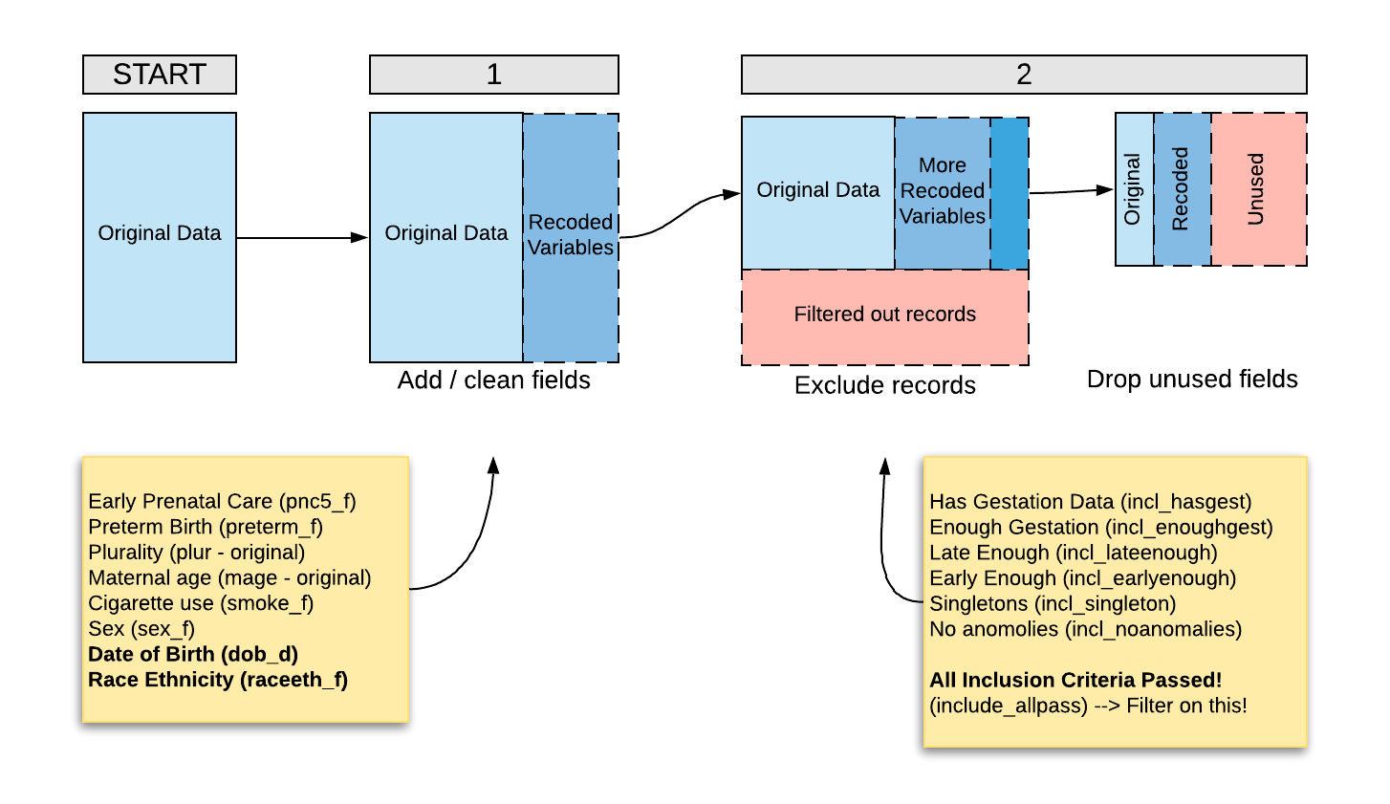
Big Picture

Slide 21
Big Picture

Slide 22
Some Relevant Variables*
Exposure/Outcome
pnc5_f: Mo. Prenatal Care Began
preterm_f: Preterm birth
Covariates
mage: Maternal age
smoke_f: Cigarrette Smoking During Pregnancy
sex_f: Child's birth sex
raceeth_f: Maternal Race/Ethnicity
cores: Residence of Mother -- County
Selection Criteria
plur: Plurality of birth (twins, triplets, etc.)
wksgest: Calculated Estimate of Gestation (weeknum)
dob_d: Date of birth of baby
Congenital Anomalies: multiple variables with congenital anomaly status (future: purrr/apply)
*After Recoding

Slide 23
Back to purrr::map*
A way to do many things at once…
…without explicit iteration and "bookkeeping"
Notes:
Here’s where the power comes in.

Slide 24
Two Specific Tasks
Look at all the congenital anomaly variables at once to create incl_noanomolies.
Look at all the inclusion variables at once to create incl_allpass so we can filter on it.
Notes:
Here’s where the power comes in.

Slide 25
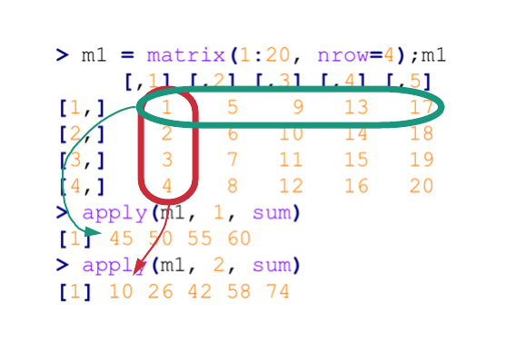
*apply() functions from Base R
apply() is a R function which enables to make quick operations on matrix, vector or array (or a data.frame coerced into one!). The operations can be done on the rows (MARGIN=1) or columns (MARGIN=2) [or more…].
> m1 = matrix(1:20, nrow=4);m1
[,1] [,2] [,3] [,4] [,5]
[1,] 1 5 9 13 17
[2,] 2 6 10 14 18
[3,] 3 7 11 15 19
[4,] 4 8 12 16 20
> apply(m1, MARGIN = 1, sum)
[1] 45 50 55 60
> apply(m1, MARGIN = 2, sum)
[1] 10 26 42 58 74

Slide 26
Congenital Anomalies (apply)
congen_anom = c("anen","mnsb","cchd", "cdh", "omph","gast", "limb", "cl","cp","dowt","cdit", "hypo") #(HW2)
births[,congen_anom] %>% head # Following so far?
test_df = tibble(a = rep("N", 3), b = c("N", "U", "Y")); test_df
test_df == "N" # Still with it?
births$incl_noanomalies = as.numeric(apply(births[,congen_anom]=="N", FUN=all, 1))
#All not present #(HW2)
Notes:
Here’s where the power comes in.

Slide 27
Congenital Anomalies (apply)
> births[,congen_anom] %>% head
anen mnsb cchd cdh omph gast limb cl cp dowt cdit hypo
1 N N N N N N N N N N N N
2 N N N N N N N N N N N N
3 N N N N N N N N N N N N
4 N N N N N N N N N N N N
5 N N N N N N N N N N N N
6 N N N N N N N N N N N N
congen_anom = c("anen","mnsb","cchd", "cdh", "omph","gast", "limb", "cl","cp","dowt","cdit", "hypo") #(HW2)
births[,congen_anom] %>% head # Following so far?
test_df = tibble(a = rep("N", 3), b = c("N", "U", "Y")); test_df
test_df == "N" # Still with it?
births$incl_noanomalies = as.numeric(apply(births[,congen_anom]=="N", FUN=all, 1))
#All not present #(HW2)
> test_df == "N"
a b
[1,] TRUE TRUE
[2,] TRUE FALSE
[3,] TRUE FALSE
Notes:
Here’s where the power comes in.

Slide 28
Back to purrr::map*
A way to do many things at once…
…without explicit iteration and "bookkeeping"
Notes:
Here’s where the power comes in.

Slide 29
Congenital Anomalies (pmap)
all(c("N", "N", "Y") == "N") # Test an idea…
# …write a function! Give 1 row of df / list, is all N?
check_for_anomalies = function(...){ all(c(...) == "N") }
test_df = tibble(a = rep("N", 3), b = c("N", "U", "Y")); test_df
pmap_lgl(test_df, check_for_anomalies) # test on df
births$incl_noanomalies2 = #All not present #(HW2)
pmap_lgl(births[,congen_anom], check_for_anomalies) %>%
as.numeric
Notes:
Here’s where the power comes in.

Slide 30
Two Specific Tasks
Look at all the congenital anomaly variables at once to create incl_noanomolies.
Look at all the inclusion variables at once to create incl_allpass so we can filter on it.
Notes:
Here’s where the power comes in.

Slide 31
Congenital Anomalies (apply)
grepl("a", c("banana", "peach", "ornge")) # Look for a sub string
str_detect(c("banana", "peach", "ornge"), "a") # Look for a sub string
# Look by column
eligibility_drops = nrow(births) –
apply(births[,grepl(____________, names(births))],
FUN=sum, MARGIN = 2, na.rm=T)
eligibility_drops
# Look by row again
births$include_allpass = apply(births[, grepl(____________, names(births))], FUN=all, MARGIN = 1)
#(HW2 indicator for the inclusion criteria yes/no)
Has Gestation Data (incl_hasgest)
Enough Gestation (incl_enoughgest)
Late Enough (incl_lateenough)
Early Enough (incl_earlyenough)
Singletons (incl_singleton)
No anomolies (incl_noanomalies)
Post-Check
What sub string goes in the blank, if I'm interested in the inclusion variables at right?
Notes:
Here’s where the power comes in.

Slide 32
Saving, Loading, & Sourcing
Patterns to splitting up your (bigger, slower) work

Slide 33
Saving, Loading, & Sourcing
# ......................................
save(births, file="births_cleaned_hw1.rda")
# ......................................
# __End Homework 1 / Start Homework 2 ####
# ......................................
# ......................................
# Eligibility criteria & more recoding (HW2 part 1) ####
# ......................................
load("births_cleaned_hw1.rda")
# or source("my_hw1_file.R")
Notes:
Here’s where the power comes in.

Slide 34
Saving, Loading, & Sourcing
source("00_libraries_and_constants.R")
# source("01_load_and_recode.R") # uncomment to rerun
load("01_births_cleaned_hw1.rda")
# See Jenny Bryan naming conventions...
Notes:
Here’s where the power comes in.

Slide 35
Bonus: Waiting efficiently!
tictoc
tic(); # or Sys.time()
# Do slow stuff # or rbenchmark
toc() # or microbenchmark
https://www.r-bloggers.com/5-ways-to-measure-running-time-of-r-code/
beepr
beepr::beep()
Notes:
Here’s where the power comes in.

Slide 36
Done!

Slide 37
Slide Template Bank

Slide 38
Post-Check You try! Open R and…
Thing 1
Thing 2
Head to the google doc and type “Done” next to your name when done!
Notes:
Please fill out the sign-in sheet so we can get a head count and figure out how to handle auditors. I’ll start, then go to Hillary!

Slide 39
Pre-Check / Post-Check / Pause & Check Answer in the google doc…
After doing a thing, enter something
Example: Type order (e.g. BCA) into google doc.

Slide 40
Small Group Activity
Template
A
B
C

