Slide 1
Generalized Linear Models in R
EPID 701, Lecture 12
Tuesday, 18 February 2020
# as you come in, run:
library(tidyverse)
library(broom)
setwd("./..")
load("births_cleaned_hw2.rda")

Slide 2
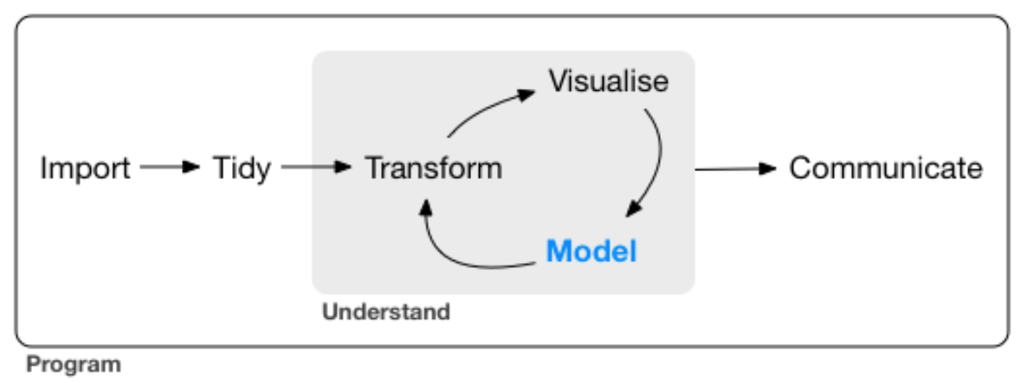
Overview
Review of Linear Regression
Linear Regression in R
Review of GLMs
Overview of R GLM functions
# Homework 4 help!

Slide 3
What is the association between maternal education and maternal age?
# creating maternal education factor variable:
births <- births %>%
mutate(meduc = ifelse(meduc==9,NA,meduc),
meduc_f = factor(meduc,
levels=c(1,2,3,4,5),
labels=c("Less Than High School",
"High School Graduate or GED",
"Some College", "Bachelors Degree", "Masters or PhD")))
# creating a smaller dataset:
set.seed(123)
births_10k = births %>%
filter(complete.cases(.)) %>%
as_tibble() %>%
sample_n(10000)

Slide 4
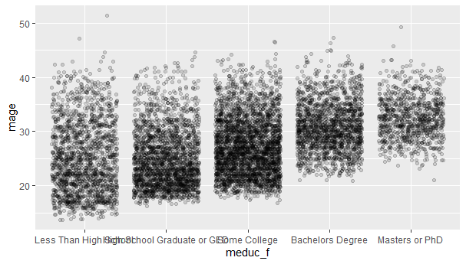
What is the association between maternal education and maternal age?
# univariate relationship
births_10k %>%
ggplot(aes(x = meduc_f, y = mage)) + geom_jitter(alpha = 0.15)

Slide 5
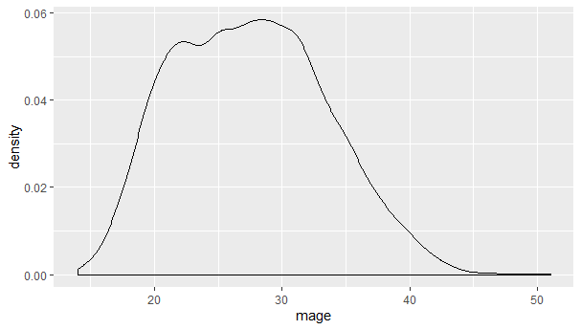
Is maternal age normally distributed?
births_10k %>%
ggplot(aes(x=mage)) +
geom_density()

Slide 6
Simple Linear Regression
Given data points (x and y), we draw a line of “best fit”.
The “slope” of the best fit line can be used to summarize the relationship between x and y.
We can find the beta estimate and best fit line by minimizing the “residual sum of squares”: the difference between each observation and it’s model-predicted value, squared and summed

Slide 7
What is the association between maternal education and maternal age?
lm(outcome ~ exposure, data = .)
m_linear <- lm(mage ~ meduc, data = births_10k) m_linear
> m_linear
Call:
lm(formula = mage ~ meduc, data = births_10k)
Coefficients:
(Intercept) meduc
21.780 2.061
“For every one-unit increase in maternal education, we would expect an increase of 2.061 years in mean maternal age.”
https://www.rdocumentation.org/packages/stats/versions/3.6.2/topics/lm

Slide 8
Looking at parts of model output
# coefficients
coef(m_linear) # or
m_linear$coefficients
# 95% confidence intervals
confint(m_linear)
# AIC value
AIC(m_linear)
> coef(m_linear) # or
(Intercept) meduc
21.780088 2.060866
> m_linear$coefficients
(Intercept) meduc
21.780088 2.060866
> confint(m_linear)
2.5 % 97.5 %
(Intercept) 21.515561 22.04461
meduc 1.973692 2.14804
> AIC(m_linear)
[1] 61956.14

Slide 9
Model summary
> summary(m_linear)
Call:
lm(formula = mage ~ meduc, data = births_10k)
Residuals:
Min 1Q Median 3Q Max
-11.0844 -3.9627 -0.9018 3.0982 27.1590
Coefficients:
Estimate Std. Error t value Pr(>|t|)
(Intercept) 21.78009 0.13495 161.40 <2e-16 ***
meduc 2.06087 0.04447 46.34 <2e-16 ***
---
Signif. codes: 0 ‘***’ 0.001 ‘**’ 0.01 ‘*’ 0.05 ‘.’ 0.1 ‘ ’ 1
Residual standard error: 5.358 on 9998 degrees of freedom
Multiple R-squared: 0.1768, Adjusted R-squared: 0.1767
F-statistic: 2147 on 1 and 9998 DF, p-value: < 2.2e-16
summary(m_linear)

Slide 10
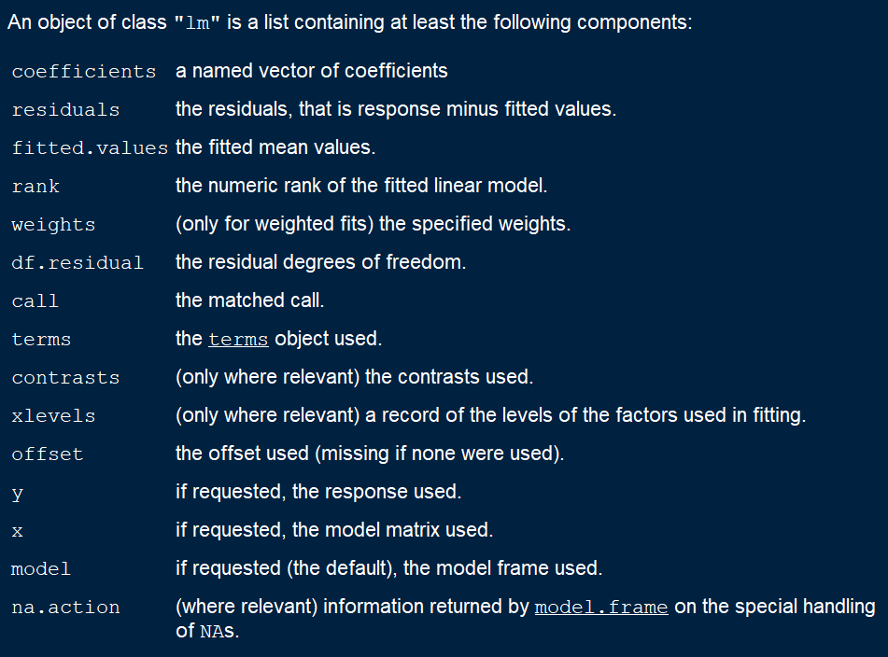
Model summary
summary(m_linear)

Slide 11
broom
Takes a format that is not in a data frame and converts it to a tidy data frame.
Output = a dataframe, no row names!
tidy(): summarizes statistical findings
augment(): add columns (predictions, residuals, clusters)
glance(): one-row summary of model
Introduction to broom:
https://cran.r-project.org/web/packages/broom/vignettes/broom.html

Slide 12
broom
tidy(m_linear)
glance(m_linear)
# A tibble: 2 x 5
term estimate std.error statistic p.value
<chr> <dbl> <dbl> <dbl> <dbl>
1 (Intercept) 21.8 0.135 161. 0
2 meduc 2.06 0.0445 46.3 0
# A tibble: 1 x 11
r.squared adj.r.squared sigma statistic p.value df logLik AIC BIC deviance df.residual
<dbl> <dbl> <dbl> <dbl> <dbl> <int> <dbl> <dbl> <dbl> <dbl> <int>
1 0.177 0.177 5.36 2147. 0 2 -30975. 61956. 61978. 287069. 9998>

Slide 13
broom
augment(): add columns (predictions, residuals, clusters) to a dataset with information from a model
augment(m_linear, data = births_10k %>%
select(mage, meduc)) %>% head()
# A tibble: 6 x 9
mage meduc .fitted .se.fit .resid .hat .sigma .cooksd .std.resid
<int> <int> <dbl> <dbl> <dbl> <dbl> <dbl> <dbl> <dbl>
1 24 1 23.8 0.0958 0.159 0.000319 5.36 0.000000141 0.0297
2 32 2 25.9 0.0640 6.10 0.000142 5.36 0.0000923 1.14
3 36 3 28.0 0.0544 8.04 0.000103 5.36 0.000116 1.50
4 27 2 25.9 0.0640 1.10 0.000142 5.36 0.00000299 0.205
5 33 5 32.1 0.112 0.916 0.000438 5.36 0.00000640 0.171
6 24 3 28.0 0.0544 -3.96 0.000103 5.36 0.0000282 -0.740

Slide 14
broom
Or make your own model output summary table!
m_linear %>% tidy() %>%
bind_cols(m_linear %>% confint_tidy())
# A tibble: 2 x 7
term estimate std.error statistic p.value conf.low conf.high
<chr> <dbl> <dbl> <dbl> <dbl> <dbl> <dbl>
1 (Intercept) 21.8 0.135 161. 0 21.5 22.0
2 meduc 2.06 0.0445 46.3 0 1.97 2.15

Slide 15
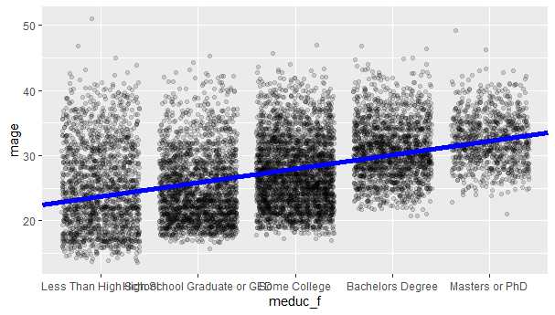
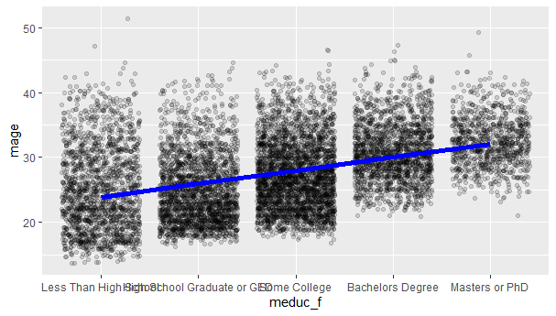
# graphing our model predictions
births_10k %>%
ggplot(aes(x=meduc_f, y=mage)) +
geom_jitter(alpha=0.15) +
geom_abline(intercept=21.8, slope=2.06, color="blue", size=2)
births_10k %>%
ggplot(aes(x=meduc_f, y=mage)) +
geom_jitter(alpha=0.15) +
geom_smooth(aes(x=meduc, y=mage),
method=lm, se=F, color="blue", size=2)

Slide 16
Problem 1: Variable distribution
But what if the outcome variable is not normal?
A binary variable? Binomial
A categorical variable? Multinomial
An ordinal variable? Ordinal Logistic
A count or rate variable? Poisson Quasi-Poisson
We can address these in R using various outcome distributions.

Slide 17
Problem 2: Non-Independence
But what if observations are not independent?
Interference between adjacent units?
Correlation between outcomes for adjacent units?
Shared variables between different observations (clustering)?
Repeated measurements of the same units?
We can address these problems in R by adding terms to the regression or using more advanced regression / modeling techniques.

Slide 18
Solution: Generalized Linear Models
We can solve these problems (and more) by extending our linear model with two new features:
An outcome distribution. We can use something other than the normal distribution for our model to show how the variance depends on the mean.
A link function. Since we are still using a linear model, we need to transform our data appropriately so that it appears “linear”; so that our transformed outcome is linearly related to the exposure and other predictors.
In R, we can make these modifications directly in our line of code. We don’t have to “trick” the program to make our models work.

Slide 19
glm() syntax
You can fit regression models in R using the general-purpose glm() function. The ~ operator separates the outcome from the covariates.
glm(outcome ~ exposure + confounder, data=., family=distribution(“link”))
The model results are usually best saved in an object so that we can easily visualize or manipulate parts of our output.
m <- glm(outcome ~ exposure + confounder, data=.)

Slide 20
Review of GLMs
Regression model | Family | Link (g(Y)) | Form
linear | normal | identity | Y = β₀ + β₁X₁…+β_{k}X_{k}
linear risk | binomial | identity | R = β₀ + β₁X₁…+β_{k}X_{k}
log-risk | binomial | log | ln(R) = β₀ + β₁X₁…+β_{k}X_{k}
logit-risk | binomial | logit | logit(R) = β₀ + β₁X₁…+β_{k}X_{k}
poisson | poisson | log | ln(Y) = β₀ + β₁X₁…+β_{k}X_{k}
Y = a continuous dependent variable (outcome) or count variable (poisson models)
R = probability for a binomial outcome, e.g., risk (incidence proportion) or prevalence.
Family: the distribution of the outcome variable.
Link: the functional relation between the dependent variable and the linear combination of covariates
EPID716 2019
Notes:
GLM needs a link and log. Each model will estimate a mean given your specified combination of covariates.
Linear risk: incidence proportion E[Y] = P(Y|X1) = B0 + B1X1. B1 = RD for Y given X1 = 1 vs. X1 = 0. Change in risk per unit increase is constrained to be linear.
Log-risk regression: outcome is linear on the ln scale. Exp(B1) = RR. NEED to exponentiate! Change in ln(risk) per unit is constrained to be linear (or additive) on the log scale, change in risk per unit is exponential.
Logit-risk (logistic regression): exp(B1) = OR. The OR will approximate the RR when the outcome is rare.
Poisson: for the IRR to approximate the RR, the exposure must have negligible effects on person-time – satisfied if the population declines by no more than a few percent over the interval. * negative binomial also uses the natural log function, but residuals are assumed to follow the negative binomial distribution. There is an extra parameter that allows us to account for greater than expected variability or variability that exceed the mean.
OR > IRR > RR if R1>R0

Slide 21
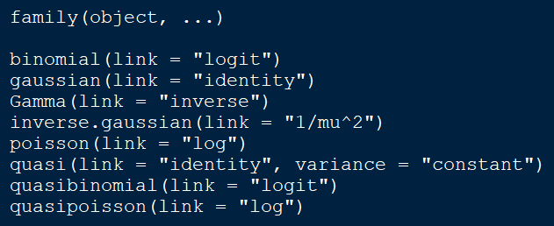
Review of GLMs
Regression model | Family | Link (g(Y)) | Form
linear | normal | identity | Y = β₀ + β₁X₁…+β_{k}X_{k}
linear risk | binomial | identity | R = β₀ + β₁X₁…+β_{k}X_{k}
log-risk | binomial | log | ln(R) = β₀ + β₁X₁…+β_{k}X_{k}
logit-risk | binomial | logit | logit(R) = β₀ + β₁X₁…+β_{k}X_{k}
poisson | poisson | log | ln(Y) = β₀ + β₁X₁…+β_{k}X_{k}
Y = a continuous dependent variable (outcome) or count variable (poisson models)
R = probability for a binomial outcome, e.g., risk (incidence proportion) or prevalence.
Family: the distribution of the outcome variable.
Link: the functional relation between the dependent variable and the linear combination of covariates
EPID716 2019
Notes:
GLM needs a link and log. Each model will estimate a mean given your specified combination of covariates.
Linear risk: incidence proportion E[Y] = P(Y|X1) = B0 + B1X1. B1 = RD for Y given X1 = 1 vs. X1 = 0. Change in risk per unit increase is constrained to be linear.
Log-risk regression: outcome is linear on the ln scale. Exp(B1) = RR. NEED to exponentiate! Change in ln(risk) per unit is constrained to be linear (or additive) on the log scale, change in risk per unit is exponential.
Logit-risk (logistic regression): exp(B1) = OR. The OR will approximate the RR when the outcome is rare.
Poisson: for the IRR to approximate the RR, the exposure must have negligible effects on person-time – satisfied if the population declines by no more than a few percent over the interval. * negative binomial also uses the natural log function, but residuals are assumed to follow the negative binomial distribution. There is an extra parameter that allows us to account for greater than expected variability or variability that exceed the mean.
OR > IRR > RR if R1>R0

Slide 22
Epidemiology Examples
Choose your distribution family link based on what you are estimating:
Risk difference family = binomial(link=“identity”)
Risk ratio family = binomial(link=“log”)
Rate difference family = poisson(link=“identity”)
Rate ratio family = poisson(link=“log”)
Odds ratio family= binomial(link=“logit”)

Slide 23
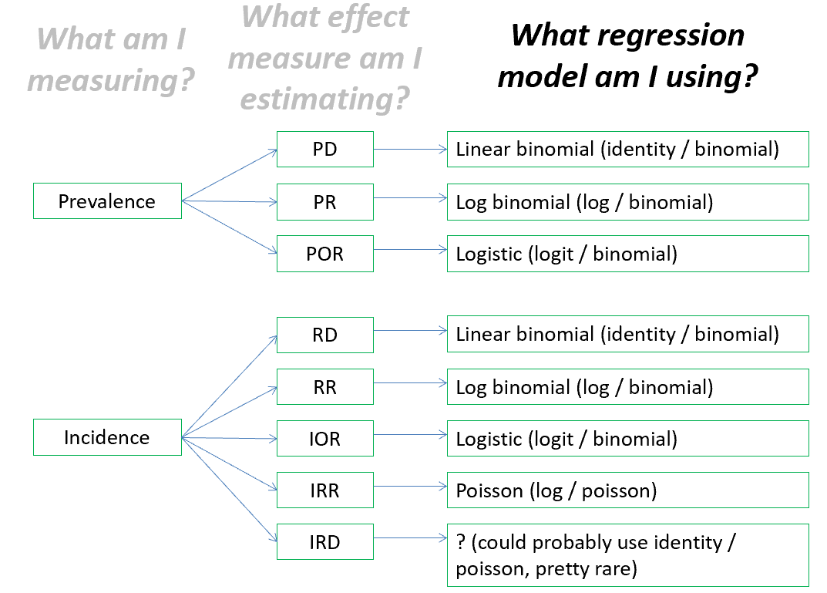
Review of GLMs
Risk difference: family = binomial(link=“identity”)
Risk ratio: family = binomial(link=“log”)
Odds ratio: family= binomial(link=“logit”)
Rate ratio: family = poisson(link=“log”)
Rate difference: family = poisson(link=“identity”)
EPID718 2018

Slide 24
Question for the Google Doc
What is the association between maternal education and maternal age?
Convert your lm() model into a glm() and post your code and estimate in the notes.
glm(outcome ~ exposure + confounder, data=., family=distribution(“link”))

Slide 25
Question for the Google Doc
What is the association between maternal education and maternal age?
glm_linear <- glm(mage ~ meduc, data = births_10k, family=gaussian(link="identity"))
tidy(glm_linear)
# A tibble: 2 x 5
term estimate std.error statistic p.value
<chr> <dbl> <dbl> <dbl> <dbl>
1 (Intercept) 21.8 0.135 161. 0
2 meduc 2.06 0.0445 46.3 0

Slide 26
What is the association between early prenatal care and preterm birth?
births_10k %>%
group_by(pnc5_f) %>%
summarize(n=n(), n_preterm = sum(preterm, na.rm=T), pct_preterm = n_preterm / n * 100) %>%
mutate(preterm_RD = pct_preterm - lag(pct_preterm))
# A tibble: 2 x 5
pnc5_f n n_preterm pct_preterm preterm_RD
<fct> <int> <dbl> <dbl> <dbl>
1 No Early PNC 851 110 12.9 NA
2 Early PNC 9149 890 9.73 -3.20

Slide 27
Linear risk regression
# risk difference
glm_rd <- glm(preterm ~ pnc5_f, data = births_10k, family=binomial(link="identity"))
tidy(glm_rd, conf.int = T)
“The absolute risk of preterm birth among those that received early prenatal care was 3.2 percentage points lower than the absolute risk among those who did not receive early prenatal care.”
# A tibble: 2 x 7
term estimate std.error statistic p.value conf.low conf.high
<chr> <dbl> <dbl> <dbl> <dbl> <dbl> <dbl>
1 (Intercept) 0.129 0.0115 11.2 2.60e-29 0.108 0.153
2 pnc5_fEarly PNC -0.0320 0.0119 -2.69 7.25e- 3 -0.0564 -0.00967

Slide 28
Log-risk regression
“The risk of preterm birth among those that received early prenatal care was 0.75 times the risk among those that did not receive early prenatal care.”
# risk ratio
glm_rr <- glm(preterm ~ pnc5_f, data = births_10k, family=binomial(link="log"))
tidy(glm_rr, conf.int = T, exponentiate = T) # or
exp(coef(glm_rr))
# A tibble: 2 x 7
term estimate std.error statistic p.value conf.low conf.high
<chr> <dbl> <dbl> <dbl> <dbl> <dbl> <dbl>
1 (Intercept) 0.129 0.0890 -23.0 5.16e-117 0.108 0.153
2 pnc5_fEarly PNC 0.753 0.0945 -3.01 2.63e- 3 0.629 0.911

Slide 29
Question for the Google Doc
What is the association between early prenatal care and preterm birth?
Find the odds ratio and post your point estimate and 95% confidence interval in the notes.
glm(outcome ~ exposure + confounder, data=., family=distribution(“link”))

Slide 30
Question for the Google Doc
What is the association between early prenatal care and preterm birth?
glm_or <- glm(preterm ~ pnc5_f, data = births_10k, family=binomial(link="logit"))
tidy(glm_or, conf.int = T, exponentiate = T)
# A tibble: 2 x 7
term estimate std.error statistic p.value conf.low conf.high
<chr> <dbl> <dbl> <dbl> <dbl> <dbl> <dbl>
1 (Intercept) 0.148 0.102 -18.7 8.92e-78 0.121 0.181
2 pnc5_fEarly PNC 0.726 0.108 -2.96 3.04e- 3 0.590 0.901

Slide 31
What about confounding?
EPID 716

Slide 32
Multivariable regression
glm(outcome ~ exposure + confounder, data=., family=distribution(“link”))
glm_rd_conf <- glm(preterm ~ pnc5_f + mage + raceeth_f + smoker_f, data = births_10k, family=binomial(link="identity"))
# A tibble: 8 x 7
term estimate std.error statistic p.value conf.low conf.high
<chr> <dbl> <dbl> <dbl> <dbl> <dbl> <dbl>
1 (Intercept) 8.61e-2 0.0180 4.78 1.73e- 6 5.29e-2 0.121
2 pnc5_fEarly PNC -2.40e-2 0.0117 -2.06 3.94e- 2 -4.80e-2 -0.00225
3 mage 4.66e-4 0.000501 0.930 3.52e- 1 -4.27e-4 0.00137
4 raceeth_fOther 8.59e-3 0.00791 1.09 2.77e- 1 -6.50e-3 0.0246
5 raceeth_fWhite ~ -1.14e-2 0.0164 -0.691 4.89e- 1 -4.00e-2 0.0261
6 raceeth_fAfrica~ 7.73e-2 0.00841 9.19 3.92e-20 6.11e-2 0.0941
7 raceeth_fAmeric~ 7.88e-2 0.0306 2.58 1.00e- 2 2.52e-2 0.144
8 smoker_fSmoker 2.39e-2 0.0102 2.34 1.92e- 2 4.92e-3 0.0445
tidy(glm_rd_conf, conf.int = T)

Slide 33
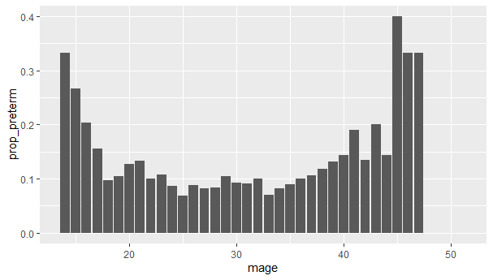
How should we model maternal age?
births_10k %>%
group_by(mage) %>%
summarize(prop_preterm = mean(preterm, na.rm=T)) %>%
ggplot(aes(x=mage, y=prop_preterm)) +
geom_col()

Slide 34
Functional form - linear
ff_mage <- glm(preterm ~ mage, data = births_10k, family=binomial(link="identity"))
tidy(ff_mage, conf.int = T)
# linear
# A tibble: 2 x 7
term estimate std.error statistic p.value conf.low conf.high
<chr> <dbl> <dbl> <dbl> <dbl> <dbl> <dbl>
1 (Intercept) 0.115 0.0143 8.03 9.99e-16 0.0895 0.141
2 mage -0.000545 0.000506 -1.08 2.81e- 1 -0.00144 0.000361

Slide 35
Functional form - linear
# creating dataframe with predictions
m.pred <- as_tibble(predict(ff_mage, type = "response", se.fit = T))
m.pred$lower <- m.pred$fit - (1.96*m.pred$se.fit) # lower bounds
m.pred$upper <- m.pred$fit + (1.96*m.pred$se.fit) # upper bounds
m.pred$x <- births_10k$mage # actual age values
m.pred$y <- births_10k$preterm # actual mortality values
m.pred

Slide 36
Functional form - linear
# creating dataframe with predictions
m.pred <- as_tibble(predict(ff_mage2, type = "response", se.fit = T))
m.pred$lower <- m.pred$fit - (1.96*m.pred$se.fit) # lower bounds
m.pred$upper <- m.pred$fit + (1.96*m.pred$se.fit) # upper bounds
m.pred$x <- births_10k$mage # actual age values
m.pred$y <- births_10k$preterm # actual mortality values
m.pred
# A tibble: 10,000 x 7
fit se.fit residual.scale lower upper x y
<dbl> <dbl> <dbl> <dbl> <dbl> <int> <dbl>
1 0.102 0.00353 1 0.0950 0.109 24 0
2 0.0976 0.00371 1 0.0903 0.105 32 1
3 0.0954 0.00516 1 0.0853 0.106 36 1
4 0.100 0.00302 1 0.0944 0.106 27 0
5 0.0970 0.00403 1 0.0891 0.105 33 0
6 0.102 0.00353 1 0.0950 0.109 24 0
7 0.101 0.00312 1 0.0947 0.107 26 0
8 0.0981 0.00343 1 0.0914 0.105 31 0
9 0.0965 0.00438 1 0.0879 0.105 34 0
10 0.0992 0.00307 1 0.0932 0.105 29 0
# ... with 9,990 more rows

Slide 37
Functional form - linear
ggplot(m.pred) +
geom_point(aes(x=x, y=fit)) + # predictions
geom_ribbon(aes(x=x, ymin=lower, ymax=upper, alpha=0.01), fill="#d1e5f0", show.legend = F) + # 95% CI
geom_smooth(aes(x=x, y=y), color = "blue", method = "loess", se = F, show.legend = F) + # actual
labs(title="Linear Model", x="Maternal Age", y="Estimated Risk (95% CI) of Preterm Birth", subtitle="Blue solid line is loess, dots are model predictions with confidence interval bands.") +
theme_bw()

Slide 38
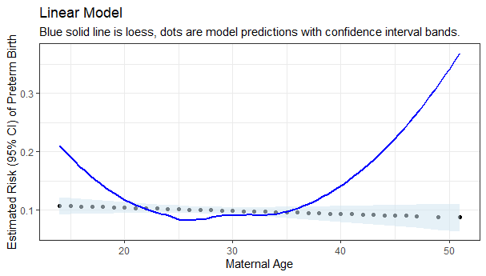
Functional form - linear
Bad fit :(
ggplot(m.pred) +
geom_point(aes(x=x, y=fit)) + # predictions
geom_ribbon(aes(x=x, ymin=lower, ymax=upper, alpha=0.01), fill="#d1e5f0", show.legend = F) + # 95% CI
geom_smooth(aes(x=x, y=y), color = "blue", method = "loess", se = F, show.legend = F) + # actual
labs(title="Linear Model", x="Maternal Age", y="Estimated Risk (95% CI) of Preterm Birth", subtitle="Blue solid line is loess, dots are model predictions with confidence interval bands.") +
theme_bw()

Slide 39
Other functional forms
Quadratic: poly(mage,2)
Polynomial: poly(mage,3)
Splines: rcs(mage,c(20,25,30))
Interaction terms: mage*pnc5_f
Indicator terms and categorical: catg(mage)
https://r4ds.had.co.nz/model-basics.html#formulas-and-model-families

Slide 40
Question for the Google Doc
Graph the functional form of maternal age as a quadratic variable and post your plot to the google doc!
Name your quadratic model “ff_mage2”

Slide 41
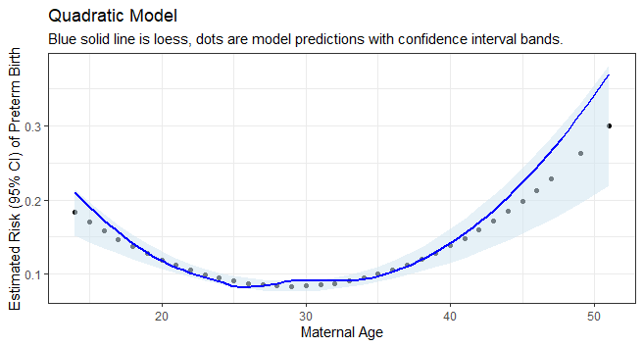
Question for the Google Doc

Slide 42
Model testing
> AIC(ff_mage); logLik(ff_mage)
[1] 6504.265
'log Lik.' -3250.132 (df=2)
> AIC(ff_mage2); logLik(ff_mage2)
[1] 6469.218
'log Lik.' -3231.609 (df=3)
AIC(ff_mage); logLik(ff_mage)
AIC(ff_mage2); logLik(ff_mage2)
> anova(ff_mage, ff_mage2, test="LRT")
Analysis of Deviance Table
Model 1: preterm ~ mage
Model 2: preterm ~ poly(mage, 2)
Resid. Df Resid. Dev Df Deviance Pr(>Chi)
1 9998 6500.3
2 9997 6463.2 1 37.047 1.153e-09 ***
---
Signif. codes: 0 ‘***’ 0.001 ‘**’ 0.01 ‘*’ 0.05 ‘.’ 0.1 ‘ ’ 1
anova(ff_mage, ff_mage2, test="LRT")

Slide 43
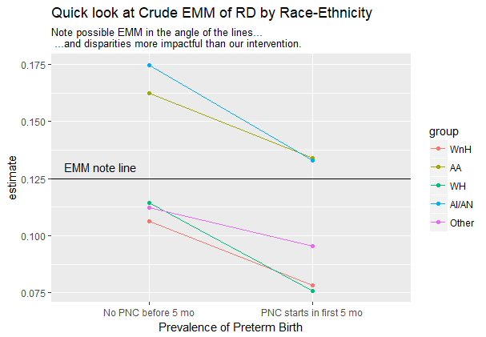
Next Steps
Lecture on 2/20:
Effect measure modification using glms
More data visualization with ggplot2

Slide 44
Multiple Linear Regression
Given data in n-dimensional space (x…x_{n} and y), draw a hyperplane (dim n-1) of “best fit”
The “slopes” of the hyperplane along each dimension can be used to summarize the relationship between each x_{i} and y.

Slide 45
How the Computer Solves a Regression
Choose a “guess” slope.
Calculate a fit statistic for the guess. (higher=worse, lower=better).
Repeat steps 1 and 2 until it finds a “good” guess (a tolerance value defined by the user or set by default).
[Optional Improvements] Keep track of your old guesses to see if you are getting “better” or “worse”. Have a system for selecting a good “jump” size between guesses. Start guessing somewhere that makes sense. Etc, etc.

Slide 46
Universal Fit Statistic: Likelihood
We typically think of linear regression as using the sum of squared errors fit statistic (i.e. “least-squares regression). It turns out that this is a special case of a more general fit statistic: the likelihood.
The likelihood is the probability of observing the data you have under a given set of assumed “slope” values $β_{0},β_{1},β_{2}, etc.$
The maximum likelihood estimate (MLE) is the set of assumed “slope” values $β_{0},β_{1},β_{2},etc$ that gives the highest likelihood (our best guess).
We can use the values of the likelihood function near the MLE to estimate the precision of our estimates (i.e. calculate confidence intervals or statistical tests for $β_{0},β_{1},β_{2}$)

