Slide 1
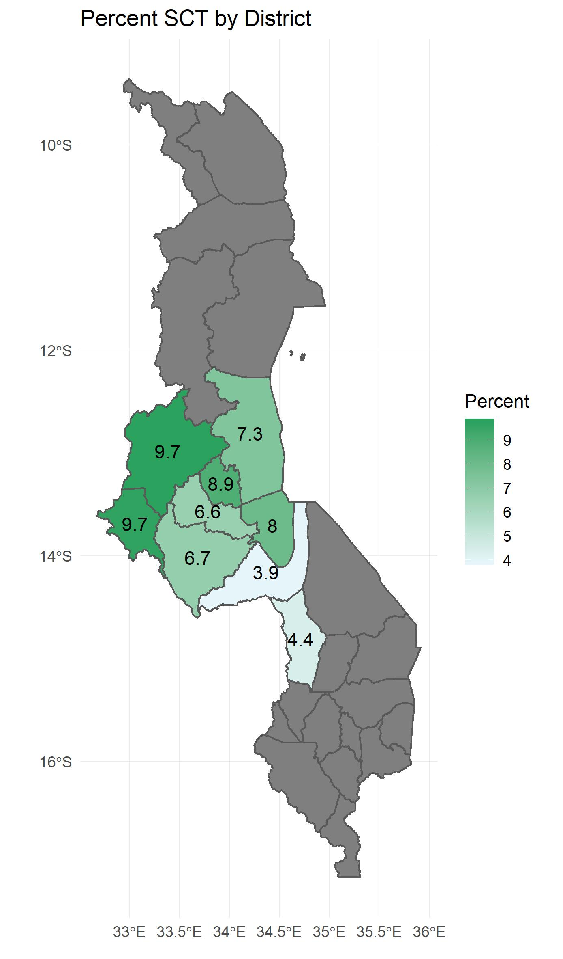
Sickle cell: R + QGIS
malawi %>% # shapefile
left_join(mapdat, by=c("NAME_1"="district")) %>%
ggplot(aes(fill = percent)) +
geom_sf() +
theme_minimal() + geom_sf_label(aes(geometry = st_centroid(geometry), label=round(percent,1)), label.size = 0, show.legend = NA, fill = NA) +
scale_fill_gradient(low = "#E5F5F9", high = "#2CA25F") + labs(title="Percent SCT by District", fill="Percent") + xlab(element_blank()) + ylab(element_blank())

Slide 2
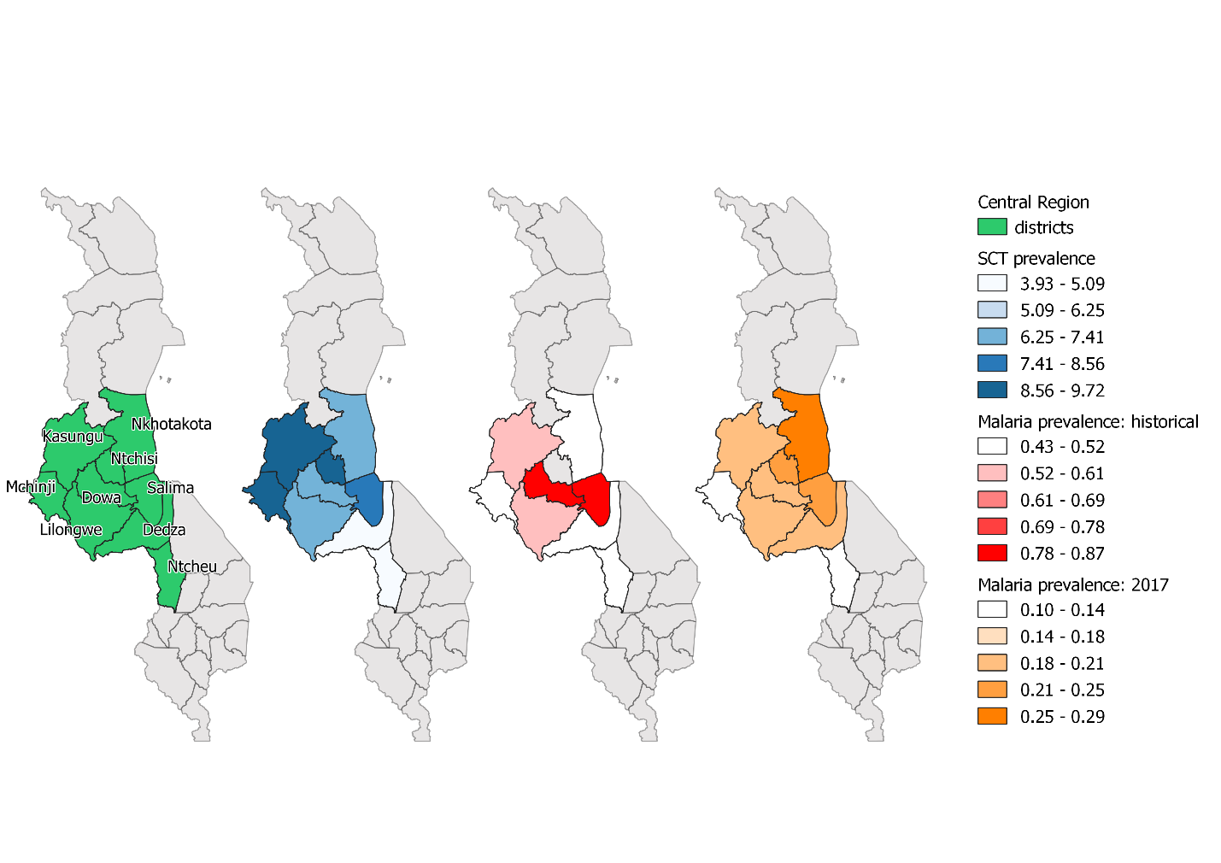
Sickle cell: R + QGIS
district_SCT_pct <- merge(malawi, SCT_pct, by.x = "NAME_1", by.y = "district") district_HIV_pct <- merge(malawi, HIV_pct, by.x = "NAME_1", by.y = "district")
district_all <- merge(malawi, fig1, by.x = "NAME_1", by.y = "district")
writeOGR(district_SCT_pct,
dsn = “./district_SCT_pct.shp", "district_SCT_pct.shp", driver = "ESRI Shapefile", overwrite_layer = T)

Slide 3
Malawi health facility locations
ggplot() +
geom_sf(data=malawi) +
geom_sf(data=facility2018_sf, alpha=0.5, color="red") +
theme_bw(base_size = 18) + scale_x_continuous(breaks=c(34, 35))

Slide 4
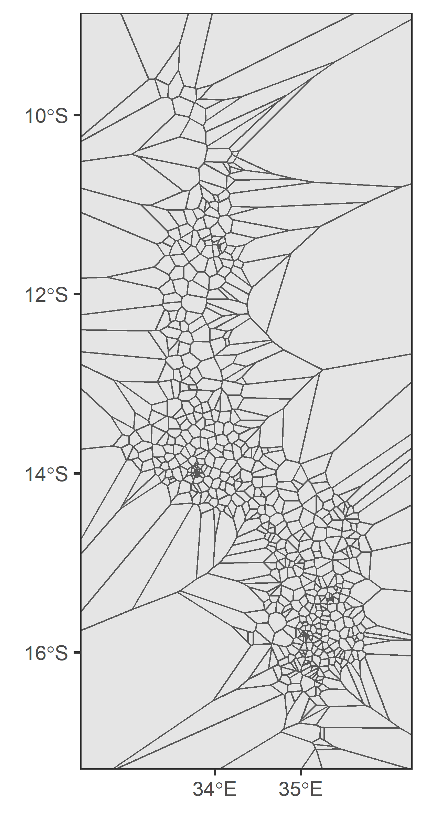
Voronoi polygons
# creating voronoi polygons. st_union necessary because st_voronoi doesn't work on sf object. Have to combine them into a multipoint
object.
vpolygons2018 <- st_voronoi(st_union(facility2018_sf))
ggplot() +
geom_sf(data=vpolygons2018) +
theme_bw(base_size = 18) +
scale_x_continuous(breaks=c(34,35)) +
scale_y_continuous(breaks=c(-10,-12,-14,-16)) +
coord_sf(xlim=c(440000,850000), ylim=c(8087000,9021000), expand=F)

Slide 5
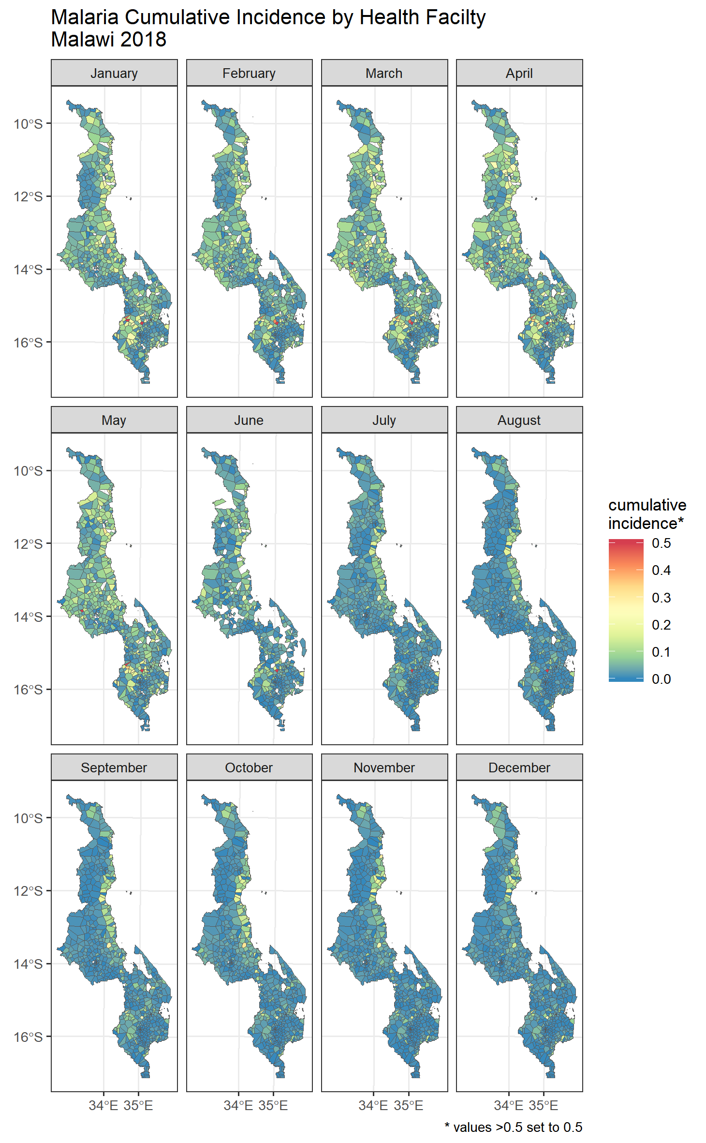
ggplot() +
geom_sf(data=incidence2018_revise, lwd=0.1, aes(fill=variable)) +
facet_wrap(~period, nrow=3, ncol=4) +
theme_bw(base_size = 8.5) +
scale_fill_distiller(palette = "Spectral") +
theme(legend.key.height = unit(.5,"cm")) +
ggtitle("Malaria Cumulative Incidence by Health Facilty \nMalawi 2018") +
labs(fill = "cumulative \nincidence*", caption = "* values >0.5 set to 0.5") +
scale_x_continuous(breaks=c(34, 35))

Slide 6
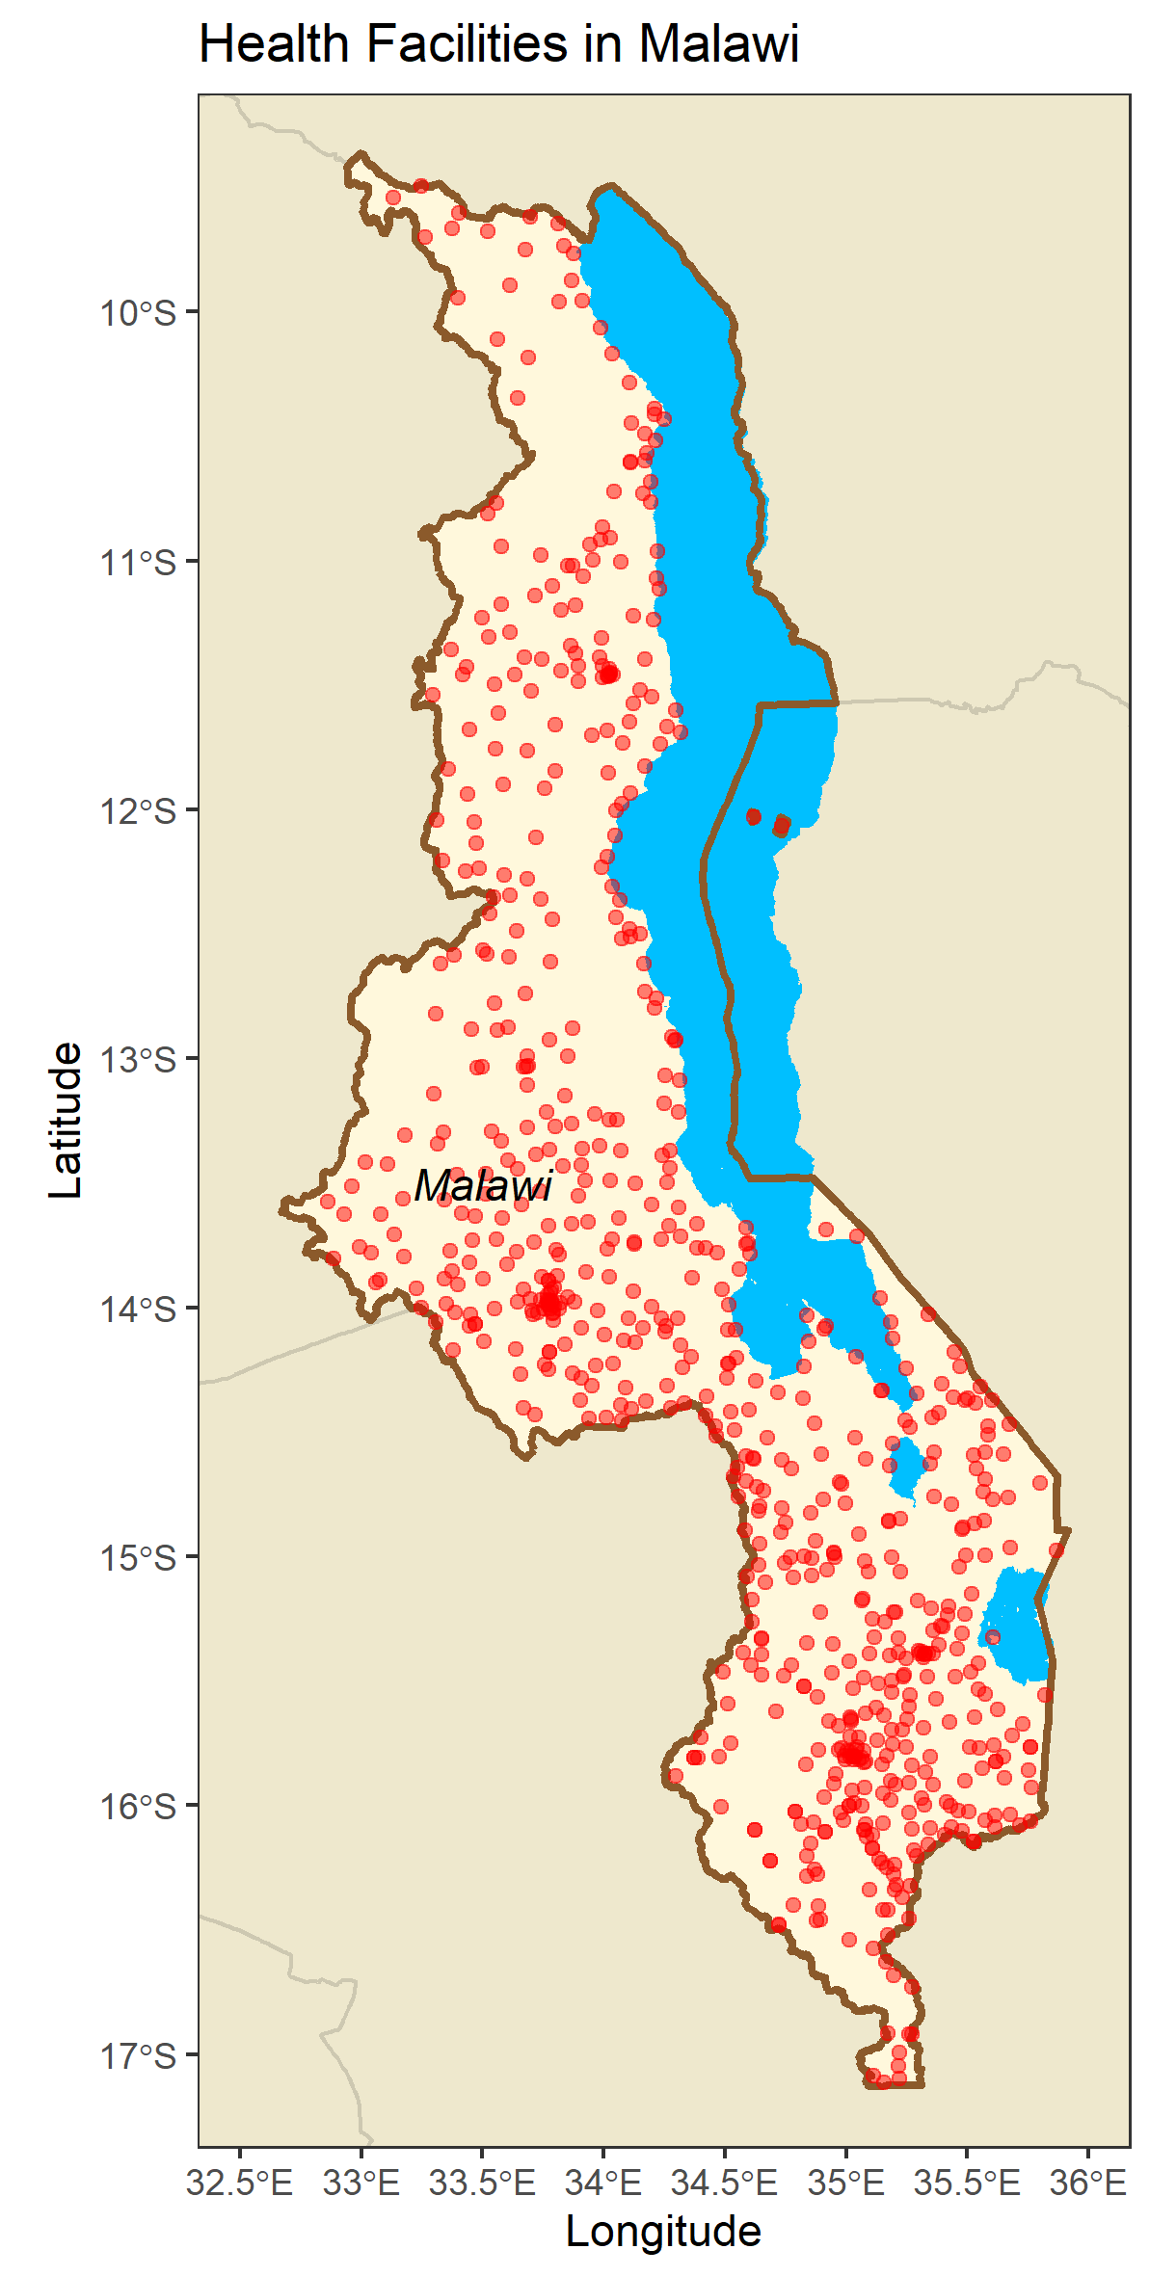
lakes <- st_read("./lake malawi/Malawi_lakes.shp")
malawi <- readRDS(gzcon(url("https://biogeo.ucdavis.edu/data/gadm3.6/Rsf/gadm36_MWI_0_sf.rds")))
mozam <- readRDS(gzcon(url("https://biogeo.ucdavis.edu/data/gadm3.6/Rsf/gadm36_MOZ_0_sf.rds")))
tanzania <- readRDS(gzcon(url("https://biogeo.ucdavis.edu/data/gadm3.6/Rsf/gadm36_TZA_0_sf.rds")))
zim <- readRDS(gzcon(url("https://biogeo.ucdavis.edu/data/gadm3.6/Rsf/gadm36_ZWE_0_sf.rds")))
zam <- readRDS(gzcon(url("https://biogeo.ucdavis.edu/data/gadm3.6/Rsf/gadm36_ZMB_0_sf.rds")))
ggplot() +
geom_sf(data=mozam,fill="cornsilk2",color="cornsilk3") +
geom_sf(data=tanzania,fill="cornsilk2",color="cornsilk3") +
geom_sf(data=zim,fill="cornsilk2",color="cornsilk3") +
geom_sf(data=zam,fill="cornsilk2",color="cornsilk3") +
geom_sf(data=malawi, fill="cornsilk") +
geom_sf(data=lakes, fill="deepskyblue",color=NA) +
geom_sf(data=malawi, fill=NA, color="tan4", size=1) +
theme_bw() +
geom_sf(data=facility2018_sf, alpha=0.5, color="red") +
labs(title = "Health Facilities in Malawi", x = "Longitude", y = "Latitude") +
xlim(32.5,36) + ylim(-17,-9.5) +
theme(panel.background = element_rect(fill = "lightblue1")) +
annotate(geom="text", x=33.5,y=-13.5,label="Malawi", fontface = "italic",color="black")

Slide 7
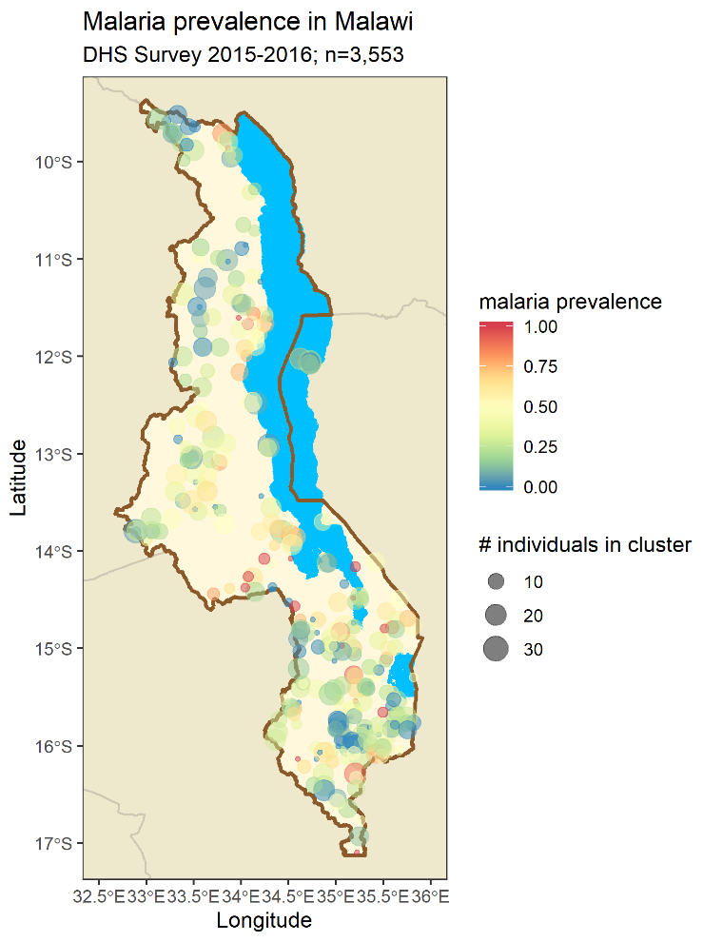
# load map RDS files of border countries and lakes
load("./rds/SEAfrica.rdata")
plot <- ggplot(data = dhs_map) +
geom_sf(data=SEAf,fill="cornsilk2",color="cornsilk3") +
geom_sf(data=malawi, fill="cornsilk") +
geom_sf(data=lakes, fill="deepskyblue",color=NA) + geom_sf(data=malawi,fill=NA,color="tan4",size=1) +
geom_sf(data=dhs_map %>% filter(pcr==1) %>% group_by(month, CLUSTER) %>% summarise(num = n(), prev=mean(malaria, na.rm = T)), aes(color=prev, size=num), alpha=0.5, show.legend = "point") +
labs(title = "Malaria prevalence in Malawi", subtitle = str_wrap("DHS Survey 2015-2016; n=3,553"), x = "Longitude", y = "Latitude", size = "# individuals in cluster", color = "malaria prevalence") +
theme_bw() +
scale_color_distiller(palette ="Spectral") +
xlim(32.5,36) + ylim(-17,-9.5)

Slide 8
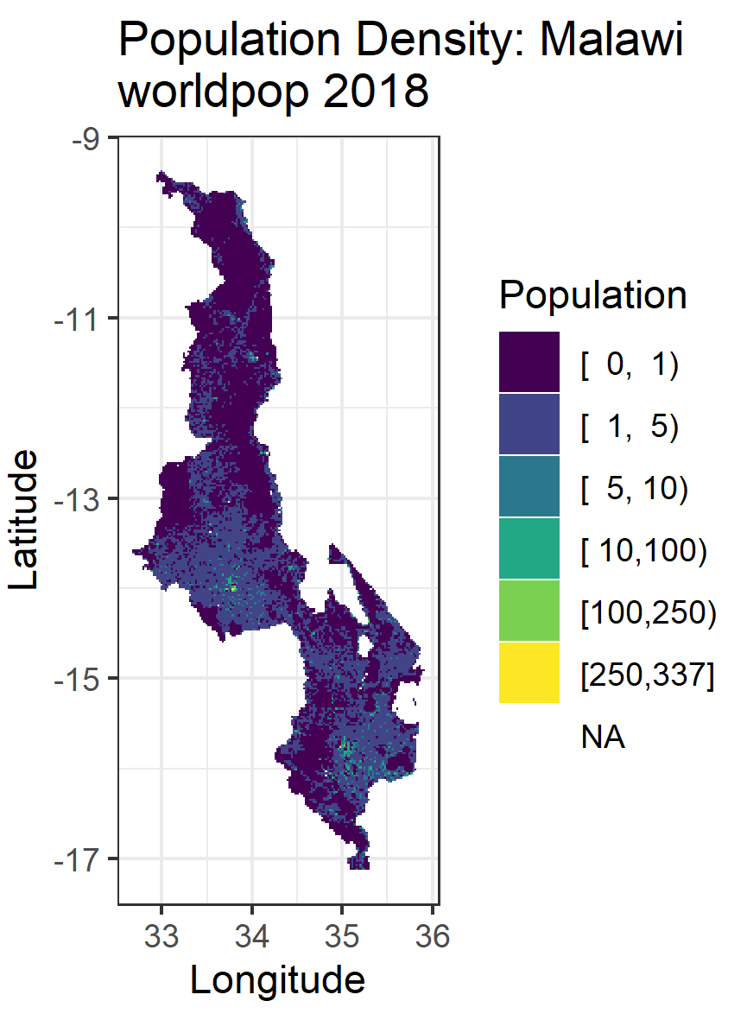
library(rasterVis)
popdens <- raster("./Malawi census boundaries/worldpop_mwi_ppp_2018.tif")
rasterVis::gplot(popdens) +
geom_tile(aes(fill = Hmisc::cut2(value,cuts = c(0,1,5,10,100,250)))) +
scale_fill_ordinal(name="Population") +
coord_equal() +
theme_bw() +
labs(title="Population Density: Malawi \nworldpop 2018", x="Longitude", y="Latitude")

