Slide 1
EPID 701 Spring 2020 R for Epidemiologists
Advanced purrr, patterns, speed (WILL START AT 9:30!)
Prep: notes | R open if you want!
2020.04.07 – L22 – Mike
learnr.web.unc.edu
Notes:
Welcome to the R class! Today I will talk about course logistics and give you some background on R. I’ll also demo how to install R and your homework for today will be to install R for next week. I’ll also have you fill out a short survey online so that I and the other teachers can get to know you and the level of R experience you are at.

Slide 2
Today: Examples & Patterns
purrr Reminders!
purrr Examples & Patterns
Most of our time today
Iteration: nest, walk, modelling, study design & simulation, adverbs, deep nesting, parallel processing, reduce
Algorithms, complexity, & speed

Slide 3
Follow Jenny Bryan!
"Of course, someone has to write loops. It doesn’t have to be you."
— Jenny Bryan
https://jennybc.github.io/purrr-tutorial/
Or Functionals in Hadley's Advanced R:
https://adv-r.hadley.nz/functionals.html

Slide 4
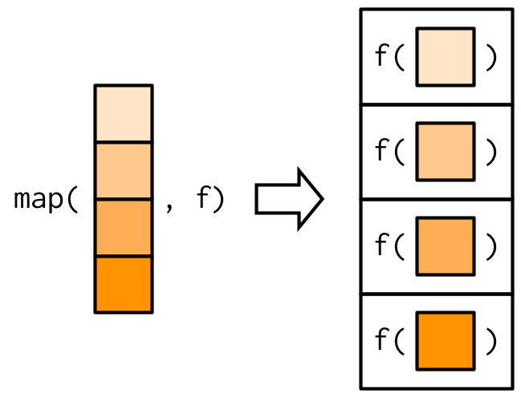
What's purrr again?
Functions that work as iterators
Frequently pass functions as arguments

Slide 5
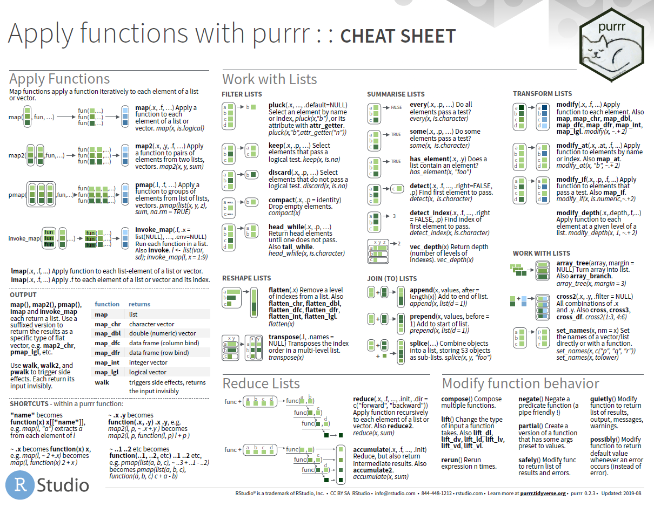
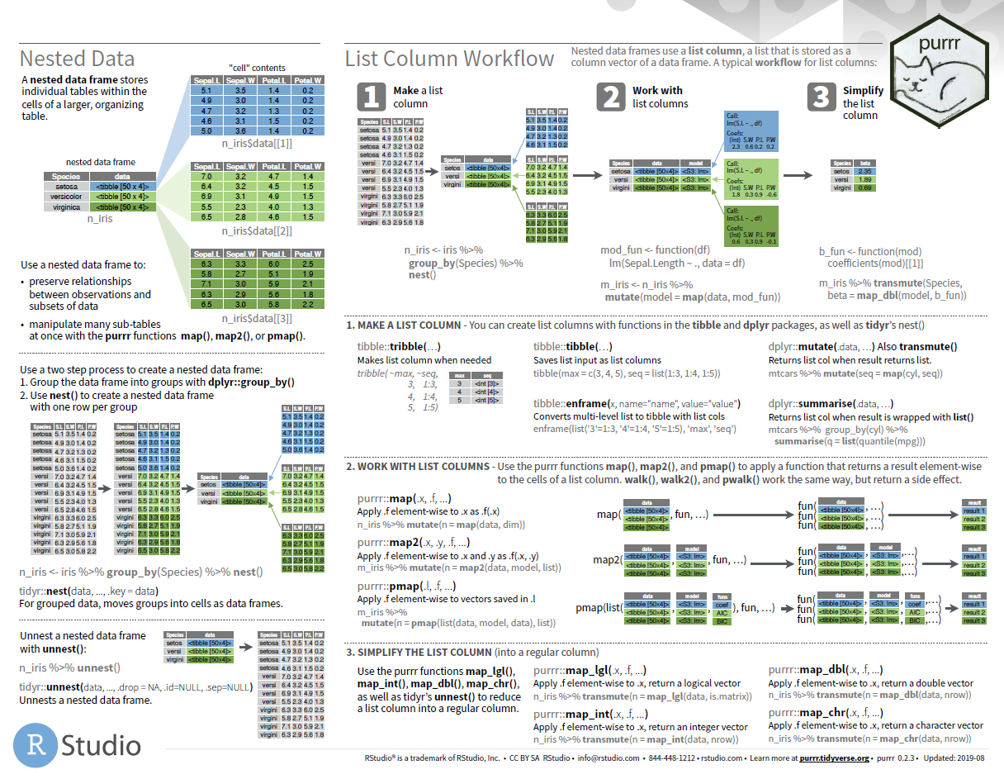
What's purrr again?

Slide 6
Example: Scan for ICD codes
Remember
congen_anom?
str_detect_any = function(string, pattern){str_detect(string, pattern) %>% any}
is_mvc = apply(death_icd_sample, 1, str_detect_any,
pattern = "U011|V[0-9][1-9]|X82|Y03|Y361") # regex rocks
# Or
is_mvc = death_icd_sample %>% array_branch(1) %>%
map_lgl(str_detect_any, pattern = "U011|V[0-9][1-9]|X82|Y03|Y361")
# Or death_icd %>% select(matches("^cod[0-9]$")) ... to do without extracting
# Note str_detect_any will break if you're passing a recursive list. unlist() / c(..., recursive=T) to flatten...

Slide 7
Example: walk
Walk a list… & do a thing
#..........................
# Get new data & clean up after ####
#..........................
# Download files
file_locations = paste0("http://www.doc.state.nc.us/offenders/",c("OFNT3AA1", "APPT7AA1", "APPT9BJ1", "INMT4AA1", "INMT4BB1", "INMT4CA1", "INMT9CF1", "OFNT1BA1", "OFNT3BB1", "OFNT3CE1", "OFNT3DE1", "OFNT9BE1"),".zip")
walk2(file_locations, basename(file_locations), ~ download.file(.x, .y))
# Unzip them all, then delete
walk(list.files(pattern = "*.zip$"), unzip, overwrite = T)
walk(list.files(pattern = "*.zip$"), ~ if (file.exists(.x)) file.remove(.x) )
beepr::beep()
#..........................

Slide 8
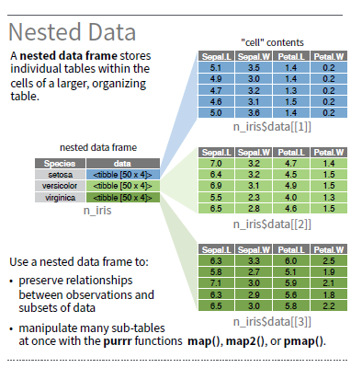
Example: nest data

Slide 9
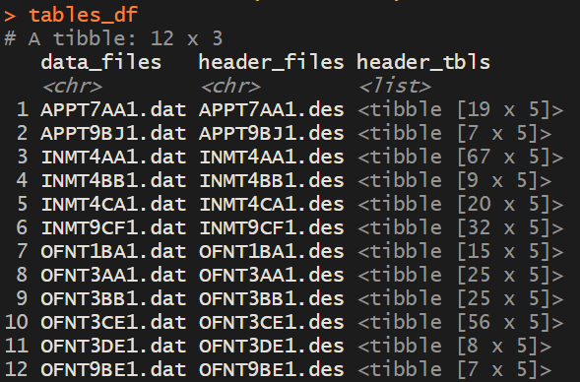
Example: nest data
tables_df = tibble(data_files = list.files(pattern = "*.dat$"),
header_files = list.files(pattern = "*.des$"),) %>%
mutate(header_tbls = map(header_files, ~ read_header_file(.x)))
tables_df %>% unnest(header_tbls)

Slide 10
Example: nesting w/ births
NOTE: Dplyr can do this (better!) /c it's crude! But for more complex models…
Prep:
model_data = births_sm %>%
mutate(preterm = if_else(preterm_f == "preterm", 1, 0)) %>%
mutate(pnc5 = if_else(pnc5_f == "Early PNC", 1, 0)) %>%
left_join(nc %>% st_set_geometry(NULL) %>%
mutate(cores = COUNTYFP %>% as.numeric) %>%
select(county_name = NAME, cores)) %>% as_tibble()

Slide 11
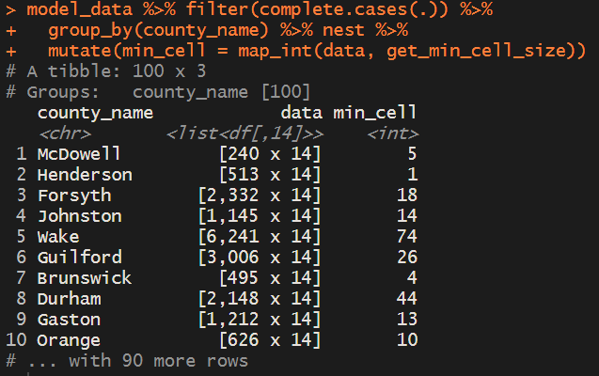
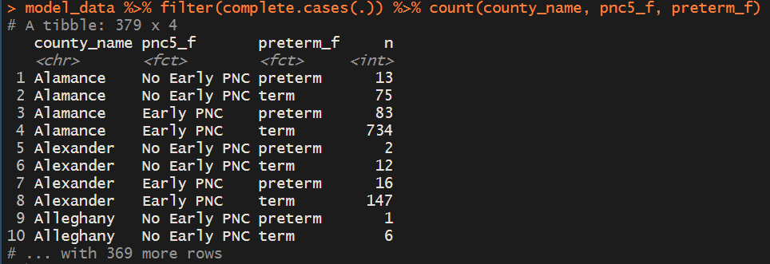
Example: nesting w/ births
Preparing for a RD model…uh oh!
table(model_data[, c("preterm", "pnc5")]) %>% min
get_min_cell_size = function(tbl, v = c("preterm", "pnc5")){
tbl[,v] %>% table %>% min
}
model_data %>% get_min_cell_size
model_data %>% filter(complete.cases(.)) %>% count(county_name, pnc5_f, preterm_f)
model_data %>% filter(complete.cases(.)) %>%
group_by(county_name) %>% nest %>%
mutate(min_cell = map_int(data, get_min_cell_size))

Slide 12
Example: nesting w/ births
Wrap my model in a function.
Given a dataset (of known specification!)….
return a model.
get_rd_model = function(tbl){ # Mike's (crude, this time) model
glm(data = tbl, preterm ~ pnc5_f, family=gaussian(link="identity"))
}

Slide 13
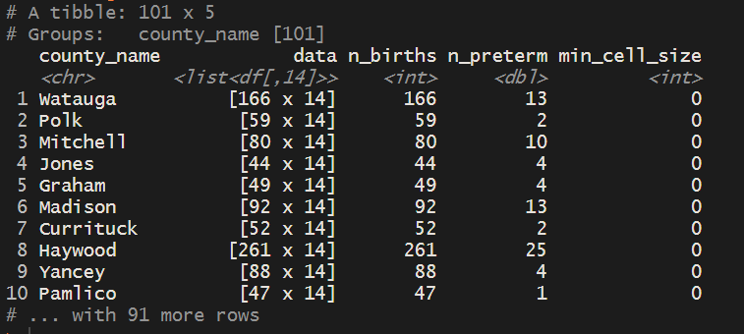
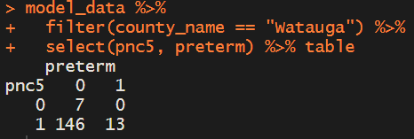
Example: nesting w/ births
Yep, uh oh.
model_data %>%
filter(!is.na(preterm), !is.na(pnc5)) %>%
group_by(county_name) %>% nest() %>% # like summarize, but kept my data
mutate(n_births = map_int(data, nrow),
n_preterm = map_dbl(data, ~sum(.x$preterm)),
min_cell_size = map_int(data, get_min_cell_size)) %>%
arrange(min_cell_size)

Slide 14
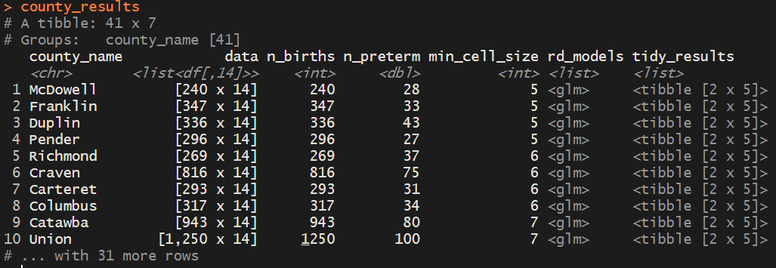
Example: nesting w/ births
county_results = model_data %>%
filter(!is.na(preterm), !is.na(pnc5)) %>%
group_by(county_name) %>% nest() %>% # like summarize, but kept my data
mutate(n_births = map_int(data, nrow),
n_preterm = map_dbl(data, ~sum(.x$preterm)),
min_cell_size = map_int(data, get_min_cell_size)) %>%
arrange(min_cell_size) %>% # uh oh!
filter(min_cell_size > 4) %>% # 1 2 or 3 will error!
mutate(rd_models = map(data, get_rd_model)) %>%
mutate(tidy_results = map(rd_models, broom::tidy))
county_results

Slide 15
Example: nesting w/ births
BIRTHS
county_results_clean = county_results %>%
select(county_name, n_births, n_preterm, min_cell_size, tidy_results) %>%
unnest(tidy_results) %>%
filter(term == "pnc5_fEarly PNC")

Slide 16
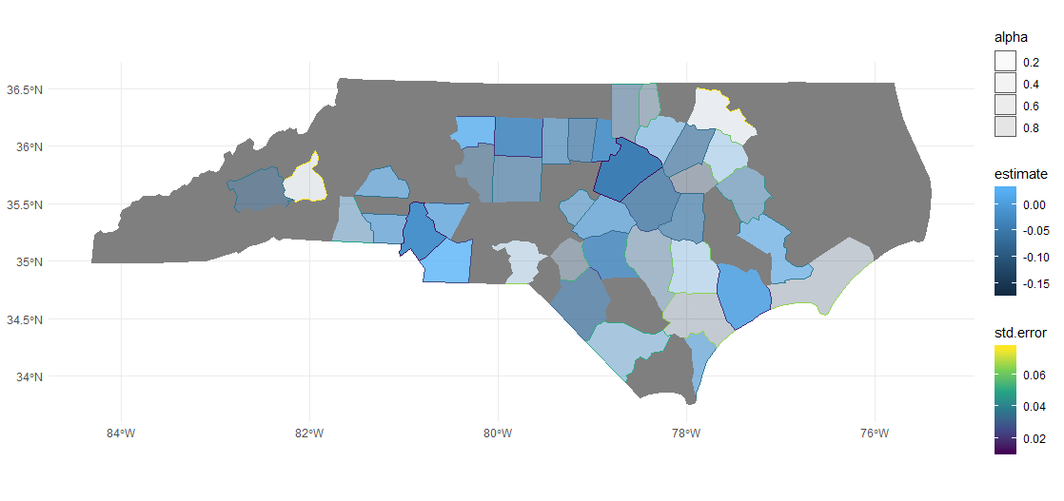
Example: nesting w/ births
Map it
scale01 = function(x){(x-min(x)) / (max(x) - min(x))} # helper function. Push st.error to 0-1
nc %>% left_join(county_results_clean, by = c("NAME" = "county_name")) %>%
mutate(alpha = 1-(scale(std.error)/6+0.5)) %>%
ggplot(aes(fill = estimate, color = std.error, alpha = alpha, geometry = geometry)) +
geom_sf() + scale_color_viridis_c(option="magma") + theme_minimal()

Slide 17
Example: adverbs!

Slide 18
Example: nesting w/ births
possibly(), given a function, returns a new function
county_results = model_data %>%
filter(!is.na(preterm), !is.na(pnc5)) %>%
group_by(county_name) %>% nest() %>% # like summarize, but kept my data
mutate(n_births = map_int(data, nrow),
n_preterm = map_dbl(data, ~sum(.x$preterm)),
min_cell_size = map_int(data, get_min_cell_size)) %>%
arrange(min_cell_size) %>% # uh oh!
filter(min_cell_size > 4) %>% # try 1 2 or 3!
mutate(rd_models = map(data, get_rd_model)) %>%
# mutate(rd_models = map(data, ~ possibly(get_rd_model, otherwise = list(NULL))(.x))) %>%
mutate(tidy_results = map(rd_models, broom::tidy))
# mutate(tidy_results = map(rd_models, possibly(broom::tidy, otherwise = list(NULL))))
county_results

Slide 19
Nesting: opioid action plan
# _ ED data ####
ed_data = tibble(measure_id = "ED_overdose", filename = "NCDETECT/OverdoseReport.202002.csv") %>%
mutate(orig_data = read_csv(filename) %>% list,
file_facts = get_file_facts(filename) %>% list) #TODO: collapse to char?
ed_data$harmonized_data = ed_data$orig_data[[1]] %>%
mutate(place = county,
place_type = "Counties",
date = lubridate::ymd(paste0(as.character(YYYYMM), "01")),
date_span = "month",
value_count = Opioid,
precision_type = "Actual",
notes = "") %>%
mutate(year = year(date)) %>% left_join(pop_data) %>% mutate(rate_denom = rate_denom / 12) %>% # rt parts
select(place, place_type, date, date_span, value_count, rate_denom, precision_type, notes) %>%
list

Slide 20
Nesting: opioid action plan
harmonized_step = bind_rows(ed_data, death_data,
pills_data, illict_data,
comm_naloxone_data, acute_hep_c_data,
bup_script_data, opioid_dx_un_data,
action_data) %>%
mutate(harmonized_data = map(harmonized_data, drop_blanks))
harmonized_step

Slide 21
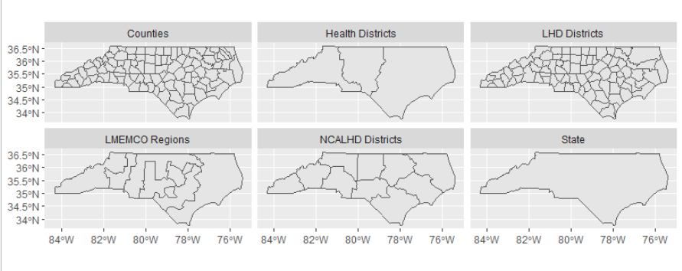
Nesting: opioid action plan
region_step = harmonized_step %>%
mutate(region_data = map(harmonized_data, append_regions, place_tbl = place_tbl))
map_shapes = counties %>% rbind(regions)
map_shapes %>% st_write("maps/oap_map_shapes.shp", delete_layer=TRUE)
ggplot(map_shapes) + geom_sf()+ facet_wrap( ~ place_type) # My god. Beautiful.
ggsave("Region map.png")

Slide 22
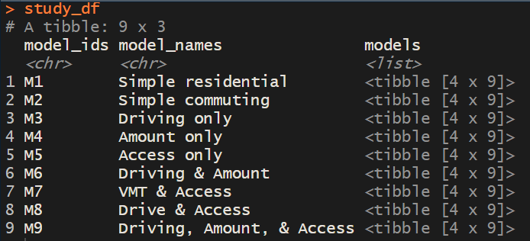
Example: deep nesting: dissertation

Slide 23
Sidenote for large analyses….
#..........................
# Libraries and previous work
#..........................
setwd("D:/User/Dropbox (Personal)/Education/Dissertation/Dissertation Code/A1_NC/")
source("00_Libraries and Constants.R")
if (!("blockcentroids_sf" %in% ls())){load(get_out_dir("01_catchment_env.rdata"))}
if (!("VMT_df" %in% ls())){load(get_out_dir("02_VMT_df.rdata"))}
if (!("grid_sf" %in% ls())){load(get_out_dir("03_grid_sf.rdata"))}
if (!("get_unidirectional_VMT" %in% ls())){load(get_out_dir("04_mike_vmt_function.rdata"))}
if (!("base_model" %in% ls())){load(get_out_dir("05_base_model.rdata"))}
if (!("stop_counts" %in% ls())){load(get_out_dir("06_agency_stop_counts.rdata"))}
if (!("agency_total_counts" %in% ls())){load(get_out_dir("07_agency_total_counts.rdata"))}
if (!("fill_model" %in% ls())){source("08_main_analysis_functions.R")} # also runs the test model
#.............................

Slide 24
furrr = future purrr
Map-Reduce framework from distributed computing
Simply replace map_*() function with future_map_*() equivalent to distribute tasks across all processors
.progress = T parameter gives you a nice progress bar (like in the read_csv() for big files

Slide 25
furrr = future purrr
study_df$filled_models = future_pmap(study_df %>% dplyr::select(model_names, this_model=models),
.f = fill_model,
.progress = T)
#.............................
# Fill models ####
#.............................
fill_model = function(model_names, this_model){
print(paste("Processing model: ", model_names))
t=Sys.time(); print(t)
this_model$vmt_grid = pmap(this_model %>%
dplyr::select(strata, total_vmt, dist_fun, access_pct) %>%
rename(this_strata = strata, this_total_vmt = total_vmt,
this_dist_fun = dist_fun, this_access_pct = access_pct),
get_vmt_sum_grid,
pop_points = pop_points, this_grid_sf = grid_sf)
this_model$vmt_grid = get_stabilized_vmt_grid(this_model)
this_model$lea_vmt = setNames(map(this_model$vmt_grid, get_lea_vmts), strata)
# ……..

Slide 26
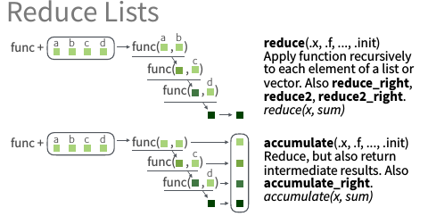
reduce(): e.g., cascade linkage

Slide 27
reduce(): e.g., cascade linkage
# df_a = crashes_to_match; df_b = deaths_to_match; link_params = link_commands %>% slice(12)
cascade_linkage = function(prev_linked_ids = NULL, link_params, df_a, df_b){
# Find UID names
df_a_uid = df_a %>% names %>% str_detect("uid") %>% names(df_a)[.]
df_b_uid = df_b %>% names %>% str_detect("uid") %>% names(df_b)[.]
# Interpret link params
link_descr = link_params %>% select(matches("link_"))
link_params = link_params %>% select(matches("l_"))
exact_params = link_params %>% slice(1) %>% map_lgl(~ !is.na(.x) & .x == 0) %>%
enframe() %>% filter(value) %>% pull(name) # TODO Clean up
filter_param_names = link_params %>% slice(1) %>% map_lgl(~ !is.na(.x) & .x > 0) %>%
enframe() %>% filter(value) %>% pull(name) # TODO Clean up
filter_params = link_params %>% select(filter_param_names)
# ignore_params - implicit (removing NAs)
#Subset to uids not already found, given n=1 (could try n=...3)
if(!is_null(prev_linked_ids)){
df_a = df_a %>% filter(!(df_a[[df_a_uid]] %in% prev_linked_ids[[df_a_uid]]))
}

Slide 28
reduce(): e.g., cascade linkage
# df_a = crashes_to_match; df_b = deaths_to_match; link_params = link_commands %>% slice(12)
cascade_linkage = function(prev_linked_ids = NULL, link_params, df_a, df_b){
# subset df_a to just those not previously linked
# left join what we can based on link params (NA)
# filter variables for a fuzzy match
# return new joined dataset of previous linked IDs, and the new ones I found
}
tic("Cascade linkage test: deaths. Est. 15s")
linked_ids = reduce(.x=link_commands %>% mutate(r =1:n()) %>% group_by(r) %>% nest %>% pull(data), # iterate over link commands
.f=cascade_linkage,
df_a = df_a,
df_b = df_b,
.init = NULL) # no known links yet
toc()

Slide 29
reduce(): e.g., cascade linkage
# Left join
linked_ids = df_a %>% inner_join(df_b, by=exact_params) %>% #head(2) %>% t
select(df_a_uid, df_b_uid) %>%
mutate(link_id = link_descr$link_id, link_name = link_descr$link_name) %>%
select(link_id, link_name, everything())
# Filters
if(length(filter_params) != 0){
# get_var_dist for each filter_params
# df_A_subset = df_A %>% filter()
joined_data = linked_ids %>% left_join(df_a, by=df_a_uid) %>% left_join(df_b, by=df_b_uid)
to_filter = map_dfc(filter_param_names, get_var_dist, linked_ids %>% left_join(df_a, by=df_a_uid),
linked_ids %>% left_join(df_b, by=df_b_uid), explicit_missing = F)
filter_results = map2_dfc(to_filter, filter_params, ~ if_else(is.na(.x), F, .x <= .y))
full_filter = filter_results %>% array_tree(1) %>% map_lgl(all)
linked_ids = linked_ids %>% filter(full_filter)
}
# Return bound rows with previous ids
if(prev_linked_ids %>% is_null){return(linked_ids)} # %>% head(3)
return(bind_rows(prev_linked_ids, linked_ids))
}

Slide 30
Complexity, Algorithms, Speed
Big O notation
Thinking critically

Slide 31
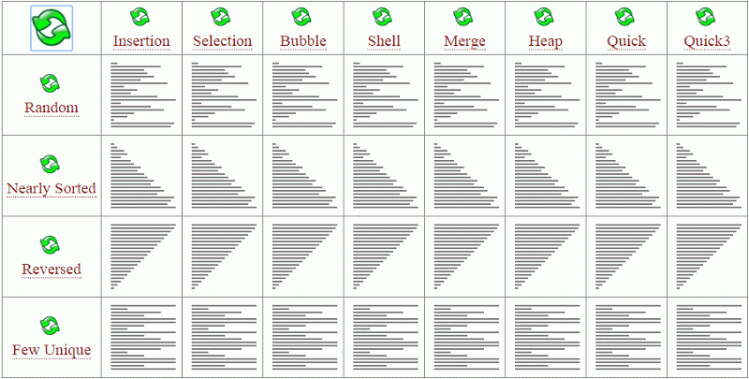
Algorithm Complexity Theory
'Big O notation' is from computer science algorithmic complexity theory.
Classic example is sorting.
E.g. Bubble is O(n²) but Quick is O(N log N) (faster)

Slide 32
Relevance for R?
Be conscious of memory & speed trade offs
… and sometimes a little efficiency helps both a lot

Slide 33
Examples
Reading 100 very large files, deduplicating them.
Worried about memory? Prune as you go, even if perhaps less efficient.
Memory no obstacle? Consider loading them all in (nesting?) and duplicating once
Spatial – calculate avg pop centroid distance to nearest 10 hospitals vs. alcohol / tobacco outlets
Memory no object? Calculate all distances, take avg of min 10 of each row.
Or maybe calculate "viewing window" first (20mi buffer?) then do the math.

Slide 34
Not theoretical at all!
#.......................
# > Build new records function ####
#.......................
new_records = function(data1, file2, format2){
data2 = read_fwf(file2,
col_positions = fwf_positions(format2$start, format2$end, format2$var),
col_types=rep("c", format2 %>% nrow) %>% paste0(collapse = ""))
if(is.na(data1)){return(data2)}
data2 %>% anti_join(data1)
}

Slide 35
TAKEAWAYS
Use purrr to abstract and organize your work at a higher level. Think rectangularly / parallelly
Using purrr over loops empowers new approaches, functional programming (nesting, parallel processing)
Consider algorithmic complexity…when you need to! Code complexity is its own drain along with memory and processing time.

Slide 36
DONE!
Turn in homework 6
2 classes left:
Other models 1 & 2
Presentation materials due 4/14
Presentation classes 4/16 & 4/21

