Slide 1
Special Topics: Other Model Types in R
EPID 701, Lecture 23
Thursday, 9 April 2020
Hillary Topazian

Slide 2
Overview & Acknowledgements
Survival analysis
Multilevel modeling
Superstars Sarah Levintow and Nick Brazeau ☺
I am still new to this and learning with you!

Slide 3
Intro to Survival Analysis
Epidemiological methods to analyze time-to-event outcomes:
Time until death (a.k.a., survival)
Time until disease occurrence
Time until treatment initiation or discontinuation
Evaluate effect of treatment on the outcome – both occurrence and timing of the event of interest.
library(tidyverse)
library(survival)
library(ggfortify)
library(survminer)
library(ggkm) # run this code to install - devtools::install_github("sachsmc/ggkm") library(survutils)

Slide 4
Intro to Survival Analysis
Single ascertainment of presence/absence of the outcome:
vs.
Measure outcomes over time:
Treatment
Outcome
Treatment
A=1
Treatment
A=0
Follow-up time (t) for
Outcome

Slide 5
Survival Methods
Survival at time t: Probability of event-free survival up to time t.
This is the complement of the cumulative risk of the event.
Cumulative risk at time t: Risk(t) = 1 – Survival(t)
Hazard at time t: Instantaneous rate of events. Conditional probability of the event at time t, given survival to time t.

Slide 6
Survival Methods
Kaplan-Meier is a non-parametric estimator of survival.
Defined as the cumulative product of the estimated probability of not incurring an event.
Other non-parametric estimators: Nelson-Aalen (cumulative hazard), Aalen-Johansen (competing events).
Parametric survival methods assume the underlying distribution of the survival times follows a known probability distribution.
Exponential, Weibull, lognormal, etc.
Cox proportional hazards model is a semiparametric approach, used to estimate the relationship between the hazard function and predictor variables.

Slide 7
Survival Analysis in R
Lots of package options!
Core survival analysis methods: survival (most other packages rely on it)
Survival plots: ggfortify and survminer
Tidy your Cox models: survutils
Dealing with competing risks: cmprsk
More here: https://cran.r-project.org/web/views/Survival.html

Slide 8
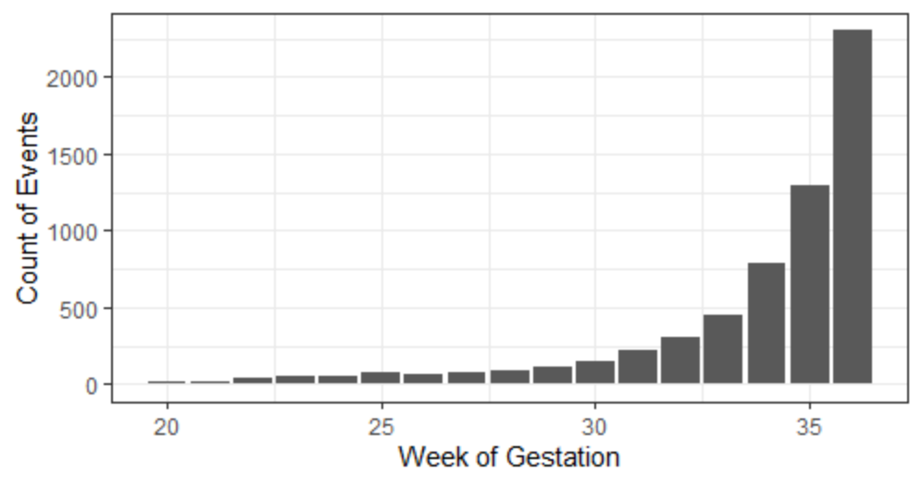
Births Example
Preterm birth as a time-to-event outcome.
Time to event: wksgest
Event status: preterm
Risk period: 20-36 weeks of gestation
# Dependent variable for survival analysis is two-part: the time to event (wksgest) and the event status (preterm)
births %>%
filter(preterm_f=="preterm") %>%
ggplot(aes(x=wksgest)) +
geom_bar() +
ylab("Count of Events") +
xlab("Week of Gestation") +
theme_bw()

Slide 9
Survival objects
# Fit a basic survival model
s <- survival::survfit(Surv(wksgest, preterm) ~ 1, data=births, type="kaplan-meier")
https://www.rdocumentation.org/packages/survival/versions/3.1-11/topics/Surv
https://www.rdocumentation.org/packages/survival/versions/2.11-4/topics/survfit

Slide 10
Survival objects
> str(s)
List of 16
$ n : int 62370
$ time : num [1:26] 20 21 22 23 24 25 26 27 28 29 ...
$ n.risk : num [1:26] 62370 62352 62330 62287 62239 ...
$ n.event : num [1:26] 18 22 43 48 55 72 63 75 89 111 ...
$ n.censor : num [1:26] 0 0 0 0 0 0 0 0 0 0 ...
$ surv : num [1:26] 1 0.999 0.999 0.998 0.997 ...
$ std.err : num [1:26] 0.000068 0.000101 0.000146 0.000184 0.000219 ...
$ cumhaz : num [1:26] 0.000289 0.000641 0.001331 0.002102 0.002986 ...
$ std.chaz : num [1:26] 0.000068 0.000101 0.000146 0.000184 0.000219 ...
$ type : chr "right"
$ logse : logi TRUE
$ conf.int : num 0.95
$ conf.type: chr "log"
$ lower : num [1:26] 1 0.999 0.998 0.998 0.997 ...
$ upper : num [1:26] 1 1 0.999 0.998 0.997 ...
$ call : language survfit(formula = Surv(wksgest, preterm) ~ 1, data = births, type = "kaplan-meier")
- attr(*, "class")= chr "survfit"
# Check out the survival object
str(s)

Slide 11
Survival objects
> str(s)
List of 16
$ n : int 62370
$ time : num [1:26] 20 21 22 23 24 25 26 27 28 29 ...
$ n.risk : num [1:26] 62370 62352 62330 62287 62239 ...
$ n.event : num [1:26] 18 22 43 48 55 72 63 75 89 111 ...
$ n.censor : num [1:26] 0 0 0 0 0 0 0 0 0 0 ...
$ surv : num [1:26] 1 0.999 0.999 0.998 0.997 ...
$ std.err : num [1:26] 0.000068 0.000101 0.000146 0.000184 0.000219 ...
$ cumhaz : num [1:26] 0.000289 0.000641 0.001331 0.002102 0.002986 ...
$ std.chaz : num [1:26] 0.000068 0.000101 0.000146 0.000184 0.000219 ...
$ type : chr "right"
$ logse : logi TRUE
$ conf.int : num 0.95
$ conf.type: chr "log"
$ lower : num [1:26] 1 0.999 0.998 0.998 0.997 ...
$ upper : num [1:26] 1 1 0.999 0.998 0.997 ...
$ call : language survfit(formula = Surv(wksgest, preterm) ~ 1, data = births, type = "kaplan-meier")
- attr(*, "class")= chr "survfit"
# Check out the survival object
str(s)
# Check counts manually
table(births$preterm_f, births$wksgest)
> table(births$preterm_f, births$wksgest)
20 21 22 23 24 25 26 27 28 29
preterm 18 22 43 48 55 72 63 75 89 111
term 0 0 0 0 0 0 0 0 0 0

Slide 12
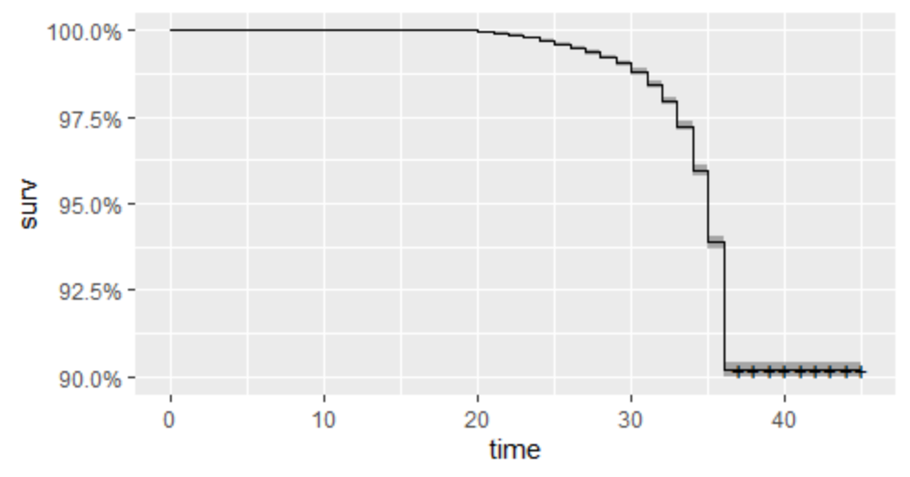
Graphing survival objects
# Quick one-line plot
ggplot2::autoplot(s)

Slide 13
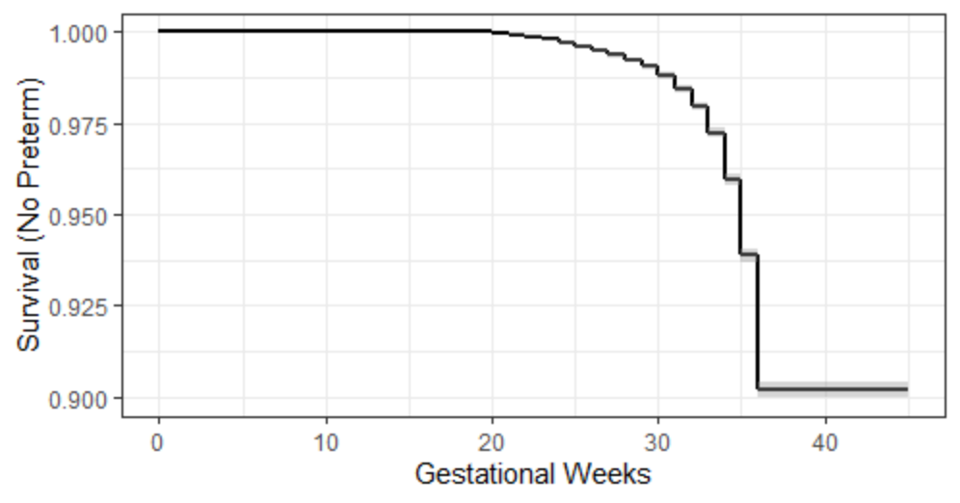
Graphing survival objects
# Try out plotting using 'geom_km’
ggplot(births, aes(time = wksgest, status = preterm)) +
ggkm::geom_km() +
ggkm::geom_kmband() +
xlab("Gestational Weeks") +
ylab("Survival (No Preterm)") +
theme_bw()
Survival plots w/ table of counts
https://github.com/michaelway/ggkm

Slide 14
Tidy survival objects
# Summary of survival data
s_table <- tidy(s); s_table
> s_table <- tidy(s); s_table
# A tibble: 26 x 8
time n.risk n.event n.censor estimate std.error conf.high conf.low
<dbl> <dbl> <dbl> <dbl> <dbl> <dbl> <dbl> <dbl>
1 20 62370 18 0 1.00 0.0000680 1.00 1.00
2 21 62352 22 0 0.999 0.000101 1.00 0.999
3 22 62330 43 0 0.999 0.000146 0.999 0.998
4 23 62287 48 0 0.998 0.000184 0.998 0.998
5 24 62239 55 0 0.997 0.000219 0.997 0.997
6 25 62184 72 0 0.996 0.000258 0.996 0.995
7 26 62112 63 0 0.995 0.000288 0.995 0.994
8 27 62049 75 0 0.994 0.000320 0.994 0.993
9 28 61974 89 0 0.992 0.000354 0.993 0.992
10 29 61885 111 0 0.990 0.000393 0.991 0.990
# ... with 16 more rows

Slide 15
Summarize survival objects
# Create a data frame with survival data for further analysis/plotting
s_df <- data.frame(
time = s_summary$time,
n_at_risk = s_summary$n.risk,
n_preterm = s_summary$n.event,
survival = s_summary$surv,
risk = 1-s_summary$surv,
lower_ci_risk = 1 - s_summary$upper,
upper_ci_risk = 1 - s_summary$lower)
s_df
> s_df
time n_at_risk n_preterm survival risk lower_ci_risk upper_ci_risk
1 20 62370 18 0.9997114 0.0002886003 0.0001552866 0.0004218962
2 21 62352 22 0.9993587 0.0006413340 0.0004426302 0.0008399983
3 22 62330 43 0.9986692 0.0013307680 0.0010446241 0.0016168299
4 23 62287 48 0.9978996 0.0021003688 0.0017410089 0.0024595993
5 24 62239 55 0.9970178 0.0029822030 0.0025541737 0.0034100486
6 25 62184 72 0.9958634 0.0041366041 0.0036327650 0.0046401885
7 26 62112 63 0.9948533 0.0051467051 0.0045849760 0.0057081173
8 27 62049 75 0.9936508 0.0063492063 0.0057256538 0.0069723678
9 28 61974 89 0.9922238 0.0077761744 0.0070865718 0.0084652981
10 29 61885 111 0.9904441 0.0095558762 0.0087920794 0.0103190845
11 30 61774 149 0.9880552 0.0119448453 0.0110918857 0.0127970692
12 31 61625 223 0.9844797 0.0155202822 0.0145497110 0.0164898975
13 32 61402 308 0.9795414 0.0204585538 0.0193469362 0.0215689113
14 33 61094 453 0.9722783 0.0277216611 0.0264323642 0.0290092505
15 34 60641 787 0.9596601 0.0403399070 0.0387945251 0.0418828043
16 35 59854 1298 0.9388488 0.0611511945 0.0592688655 0.0630297570
17 36 58556 2300 0.9019721 0.0980278980 0.0956912486 0.1003585097

Slide 16
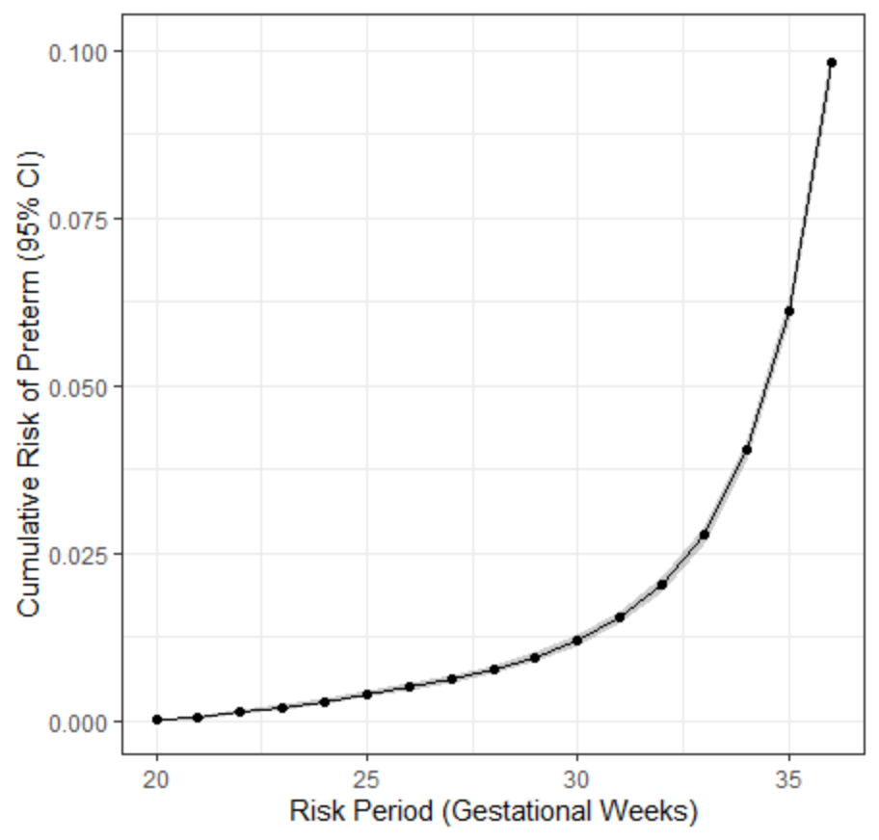
Graphing cumulative risk
# Plot cumulative risk of preterm
ggplot(data=s_df, aes(x=time, y=risk)) +
geom_ribbon(aes(ymin=lower_ci_risk, ymax=upper_ci_risk), alpha=0.25) +
geom_point() +
geom_line() +
theme_bw() +
xlab("Risk Period (Gestational Weeks)") +
ylab("Cumulative Risk of Preterm (95% CI)")

Slide 17
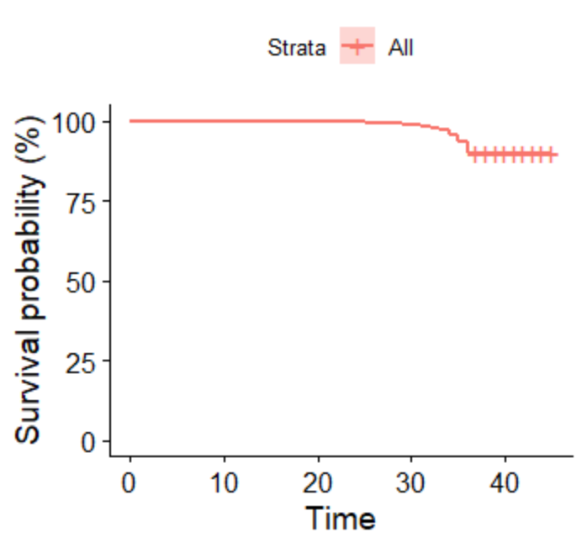
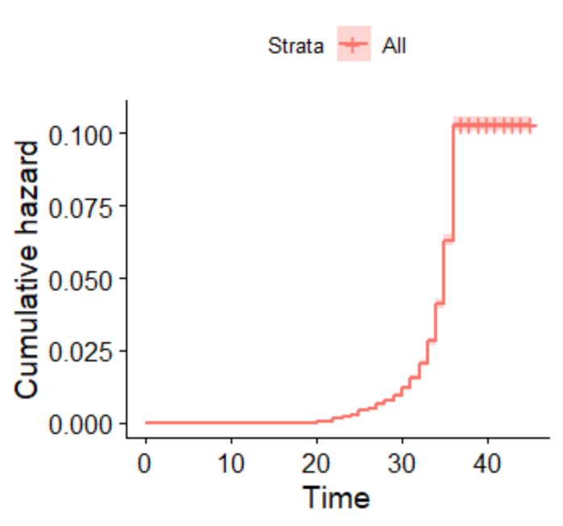
Graphing cumulative risk
# alternatively
ggsurvplot(s, fun = "pct") ggsurvplot(s, fun = "cumhaz")

Slide 18
Stratified survival analysis
> s_by_pnc
Call: survfit(formula = Surv(wksgest, preterm) ~ pnc5_f, data = births,
type = "kaplan-meier")
841 observations deleted due to missingness
pnc5_f=No Early PNC
time n.risk n.event survival std.err lower 95% CI upper 95% CI
20 5442 3 0.999 0.000318 0.999 1.000
21 5439 2 0.999 0.000411 0.998 1.000
22 5437 8 0.998 0.000662 0.996 0.999
23 5429 9 0.996 0.000860 0.994 0.998
24 5420 8 0.994 0.001004 0.993 0.996
25 5412 9 0.993 0.001143 0.991 0.995
26 5403 12 0.991 0.001306 0.988 0.993
27 5391 16 0.988 0.001495 0.985 0.991
28 5375 9 0.986 0.001591 0.983 0.989
29 5366 14 0.983 0.001729 0.980 0.987
30 5352 18 0.980 0.001891 0.976 0.984
31 5334 32 0.974 0.002146 0.970 0.978
32 5302 45 0.966 0.002457 0.961 0.971
33 5257 53 0.956 0.002772 0.951 0.962
34 5204 109 0.936 0.003312 0.930 0.943
35 5095 124 0.913 0.003811 0.906 0.921
36 4971 225 0.872 0.004527 0.863 0.881
pnc5_f=Early PNC
time n.risk n.event survival std.err lower 95% CI upper 95% CI
20 56087 12 1.000 6.18e-05 1.000 1.000
21 56075 19 0.999 9.92e-05 0.999 1.000
22 56056 32 0.999 1.41e-04 0.999 0.999
23 56024 37 0.998 1.78e-04 0.998 0.999
24 55987 47 0.997 2.16e-04 0.997 0.998
25 55940 62 0.996 2.57e-04 0.996 0.997
26 55878 49 0.995 2.86e-04 0.995 0.996
27 55829 56 0.994 3.15e-04 0.994 0.995
28 55773 75 0.993 3.50e-04 0.992 0.994
29 55698 94 0.991 3.90e-04 0.991 0.992
30 55604 125 0.989 4.37e-04 0.988 0.990
31 55479 189 0.986 5.00e-04 0.985 0.987
32 55290 258 0.981 5.74e-04 0.980 0.982
33 55032 388 0.974 6.69e-04 0.973 0.976
34 54644 656 0.963 8.01e-04 0.961 0.964
35 53988 1151 0.942 9.87e-04 0.940 0.944
36 52837 2040 0.906 1.23e-03 0.903 0.908
# Time-to-Preterm (by pnc5)
# Fit a survival model by prenatal care group
s2 <- survival::survfit(Surv(wksgest, preterm) ~ pnc5, data=births, type="kaplan-meier")
s_by_pnc <- summary(s2)
s_by_pnc
# use tidy()

Slide 19
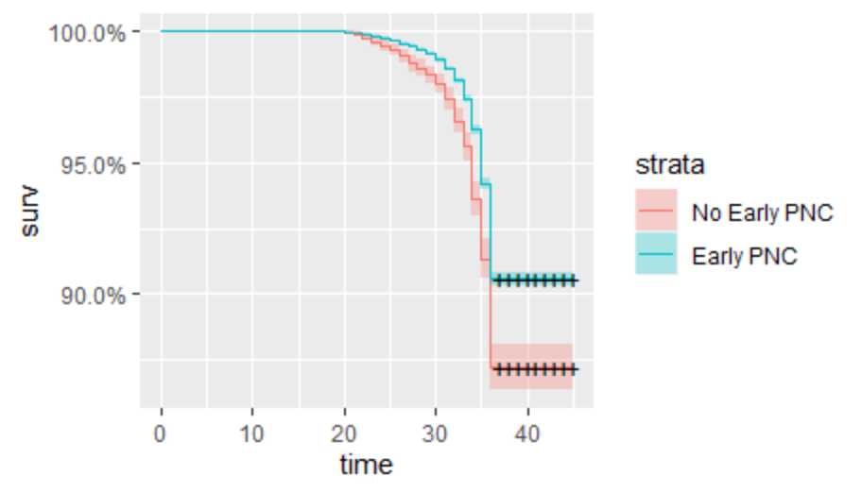
Stratified survival analysis
#Quick plot
ggplot2::autoplot(s2)

Slide 20
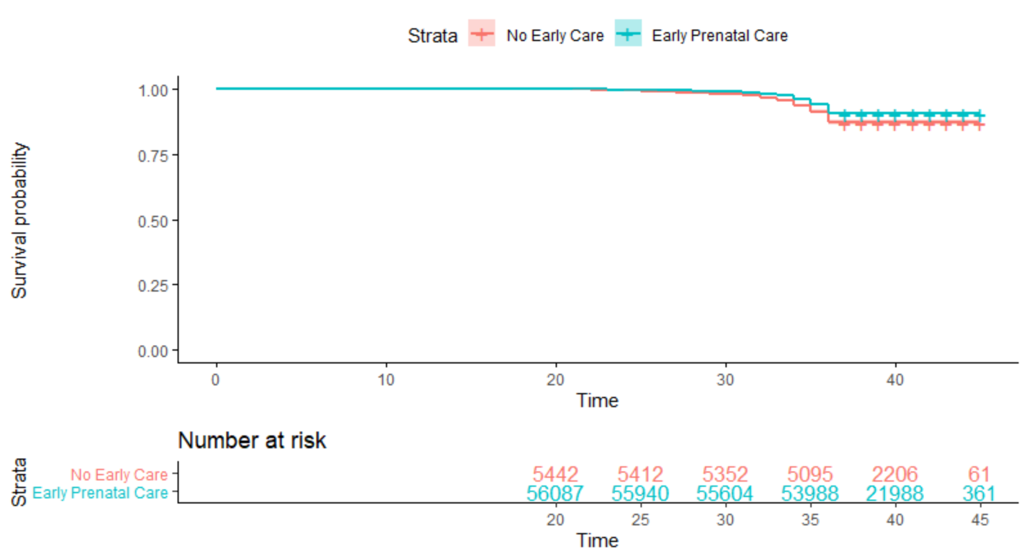
Stratified survival analysis
# Plot with risk table
survminer::ggsurvplot(s2, conf.int = T, risk.table = T, risk.table.col = "strata", legend.labs = c("No Early Care", "Early Prenatal Care"), ggtheme = theme_classic())

Slide 21
Stratified survival analysis
> s_pnc_df
time exposure n_at_risk n_preterm survival risk lower_ci_risk upper_ci_risk
1 20 No Early Care 5442 3 0.9994487 0.0005512679 0.000000e+00 0.0011747083
2 21 No Early Care 5439 2 0.9990812 0.0009187799 1.134943e-04 0.0017234169
3 22 No Early Care 5437 8 0.9976112 0.0023888276 1.090978e-03 0.0036849906
4 23 No Early Care 5429 9 0.9959574 0.0040426314 2.355345e-03 0.0057270644
5 24 No Early Care 5420 8 0.9944873 0.0055126792 3.543526e-03 0.0074779406
6 25 No Early Care 5412 9 0.9928335 0.0071664829 4.922858e-03 0.0094050494
7 26 No Early Care 5403 12 0.9906284 0.0093715546 6.808303e-03 0.0119281913
8 27 No Early Care 5391 16 0.9876883 0.0123116501 9.377508e-03 0.0152371020
9 28 No Early Care 5375 9 0.9860345 0.0139654539 1.084276e-02 0.0170782881
10 29 No Early Care 5366 14 0.9834620 0.0165380375 1.314383e-02 0.0199205675
11 30 No Early Care 5352 18 0.9801544 0.0198456450 1.613312e-02 0.0235441652
12 31 No Early Care 5334 32 0.9742742 0.0257258361 2.151050e-02 0.0299230104
13 32 No Early Care 5302 45 0.9660051 0.0339948548 2.916818e-02 0.0387975310
14 33 No Early Care 5257 53 0.9562661 0.0437339214 3.828511e-02 0.0491518614
15 34 No Early Care 5204 109 0.9362367 0.0637633223 5.724923e-02 0.0702324000
16 35 No Early Care 5095 124 0.9134509 0.0865490628 7.904805e-02 0.0939889776
17 36 No Early Care 4971 225 0.8721058 0.1278941566 1.189757e-01 0.1367223390
18 20 Early Care 56087 12 0.9997860 0.0002139533 9.290568e-05 0.0003349863
19 21 Early Care 56075 19 0.9994473 0.0005527127 3.581817e-04 0.0007472059
20 22 Early Care 56056 32 0.9988767 0.0011232549 8.460044e-04 0.0014004285
21 23 Early Care 56024 37 0.9982171 0.0017829444 1.433744e-03 0.0021320223
22 24 Early Care 55987 47 0.9973791 0.0026209282 2.197708e-03 0.0030439693
23 25 Early Care 55940 62 0.9962736 0.0037263537 3.221973e-03 0.0042304789
24 26 Early Care 55878 49 0.9954000 0.0045999964 4.039830e-03 0.0051598473
25 27 Early Care 55829 56 0.9944016 0.0055984453 4.980761e-03 0.0062157460
26 28 Early Care 55773 75 0.9930643 0.0069356535 6.248586e-03 0.0076222463
27 29 Early Care 55698 94 0.9913884 0.0086116212 7.846643e-03 0.0093760093
28 30 Early Care 55604 125 0.9891597 0.0108403017 9.982950e-03 0.0116969109
29 31 Early Care 55479 189 0.9857899 0.0142100665 1.323007e-02 0.0151890863
30 32 Early Care 55290 258 0.9811899 0.0188100629 1.768510e-02 0.0199337357
31 33 Early Care 55032 388 0.9742721 0.0257278870 2.441674e-02 0.0270372715
32 34 Early Care 54644 656 0.9625760 0.0374240020 3.585196e-02 0.0389934803
33 35 Early Care 53988 1151 0.9420543 0.0579456915 5.601011e-02 0.0598773036
34 36 Early Care 52837 2040 0.9056822 0.0943177563 9.189571e-02 0.0967333386
# Create a data frame
s_pnc_df <- data.frame(
time = s_by_pnc$time,
exposure = factor(as.numeric(s_by_pnc$strata), levels = c(1,2), labels=c("No Early Care", "Early Care")),
n_at_risk = s_by_pnc$n.risk,
n_preterm = s_by_pnc$n.event,
survival = s_by_pnc$surv,
risk = 1 – s_by_pnc$surv,
lower_ci_risk = 1 – s_by_pnc$upper,
upper_ci_risk = 1 – s_by_pnc$lower)
s_pnc_df

Slide 22
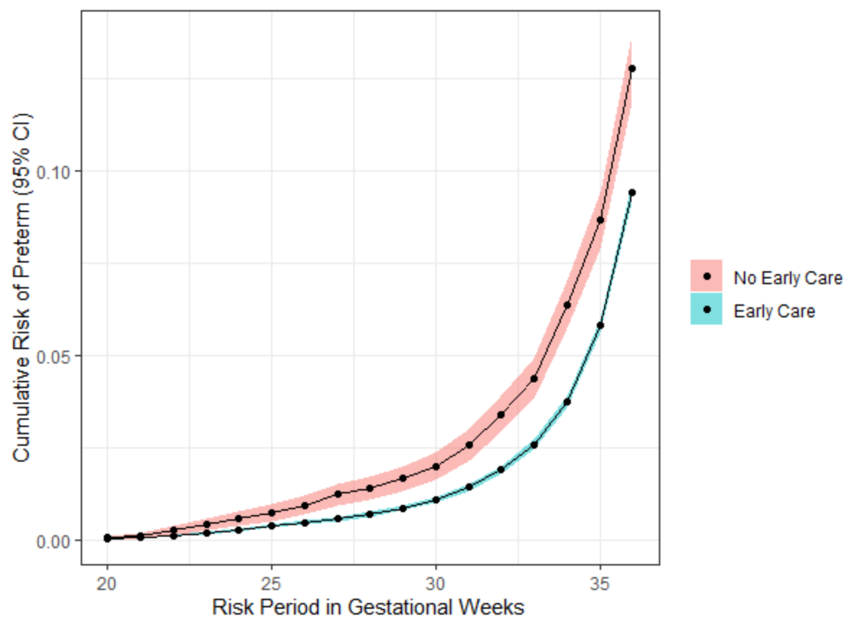
Stratified survival analysis
# Plot cumulative risk by exposure group
ggplot(data=s_pnc_df, aes(x=time, y=risk, group=exposure, fill=exposure)) +
geom_ribbon(aes(ymin=lower_ci_risk, ymax=upper_ci_risk), alpha=0.5) +
geom_point() +
geom_line() +
theme_bw() +
xlab("Risk Period in Gestational Weeks") +
ylab("Cumulative Risk of Preterm (95% CI)") +
theme(legend.title = element_blank())

Slide 23
Stratified survival analysis
# Log-rank test: difference between the survival curves
survival::survdiff(Surv(wksgest, preterm) ~ pnc5_f, data=births)
> survival::survdiff(Surv(wksgest, preterm) ~ pnc5_f, data=births)
Call:
survival::survdiff(formula = Surv(wksgest, preterm) ~ pnc5_f,
data = births)
n=61529, 841 observations deleted due to missingness.
N Observed Expected (O-E)^2/E (O-E)^2/V
pnc5_f=No Early PNC 5442 696 519 60.65 67.9
pnc5_f=Early PNC 56087 5290 5467 5.75 67.9
Chisq= 67.9 on 1 degrees of freedom, p= <2e-16
https://www.rdocumentation.org/packages/survival/versions/3.1-11/topics/survdiff

Slide 24
Cox models
# Traditional adjustment for confounders is to use a Cox model and estimate hazard ratio
# Unadjusted Cox model
survival::coxph(Surv(wksgest, preterm) ~ pnc5_f, data = births)
> survival::coxph(Surv(wksgest, preterm) ~ pnc5_f, data = births)
Call:
survival::coxph(formula = Surv(wksgest, preterm) ~ pnc5_f, data = births)
coef exp(coef) se(coef) z p
pnc5_fEarly PNC -0.32962 0.71920 0.04032 -8.175 2.96e-16
Likelihood ratio test=61.43 on 1 df, p=4.588e-15
n= 61529, number of events= 5986
(841 observations deleted due to missingness)
https://www.rdocumentation.org/packages/survival/versions/3.1-11/topics/coxph

Slide 25
Adjusting for confounding
# Adjusted Cox model
survival::coxph(Surv(wksgest, preterm) ~ pnc5_f + mage + raceeth_f + smoker_f, data = births)
> survival::coxph(Surv(wksgest, preterm) ~ pnc5_f + mage + raceeth_f + smoker_f, data = births)
Call:
survival::coxph(formula = Surv(wksgest, preterm) ~ pnc5_f + mage +
raceeth_f + smoker_f, data = births)
coef exp(coef) se(coef) z p
pnc5_fEarly PNC -0.231961 0.792977 0.040821 -5.682 1.33e-08
mage 0.004919 1.004931 0.002219 2.217 0.0266
raceeth_fOther 0.237771 1.268419 0.038107 6.240 4.39e-10
raceeth_fWhite Hispanic 0.025406 1.025732 0.091615 0.277 0.7815
raceeth_fAfrican American 0.589207 1.802558 0.029876 19.721 < 2e-16
raceeth_fAmerican Indian or Alaska Native 0.523681 1.688231 0.094337 5.551 2.84e-08
smoker_fSmoker 0.332474 1.394414 0.038576 8.619 < 2e-16
Likelihood ratio test=505.3 on 7 df, p=< 2.2e-16
n= 61497, number of events= 5984
(873 observations deleted due to missingness)
https://www.rdocumentation.org/packages/survival/versions/3.1-11/topics/coxph

Slide 26
Adjusting for confounding
# Tidy Cox output
pnc_cox <- survival::coxph(Surv(wksgest, preterm) ~ pnc5_f + mage + raceeth_f + smoker_f, data = births)
cox_df <- survutils::get_cox_summary(pnc_cox, ci = 95)
cox_df
> cox_df
coef se z p HR HRse HRz HRp HRCILL HRCIUL
pnc5_fEarly PNC -0.232 0.041 -5.682 0.000 0.793 0.032 -6.395 0.000 0.732 0.859
mage 0.005 0.002 2.217 0.027 1.005 0.002 2.211 0.027 1.001 1.009
raceeth_fOther 0.238 0.038 6.240 0.000 1.268 0.048 5.553 0.000 1.177 1.367
raceeth_fWhite Hispanic 0.025 0.092 0.277 0.782 1.026 0.094 0.274 0.784 0.857 1.227
raceeth_fAfrican American 0.589 0.030 19.721 0.000 1.803 0.054 14.903 0.000 1.700 1.911
raceeth_fAmerican Indian or Alaska Native 0.524 0.094 5.551 0.000 1.688 0.159 4.321 0.000 1.403 2.031
smoker_fSmoker 0.332 0.039 8.619 0.000 1.394 0.054 7.332 0.000 1.293 1.504
https://www.rdocumentation.org/packages/survival/versions/3.1-11/topics/coxph

Slide 27
Adjusting for confounding: IPTW
# Alternative: use IPTW to estimate weighted risks and measures of effect
births2 <- births %>%
filter(!is.na(preterm_f) & !is.na(pnc5_f) & !is.na(mage) & !is.na(raceeth_f) & !is.na(smoker_f)) %>%
mutate(pnc5 = case_when(pnc5_f=="No Early PNC"~0, pnc5_f=="Early PNC"~1, TRUE ~ NA_real_))
ps_model <- glm(data = births2, pnc5 ~ mage + raceeth_f + smoker_f, family=binomial("logit"))
births2$ps <- predict(ps_model, type = "response")
births2$iptw_u <- ifelse(births2$pnc5==1, 1/births2$ps, 1/(1-births2$ps))
p_exposure <- sum(births2$pnc5) / nrow(births2)
births2$iptw_s <- ifelse(births2$pnc5==1, p_exposure/births2$ps, (1-p_exposure)/(1-births2$ps))

Slide 28
Adjusting for confounding: IPTW
# Weighted Cox model
survival::coxph(Surv(wksgest, preterm) ~ pnc5, weights = iptw_s, data = births2)
survutils::get_cox_summary( coxph(Surv(wksgest, preterm) ~ pnc5, weights = iptw_s, data = births2), ci = 95)
coef se z p HR HRse HRz HRp HRCILL HRCIUL
pnc5 -0.254 0.042 -6.123 0 0.775 0.032 -6.973 0 0.715 0.841

Slide 29
Adjusting for confounding: IPTW
# Weighted KM survival curves - to get estimates of risk s_by_pnc <- summary( survival::survfit(Surv(wksgest, preterm) ~ pnc5, weights = iptw_s, data=births2, type="kaplan-meier") )
# Dataframe
s_pnc_df <- data.frame(
time = s_by_pnc$time,
exposure = factor(as.numeric(s_by_pnc$strata), levels = c(1,2), labels=c("No Early Care", "Early Care")),
n_at_risk = s_by_pnc$n.risk,
n_preterm = s_by_pnc$n.event,
survival = s_by_pnc$surv,
risk = 1 - s_by_pnc$surv,
lower_ci_risk = 1 - s_by_pnc$upper,
upper_ci_risk = 1 - s_by_pnc$lower)

Slide 30
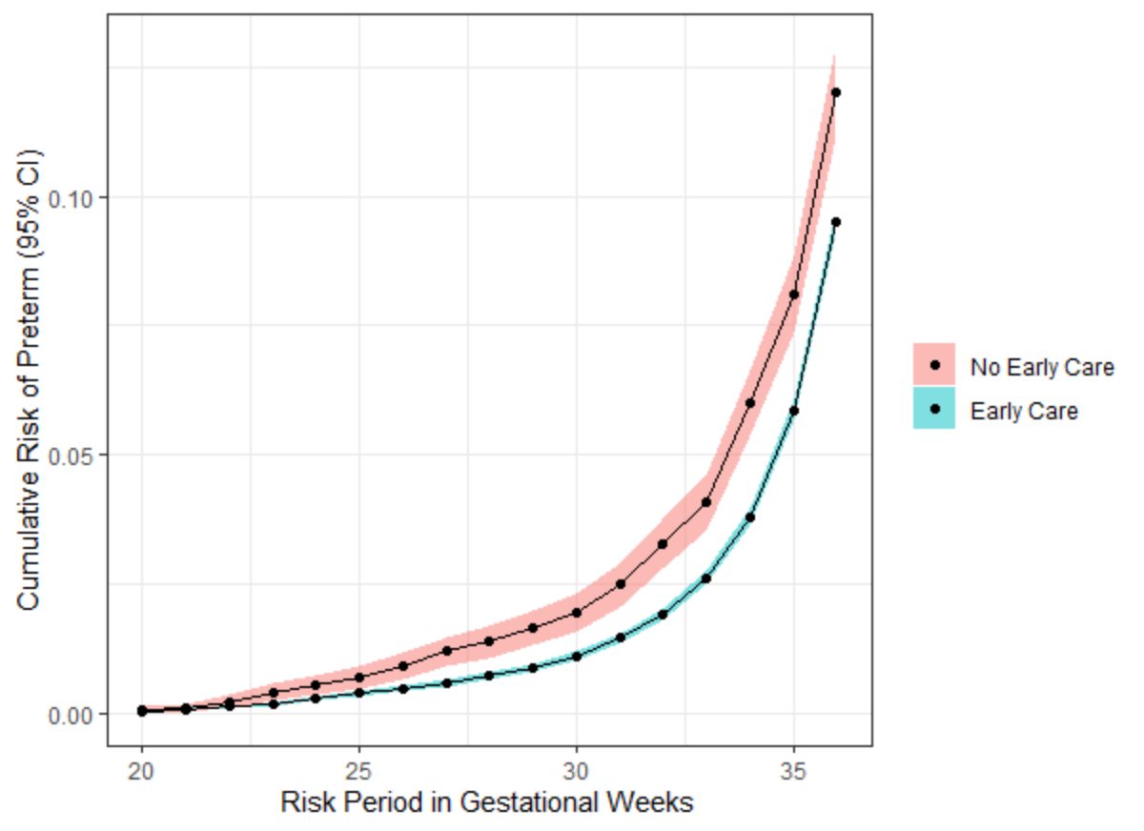
Adjusted cumulative risk
# Plot cumulative risk by exposure group
ggplot(data=s_pnc_df, aes(x=time, y=risk, group=exposure, fill=exposure)) +
geom_ribbon(aes(ymin=lower_ci_risk, ymax=upper_ci_risk), alpha=0.5) +
geom_point() +
geom_line() +
theme_bw() +
xlab("Risk Period in Gestational Weeks") +
ylab("Cumulative Risk of Preterm (95% CI)") +
theme(legend.title = element_blank())

Slide 31
Forest plots
model <- survival::coxph(Surv(wksgest, preterm) ~ pnc5_f + mage + raceeth_f + smoker_f, data = births)
survutils::get_cox_summary(model, ci = 95) %>% select(HR,p)
survminer::ggforest(model)
HR p
pnc5_fEarly PNC 0.793 0.000
mage 1.005 0.027
raceeth_fOther 1.268 0.000
raceeth_fWhite Hispanic 1.026 0.782
raceeth_fAfrican American 1.803 0.000
raceeth_fAmerican Indian or Alaska Native 1.688 0.000
smoker_fSmoker 1.394 0.000

Slide 32
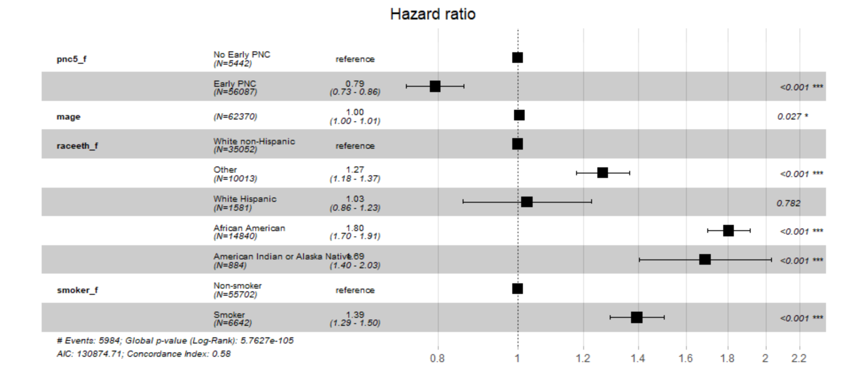
Forest plots
ALERT
Table 2 fallacy
model <- survival::coxph(Surv(wksgest, preterm) ~ pnc5_f + mage + raceeth_f + smoker_f, data = births)
survutils::get_cox_summary(model, ci = 95)
survminer::ggforest(model)

Slide 33
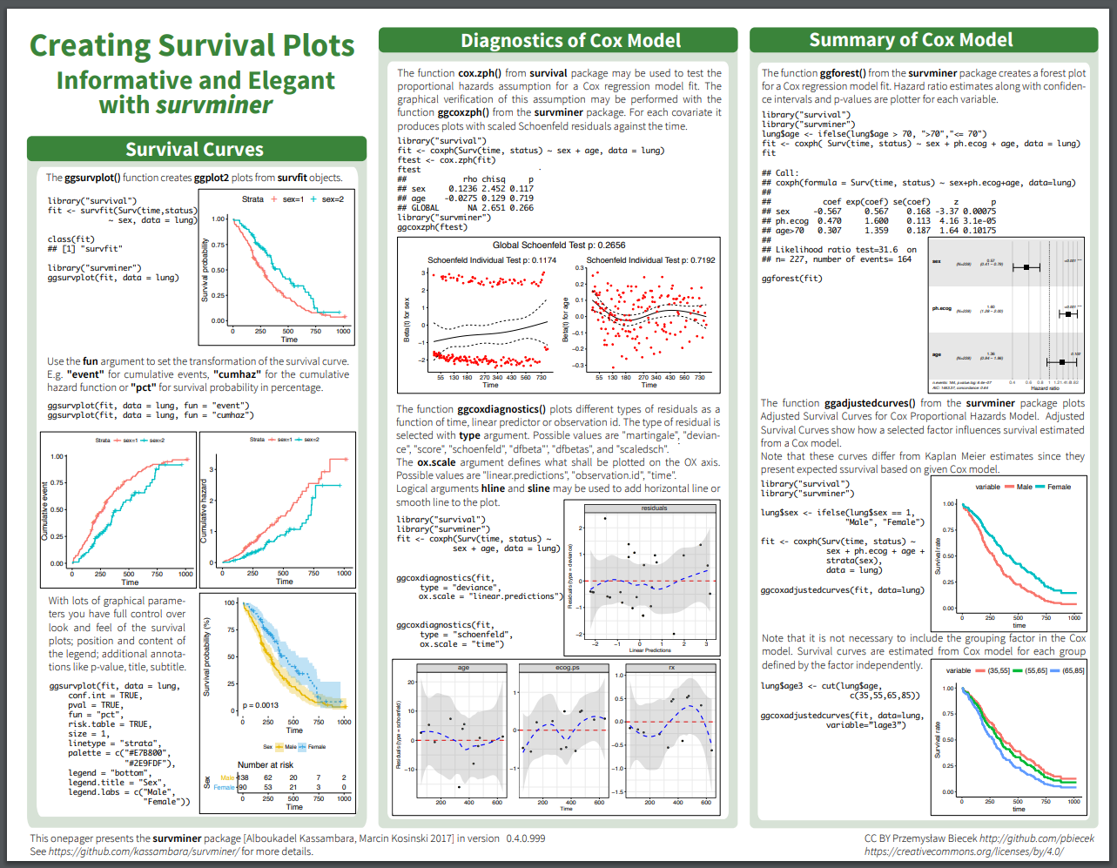
# Plotting help
https://rpkgs.datanovia.com/survminer/survminer_cheatsheet.pdf

Slide 34
Censoring and Competing Events
Survival methods need to account for censoring and competing events in analyzing time-to-event data.
Censoring events (e.g., study drop-out) prevent our observation of the outcome.
Censoring event
Treatment
Outcome

Slide 35
Censoring and Competing Events
Censoring events (e.g., study drop-out) prevent our observation of the outcome.
Informative censoring occurs when there are determinants of both censoring and the outcome.
If not dealt with analytically, can bias risk estimates.
Determinants
Censoring event
Treatment
Outcome

Slide 36
Censoring and Competing Events
Competing events (e.g., death) prevent the occurrence of the outcome.
Treating competing events like censoring events (i.e., assuming outcome could later occur) can bias our estimates of risk.
X
Treatment
Outcome
Competing event
Outcome

Slide 37
IP Weights for Survival Analysis
Confounding: Apply IPTW to survival data
Censoring: Account for potentially informative censoring by applying IPCW.
Competing risks: Use an IP-weighted estimator that allows for multiple event types.
# Check out cmprisk package to appropriately handle competing events in survival analysis
https://cran.r-project.org/web/packages/cmprsk/cmprsk.pdf

Slide 38
Intro to Multilevel Modeling
When to use? When we violate the independence assumption
Non-independence among covariates
Repeated measurements (or the same patient/person/individual)
Sampling from a classroom, village, county, etc.
Clusters differ systematically
# Check out this article w/ J Biebs examples:
Keep Calm and Learn Multilevel Logistic Modeling: A Simplified Three-Step Procedure Using Stata, R, Mplus, and SPSS
https://www.rips-irsp.com/articles/10.5334/irsp.90/

Slide 39
Multilevel Modeling
We can fit a different slope and/or intercept to each cluster (intracluster— “random” effect, grouping factors to control) while accounting for an overall “fixed” effect (variables we think will have an effect on the outcome)
We are trying to determine the [risk, odds, etc] of someone with treatment exposure, i, that is part of cluster, j.
Usually results in coefficients with a smaller variance as opposed to models which stratify.

Slide 40
Resources
Towards Data Science: https://towardsdatascience.com/using-mixed-effects-models-for-linear-regression-7b7941d249b
Multilevel Modeling of Educational Data using R: https://www.r-bloggers.com/multilevel-modeling-of-educational-data-using-r-part-1/
Getting Started with Mixed Effect Modeling in R: https://www.jaredknowles.com/journal/2013/11/25/getting-started-with-mixed-effect-models-in-r
Multilevel Modeling in R: https://rpubs.com/rslbliss/r_mlm_ws
Multilevel Modeling in R (book, $): https://www.amazon.com/Multilevel-Modeling-Statistics-Behavioral-Sciences-ebook-dp-B00L2EBEOO/dp/B00L2EBEOO/

Slide 41
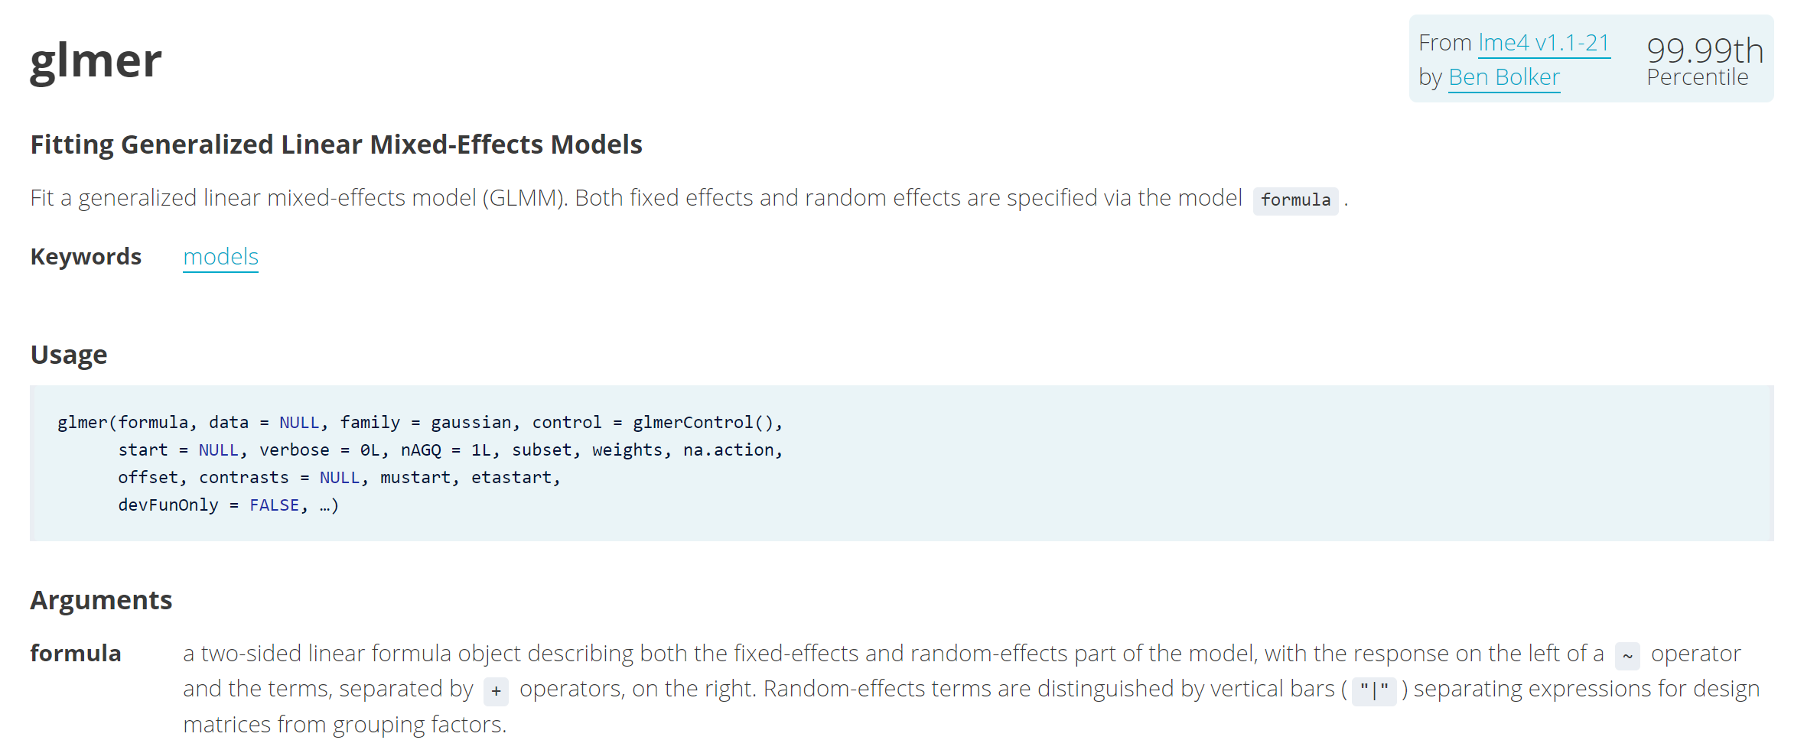
https://www.rdocumentation.org/packages/lme4/versions/1.1-21/topics/glmer

Slide 42
Effect of mage on wksgest, taking raceeth_f into account
library(lme4)
library(broom)

Slide 43
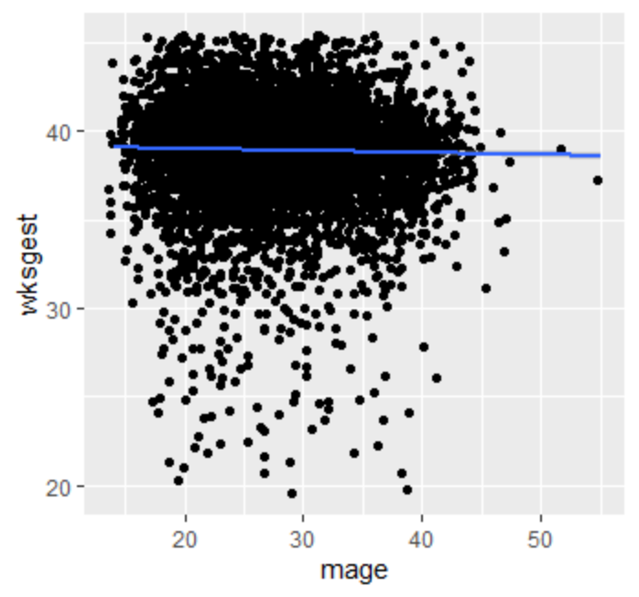
Relationship between mage and wksgest
ggplot(births %>% sample_n(10000), aes(mage, wksgest)) +
geom_jitter() +
geom_smooth(method="lm")

Slide 44
Relationship between mage and wksgest
ggplot(births %>% sample_n(10000), aes(mage, wksgest)) +
geom_jitter() +
geom_smooth(method="lm")
# basic model
glm(data=births, wksgest ~ mage, family = gaussian("identity")) %>%
broom::tidy()
# A tibble: 2 x 5
term estimate std.error statistic p.value
<chr> <dbl> <dbl> <dbl> <dbl>
1 (Intercept) 39.2 0.0463 846. 0
2 mage -0.00916 0.00165 -5.57 0.0000000260

Slide 45
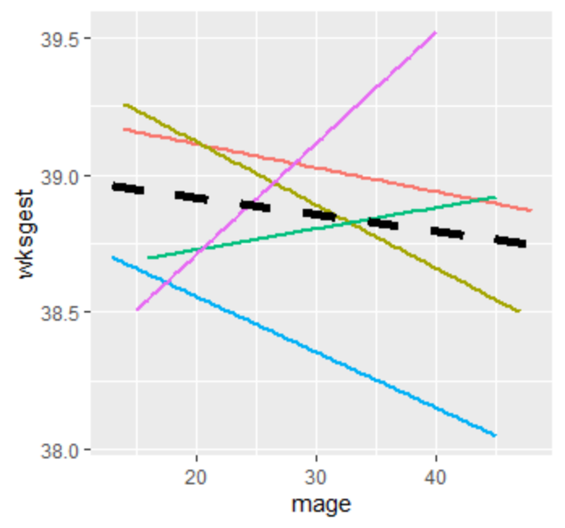
Stratify by raceeth_f
ggplot(births %>% sample_n(10000), aes(mage, wksgest, color=raceeth_f)) +
geom_smooth(method="lm", se=F, show.legend = F) + # by raceeth_f
geom_smooth(color="black", method="lm", size=2, lty=2, se=F, show.legend = F) # overall

Slide 46
M1: Fixed effects – mage, raceeth_f
# additive
glm_mod_add = glm(data=births, wksgest ~ mage+raceeth_f, family = gaussian("identity"))
broom::tidy(glm_mod_add) %>% bind_cols(broom::confint_tidy(glm_mod_add))
Intercept: risk among WnH, youngest age
mage: RD, same among all raceeth_f groups
# A tibble: 6 x 7
term estimate std.error statistic p.value conf.low conf.high
<chr> <dbl> <dbl> <dbl> <dbl> <dbl> <dbl>
1 (Intercept) 39.5 0.0483 818. 0. 39.4 39.6
2 mage -0.0160 0.00166 -9.64 5.58e- 22 -0.0192 -0.0127
3 raceeth_fOther -0.134 0.0275 -4.89 1.03e- 6 -0.188 -0.0805
4 raceeth_fWhite Hispanic -0.0468 0.0624 -0.750 4.53e- 1 -0.169 0.0755
5 raceeth_fAfrican American -0.627 0.0240 -26.1 2.56e-149 -0.674 -0.580
6 raceeth_fAmerican Indian or~ -0.346 0.0827 -4.18 2.88e- 5 -0.508 -0.184

Slide 47
M2: Random intercept –raceeth_f
multi_int = lme4::lmer(data=births, wksgest ~ mage + (1|raceeth_f))
tidy(multi_int, conf.level=0.95, conf.int=T)
# new lme4 tidiers to come in broom.mixed
Intercept: global mean baseline risk (distribution), youngest age
mage: global RD effect (same among all groups)
> tidy(multi_int, conf.level=0.95, conf.int=T)
# A tibble: 4 x 7
term estimate std.error statistic conf.low conf.high group
<chr> <dbl> <dbl> <dbl> <dbl> <dbl> <chr>
1 (Intercept) 39.3 0.126 312. 39.0 39.5 fixed
2 mage -0.0159 0.00166 -9.62 -0.0192 -0.0127 fixed
3 sd_(Intercept).raceeth_f 0.259 NA NA NA NA raceeth_f
4 sd_Observation.Residual 2.43 NA NA NA NA Residual

Slide 48
M3: EMM – mage, raceeth_f
Intercept: risk among WnH, youngest age
mage: RD among WnH. RD changes within strata of raceeth_f
# add interaction term
glm_mod_int = glm(data=births, wksgest ~ mage*raceeth_f, family = gaussian("identity"))
broom::tidy(glm_mod_int) %>% bind_cols(broom::confint_tidy(glm_mod_int))
# A tibble: 10 x 7
term estimate std.error statistic p.value conf.low conf.high
<chr> <dbl> <dbl> <dbl> <dbl> <dbl> <dbl>
1 (Intercept) 39.5 0.0648 609. 0. 39.3 39.6
2 mage -0.0142 0.00226 -6.29 3.17e-10 -0.0187 -0.00979
3 raceeth_fOther -0.0158 0.131 -0.121 9.04e- 1 -0.273 0.241
4 raceeth_fWhite Hispanic -0.0146 0.285 -0.0513 9.59e- 1 -0.573 0.544
5 raceeth_fAfrican American -0.530 0.110 -4.80 1.60e- 6 -0.746 -0.313
6 raceeth_fAmerican Indian or~ -0.144 0.362 -0.397 6.91e- 1 -0.854 0.566
7 mage:raceeth_fOther -0.00421 0.00455 -0.925 3.55e- 1 -0.0131 0.00471
8 mage:raceeth_fWhite Hispanic -0.00113 0.0101 -0.112 9.11e- 1 -0.0210 0.0187
9 mage:raceeth_fAfrican Ameri~ -0.00362 0.00405 -0.893 3.72e- 1 -0.0116 0.00432
10 mage:raceeth_fAmerican Indi~ -0.00782 0.0139 -0.560 5.75e- 1 -0.0352 0.0195

Slide 49
M4: Random slope & intercept – raceeth_f
multi_intslope = lme4::lmer(data=births, wksgest ~ mage + (1 + mage|raceeth_f))
tidy(multi_intslope, conf.level=0.95, conf.int=T)
# new lme4 tidiers to come in broom.mixed
Intercept: global mean baseline risk (distribution), youngest age
mage: global RD effect (distribution)
> tidy(multi_intslope, conf.level=0.95, conf.int=T) # new lme4 tidiers to come in broom.mixed
# A tibble: 6 x 7
term estimate std.error statistic conf.low conf.high group
<chr> <dbl> <dbl> <dbl> <dbl> <dbl> <chr>
1 (Intercept) 39.3 0.322 122. 38.7 39.9 fixed
2 mage -0.0161 0.00174 -9.25 -0.0195 -0.0127 fixed
3 sd_(Intercept).raceeth_f 0.711 NA NA NA NA raceeth~
4 sd_mage.raceeth_f 0.00114 NA NA NA NA raceeth~
5 cor_(Intercept).mage.raceeth~ 0.994 NA NA NA NA raceeth~
6 sd_Observation.Residual 2.43 NA NA NA NA Residual

Slide 50
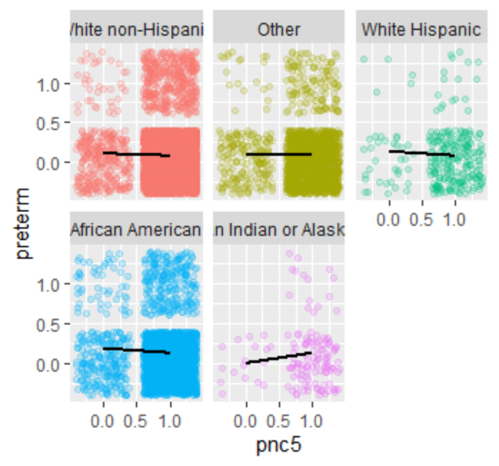
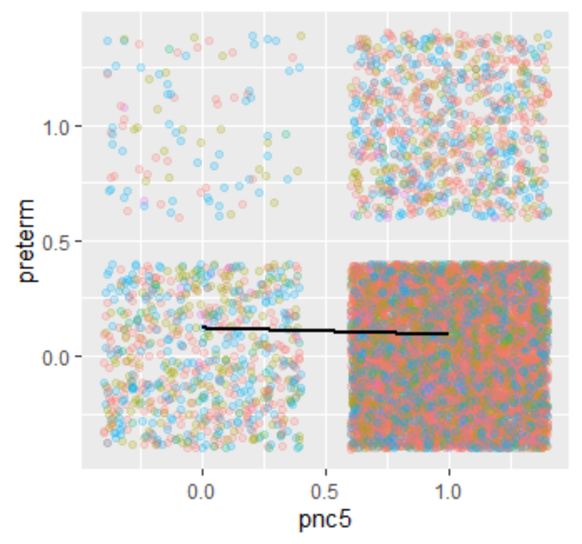
You can also have binary outcomes!
births$pnc5 <- ifelse(births$pnc5_f=="Early PNC",1,0)
multi_intslope2 = lme4::glmer(data=births, preterm ~ pnc5 + (1 + pnc5|raceeth_f), family = binomial(link="logit"))
tidy(multi_intslope2, conf.level=0.95, conf.int=T)
# A tibble: 5 x 8
term estimate std.error statistic p.value conf.low conf.high group
<chr> <dbl> <dbl> <dbl> <dbl> <dbl> <dbl> <chr>
1 (Intercept) -1.92 0.106 -18.2 5.94e-74 -2.13 -1.72 fixed
2 pnc5 -0.266 0.0479 -5.56 2.72e- 8 -0.360 -0.172 fixed
3 sd_(Intercept).race~ 0.222 NA NA NA NA NA raceet~
4 sd_pnc5.raceeth_f 0.0435 NA NA NA NA NA raceet~
5 cor_(Intercept).pnc~ 1.00 NA NA NA NA NA raceet~

